Slide 1
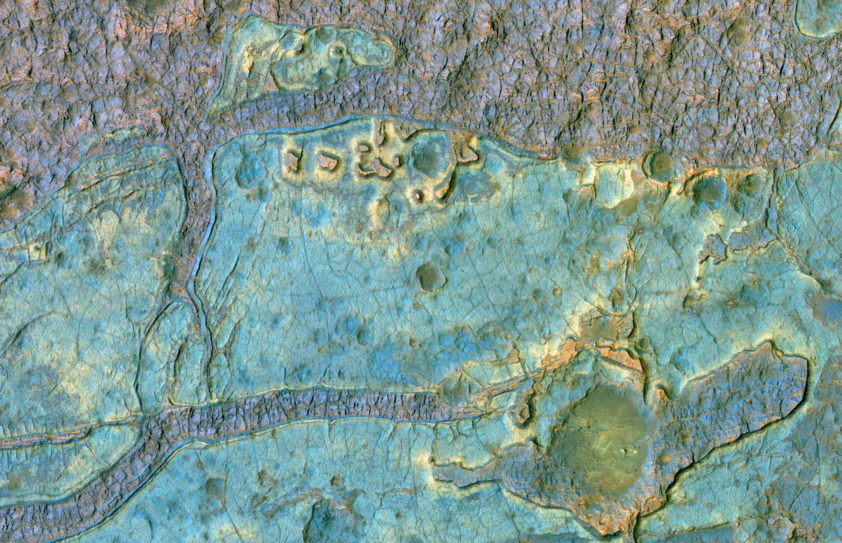
20 Years of Mars Science from MRO/HiRISE
Alfred McEwen, Shane Byrne, and the HiRISE science team
9 September 2025, EPSC, The Hague
ESP_068219_1775

Slide 2
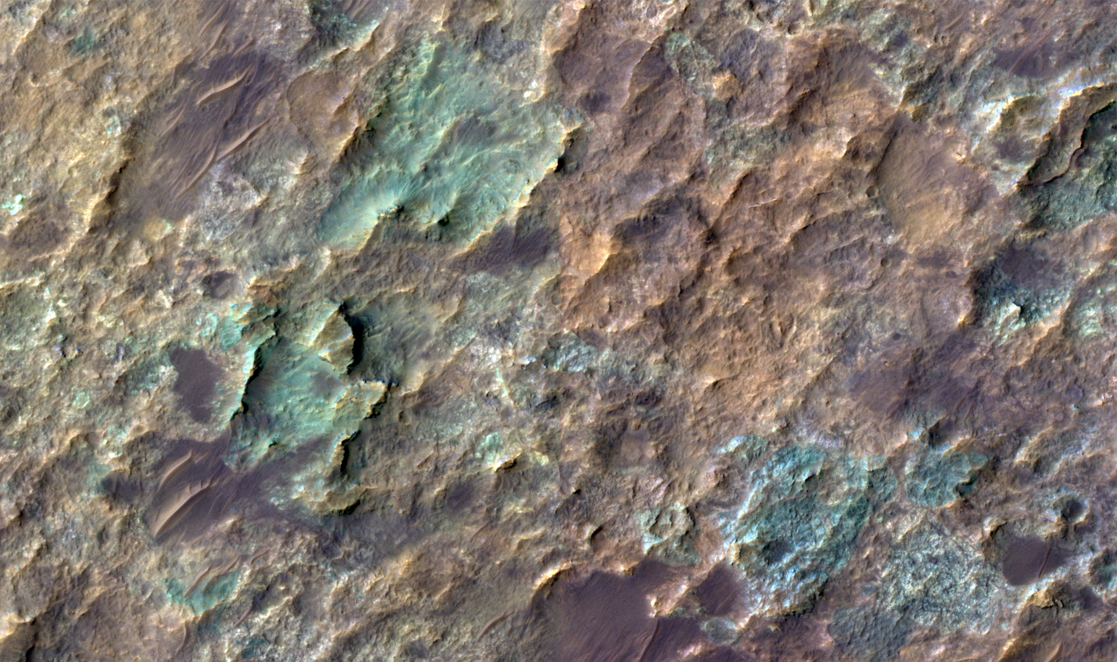
HiRISE @ Mars:
10 August 2026
105,977 images of the Martian Surface returned!
56,507 Gigapixels
Could cover 5.33% of Martian surface (3.58% unique)
9968 stereo pairs completed, 1273 Digital Terrain Models (DTMs) archived
ESP_93841_1480 acquired on 03 Aug 2026

Slide 3
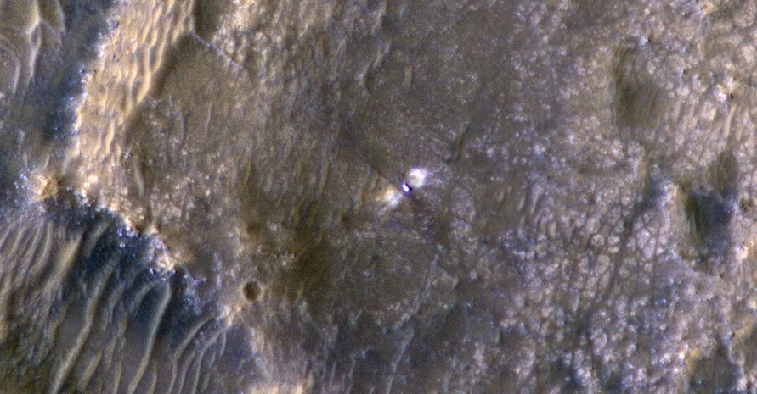
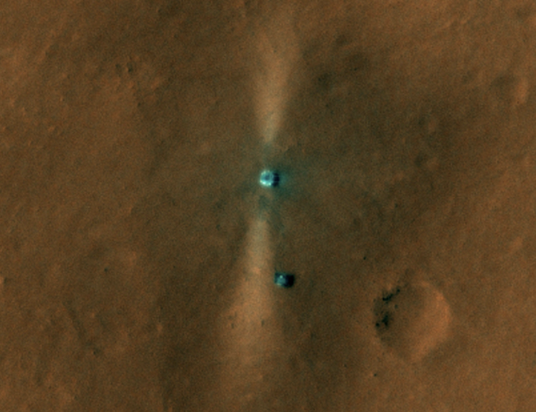
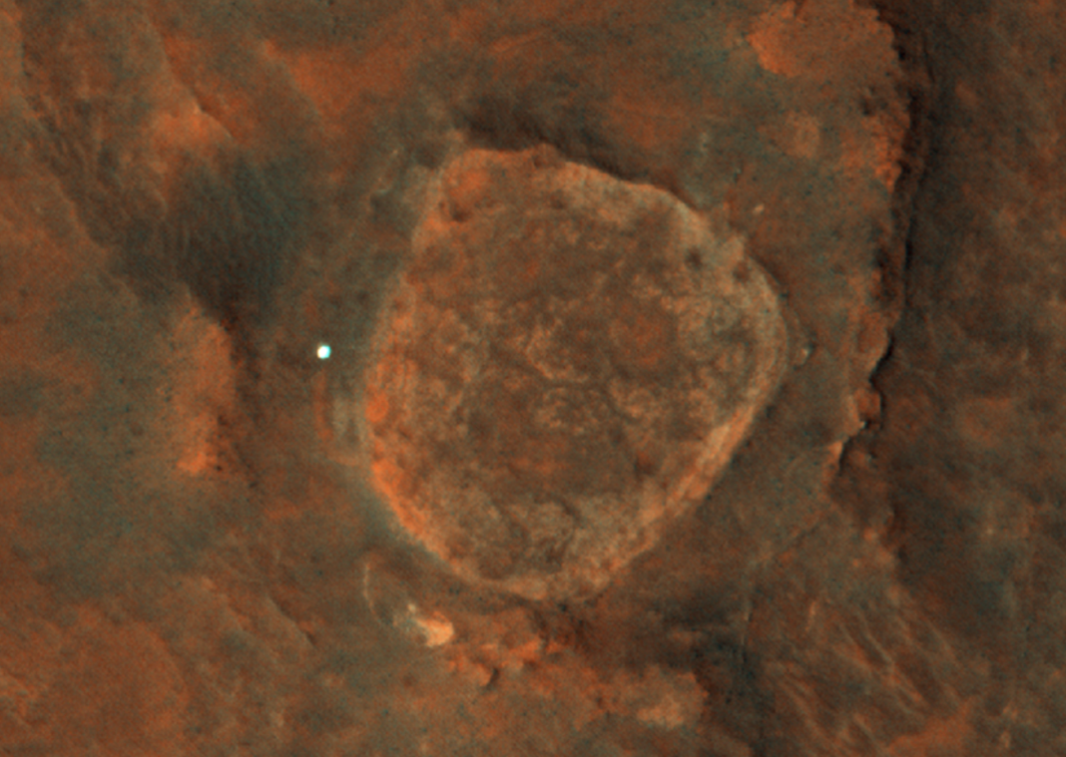
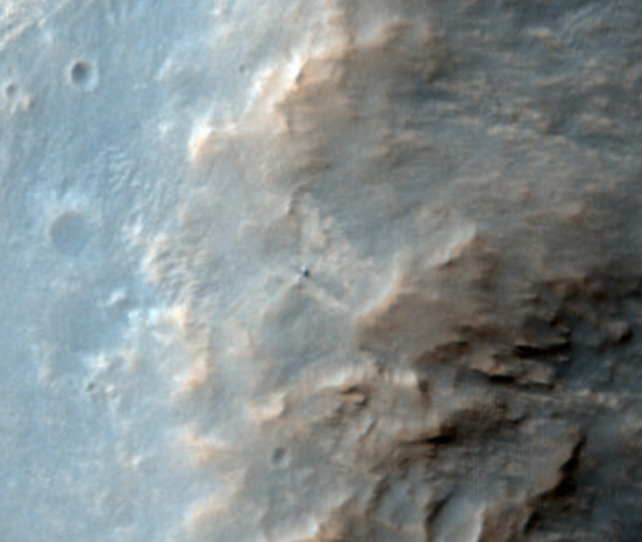
Perseverance
Curiosity
Supporting and Monitoring Surface Rover Operations
Tianwen-1
And Zhurong
Spirit
Opportunity

Slide 4
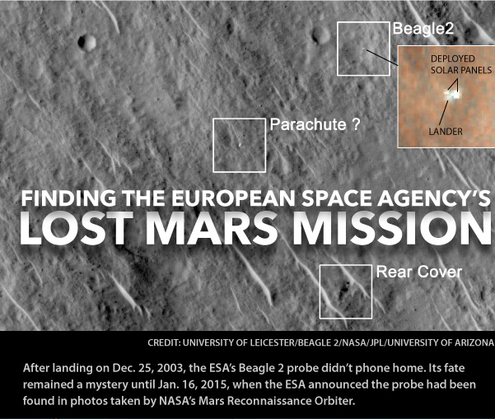
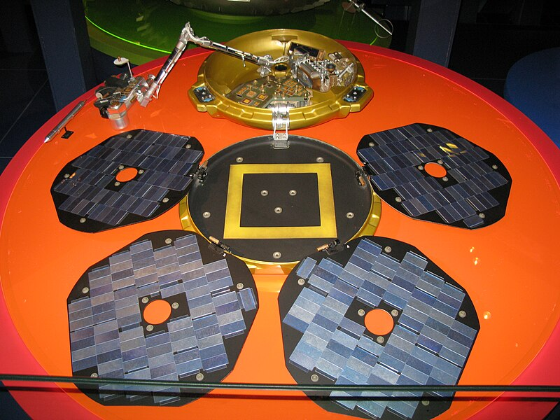
ESA Beagle-2 lander found from public image suggestion:
https://www.uahirise.org/hiwish/

Slide 5
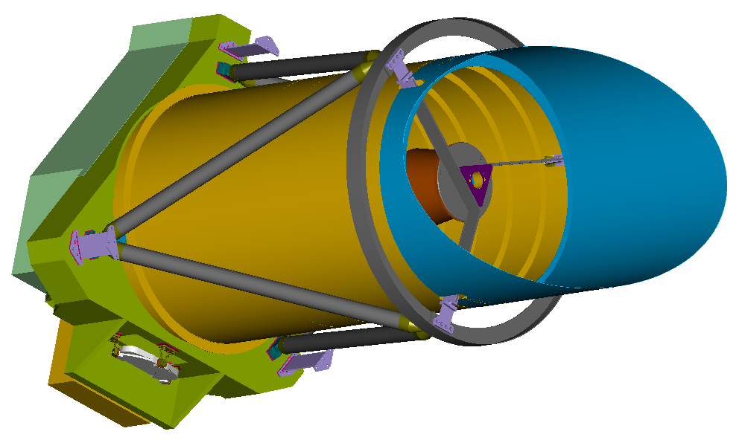

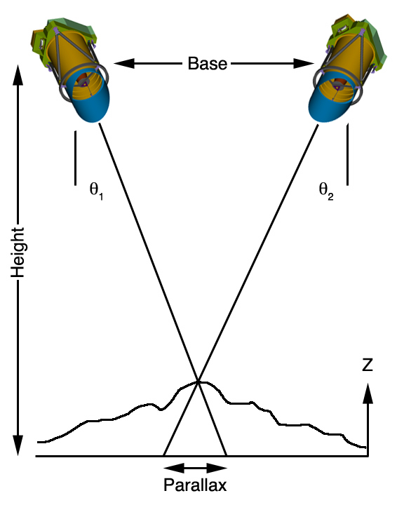
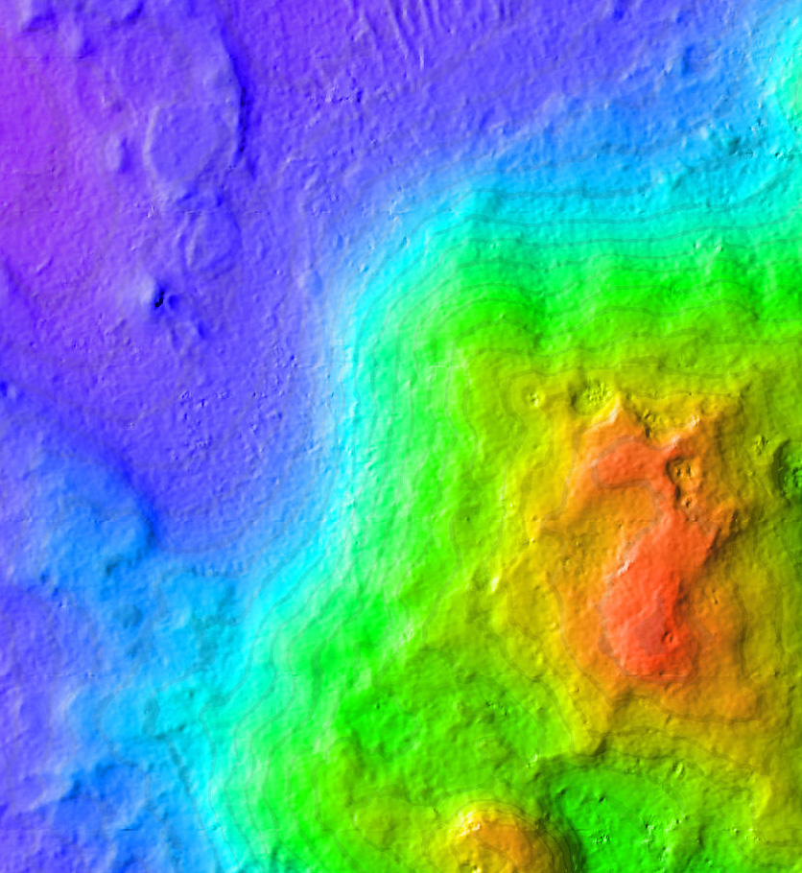
HiRISE Stereo Data Acquisition
Must point spacecraft to the side on 2 different orbits
Produce 1-m scale Digital Terrain Models!
Home Plate
Left: DTM of part of Columbia Hills, explored by Spirit rover

Slide 6
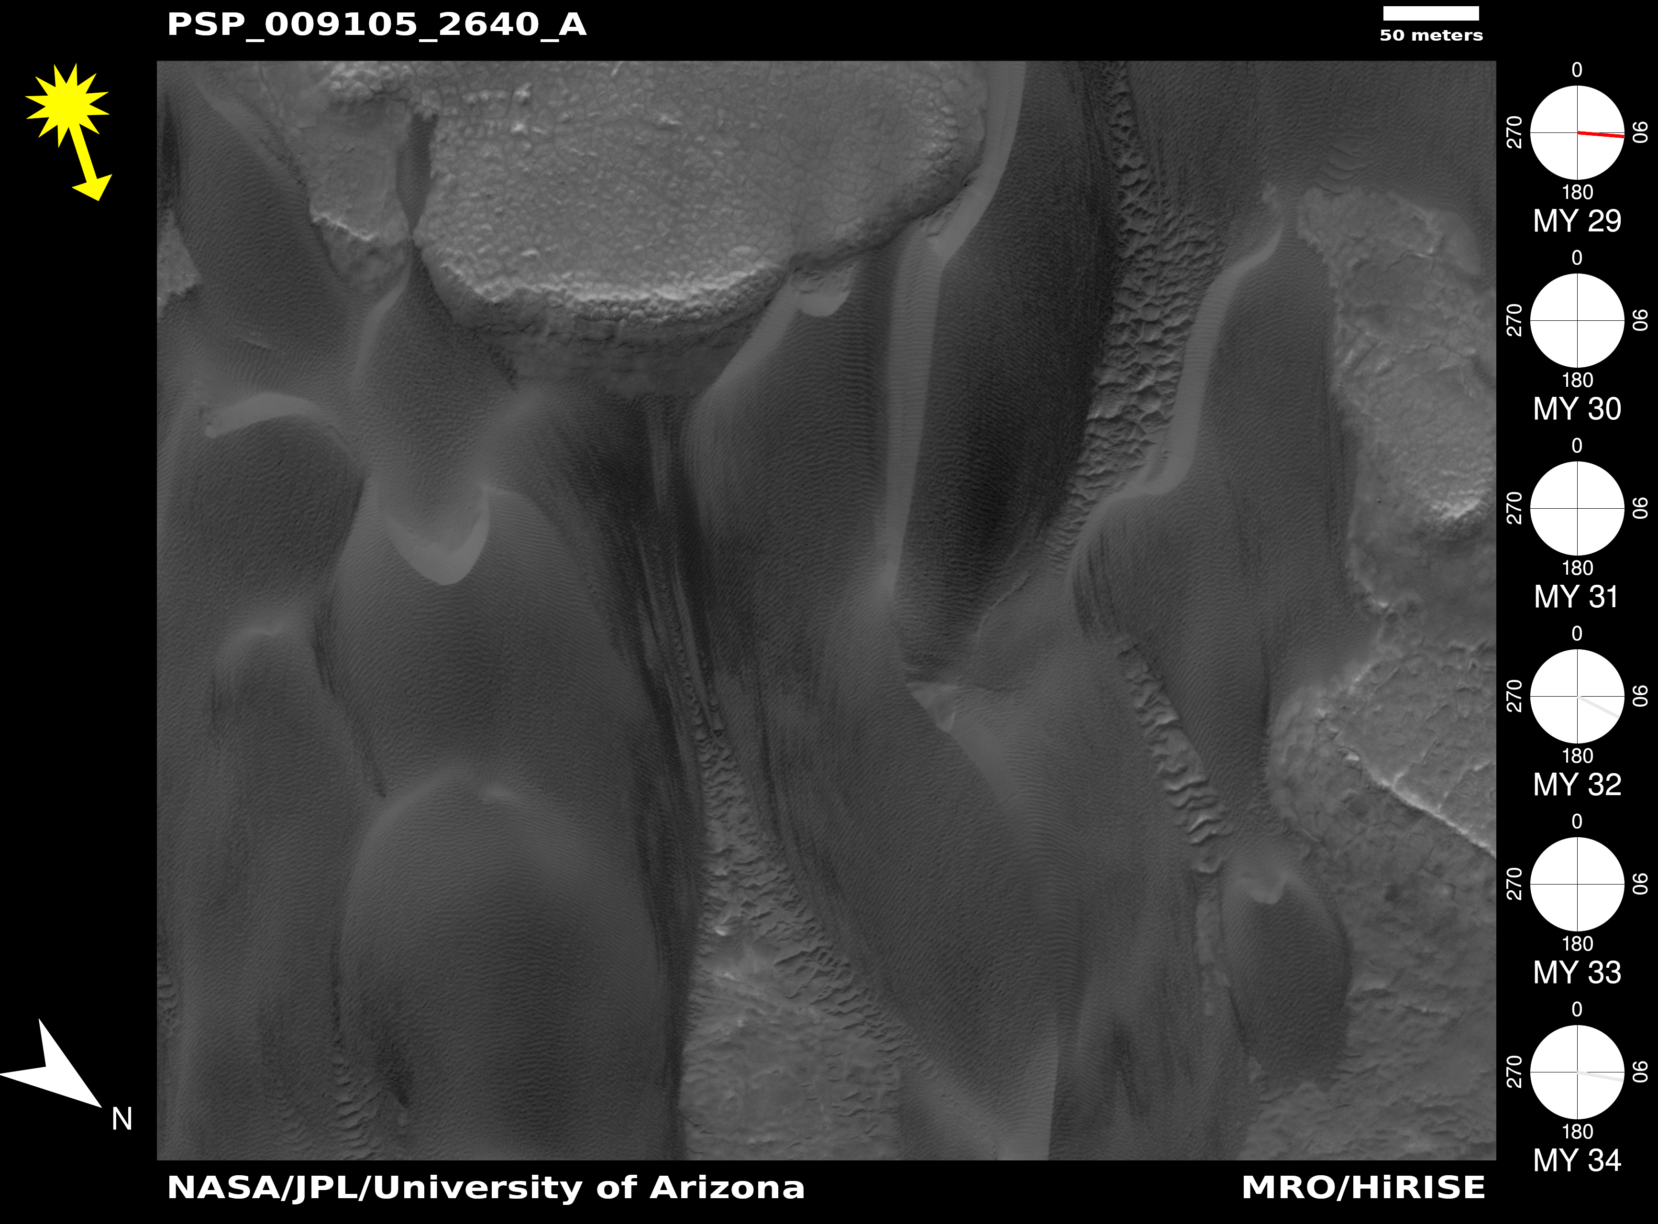
DTMs used to orthorectify images at different times to make animations

Slide 7
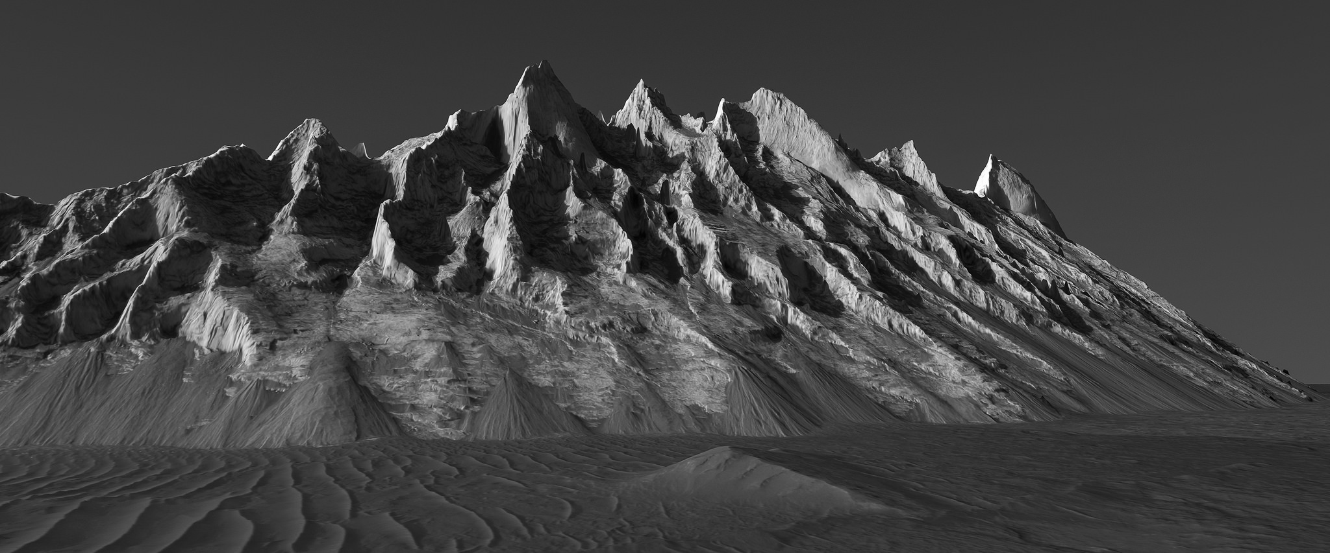
Mound in Ganges Chasm, Mars. No vertical exaggeration! https://www.flickr.com/photos/136797589@N04/
DTMs used to reproject images for different perspectives

Slide 8
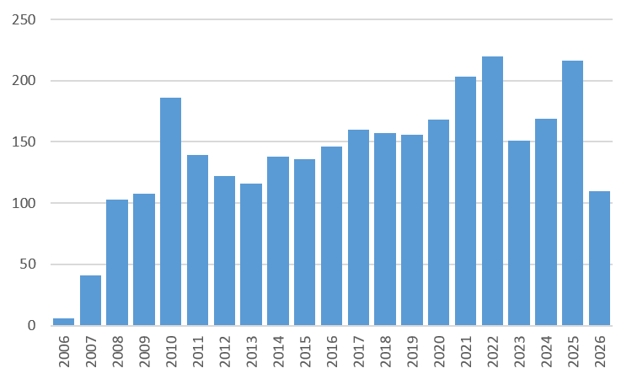
HiRISE Science Publications
NASA ADS search of peer-reviewed publications with “HiRISE” and “Mars” in the full text from 2006-2026
2951 refereed publications
Increasing numbers with first authors from non-US institutions

Slide 9
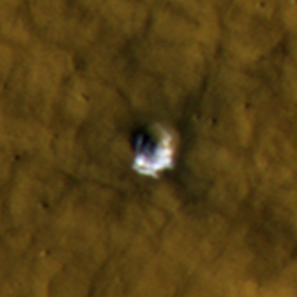
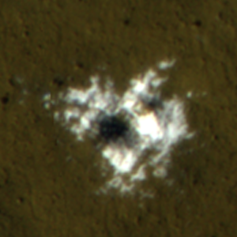
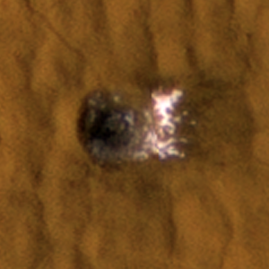
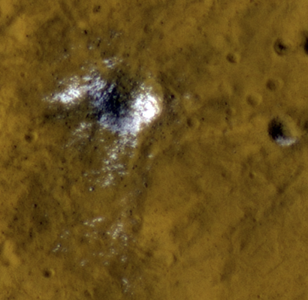
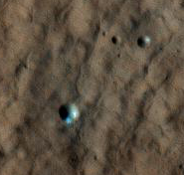
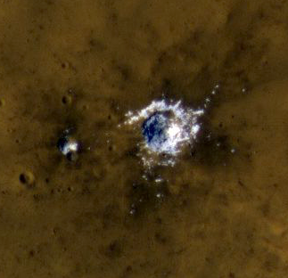
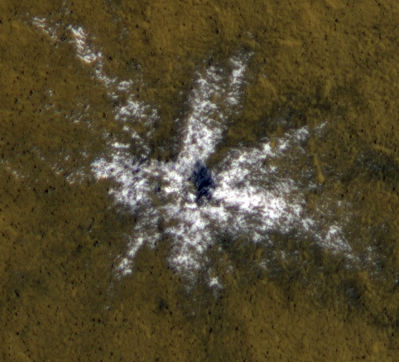
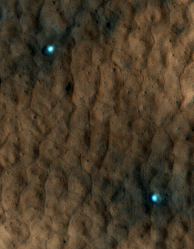
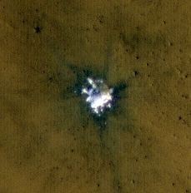
Ice Exposed by New Impacts (Byrne et al. 2009; Dundas and Byrne 2010; Dundas et al. 2014)
New impacts north of 35 N and south of 45 S latitudes have distinct ice patches.
Image sequences show that the ice fades over time.
Sublimation modeling indicate that mm of ice sublimate before it fades, indicating clean ice.
Ice is a critical resource to possible human explorers of Mars.

Slide 10
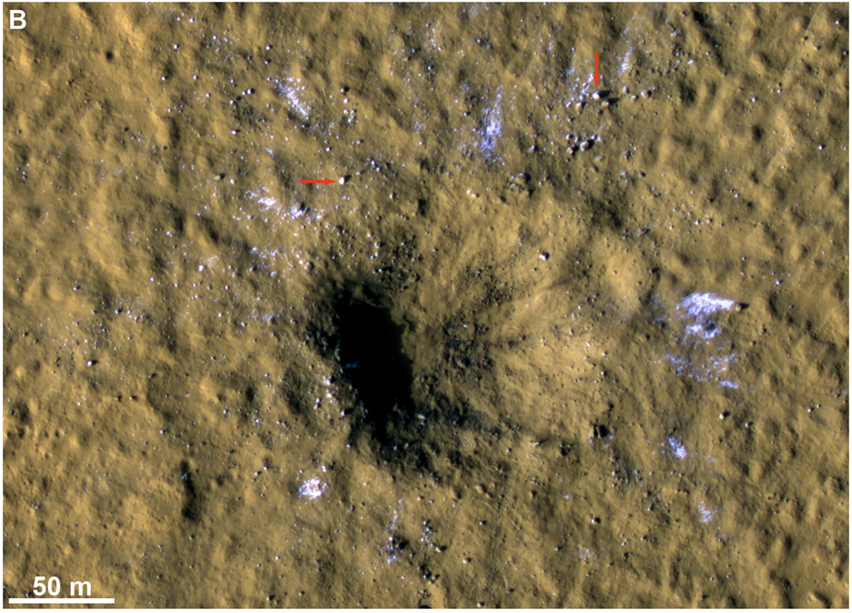
A new record setter…
  Formed on December 24th 2021
  150m crater excavates to ~15m
  Just traces of ice at 35N
  Blocks of ice (arrows) shrinking from sublimation
  Stongest seismic event recorded by InSight
Dundas et al. 2022

Slide 11
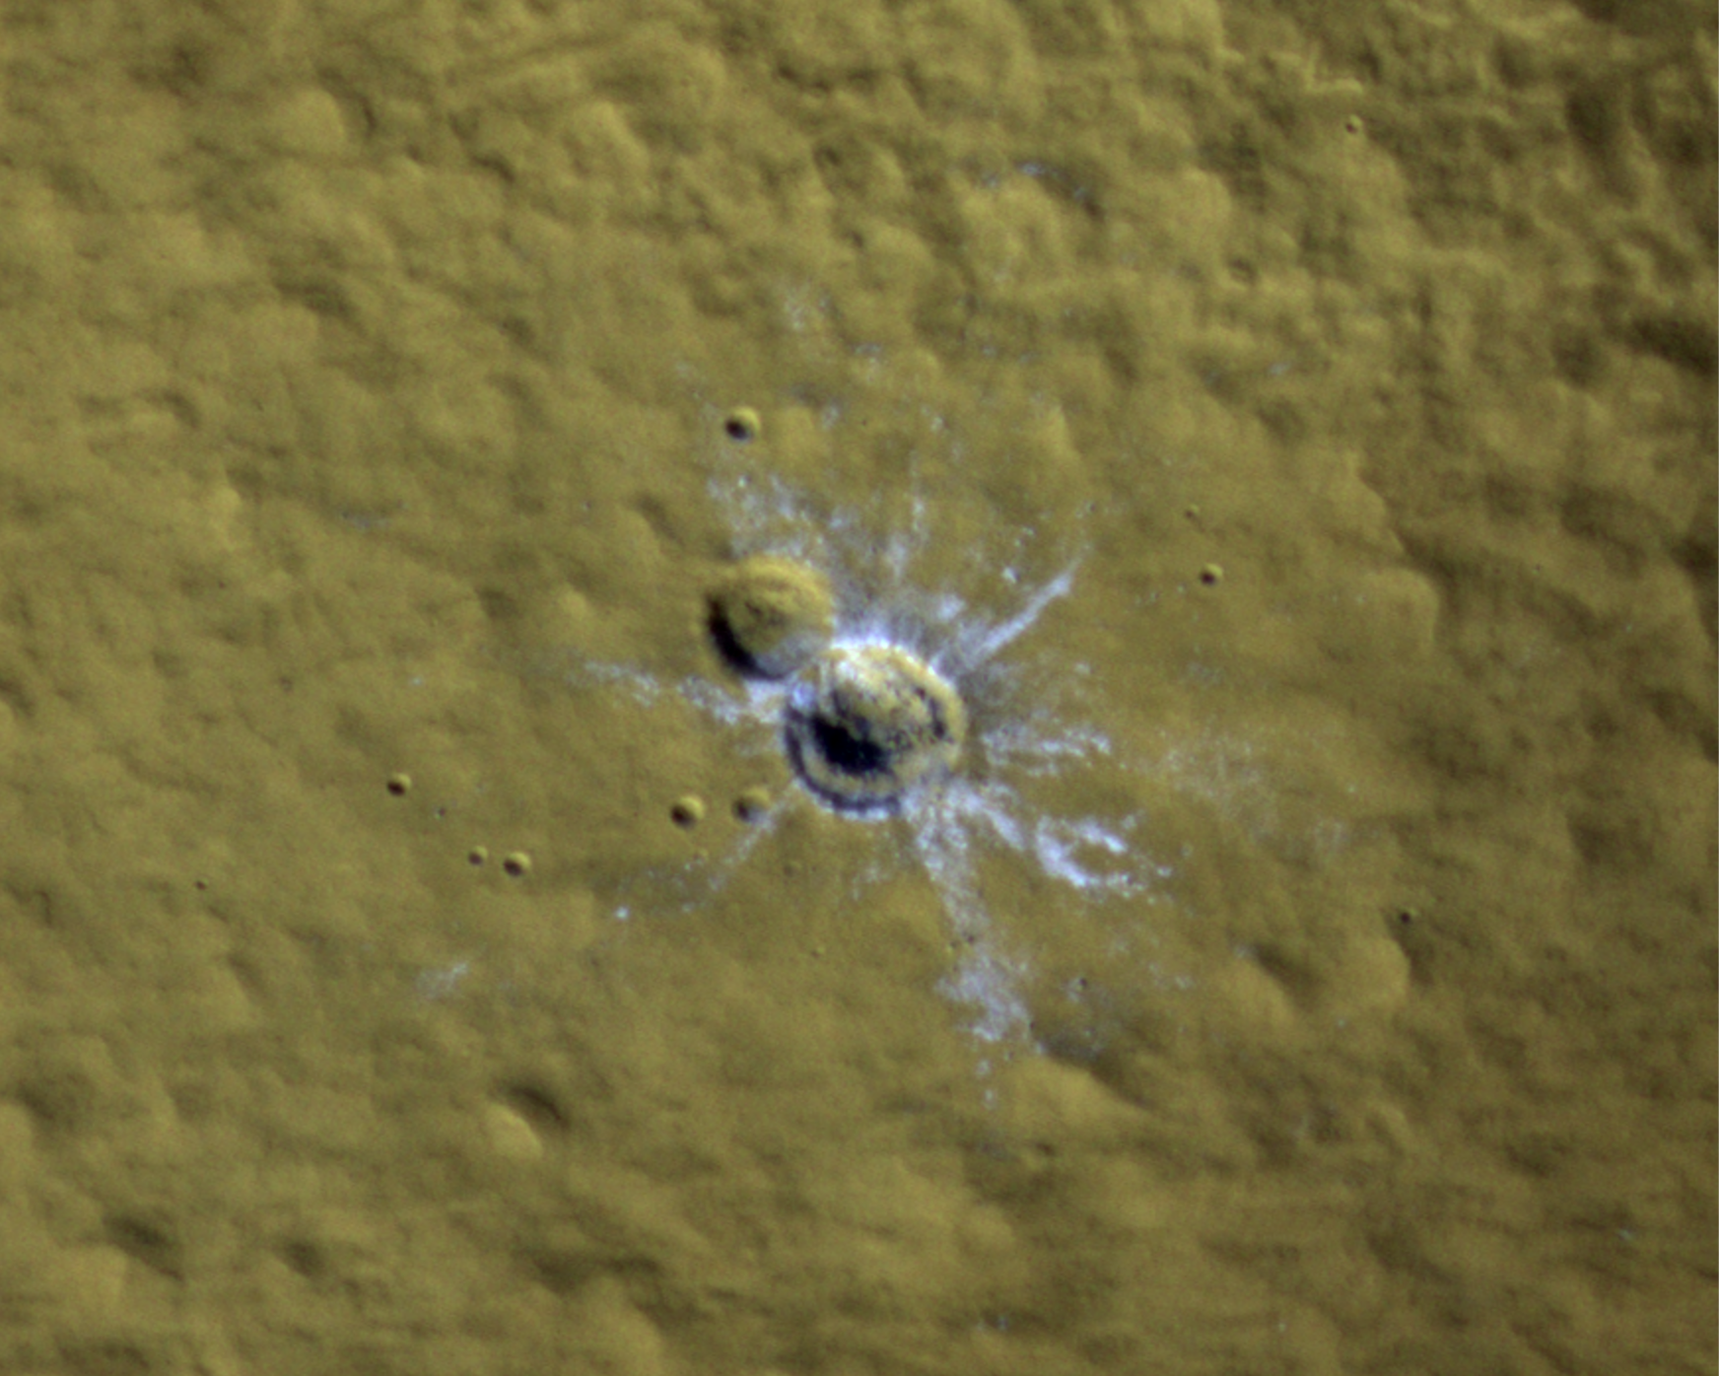
A new record for lowest-latitude ice?
33 N latitude
ESP_093627_2130 acquired 17 July 2026
Ice not yet confirmed—need to monitor to track fading
23 m diameter

Slide 12
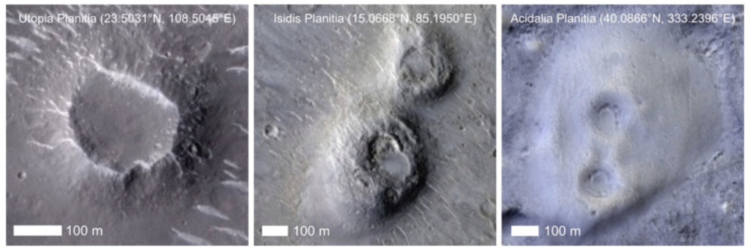
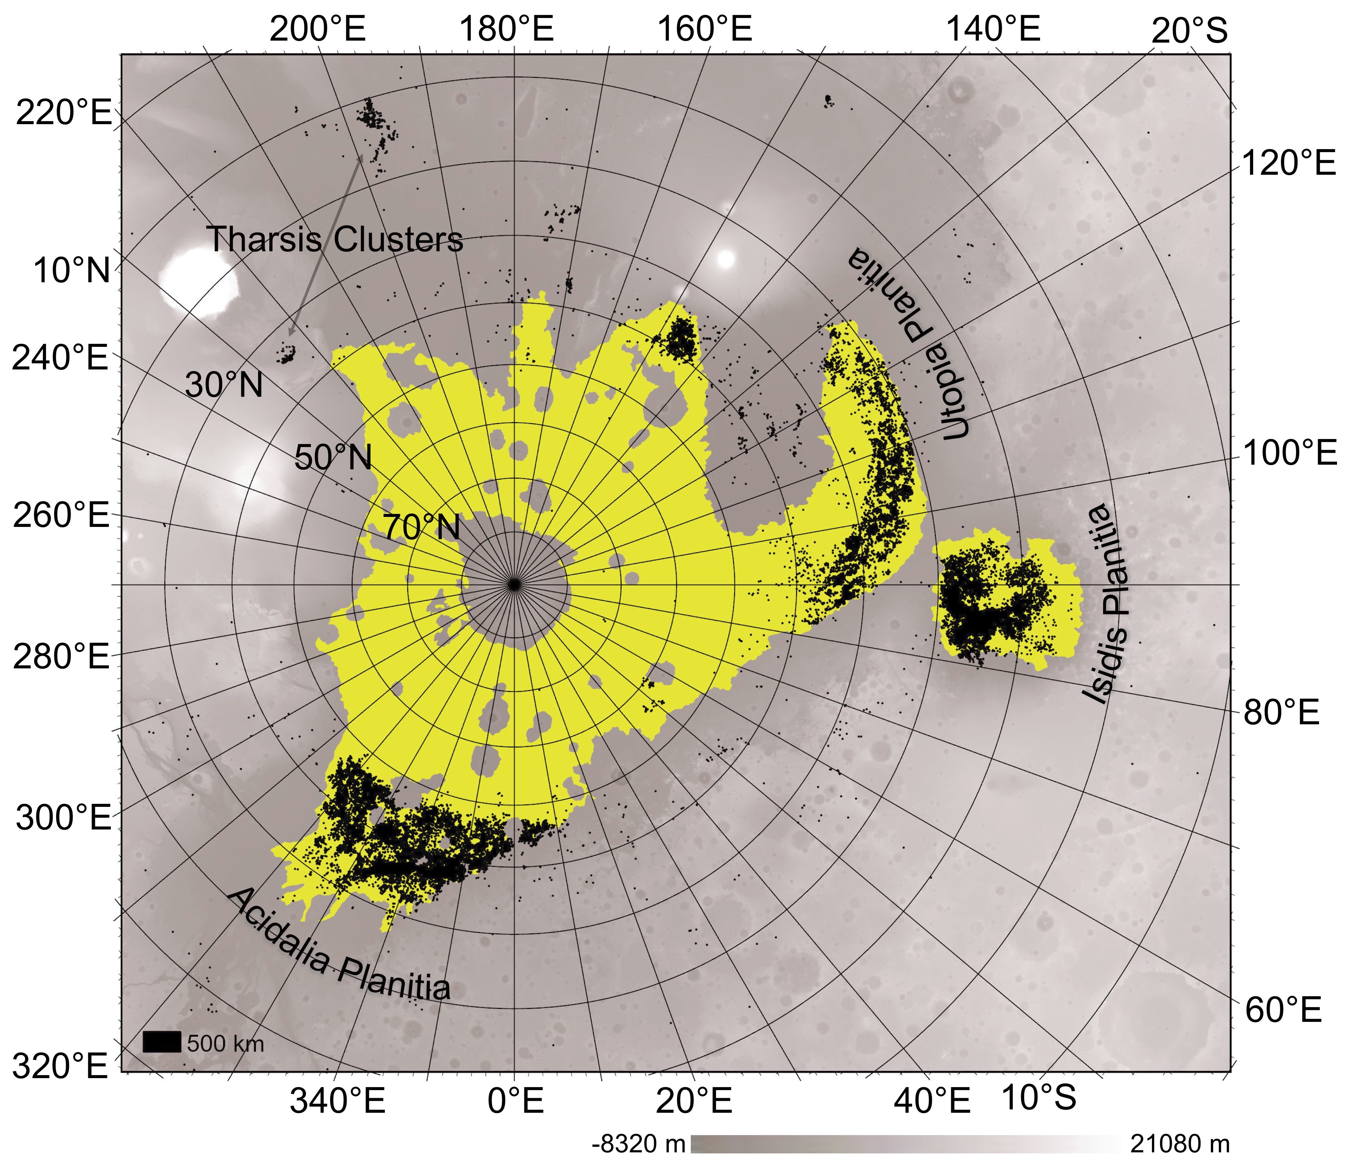
Increasing use of computer vision (machine learning) to analyze data
A global dataset of pitted cones on Mars
Mills, M.M., V.T. Bickel, A.S. McEwen, A. Valantinas
https://doi.org/10.1016/j.icarus.2024.116145
Using computer vision methods, we mapped the global population of pitted cones on Mars using images from the Context Camera (CTX) and HiRISE.
Cones strongly concentrated in the northern plains’ basins and on geologic deposits proposed to be from outflow floods or a past ocean.
Mud volcanoes on Earth occur in areas of rapid sedimentation.
The figure at right shows mapped pitted cones as black scatter points in a northern polar projection. The yellow polygon is the approximate extent of the ocean/outflow flood deposits. Basins (Utopia, Isidis, Acidalia Planitiae) are labeled.

Slide 13
What have we done lately? Relevant papers in the past ~3 months
Arvidson+ (2026) Saponite Bearing Material Excavated During the Formation of a Recent 25-m-Diameter Impact Crater in Southeastern Arabia Terra on Mars. JGR-P 131, e2025JE009535. DOI:10.1029/2025JE009535
Borchert+ (2026) Analysis of the Gilbert-type delta architecture and boulder conglomerate facies in Jezero Crater, Mars. Icarus 457, 117150. DOI:10.1016/j.icarus.2026.117150
Bryk+ (2026) Curiosity meets the Gediz Vallis Ridge: Remnants of a late-stage debris-flow dominated fan in Gale Crater. Icarus 455, 117051. DOI:10.1016/j.icarus.2026.117051
Cheng, H. C. J. (2026) Polygonal impact craters on planetary surfaces ─ A review. Icarus 457, 117126. DOI:10.1016/j.icarus.2026.117126
Davis+ (2026) Late-Stage Debris Flows Eroded Aeolis Mons in Gediz Vallis, Gale Crater, Mars.JGR-P 131, e2025JE009538. DOI:10.1029/2025JE009538
Day+ (2026) Periodic Bedrock Ridge Formation via Shielding and Interbedform Erosion: Wind Tunnel Experiments, a Field Analog, and Survey of Mars. JGR-P 131, e2025JE009326. DOI:10.1029/2025JE009326
De Blasio (2026) Sliding Terrains and Dislocated Plates in Amazonis Planitia (Mars) as the Result of Instability of a Frozen Martian Ocean. PSJ 7, 105. DOI:10.3847/PSJ/ae5b80
Gasda+ (2026) Amapari Marker Band Metal-Enrichments: Potential Mechanisms and Implications for Surface and Subsurface Water and Weathering in Gale Crater. JGR-P 131, e2025JE009153. DOI:10.1029/2025JE009153
Huang & Ye (2026) MARSIM: An End-to-End Clutter Simulation System for Global Mars Subsurface Sounding. IEEE Trans. Geosci. Rem. Sens. 64, 4503116-4503116. DOI:10.1109/TGRS.2026.3693916
Isen+ (2026) Spectral Characterization of CO2-H2O Ice Layering Under Controlled Mars Polar Conditions as Laboratory Analogs for Seasonal Cap Activity. JGR-P 131, e2026JE009752. DOI:10.1029/2026JE009752
Kreczmer+ (2026) Comparative analysis of the morphodynamics of talus slopes on Earth and Mars. Miscellanea Geographica 30, 95-104. DOI:10.2478/mgrsd-2025-0032
Li+ (2026) MAFT: A Lightweight Network for Martian Rock Segmentation Based on an Adaptive Frequency Transformer. Remote Sensing 18, 1794. DOI:10.3390/rs18111794
Liu+ (2026) Topographic Modulation of Martian Near-Surface Winds: Insights From Perseverance Measurements and CFD Modeling in Jezero Crater. ESS 13, e2025EA004986. DOI:10.1029/2025EA004986
Luo+ (2026) Automatic extraction of Martian dune crestlines under complex conditions: A comparative study of image processing, terrain analysis, and deep learning. Aeolian Research 76, 101047. DOI:10.1016/j.aeolia.2026.101047
Manelski+ (2026) Strong nickel enrichment co-located with redox-organic interactions in Neretva Vallis, Mars. Nature Communications 17, 2705. DOI:10.1038/s41467-026-70081-3
Margara, B., J. R. Johnson, A. G. Hayes, M. T. Lemmon, W. M. Grundy, J. F. Bell, and M. N. Barrington (2026) Mastcam-Z Spectrophotometric Properties of Materials at the Van Zyl Overlook, Jezero Crater. JGR-P 131, e2026JE009675. DOI:10.1029/2026JE009675
Motlhasedi+ (2026) Investigation of a potential endorheic basin on Mars in the Terra Cimmeria. Icarus 459, 117212. DOI:10.1016/j.icarus.2026.117212
Noblet+ (2026) Aspect Asymmetry in Martian Gullies: A Topographic Signature of Their Formation Process?. JGR-P 131, e2025JE009636. DOI:10.1029/2025JE009636
Raju+ (2026) A comprehensive three-dimensional thermophysical model for Mars. MNRAS 549, stag932. DOI:10.1093/mnras/stag932
Robbins+ (2026) Pitted Cones in Circular Patterns in Elysium Planitia, Mars, Imply a Mud Volcano Origin, Requiring Recent Subsurface Water. Journal of Geophysical Research (Planets) 131, e2025JE009225. DOI:10.1029/2025JE009225
Roberts+ (2026) An Aeolian Depositional Sequence Shaped by Near-Surface Water at the Base of the Layered Sulfate Unit, Gale Crater, Mars. JGR-P 131, e2025JE009556. DOI:10.1029/2025JE009556
Rojas+ (2026) Geomorphology and Mineralogy of Belén Crater in Iani Chaos (Mars) Point to Hydrothermal Activity. PSJ 7, 130. DOI:10.3847/PSJ/ae5dcb
Rudin+ (2026) Exploring methods for identifying iron meteorites on the surface of Mars from orbit. Icarus 457, 117186. DOI:10.1016/j.icarus.2026.117186
Schneck+ (2026) Modeling Wind-Driven Waves on Other Planets: Applications to Mars, Titan, and Exoplanets. JGR-P 131, e2025JE009490. DOI:10.1029/2025JE00949010.22541/essoar.176087396.60775070/v1
Scuderi+ (2026) Boxwork fracture genesis and geomorphic evolution: Gale Grater, Mars. Geomorphology 509, 110386. DOI:10.1016/j.geomorph.2026.110386
Tao+ (2026) Expanding the Global Martian Landslide Inventory with Multimodal DINOv2 Feature Fusion and SVM Classification. PSJ 7, 101. DOI:10.3847/PSJ/ae5dc7
Torres Auré+ (2026) Clay continuity between Oxia Planum and Mawrth Vallis. Icarus 457, 117113. DOI:10.1016/j.icarus.2026.117113
Wan+ (2026) Dynamic monitoring of dark slope streaks within large-scale Martian scenes using multitemporal high-resolution orbiter imagery. Adv. Sp. Res. 77, 10925-10943. DOI:10.1016/j.asr.2026.02.052
Williams+ (2026) Environmental conditions associated with carbonate-bearing rocks in lower Hawksbill Gap, Jezero western fan, Mars. Icarus 457, 117161. DOI:10.1016/j.icarus.2026.117161
Wueller+ (2026) Fretted channels in Arabia Terra on Mars: Regional stratigraphy and implications for their formation. Icarus 459, 117211. DOI:10.1016/j.icarus.2026.117211
Zhang+ (2026) Subsurface Structure of Pockmarks Around the Zhurong Landing Site Revealed by RoPeR: Implication of the Final Water Activity. JGR-P 131, e2026JE009721. DOI:10.1029/2026JE009721
Zheng+ (2026) LICM: Low-Texture Illumination Terrain Coupled Matching for High-Resolution Martian Terrain in Chryse Planitia. IEEE J. App. Earth Obs. Rem. Sens.,19, 17566-17583. DOI:10.1109/JSTARS.2026.3694069
Zhou+ (2026) Toward Stable Semi-Supervised Remote Sensing Segmentation via Co-Guidance and Co-Fusion. IEEE Trans. Geosci. Rem. Sens. 64, TGRS.2026. DOI:10.1109/TGRS.2026.3680315
Zou+ (2026) PFMGAN: A Generative Adversarial Network with Physics Fusion for DTM Generation from Martian Monocular Images. Remote Sensing 18, 1354. DOI:10.3390/rs1809135

Slide 14
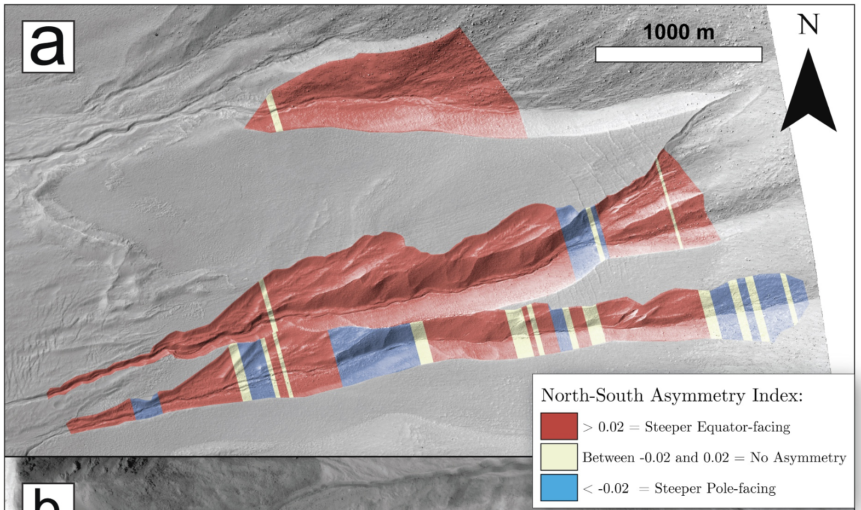
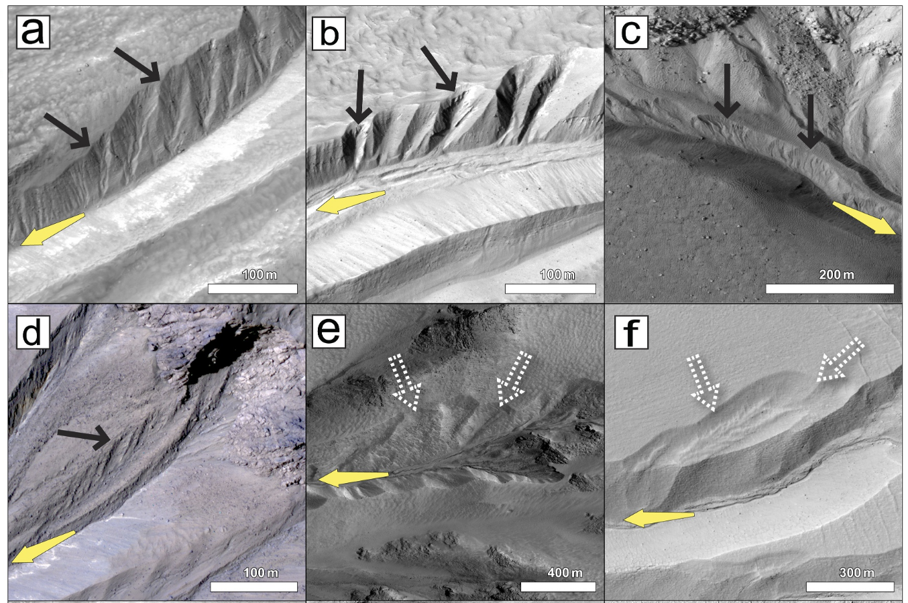
Aspect Asymmetry in Martian Gullies: A Topographic Signature of Their Formation Process?
Noblet, A., G. R. Osinski, and S. J. Conway (2026) Journal of Geophysical Research (Planets) 131, e2025JE009636. DOI:10.1029/2025JE009636
HiRISE DTMs and orthorectified images, CaSSIS & HiRISE images at 31 gully sites in the Latitude Dependent Mantle (LDM)
Quantitative comparison of steepness of opposing walls in gully alcoves.
Shallowing of pole‐facing alcove walls driven by preferential accumulation of CO₂ and H₂O frosts, leading to enhanced sediment fluxes on pole‐facing slopes.
Example map of N–S gully alcove asymmetry. HiRISE ID (a) ESP_067903_1370; 308.91◦E, 42.68◦S
Asymmetrical gully alcoves and associated morphologies. All scenes are oriented so that the equatorward direction is at the top of the frame. The downslope direction of the alcove is shown by the yellow arrow on all frames. (a–d) Sub‐alcoves (black arrows) tens of meters in width on the pole‐facing wall of gully alcoves. (e) and (f) Shallow concave depressions (dashed white arrows) on pole‐facing alcove walls. HiRISE IDs: (a) ESP_014008_1430; 322.74◦E, 36.47◦S, (b) PSP_002932_1445; 324.68◦E, 35.16◦S, (c) ESP_012266_1300; 3.74◦E, 49.81◦S, (d) PSP_003209_1445; 324.68◦E, 35.15◦S, (e) ESP_026097_2310; 26.45◦E, 50.67◦N, (f) ESP_067903_1370; 308.91◦E, 42.68◦S

Slide 15
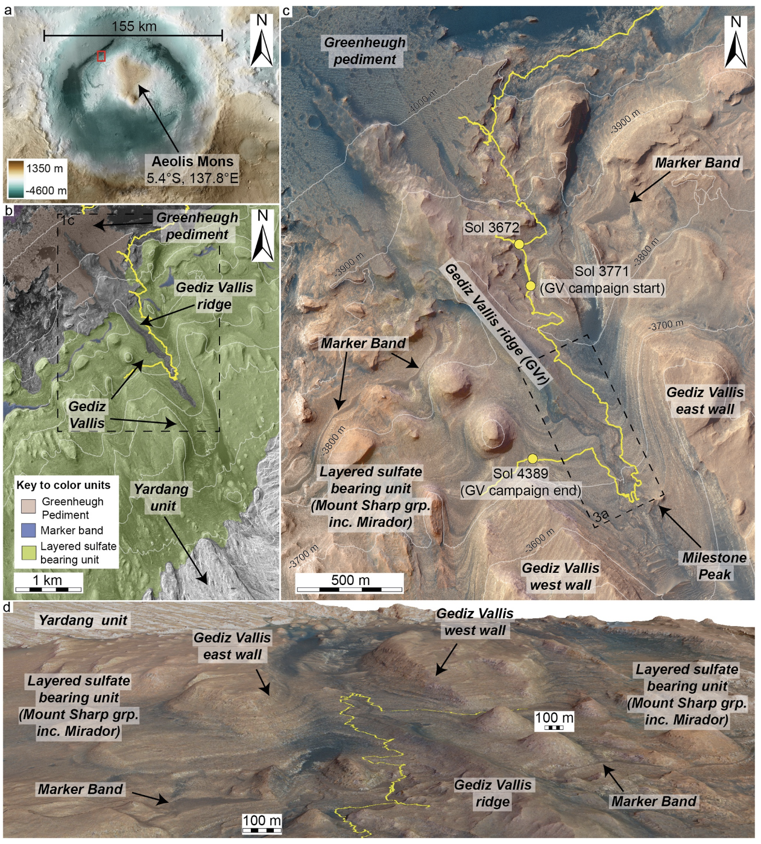
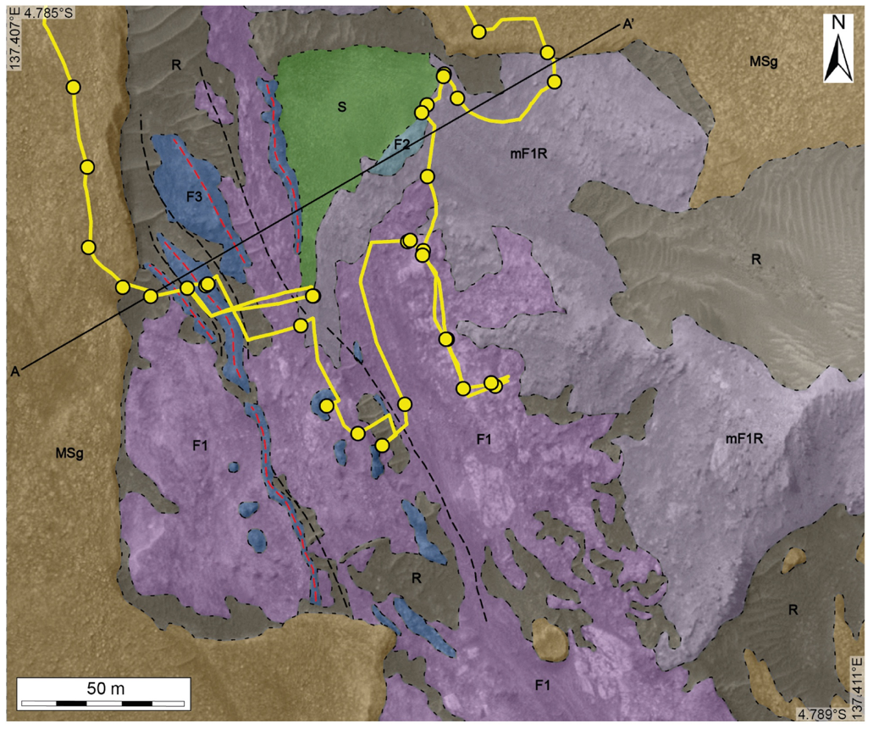
Late-Stage Debris Flows Eroded Aeolis Mons in Gediz Vallis, Gale Crater, Mars
Davis, J. M., S. A. Wilson, R. M. E. Williams, L. M. Thompson, G. Paar, J. A. Grant, A. Cowart, A. B. Bryk, S. Gupta, S. G. Banham, C. A. Mondro, E. S. Kite, M. C. Malin, D. Fey, O. Gasnault, S. Le Mouélic, and A. R. Vasavada (2026). Journal of Geophysical Research (Planets) 131, e2025JE009538. DOI:10.1029/2025JE009538
Curiosity investigation of canyon‐filling sedimentary deposits in Gediz Vallis on Aeolis Mons in Gale Crater.
Transported breccias and conglomerates record multiple sediment transport processes, including debris flows and landslides, separated by episodes of aeolian erosion and in‐situ alteration.
Debris flow deposits require continued, intermittent surface water availability late in the history of both Gale crater and Mars.
HiRISE color basemap + DTM played an integral role in the study, not just for identifying rover targets and guiding the traverse, but for extending the geologic mapping that we were able to do with the rover.
(b) HiRISE RED mosaic of NW Aeolis Mons. (c) HiRISE RGB mosaic showing Gediz Vallis, incised through the layered sulfate bearing unit, and the Gediz Vallis ridge (GVr). (d) Perspective view looking south towards Aeolis Mons and up Gediz Vallis, made from a HiRISE DTM and RGB orthomosaic.
Photogeologic map and synthetic cross section of the Arc Pass region of Gediz Vallis ridge. Mapping was performed using a combination of Navcam, Mastcam, and HiRISE data. Digitized at a 1:250 scale on a HiRISE basemap.
Notes:
Sharon, John Grant, myself, along with MSL colleagues recently published a JGR paper documenting late-stage debris flow deposits in Gale crater. While the primary data comes from Curiosity, the HiRISE colour basemap + DTM played an integral role in the study, not just for identifying rover targets and guiding the traverse, but for extending the geologic mapping that we were able to do with the rover (see Figs. 1, 4 and 17).
Davis, J.M., S.A. Wilson, R.M.E. Williams, L.M. Thompson, G. Paar, J.A. Grant, A. Cowart, A.B. Bryk, S. Gupta, S.G. Banham, C.A. Mondro, E.S. Kite, M.C. Malin, D. Fey, O. Gasnault, S. Le Mouélic, and A.R. Vasavada, Late-Stage Debris Flows Eroded Aeolis Mons in Gediz Vallis, Gale Crater, Mars, 131(6), doi: 10.1029/2025JE009538. 2026.
How the ancient climate of Mars transitioned to its current cold, hyperarid state is recorded by the sedimentary rocks preserved on its surface. Gale crater, the Curiosity rover landing site, is one such location, where the central mountain, Aeolis Mons, preserves an extensive sedimentary record. Curiosity has demonstrated that the Aeolis Mons succession comprises older, fluvio-lacustrine facies overlain by younger, aeolian facies, inferred to reflect a broad aridification trend. From orbit, multiple canyons and sediment fans are observed originating from Gale's crater rim and Aeolis Mons itself, suggesting regional, intermittent returns to wet conditions, late in the crater's history. Curiosity recently investigated Gediz Vallis, a canyon incised into Aeolis Mons, which contains a central ridge hypothesized to be a degraded alluvial fan. We use Curiosity’s remote sensing suite to test this orbital hypothesis, by investigating and characterizing these canyon-filling, sedimentary deposits in an upslope region of Gediz Vallis, Arc Pass. Here, the rover conducted an extensive campaign and was able to resolve fine-scale sedimentary facies and textures. We find these deposits consist of transported breccias and conglomerates, and record multiple sediment transport processes, including debris flows and landslides, separated by episodes of aeolian erosion and in-situ alteration. The debris flow deposits, preserved as levees and channels, require the continued, but likely intermittent, surface water availability, during the exhumation phase of Aeolis Mons, late in the history of both Gale crater and Mars. The processes recorded here are likely to be representative of regional, paleoclimatic conditions across Gale crater.

Slide 16
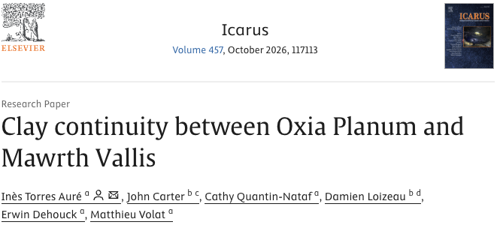
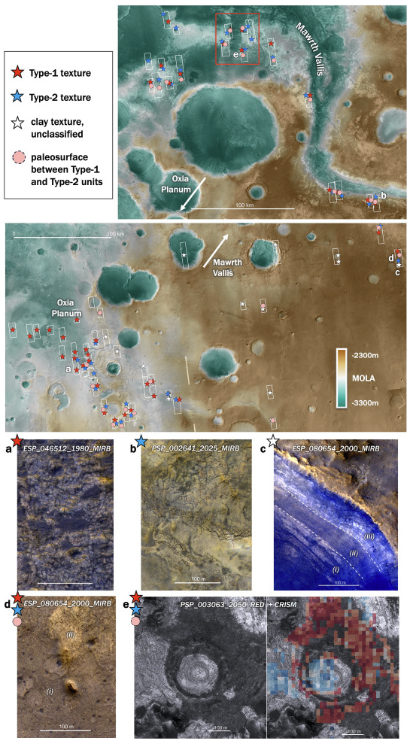
This study establishes a stratigraphic and spatial connection between the clay-bearing units of Oxia Planum and Mawrth Vallis, two of Mars' most extensively altered Noachian terrains.
CRISM and HiRISE color map clay outcrops using composition, and texture
They identify:
  A continuous deposit spanning >600 km laterally from Oxia Planum to Mawrth Vallis, draping >1300 m of elevation. Perhaps ocean sediments.
  A second distinct clay unit overlying this, but which is absent at Oxia Planum
  A cratered paleosurface between these units indicating a significant time gap
Rosalind Franklin Rover will investigate the lower unit, which turns out to be regional in extent

Slide 17
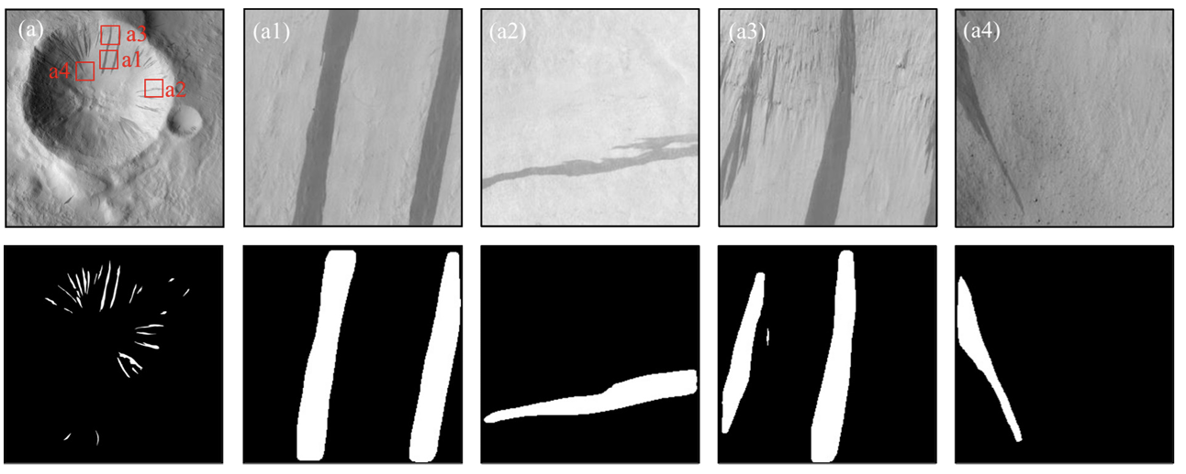
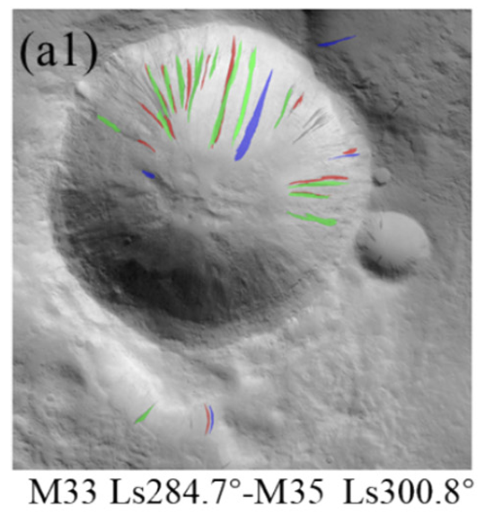
Dynamic monitoring of dark slope streaks within large-scale Martian scenes using multitemporal high-resolution orbiter imagery
B. Wan, S. Liu, X. Tong, H. Xie, Y. Feng, Y. Jin, K. Du, J. Zhang
https://doi.org/10.1016/j.asr.2026.02.052
Dark Slope Streaks (DSS) are mass wasting features found on dusty slopes on Mars and are known to be created and fade over the course of the MRO mission.
This study employs a Mask R-CNN and manual verification to extract DSS and to investigate their multi-temporal variations across large-scale Martian regions.
No clear relationship between DSS changes with surface temperature was observed, but there was an association with intensified dust activity during the autumn and winter.
Areas with greater topographic relief exhibit fewer new DSS occurrences compared to flatter terrains suggesting that complex local topography may inhibit dust mobility.
These observations further support a dry formation mechanism.
Two Mars years of change at one site

Slide 18
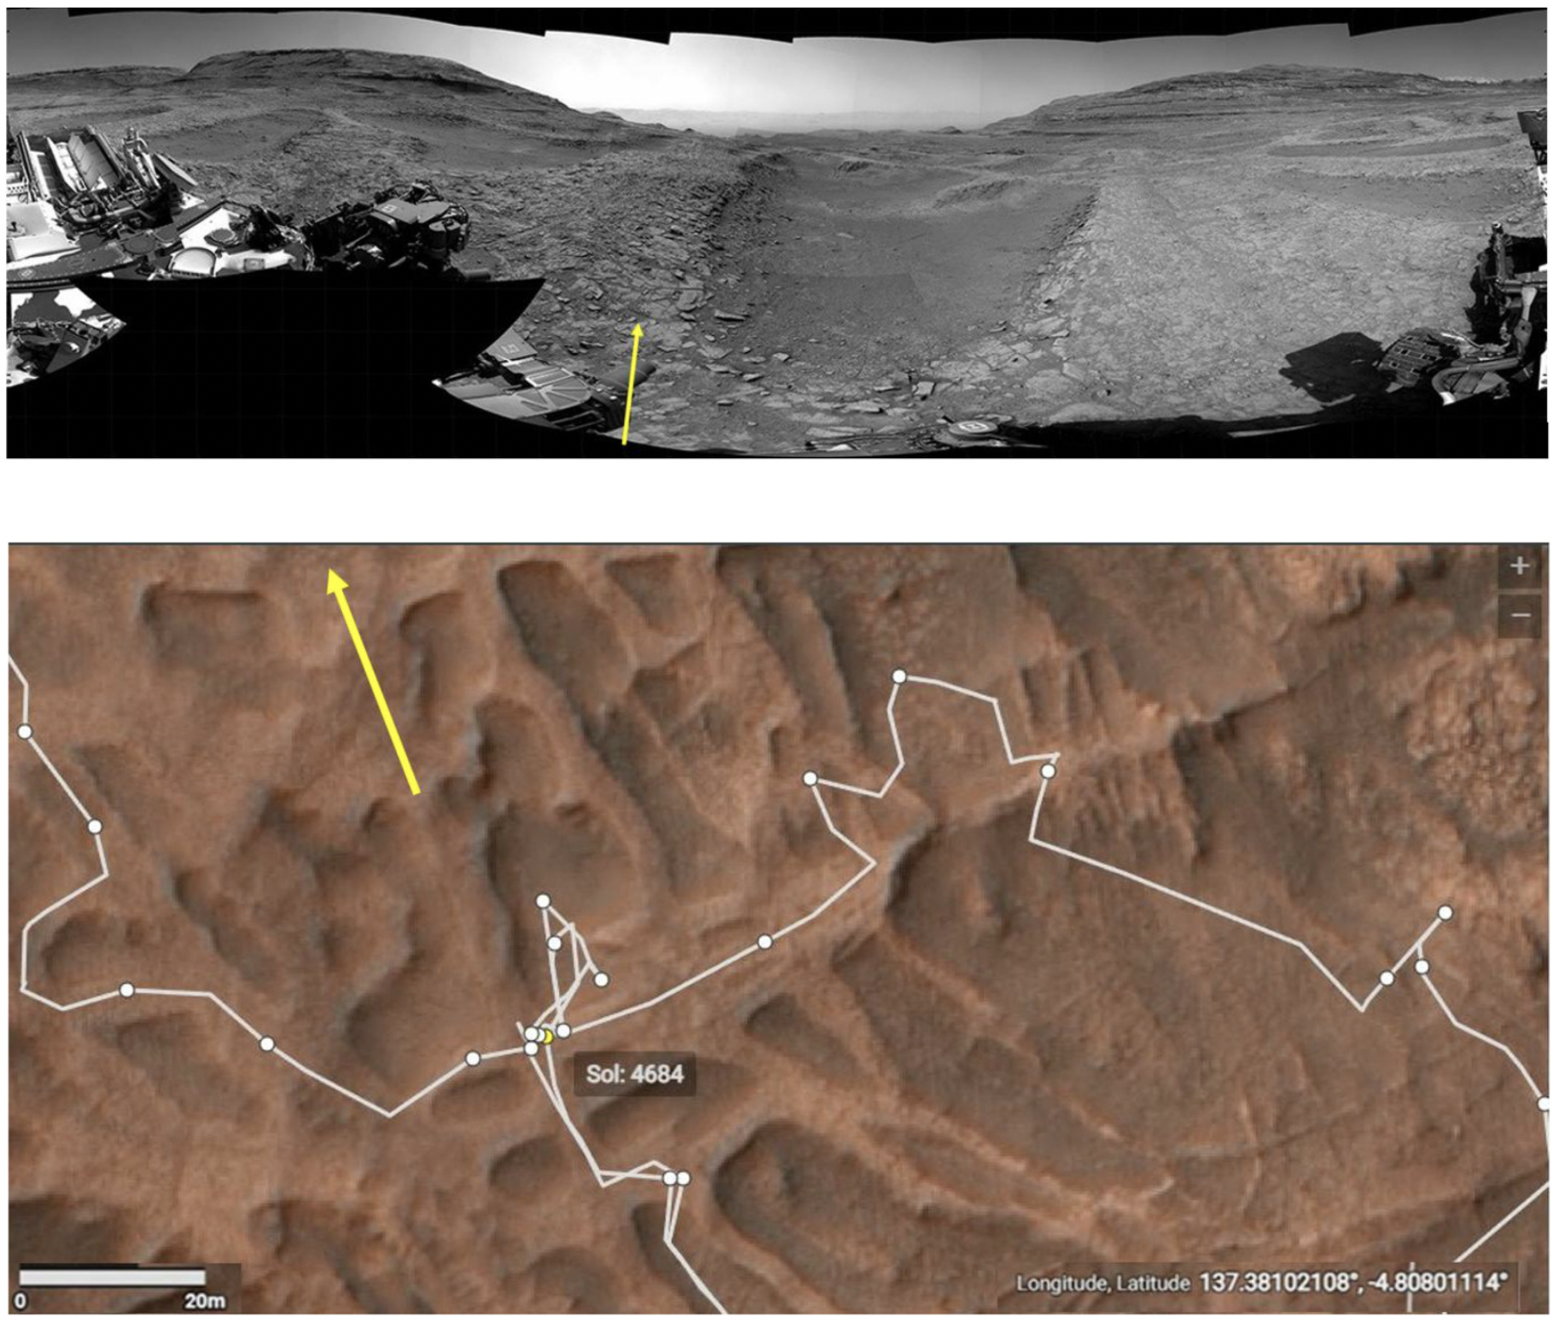
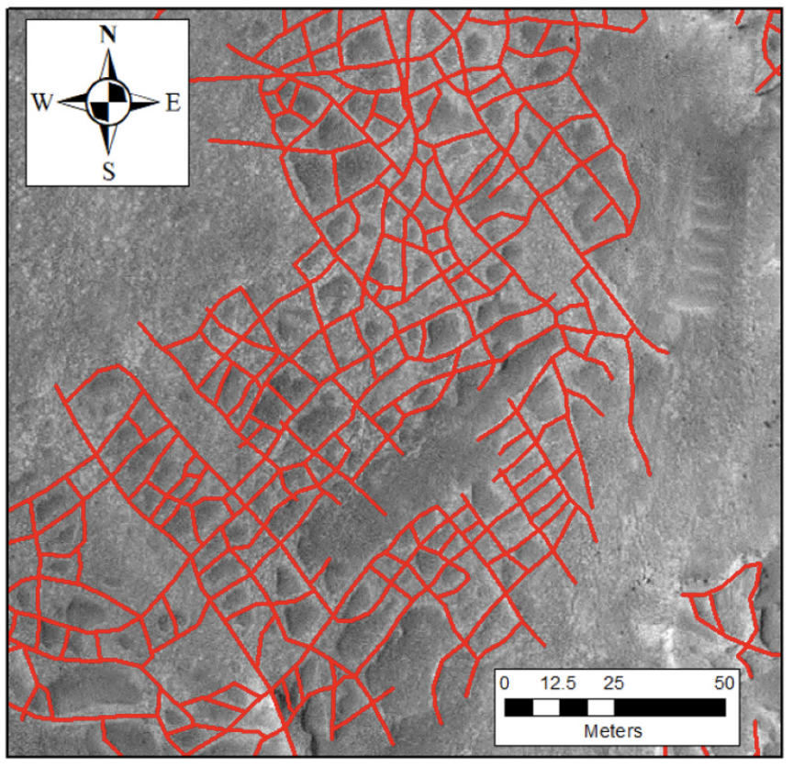
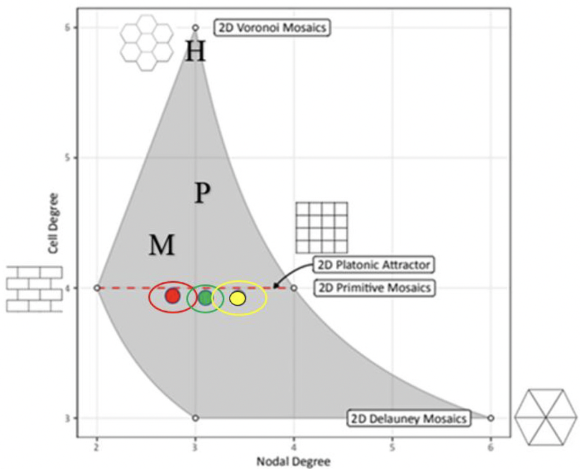
Boxwork fracture genesis and geomorphic evolution: Gale Grater, Mars
L.A. Scuderi, J. Manz, A.C. Buie, P.J. Gasda, B. Hallet
https://doi.org/10.1016/j.geomorph.2026.110386
Fluids in rock fractures may precipitate resistant minerals. Later erosion of the rock can leave behind raised ridges called boxwork.
Decameter-scale boxwork is found in only one unit in Gale Crater, which Curiosity traversed. Other fractured units lack the raised network of ridges.
Ridge networks (cells ~150-350 m²) were mapped at multiple sites using HiRISE
Boxwork viewed by both HiRISE and Curiosity
Hexagonal cracks
Periglacial cracks
Mud cracks
Symbolic Plane geometric analysis (edges-per-polygon vs edges-per-node) differentiates this unit from other fractured units (red vs yellow and green)
More T-shaped intersections in the boxwork unit suggest secondary fracturing
Evidence suggests circulation of fluids after fractures formed in some units within Gale crater and not others

Slide 19
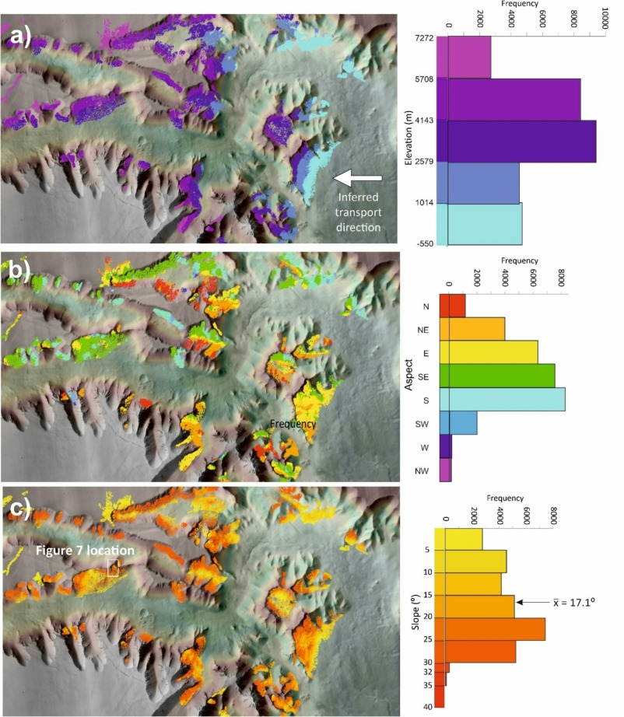
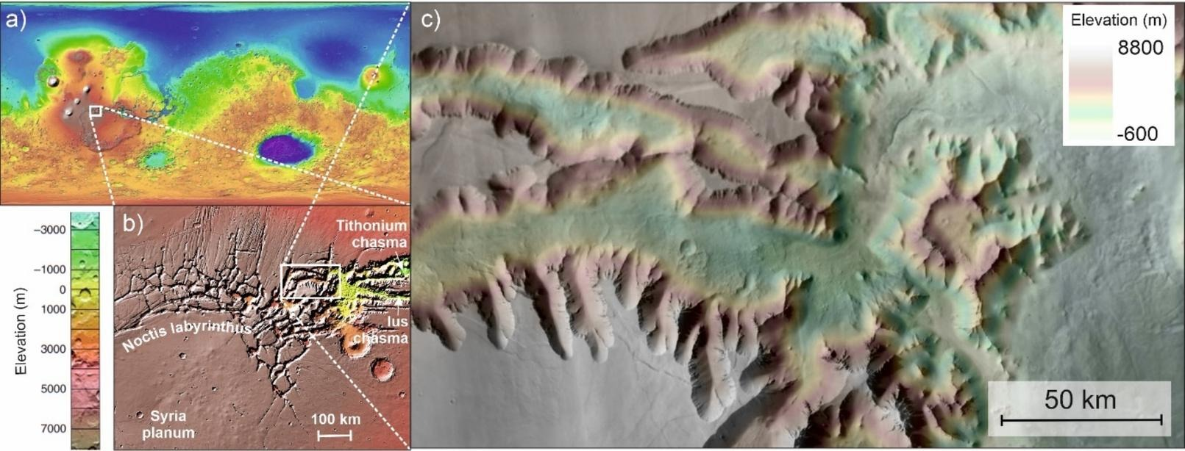
Widespread relict dunefields of Noctis Labyrinthus, Mars: Evidence of bedform formation on unusually steep slopes
Telfer, M. W., M. Day, and M. Chojnacki
https://doi.org/10.1016/j.geomorph.2025.110075
Extensive bedforms identified on slopes of canyons in Noctis Labyrinthus are interpreted to be indurated palaeo transverse climbing dunefields and mapped with HiRISE images and DTMs
These palaeodunes have ages of 5 Myr and occupy unusual geomorphological settings e.g. elevations sometimes in excess of 7000 m, and slopes up to the angle of repose of sand (∼32–34°)
Indurated dunes retain topographic expression with relief of 4-10 m, but may have lacked avalanching lee slopes.
Occurrence on east-facing slopes is consistent with westward sediment flux and winds slowing upon contact with the steep canyon walls.
ESP_070052_1500 ESP_070764_1505

Slide 20
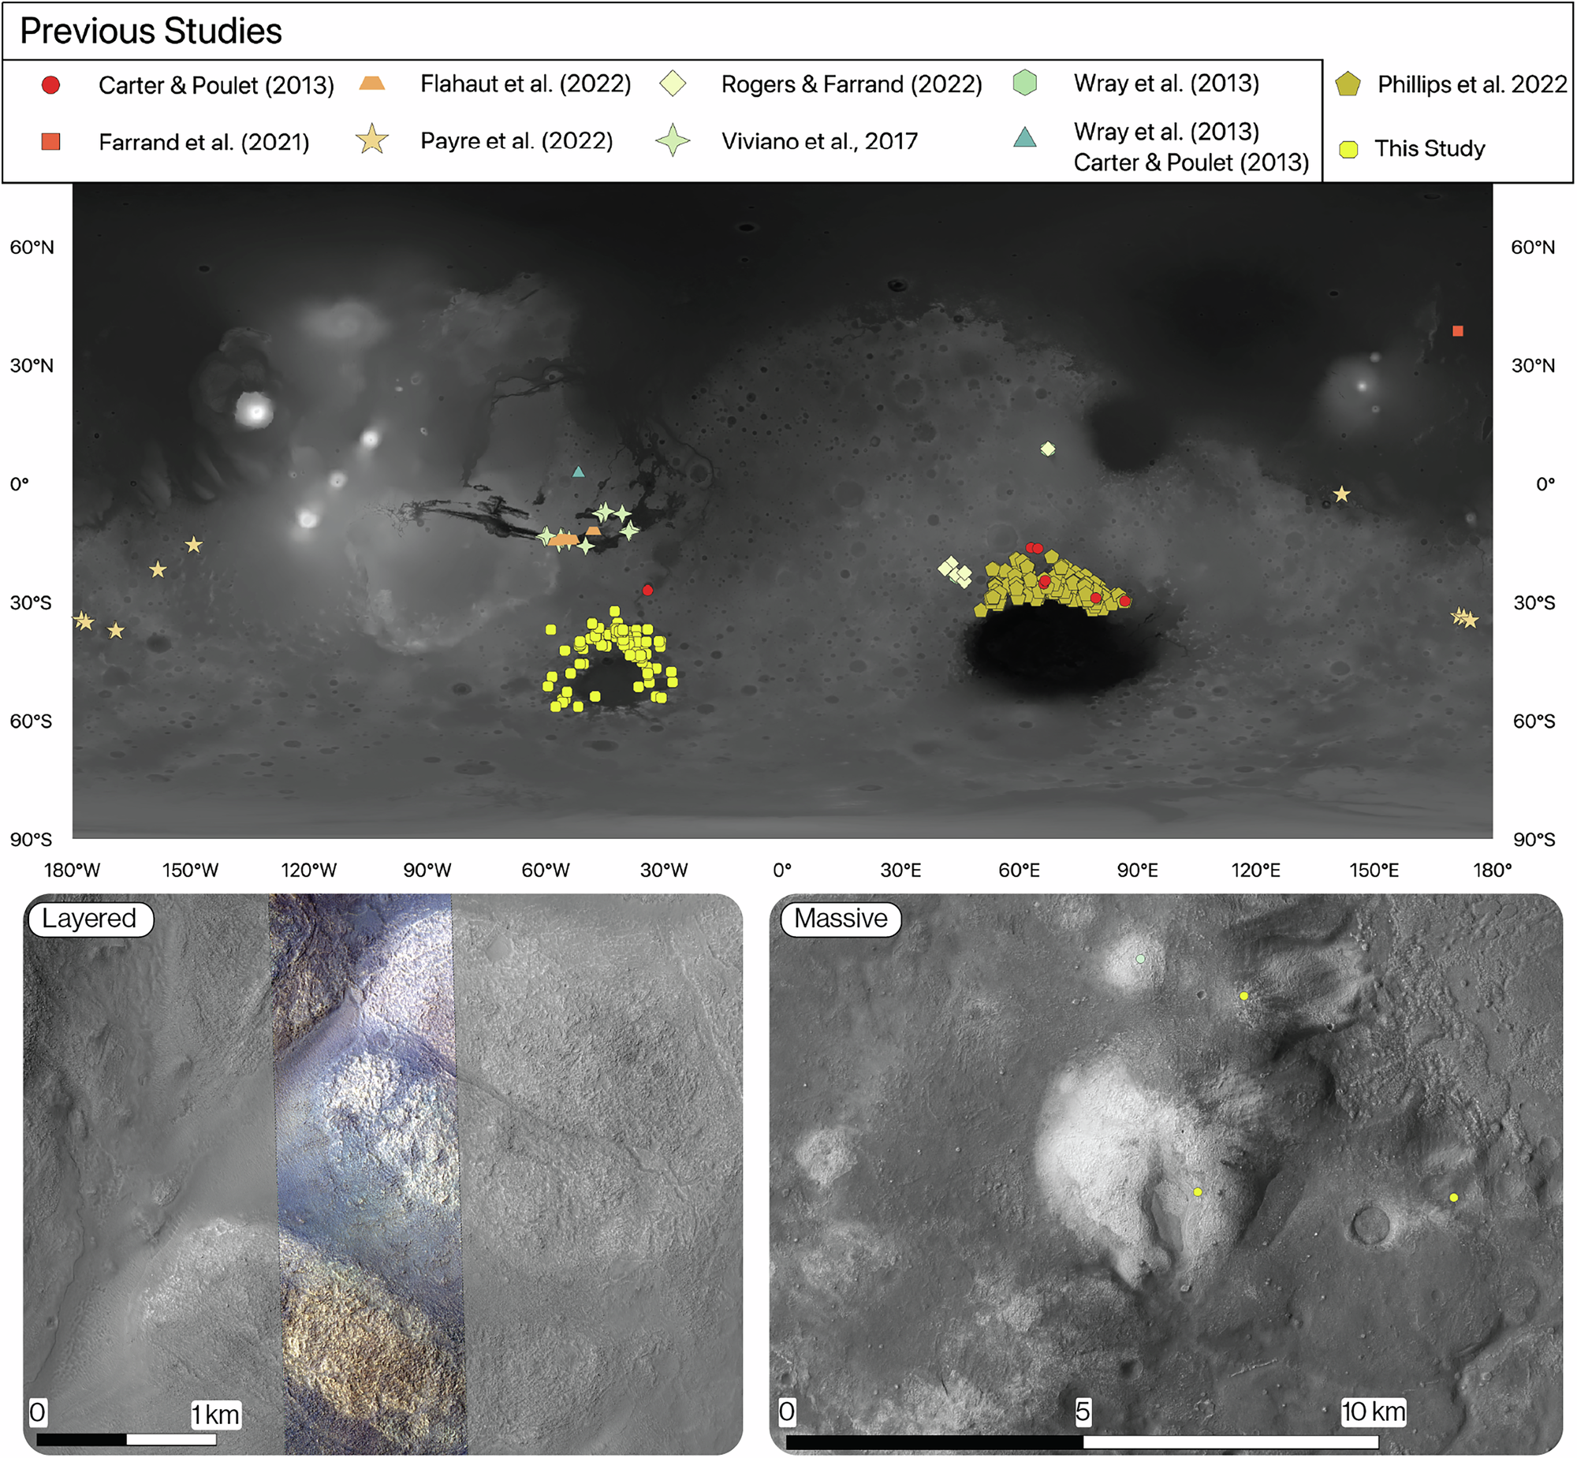
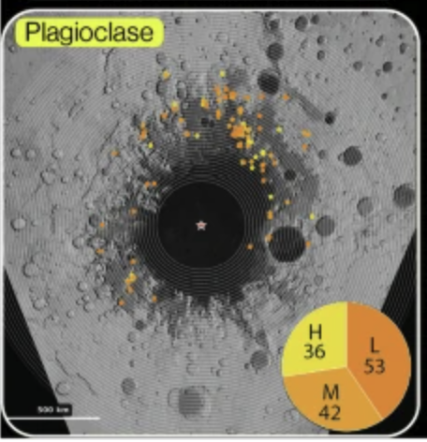
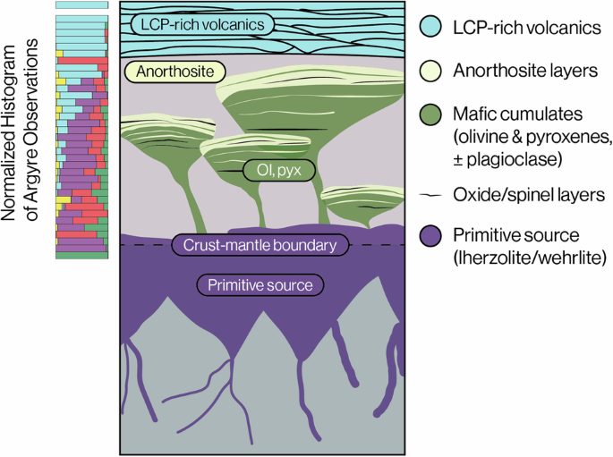
Widespread ancient anorthosites in the lower crust of Mars
Phillips, M.S., C.E. Viviano, A.D. Rogers, L. Larson, L. Tornabene, A. Trowbridge, J.E. Moersch & H.Y. McSween Jr
https://doi.org/10.1038/s43247-025-03004-7
CRISM and HiRISE IRB color used to identify feldspar-rich massifs surrounding Argyre
These are thought to be lower crustal blocks uplifted by the Argyre impact
Evolved rocks indicate crustal melting and differentiation early in Mars History

Slide 21
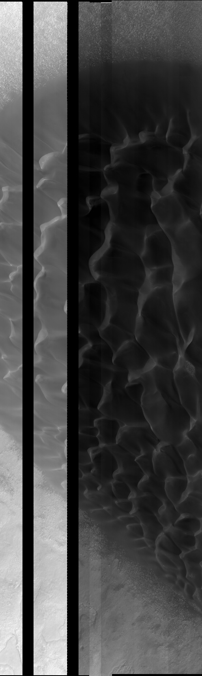
The Future of HiRISE
MRO has fuel for 10+ more years
One of 14 HiRISE CCD electronics failed in 2011, another has been intermittent since 2023
Noise threatens usefulness of other CCD channels (there are 2 channels per CCD)
There will be more image gaps from bad channels, or we may choose to return narrower images
All science objectives can still be achieved, but with reduced efficiency

