Slide 1
Mars Surface (and subsurface) Materials

Slide 2
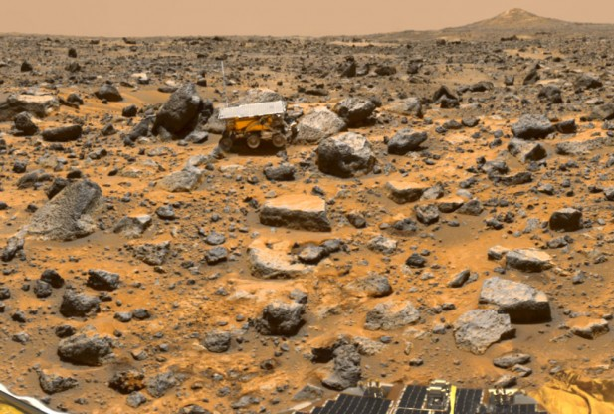
Mars surface materials are similar to parts of the Earth
  The main crustal rocks are volcanic basalt

Slide 3
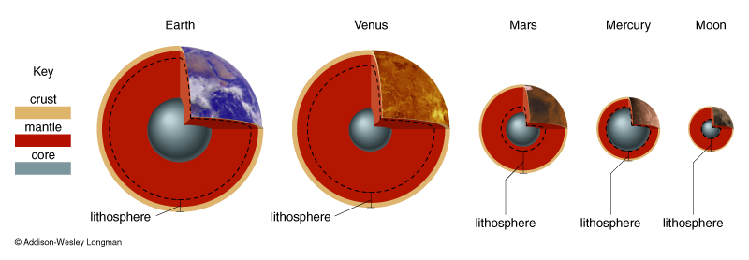
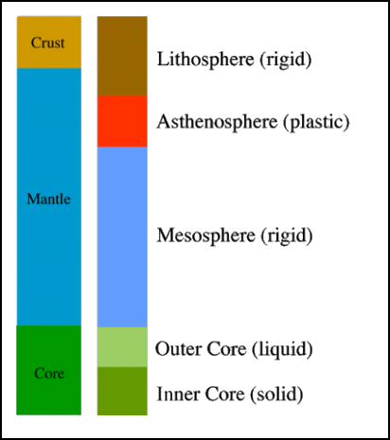
Overview of a rocky planet
  Starts as homogeneous mix of rock & iron
  Molten state allows differentiation
  Iron core cools and solidifies (not yet complete for the Earth)
Millions
of years
Billions
of years
~12,800 km

Slide 4
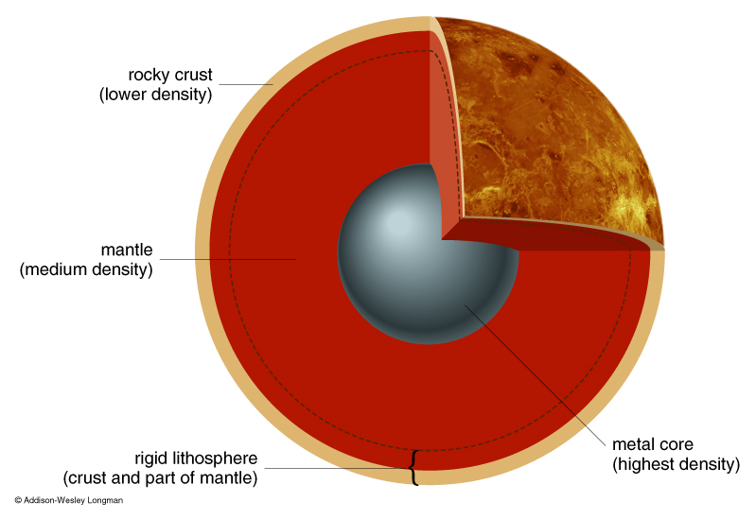
Compositional vs. mechanical terms
  Crust, mantle, core are compositionally different
    Earth has two types of crust
  Lithosphere, Asthenosphere, Mesosphere, Outer Core and Inner Core are mechanically different
    Earth’s lithosphere is divided into plates…

Slide 5
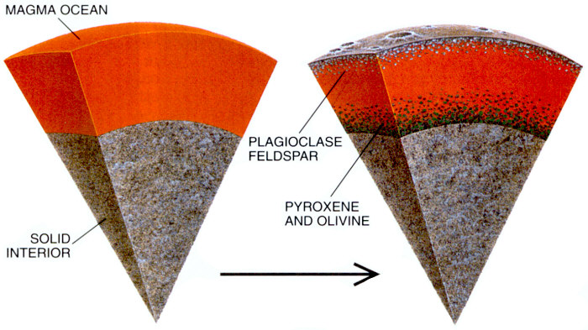
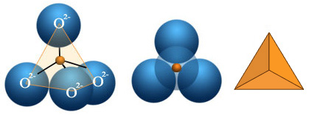
Giant Impacts make Magma Oceans
  Lunar magma ocean was probably at least a few hundred km thick
  Apollo 11 returned highland fragments, first suggestion of Magma ocean
  Idea since extended to other terrestrial planets
A melt has a bulk chemical composition, but no crystals
Minerals are mechanically separable crystals with a distinct composition
  Terrestrial planets are dominated by silicon-oxygen based minerals – silicates
Silicate rocks are built from SiO₄ tetrahedra

Slide 6
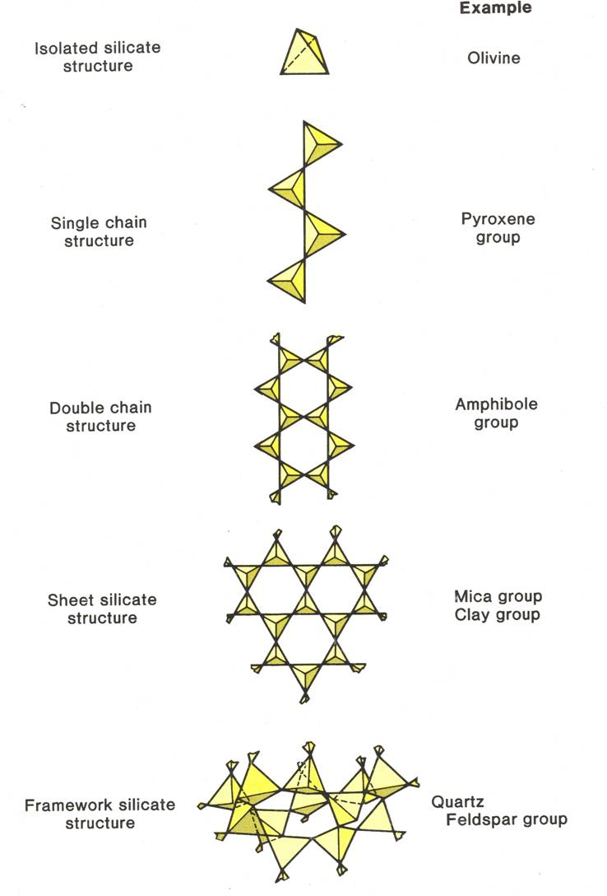
Depending on how Oxygen is shared
  Olivine
    Isolated tetrahedra joined by cations (Mg, Fe)
    (Mg,Fe)₂SiO₄ (forsterite, fayalite)
  Pyroxene
    Chains of tetrahedra sharing 2 Oxygen atoms
    (Mg, Fe) SiO₃ (orthopyroxenes)
    (Ca, Mg, Fe) SiO₃ (clinopyroxenes)
  Feldspars
    Framework where all 4 oxygen atoms are shared

Slide 7
Earth/Venus/Mars
  Olivine and pyroxene rain out of a magma ocean leaving a crust that’s more enriched in feldspar minerals
  This remaining composition is called Basaltic
  Basalt is a broad term (to be expounded upon in the volcanism lectures!)
    Variations in water content
    Variations in alkali metal content
    Variations in silica content
  These are initial crusts that will be heavily modified by:
    Stripping by Giant Impacts
    Plate Tectonics
    Volcanism
Millions
of years

Slide 8
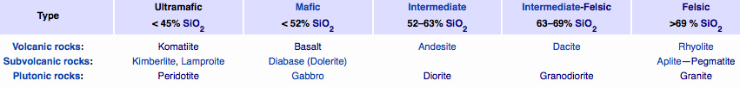
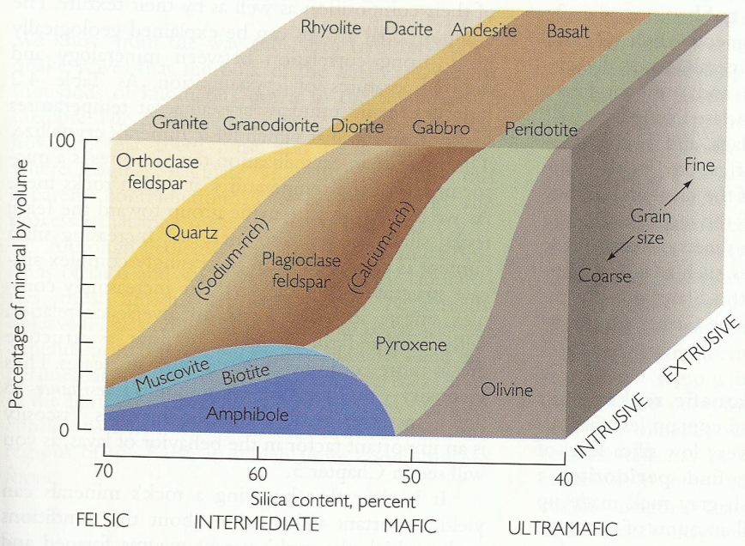
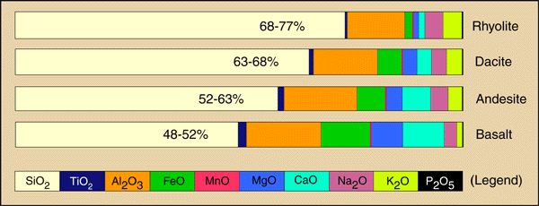
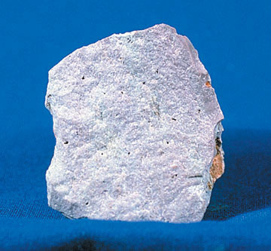
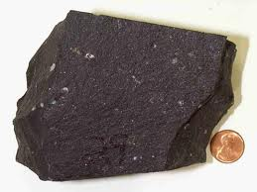
Ultrabasic
Primative
Basic
Acidic
Evolved
Fe poor
Light
Less-dense
Fe rich
Dark
Dense

Slide 9
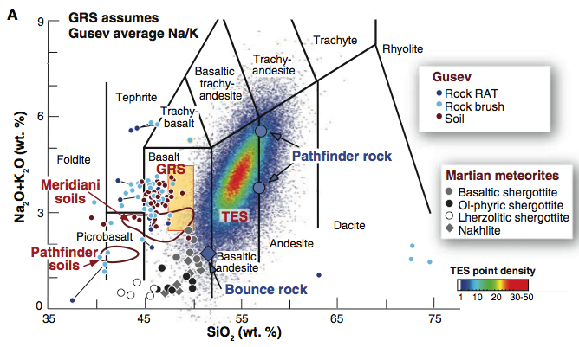
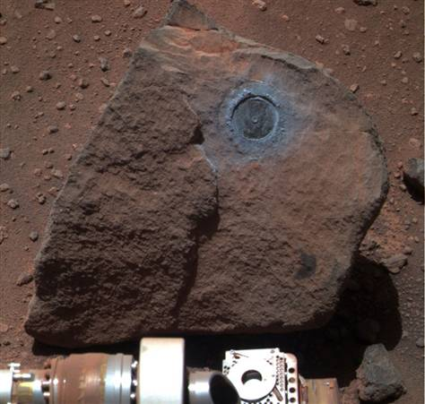
Martian in-situ and orbital measurements
  Crust dominated by basalt
  With a thin weathered coating
McSween et al., 2009

Slide 10
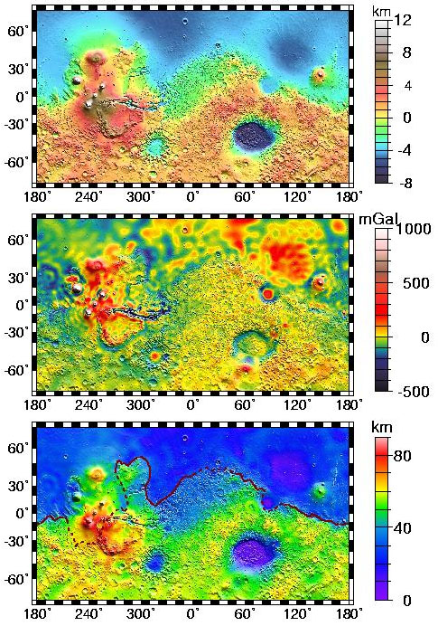
Mars: Crustal Dichotomy
Northern and southern hemispheres of Mars are very distinct:
  North
    Low elevation
    Few Craters – Young
    Smooth terrain
    Thin Crust
    Less Magnetized rock
  South
    High elevation
    Heavily cratered – Old
    Rough terrain
    Thick crust
    More Magnetized rock
Dichotomy boundary mostly follows a great circle, but is interrupted by Tharsis
No gravity signal associated with the dichotomy boundary - compensated
Theories on how to form a dichotomy:
  Giant impact
  Several large basins
  Degree 1 convection cell
  Early plate tectonics
Zuber et al., 2000

Slide 11
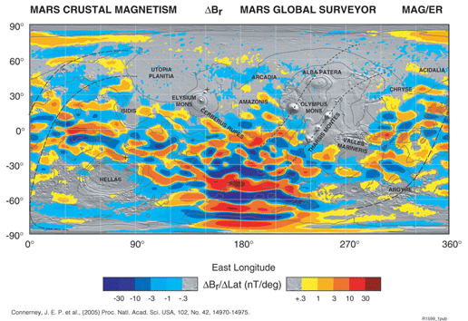

Slide 12
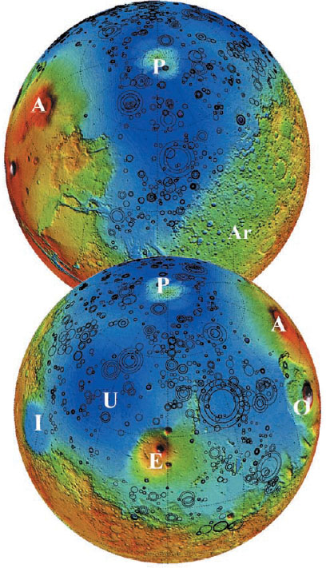
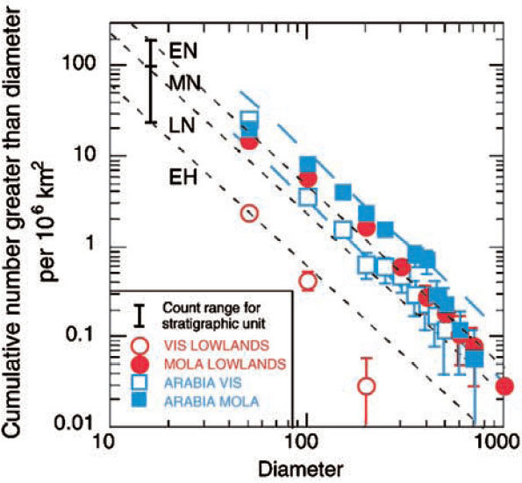
Despite all this the difference may be only skin deep
Buried impact basins in the northern hemisphere have been mapped
Before this burial the northern and southern hemispheres were indistinguishable in age
  Rules out Earth-style plate tectonics
Northern hemisphere is a thinly covered version of the southern hemisphere
  Mantled by 1-2 km of material (sediments and volcanic flows)
Frey et al., 2002

Slide 13
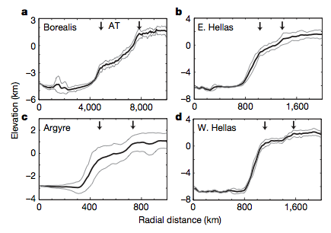
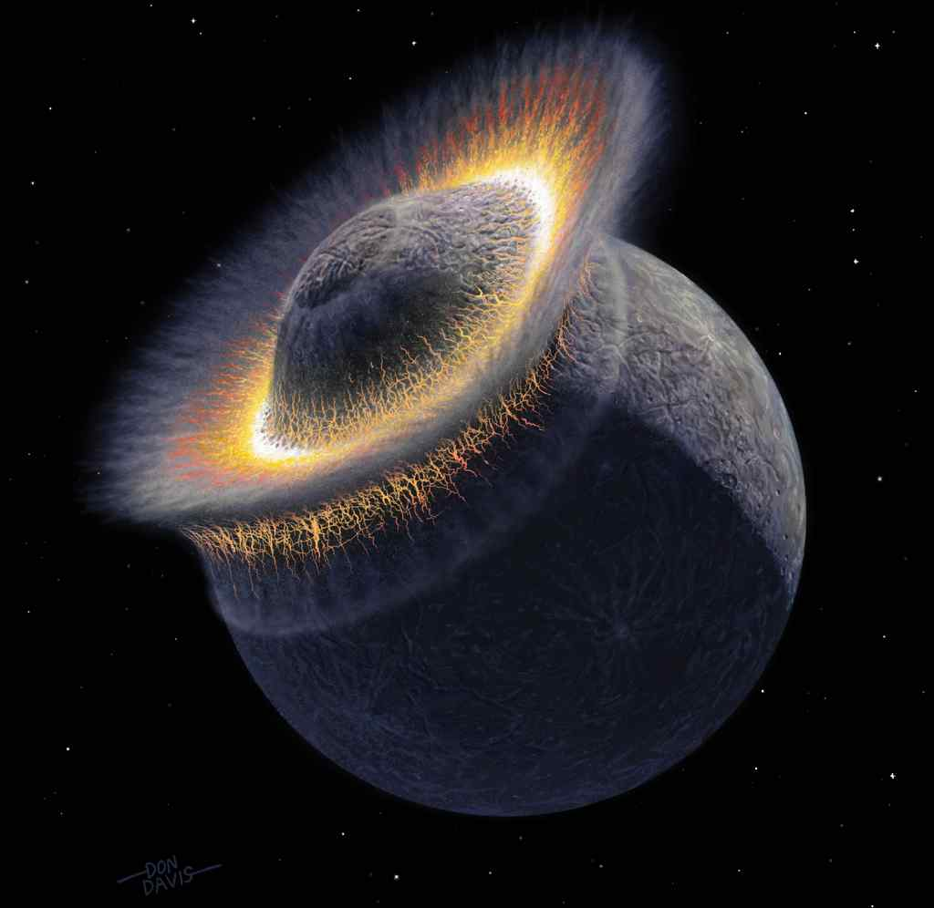
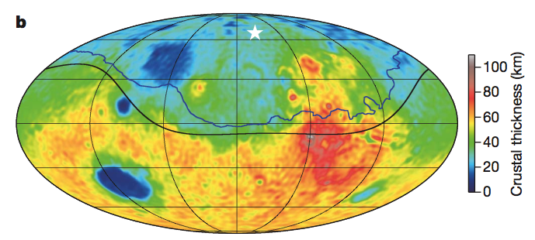
Borealis basin
  208E, 67N
  4250-5300 km in radius
Shares slope break with at ~1.5 basin radii with other basins
Largest impact structure in the solar system
Andrews-Hanna et al., 2008

Slide 14
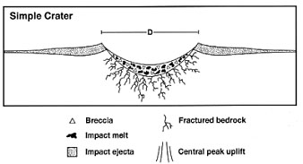
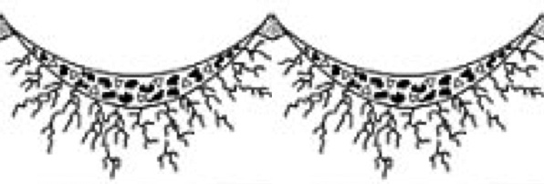
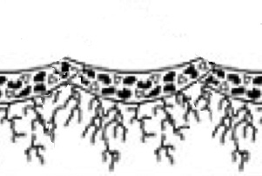
Crust of airless bodies suffers many impacts
  Repeated impacts create a layer of pulverized rock
  Old craters get filled in by ejecta blankets of new ones
Regolith grows when crater breccia lenses coalesce
Assume breccia (regolith) thickness of D/4
Maximum thickness of regolith is D_{eq}/4 , but not in all locations
Smaller craters are more numerous and have interlocking breccia lenses < D_{eq}/4
Mars does not appear to have lunar-like regolith
  More modified and indurated
Growth of Regolith
Shoemaker et al., 1969

Slide 15
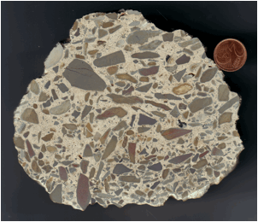
Impact breccia
  Unsorted angular fragments

Slide 16
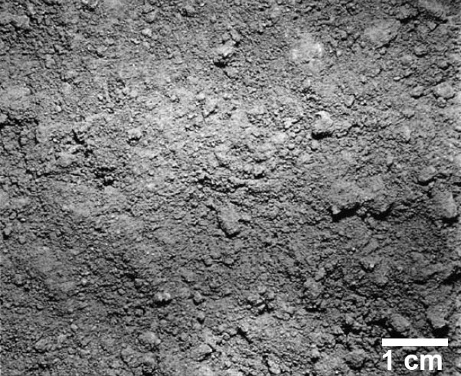
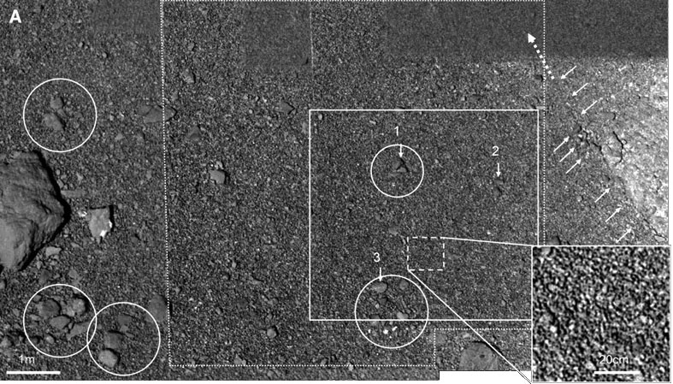
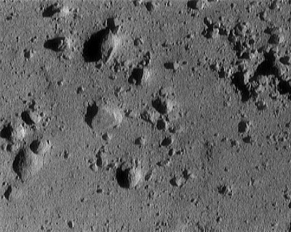
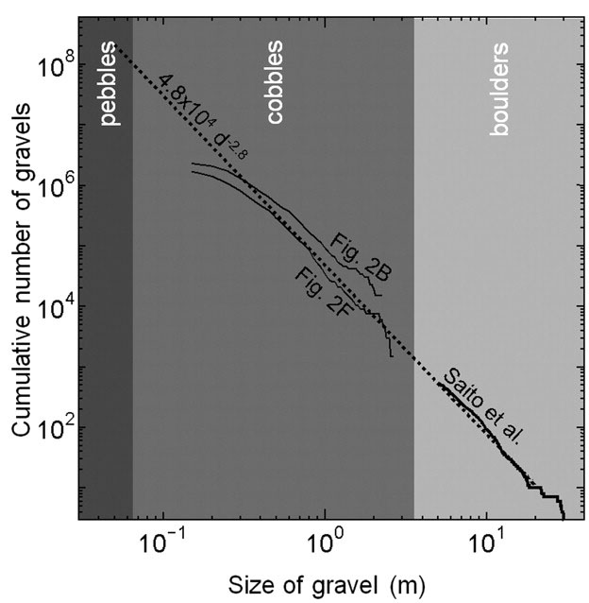
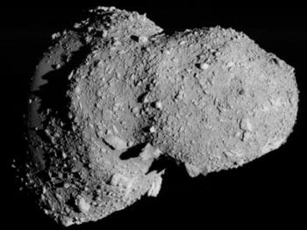
All rocky airless bodies covered with regolith (‘rock blanket’)
Moon - Helfenstein and Shepard 1999
Itokawa – Miyamoto et al. 2007
Miyamoto et al. 2007
Eros – NEAR spacecraft (12m across)

Slide 17
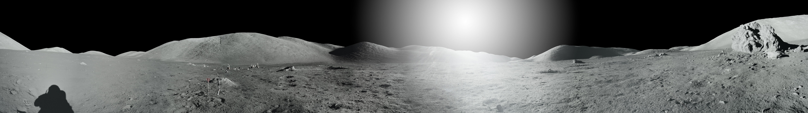
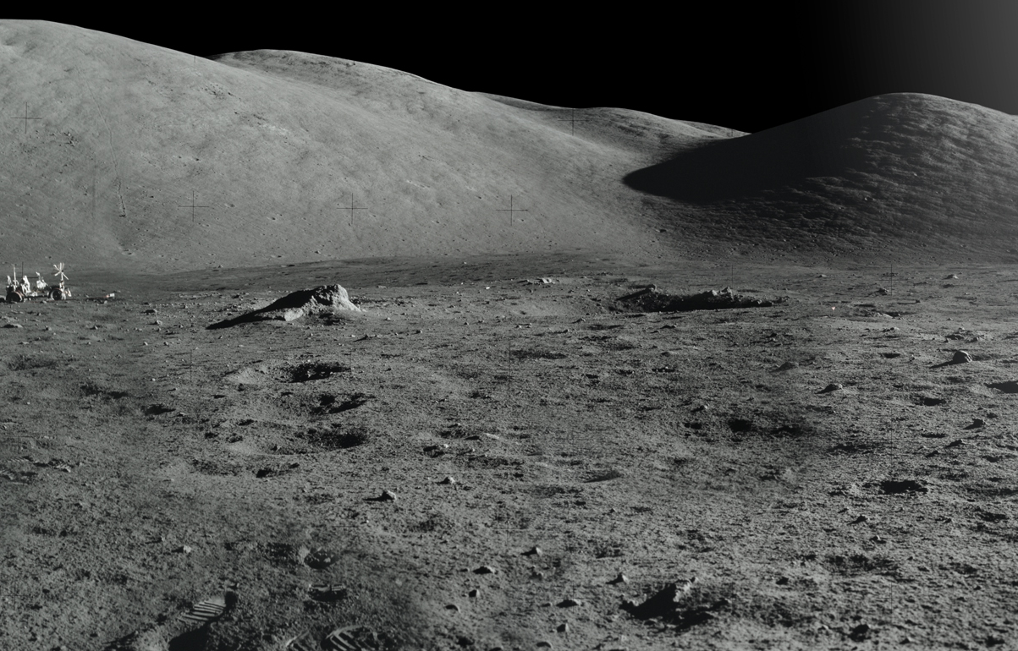
This is where the story ends (more or less) for the Moon/Mercury/asteroids

Slide 18
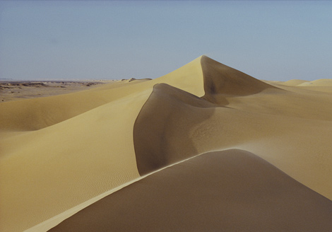
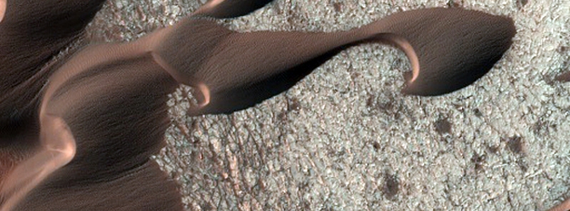
Earth
Breakup of rocks into sand sized particles is common on Earth and Mars, but the composition of these particles are very different
  Earth is mostly quartz because it survives a lot longer than anything else
  Mars is mostly chips of basalt, because that’s what dominates the local environment
  Rare places on the Earth also have basaltic sand e.g. Hawaii and Iceland
Mars

Slide 19
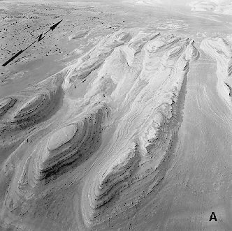
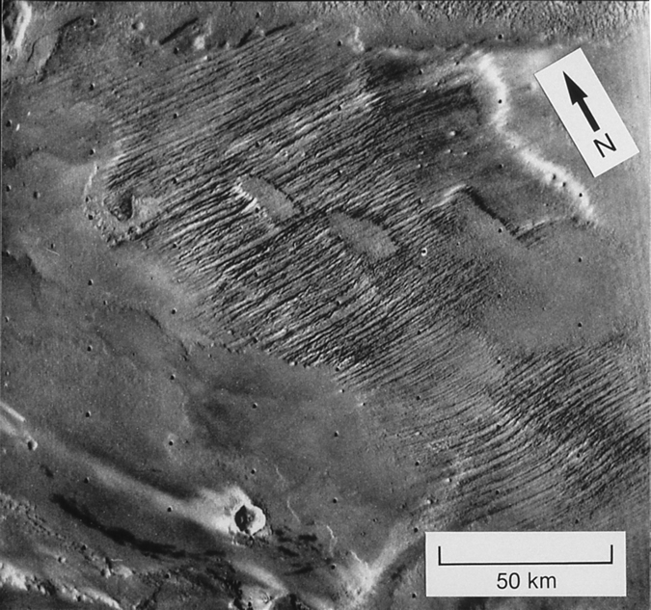
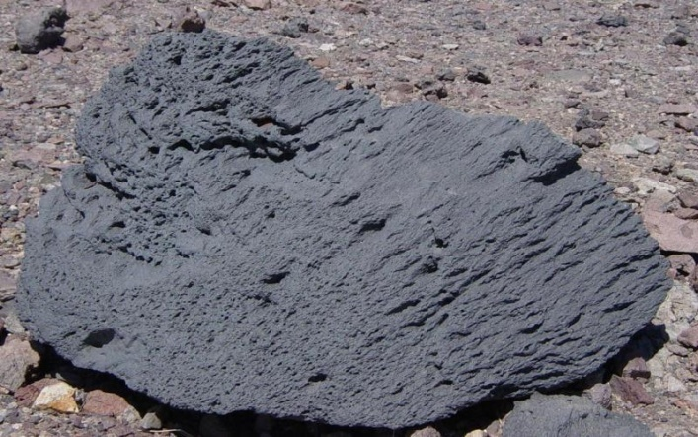
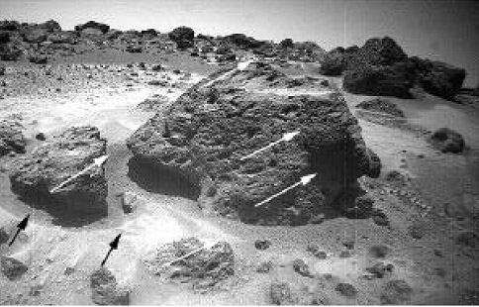
Aeolian Erosion
Yardangs
  Wind blown particles abrades surface
  Erosion leaves elongated mounds as remnants
  Requires strong, virtually unidirectional, wind.
  Eroded material must be consolidated
Recentwind action
Older wind action
Ventifacts
  Elongated erosional marks on rocks
  Usually works on originally circular vesicles
  Used as paleo-wind direction indicators e.g. pathfinder landing site

Slide 20
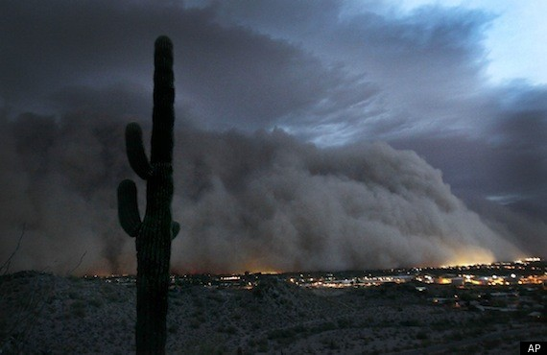
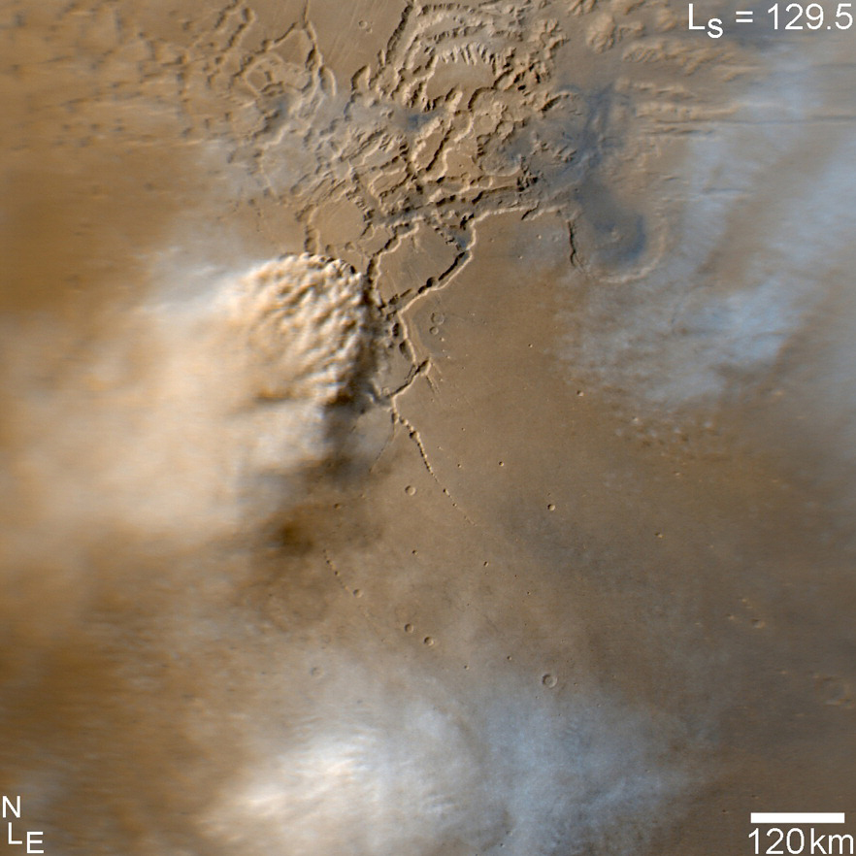
Dust is common on both Mars and Earth – but not so mobile on the Earth
Earth (Phoenix, AZ)
Mars (Noctis Labyrinthus)

Slide 21
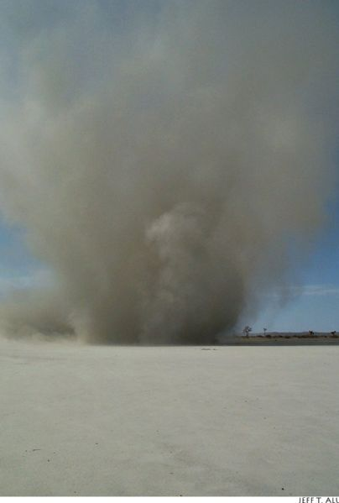
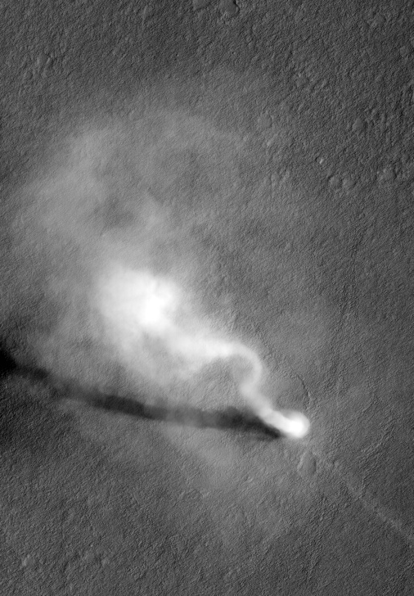
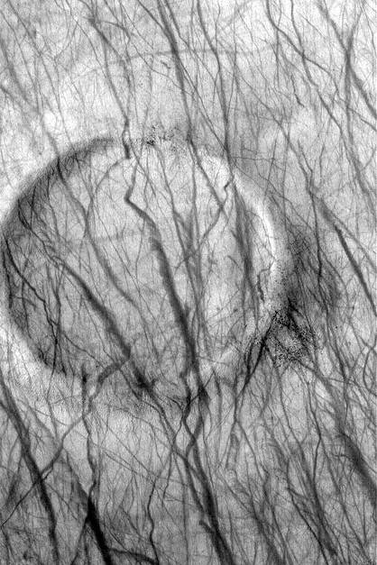
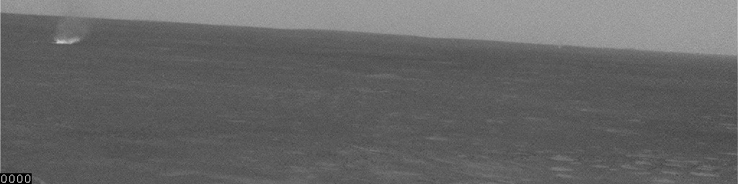
Dust Devils and their tracks common in certain areas on Mars
  Older streaks fade with time - redeposition of dust
  Dust-devil shadows indicate heights up to 20 km
Earth (Eloy)
Mars
Mars
Mars, Gusev Crater

Slide 22
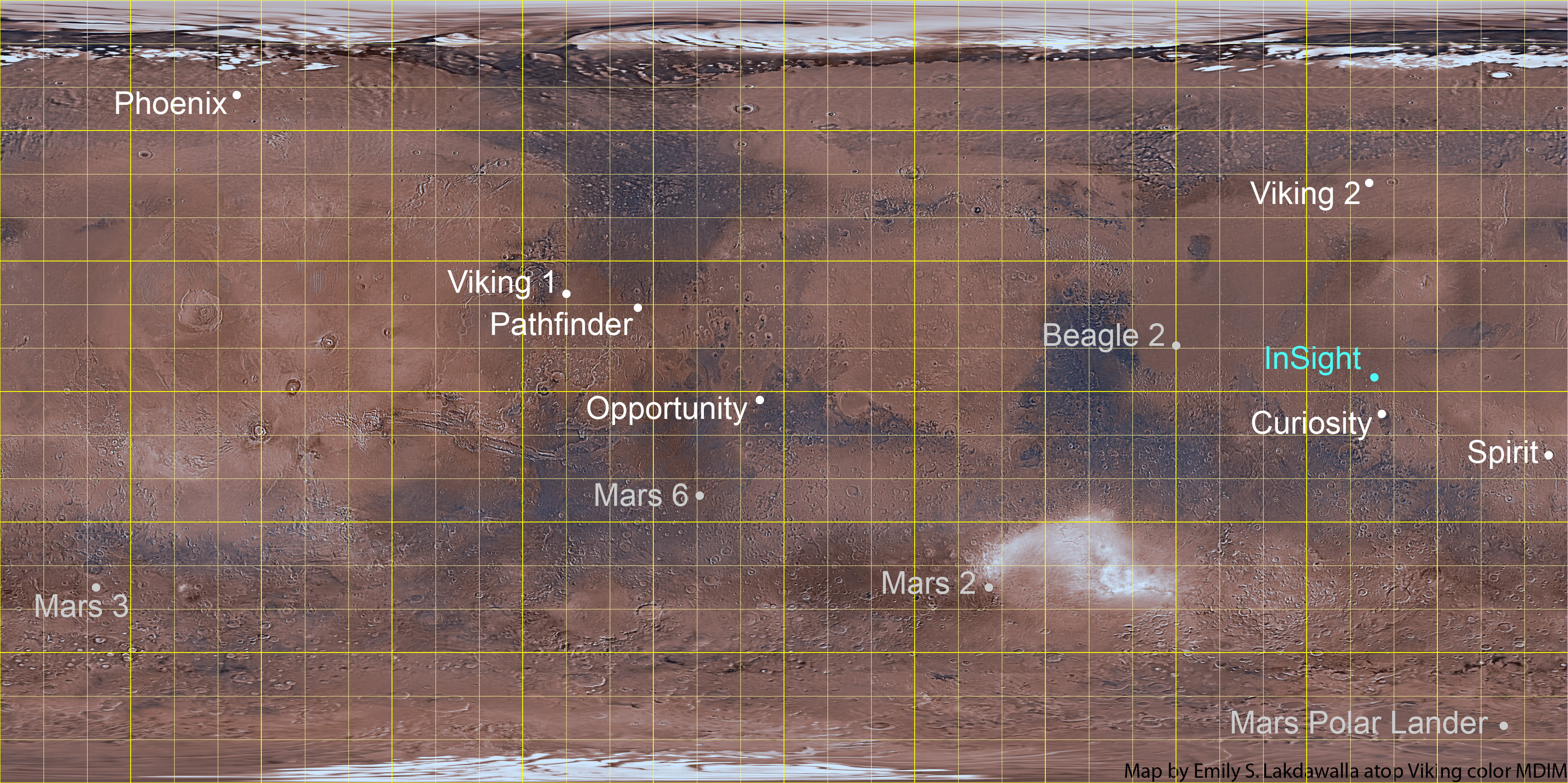
Landing Sites
. Tianwen-1
. Perseverance

Slide 23
Successful Landing Sites
. Tianwen-1
. Perseverance

Slide 24
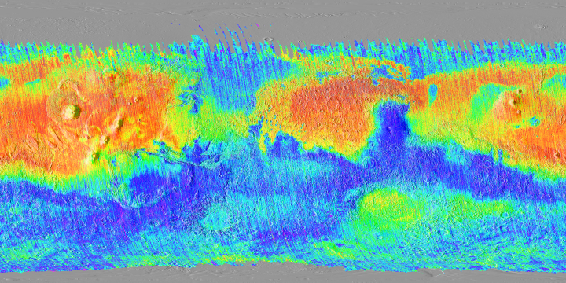
Mars has very large dusty areas
  Landed missions try to avoid these areas
  Bright and pretty featureless in HiRISE images
Dust index map from Ruff and Christensen
red = most dusty

Slide 25
Mars has very large dusty areas
  Landed missions generally avoid these areas
  Dusty areas are bright and pretty featureless in HiRISE images
. Tianwen-1
. Perseverance
Dust index map from Ruff and Christensen

Slide 26
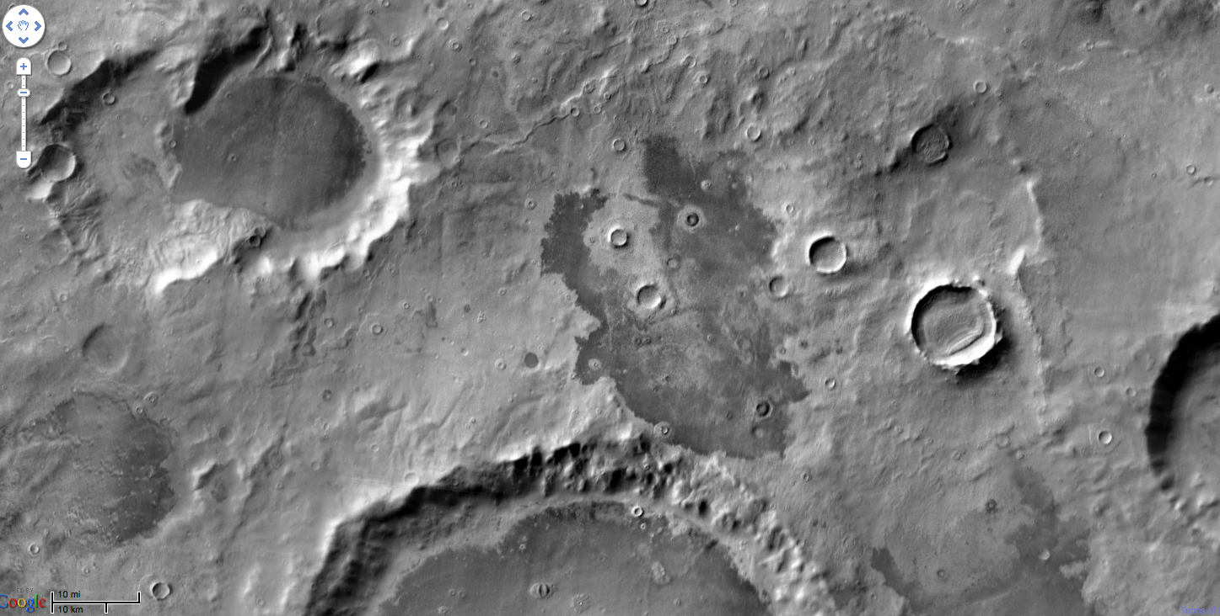
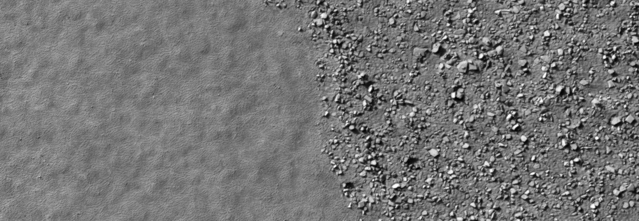
Thermal inertia is used as a predictor of rock abundance for landing site selection.
Themis Daytime IR
darker=cooler=higher TI
ESP_024117_1185

Slide 27
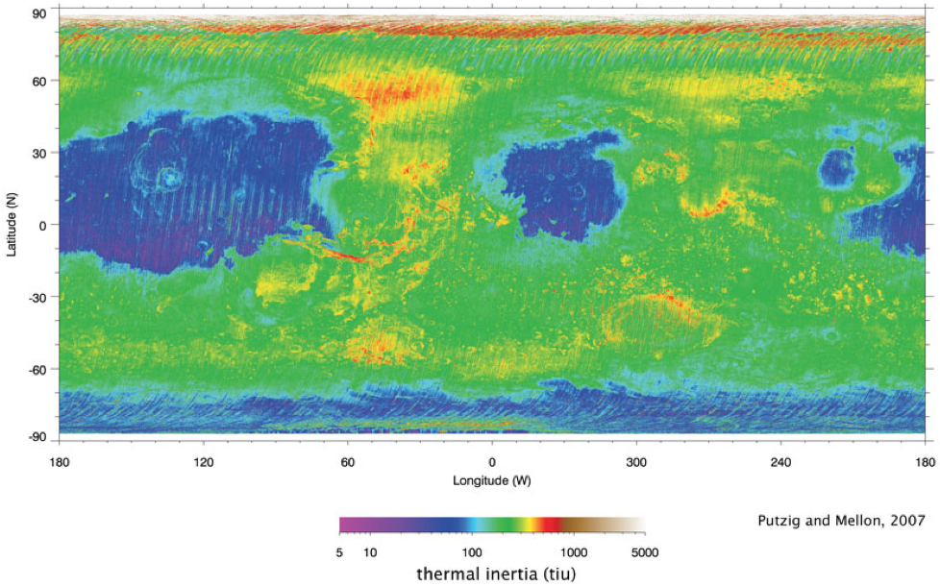
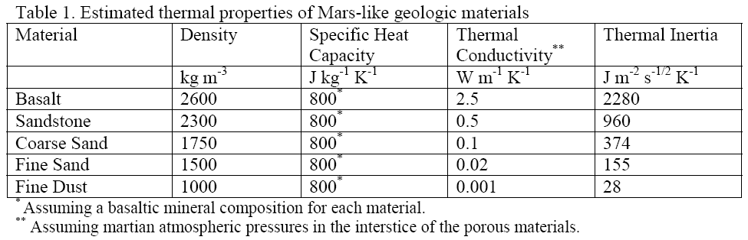
Mike Mellon, U. Colorado

Slide 28

Temperature waves propagate into the subsurface each day
The depth they reach depends on the material thermal inertia
Thermal inertia
  k is thermal conductivity
  ρ.c is density times heat capacity
  (ρ.c)^{0.5} = 900-1400 (factor of ~1.5)
The thermal ‘skin depth’ is
  τ is the timescale e.g. 1 day
  d ranges from meters to millimeters because of differences in k
d
Day
Night
ROCK
ROCK

Slide 29


Chemical weathering
  Reaction with water (maybe acidified) and/or oxygen
Pyroxenes (weathering of basalt)
  Oxidation of iron
    Fe – metallic iron
    Fe²⁺ – Ferrous iron (water soluble)
    Fe³⁺ – Ferric iron (water insoluble)
  3FeSiO₃ + O₂ ➔ 2Fe₂O₃ + 4SiO₂
  Pyroxene ultimately breaks down into Hematite and Silica
  Weathered basalt looks reddish on Earth/Mars

Slide 30


Hematite in large quantities is relatively rare on Mars – but not at the opportunity landing site
  Called “blueberries”
Discovery by Mars Global Surveyor influenced the course of the Mars Exploration rover missions

Slide 31

Feldspars
  Potassium feldspar converted to Kaolinite, a clay mineral
  2KAlSi₃O₈ + 2H₂CO₃ + H₂O ➔ Al₂Si₂O₅(OH)₄ + 4SiO₂ + 2K⁺ + 2HCO₃⁻
  Another important way in which granite is broken down
  Ion mobility Ca > Na > Mg > K > Si > Fe > Al
  Aluminum can get progressively concentrated when weathering rates are very high
Clay minerals (green) are being discovered on Mars in an increasing number of locations
Clays appear mostly in the oldest materials on the planet and require water to from.
Indicates wet conditions early in Mars’ history
Jezero Crater,
where Perseverance will land

Slide 32




What do ancient martian rocks tell us?
  Clay minerals formed in wet conditions and they’re common in ancient rocks
Wray et al., 2008
Ehlmann et al., 2009
Noachian crustal hydrothermal clays
Noachian layered clays
Ehlmann et al., 2008
Osterloo et al., 2008
Noachian delta/fan clay-bearing sediments
Noachian "glowing terrain" rich in chloride salts

Slide 33



A big change for Mars
(Bibring et al., 2006)
present
MARS
EARTH
Hadean
Archaean
Proterozoic
Phan.
4.6 Gyr
3.85 Gyr
2.5
Gyr
543 Myr
present day
oldest rocks
oldest fossil life

Slide 34




Gale crater

Slide 35



Slide 36


Water ice in the Regolith
Gamma Ray spectrometer on Mars Odyssey spacecraft has detected hydrogen (from H₂O) in near surface

Slide 37

Ground ice on Mars theorized to exist for some time
  Regolith provides the thermal insulation
  Stable ice distribution changes with climate
  Diffusive contact with the atmosphere
Water vapor
Trench in Antarctica
Surface
Up to a few feet down

Slide 38



The Phoenix lander discovered pore-filling ice and pure buried water ice

Slide 39

New craters expose this ice of wide areas – but it’s not pore filling…
How did pure ice come to be underground?
50m

Slide 40
Recap
Mars has the same rocks and minerals that the Earth does
Early differentiation resulted in a basaltic crust
  i.e. the whole crust is very similar in composition to Hawaiian lava flows
A giant impact probably rearranged enough material to create a hemispheric difference in crustal thickness
Smaller impacts pounded the crust into a regolith of angular rock fragments
  Other processes also contribute to breaking rocks up into sand and dust
Dusty areas on Mars are common and have distinct thermal behavior
Thermal inertia can be used to infer rock abundances and regolith grain sizes
Chemical alteration produced a suite of other minerals, including:
  Hematite at the opportunity landing site
  Clays in the oldest terrains that have seen seen liquid water activity
Ice is another major constituent at mid- and high-latitudes
  Pore-filling ice in the regolith is easy to explain
  Pure sheets of buried ice also exist, but are currently still a puzzle

