Slide 1
Mars Data and where to find them

Slide 2
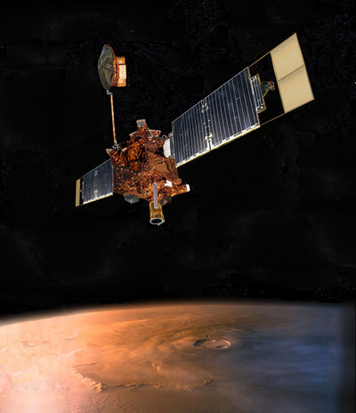
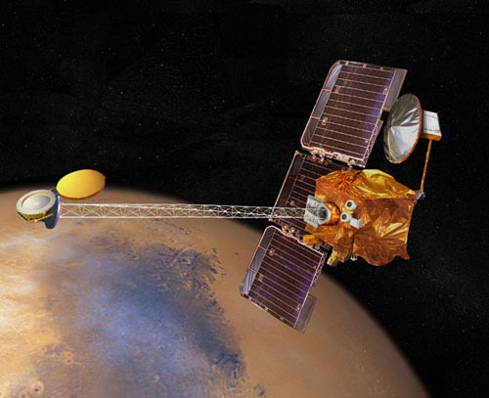
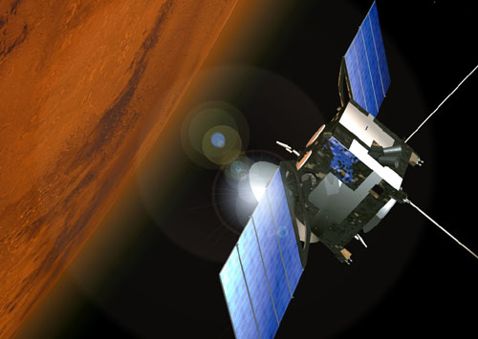
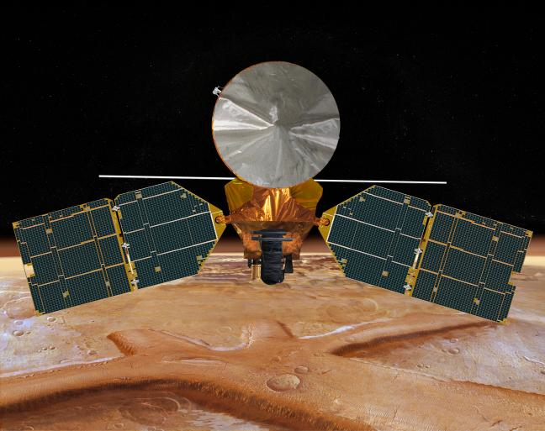
Types of instruments to talk about
  Gamma and Neutron Spectrometers
  Thermal cameras
  Spectrometers
  Hyperspectal imagers
  RADAR
  Lanser/rover data -- complicated
Mars Global Surveyor (MGS)
Mars Odyssey (ODY)
Mars Express (MEX)
Mars Reconnaissance Orbiter (MRO)

Slide 3
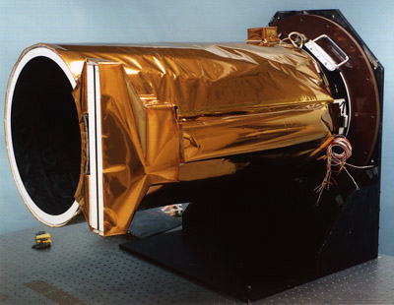
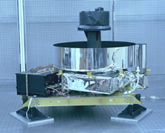
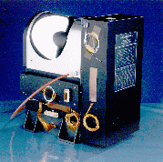
Mars Global Surveyor
  At Mars 1998-2006
  Unexpectedly had to fly backwards in its orbit
  Broken solar panel delayed mission start, but it revolutionized Mars Science
  Mars Orbiter Camera (MOC)
    Broadband visible imager, up to 1.4 m/pixel
    Image widths 3km with variable length
  Mars Orbiter Laser Altimeter
    1 micron pulsed laser at 10 Hz, footprint size ~180m
    Global topography accurate to the nearest meter
    Also measured surface reflectance, roughness and cloud heights
  Thermal Emission Spectrometer
    Broadband thermal and visible bolometers – albedo and temperature measurements
    Thermal Spectra 6-50 microns – multiple applications
    3x6 km resolution
  Magnetometer
    Particles and fields measurements
    Wasn’t expected to yield any surface info, but the broken solar panel turned out to be useful after all…

Slide 4
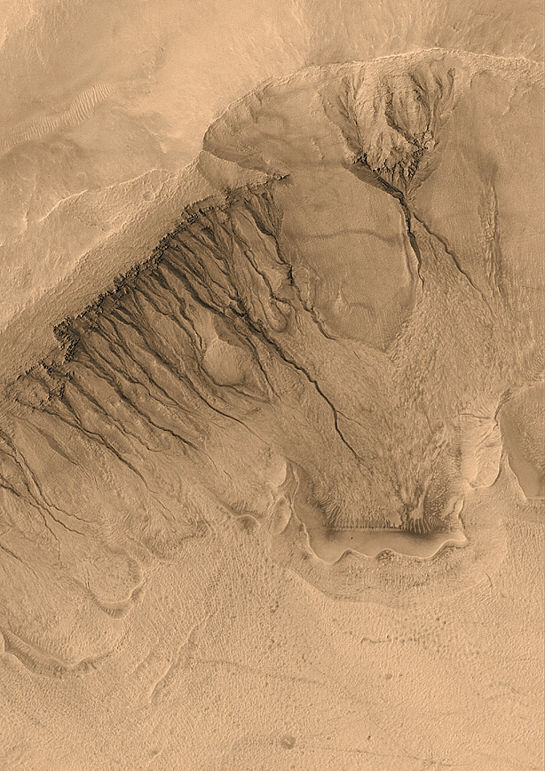
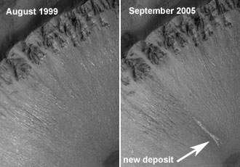
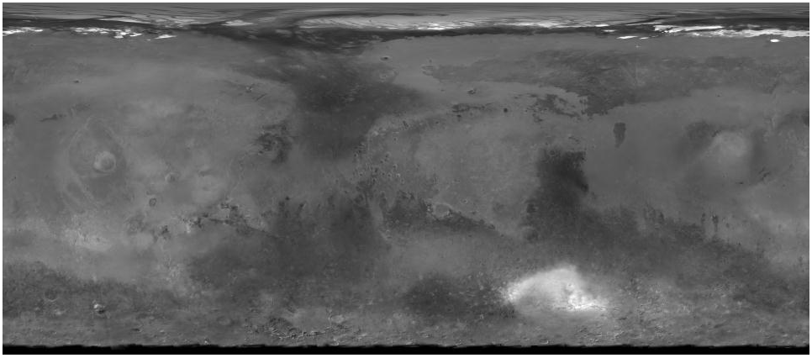
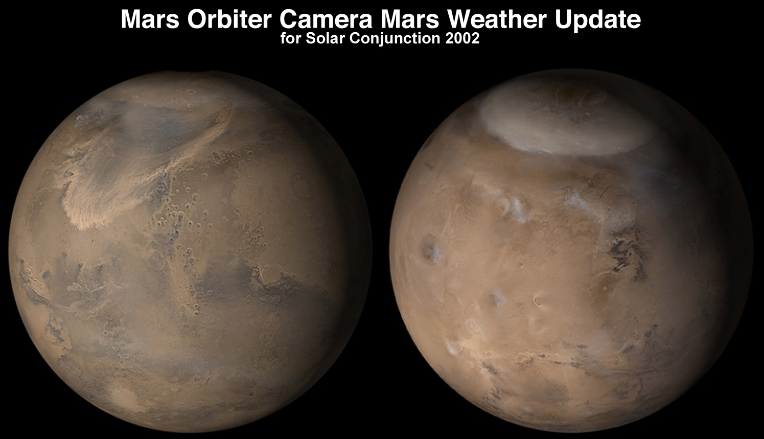
MOC
  Malin Space Science Systems
  Data can be found on the PDS and via HiReport as well as www.msss.com
Narrow angle camera
  Gullies and their activity
  Polar layers & frost changes
  New impacts
  Sedimentary layers
  Landing site safety
Wide angle camera
MOC global Atlas
Daily global weather maps

Slide 5
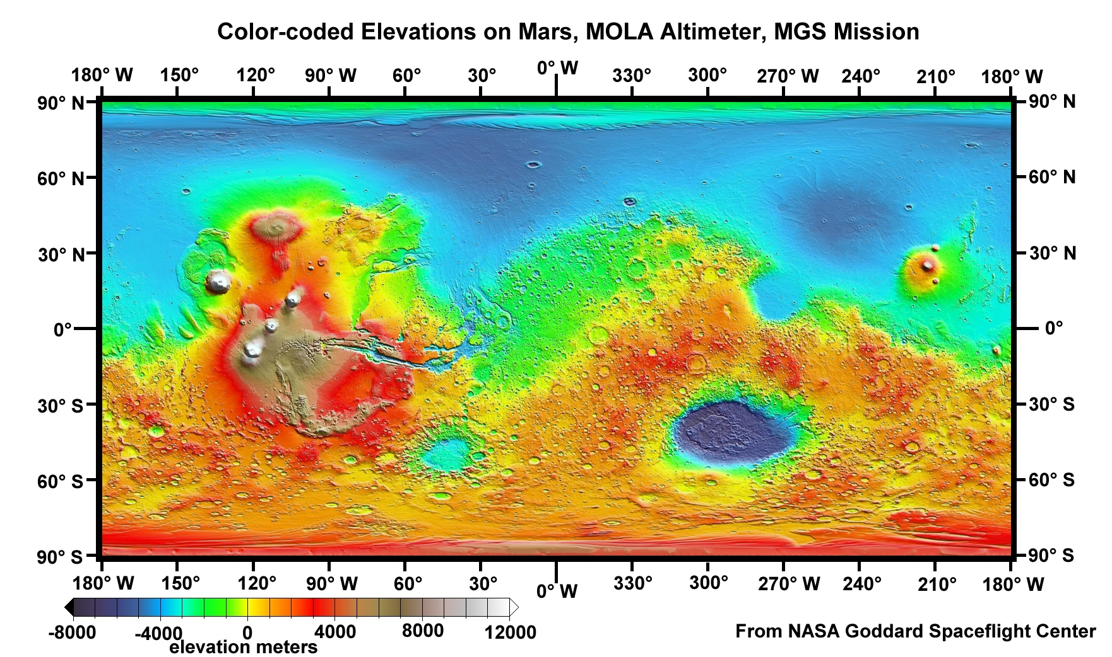
MOLA
  Global topography
  Some gaps at equator (up to a few kilometers), but complete polar coverage
  Track cross-over correction makes the dataset globally self-consistent
  This is the key dataset that everything else is georeferenced to

Slide 6
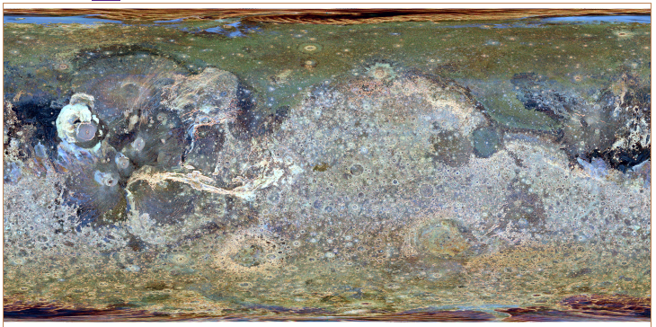
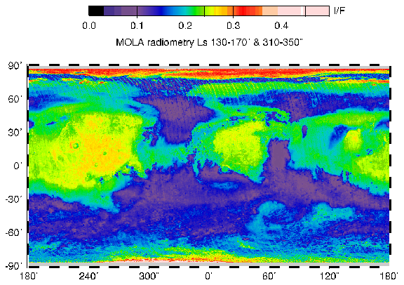
Kreslavsky & Head vertical roughness. Red, green and blue composite from roughness at 0.6 km, 2.4 km, and 9.2 km baselines.
Reflectance measurements from the active reflection
Later MOLA made passive measurements of reflected sunlight

Slide 7
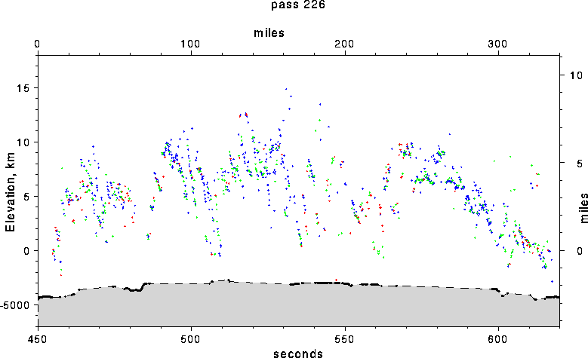
MOLA can detect clouds on both the day and night sides

Slide 8
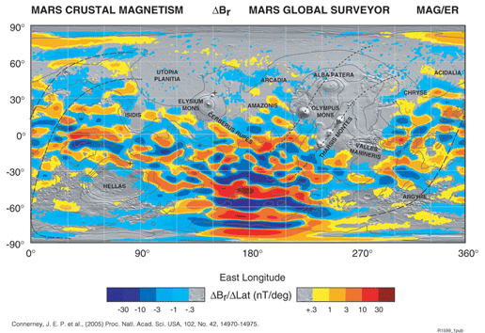
Areas of magnetized crust discovered by the MGS magnetometer
  Mars currently has no dipole field, but a dipole field existed once
  Crustal magnetization much stronger than on Earth
  This discovery was an accident enabled by the broken solar panel
Lack of magnetic field over Hellas and Argyre basins attributed to shock demagnetization
Absence of remnant fields in the northern hemisphere is a puzzle – perhaps due to hydrothermal circulation

Slide 9
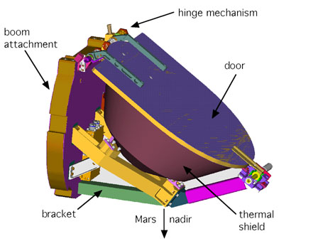
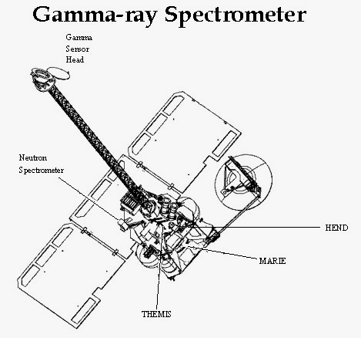
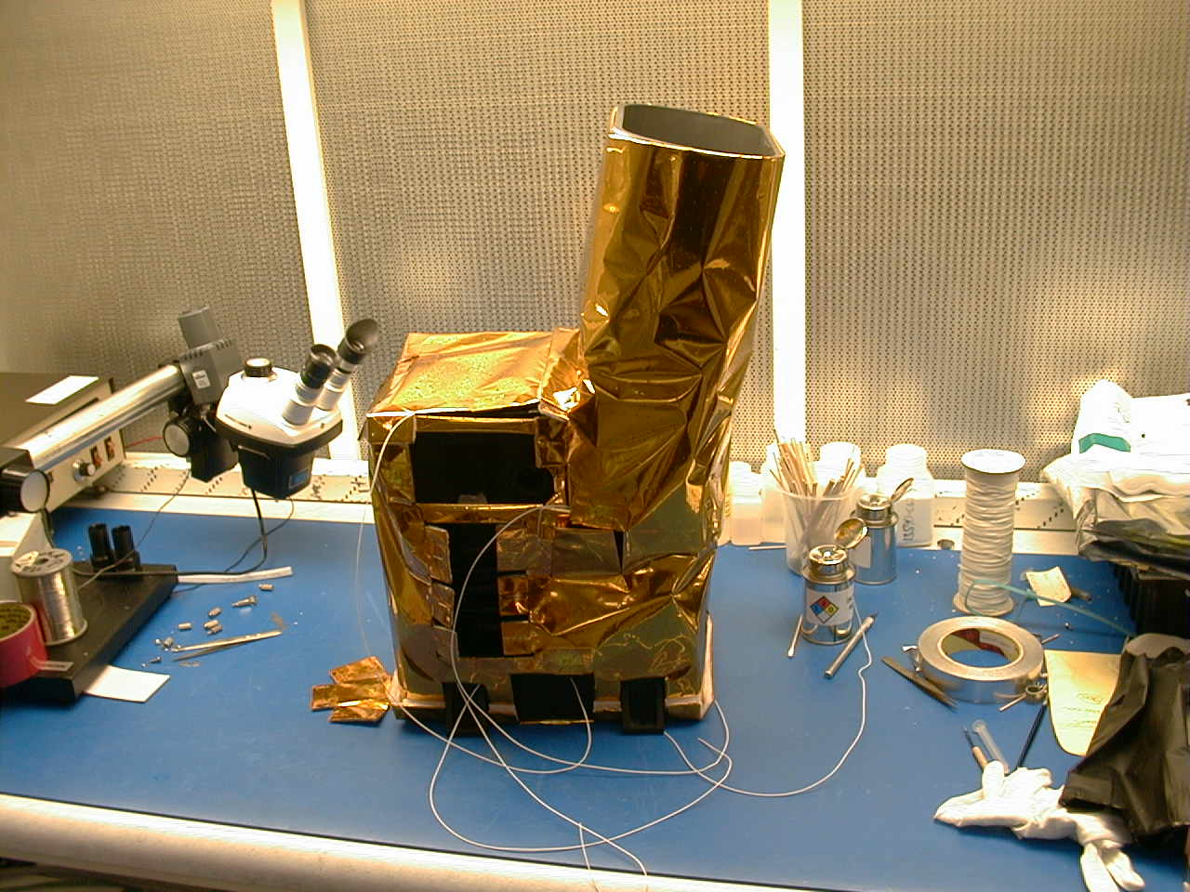
Mars Odyssey
  At Mars 2001-present
  Gamma Ray Spectrometer
    Three instruments in one
    Detects gamma rays, neutrons & high-energy neutrons
    600km resolution
    Slow accumulation of counting statistics over the mission
  THEMIS
    Visible camera, 18m/pixel with five color bands
      Has stray light issue
    IR camera, 100 m/pixel with 9 independent bands

Slide 10
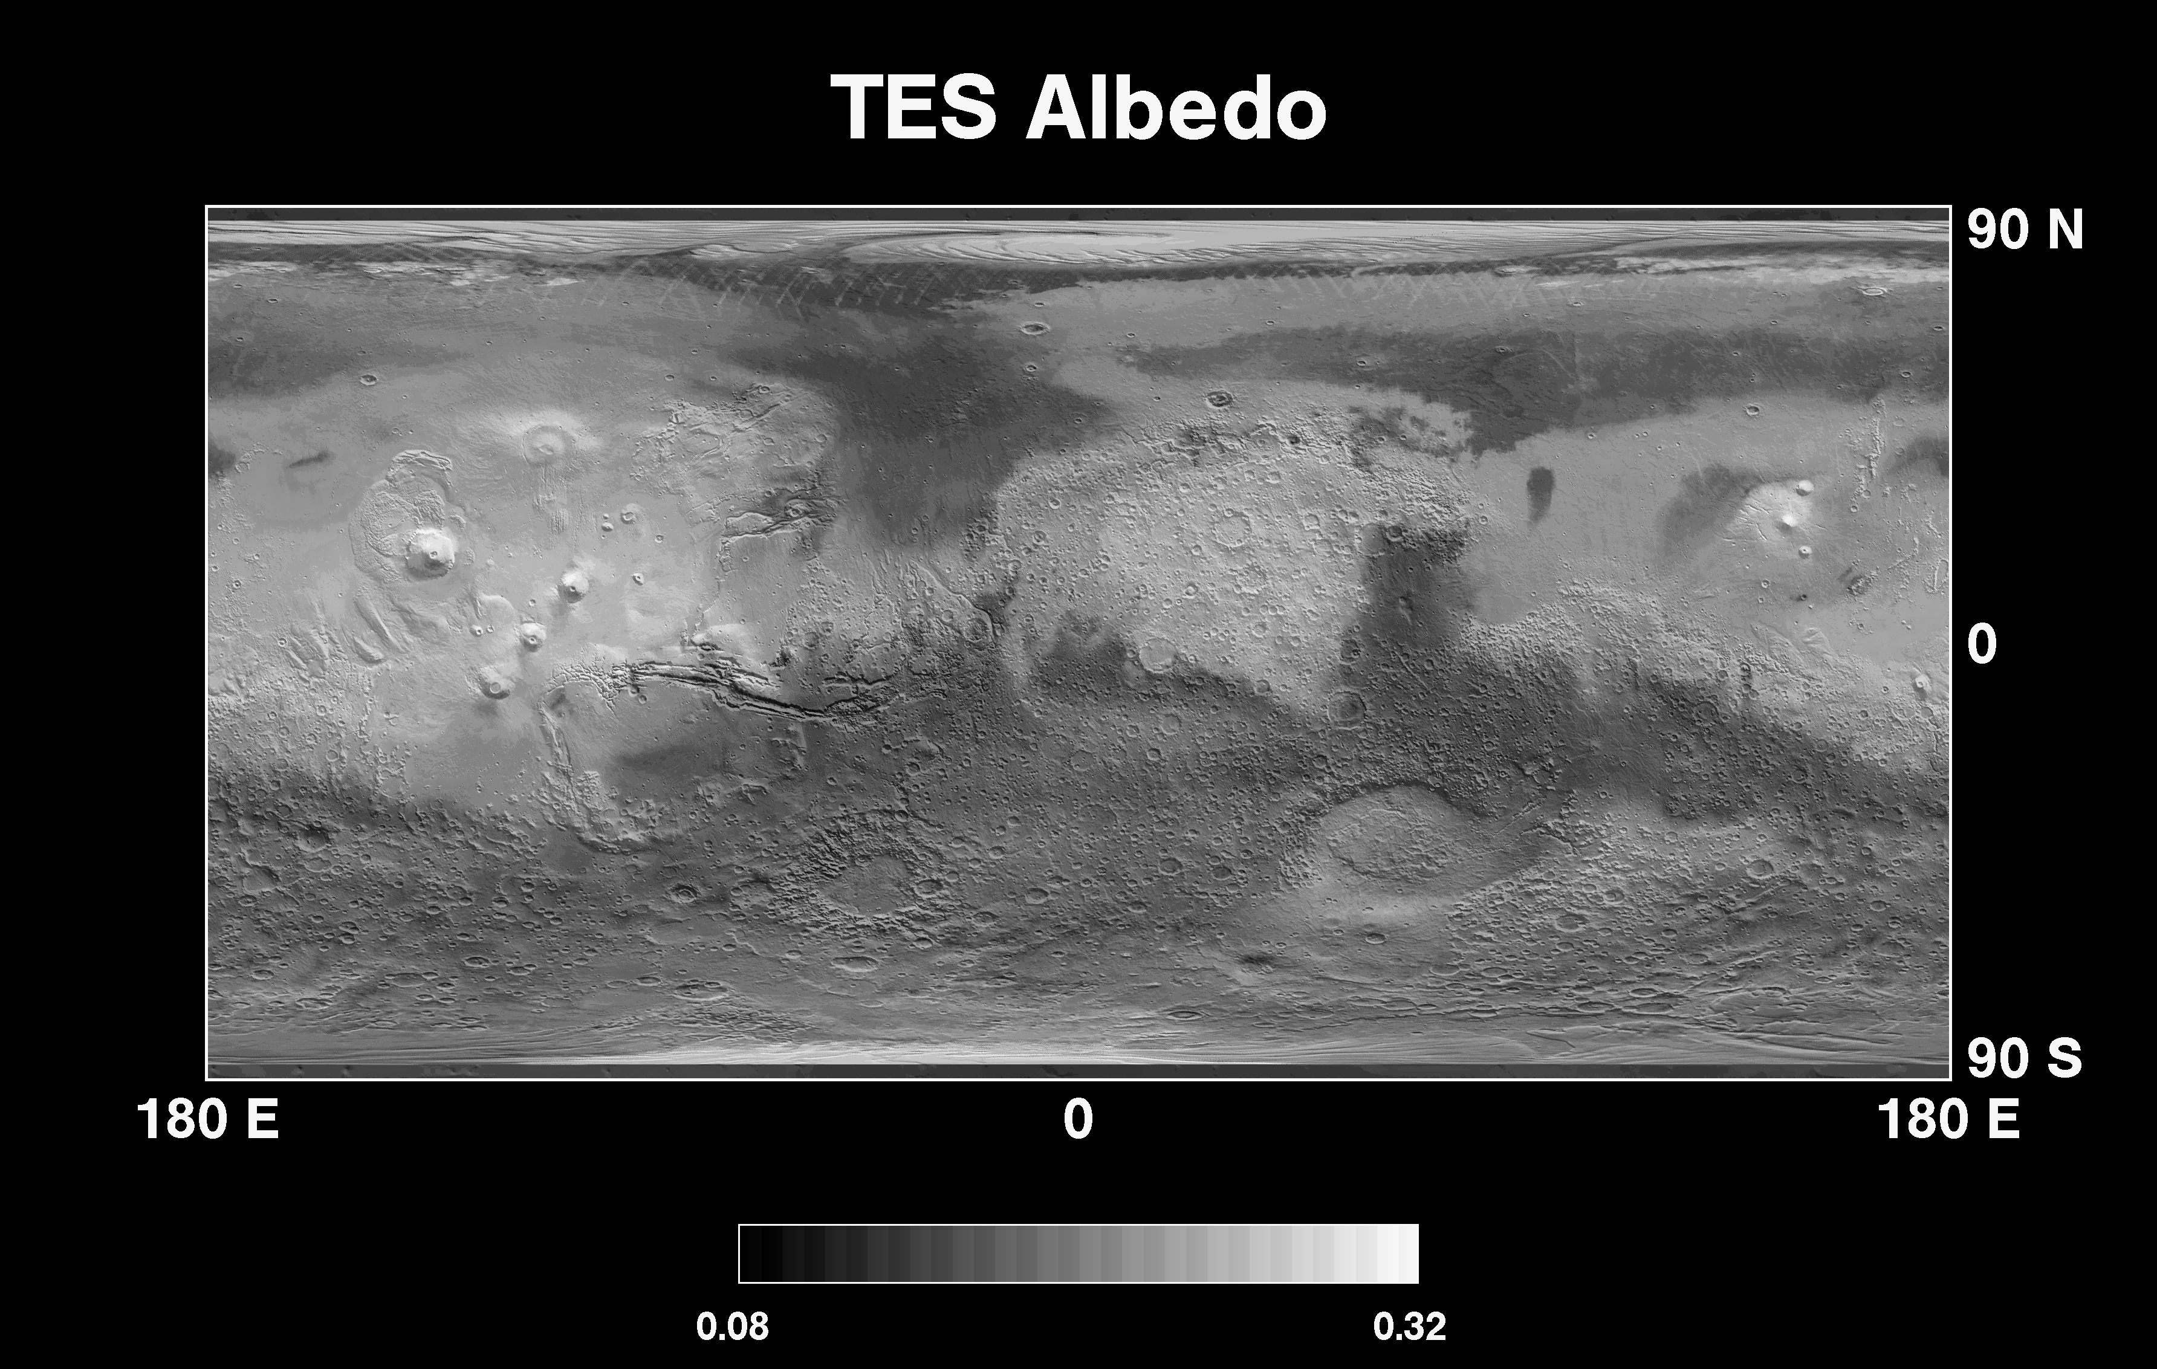
TES
  Bolometers yield albedo and radiometer yields temperature maps
  Fitting temperatures to models yields thermal inertia data

Slide 11
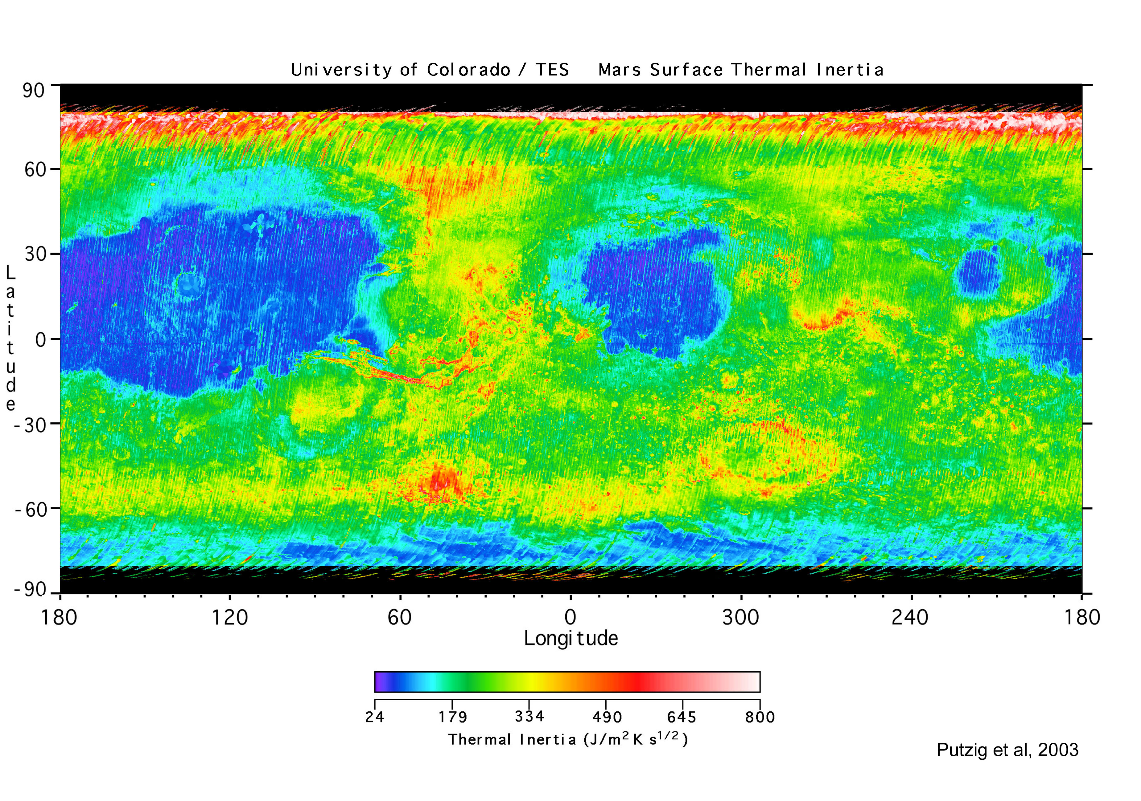
TES
  Thermal inertia

Slide 12
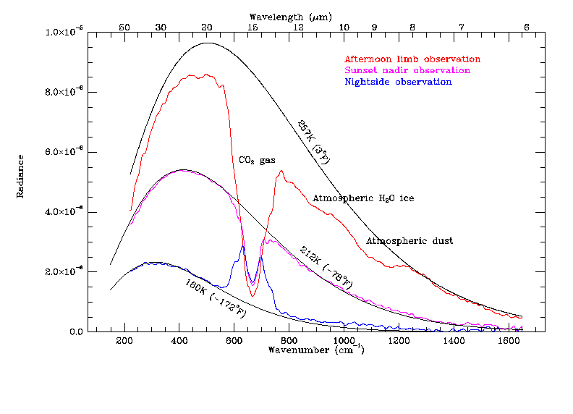
TES spectra can be used for mineralogy of the surface and studies of the atmosphere

Slide 13
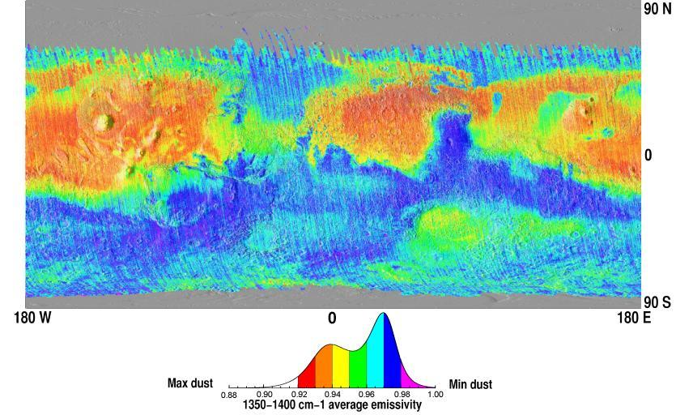
TES dust abundance map from Ruff and Christensen (JGR, 2002)

Slide 14
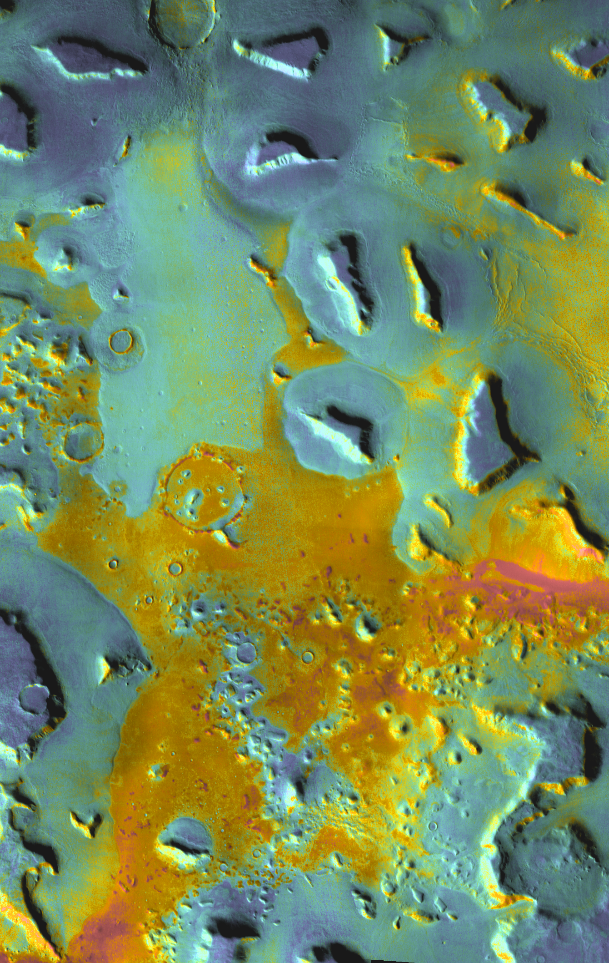
THEMIS
  Band combinations yield composition info
  Daytime IR global map at 100m/pixel is used for HiRISE targeting now
  Nighttime IR map can be used to derive thermal inertias
  THEMIS doesn’t have the temperature accuracy that TES did (especially at low temperatures), but it’s much higher spatial resolution

Slide 15
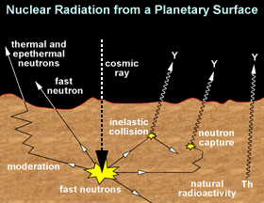
GRS – yields elemental and hydrogen (water) maps

Slide 16
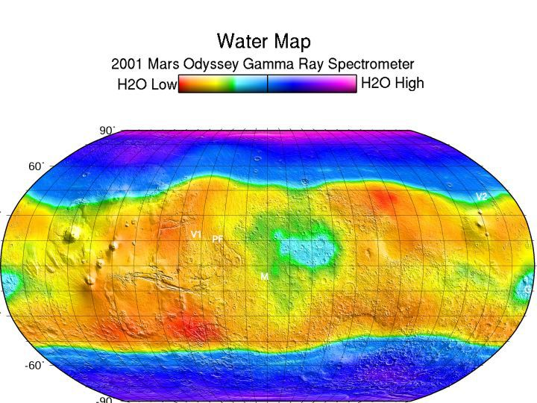
Gamma Ray spectrometer on Mars Odyssey spacecraft has detected hydrogen (from H₂O) in near surface

Slide 17
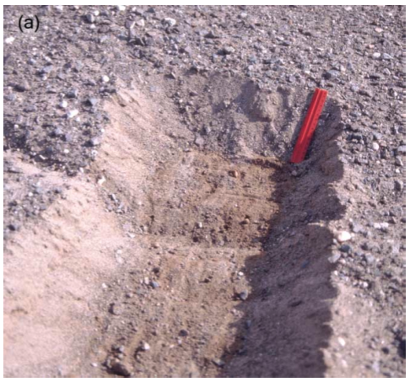
Ground ice on Mars theorized to exist for some time
  Regolith provides the thermal insulation
  Stable ice distribution changes with climate
  Diffusive contact with the atmosphere
Water vapor
Surface
Up to a few feet down

Slide 18
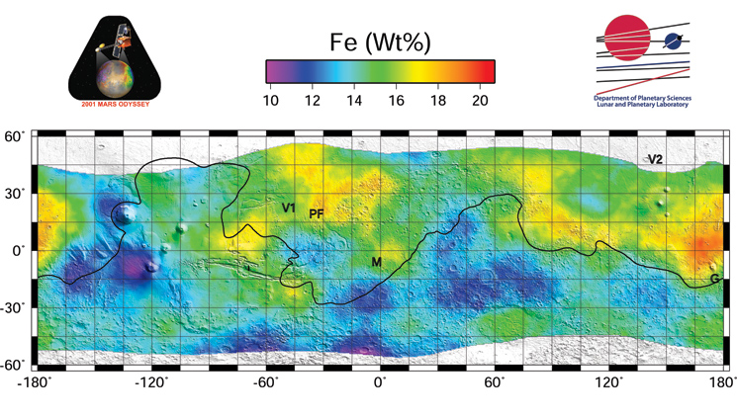
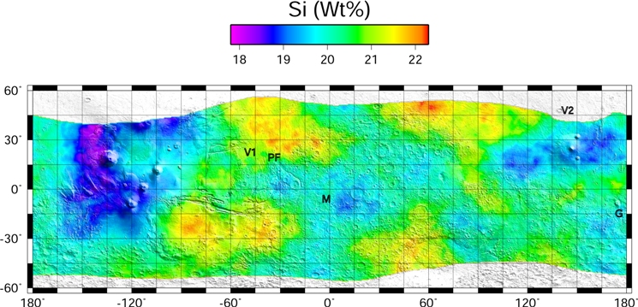
Gamma rays provide elemental maps

Slide 19
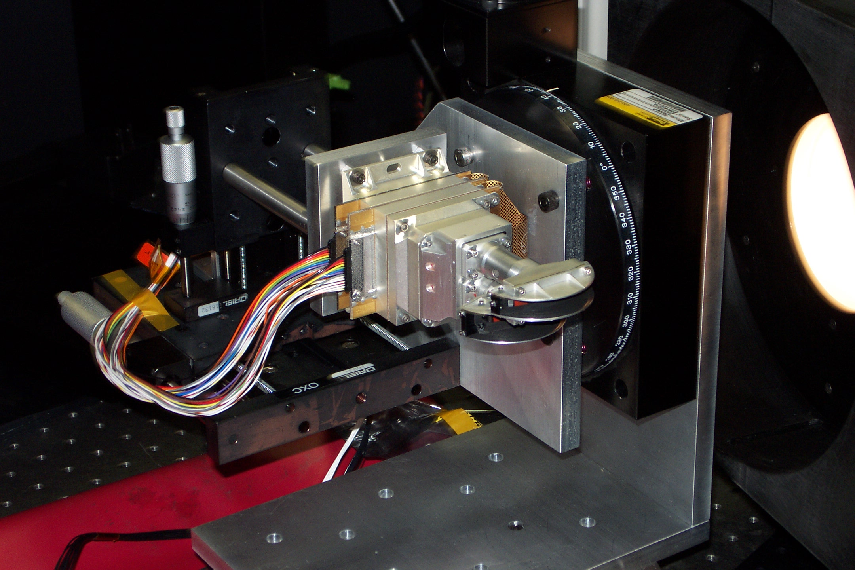
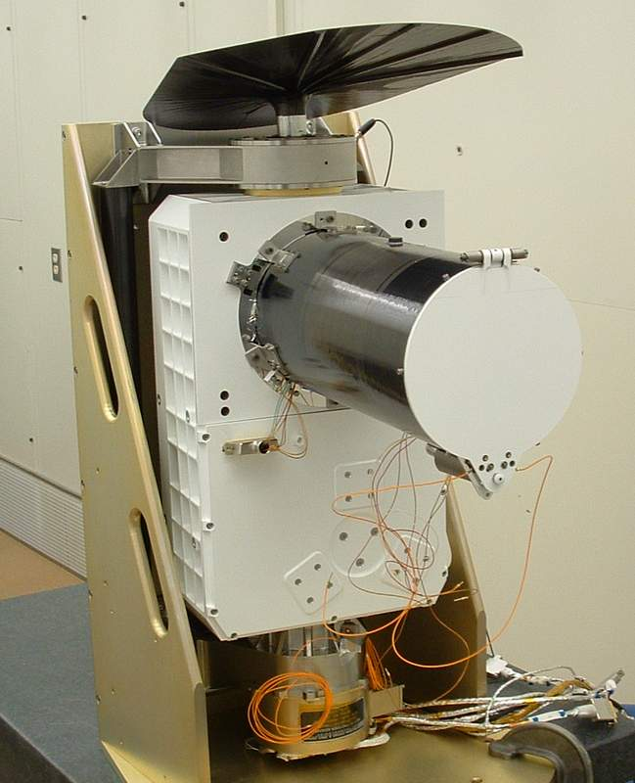
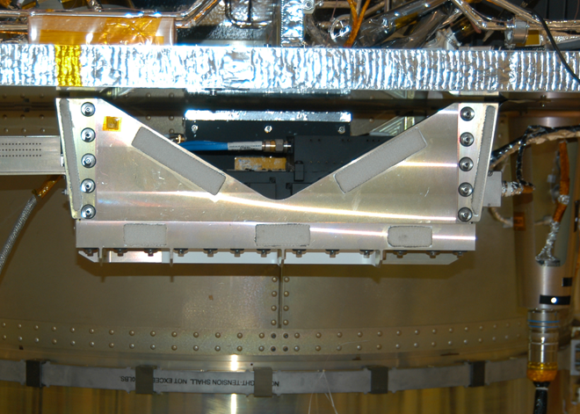
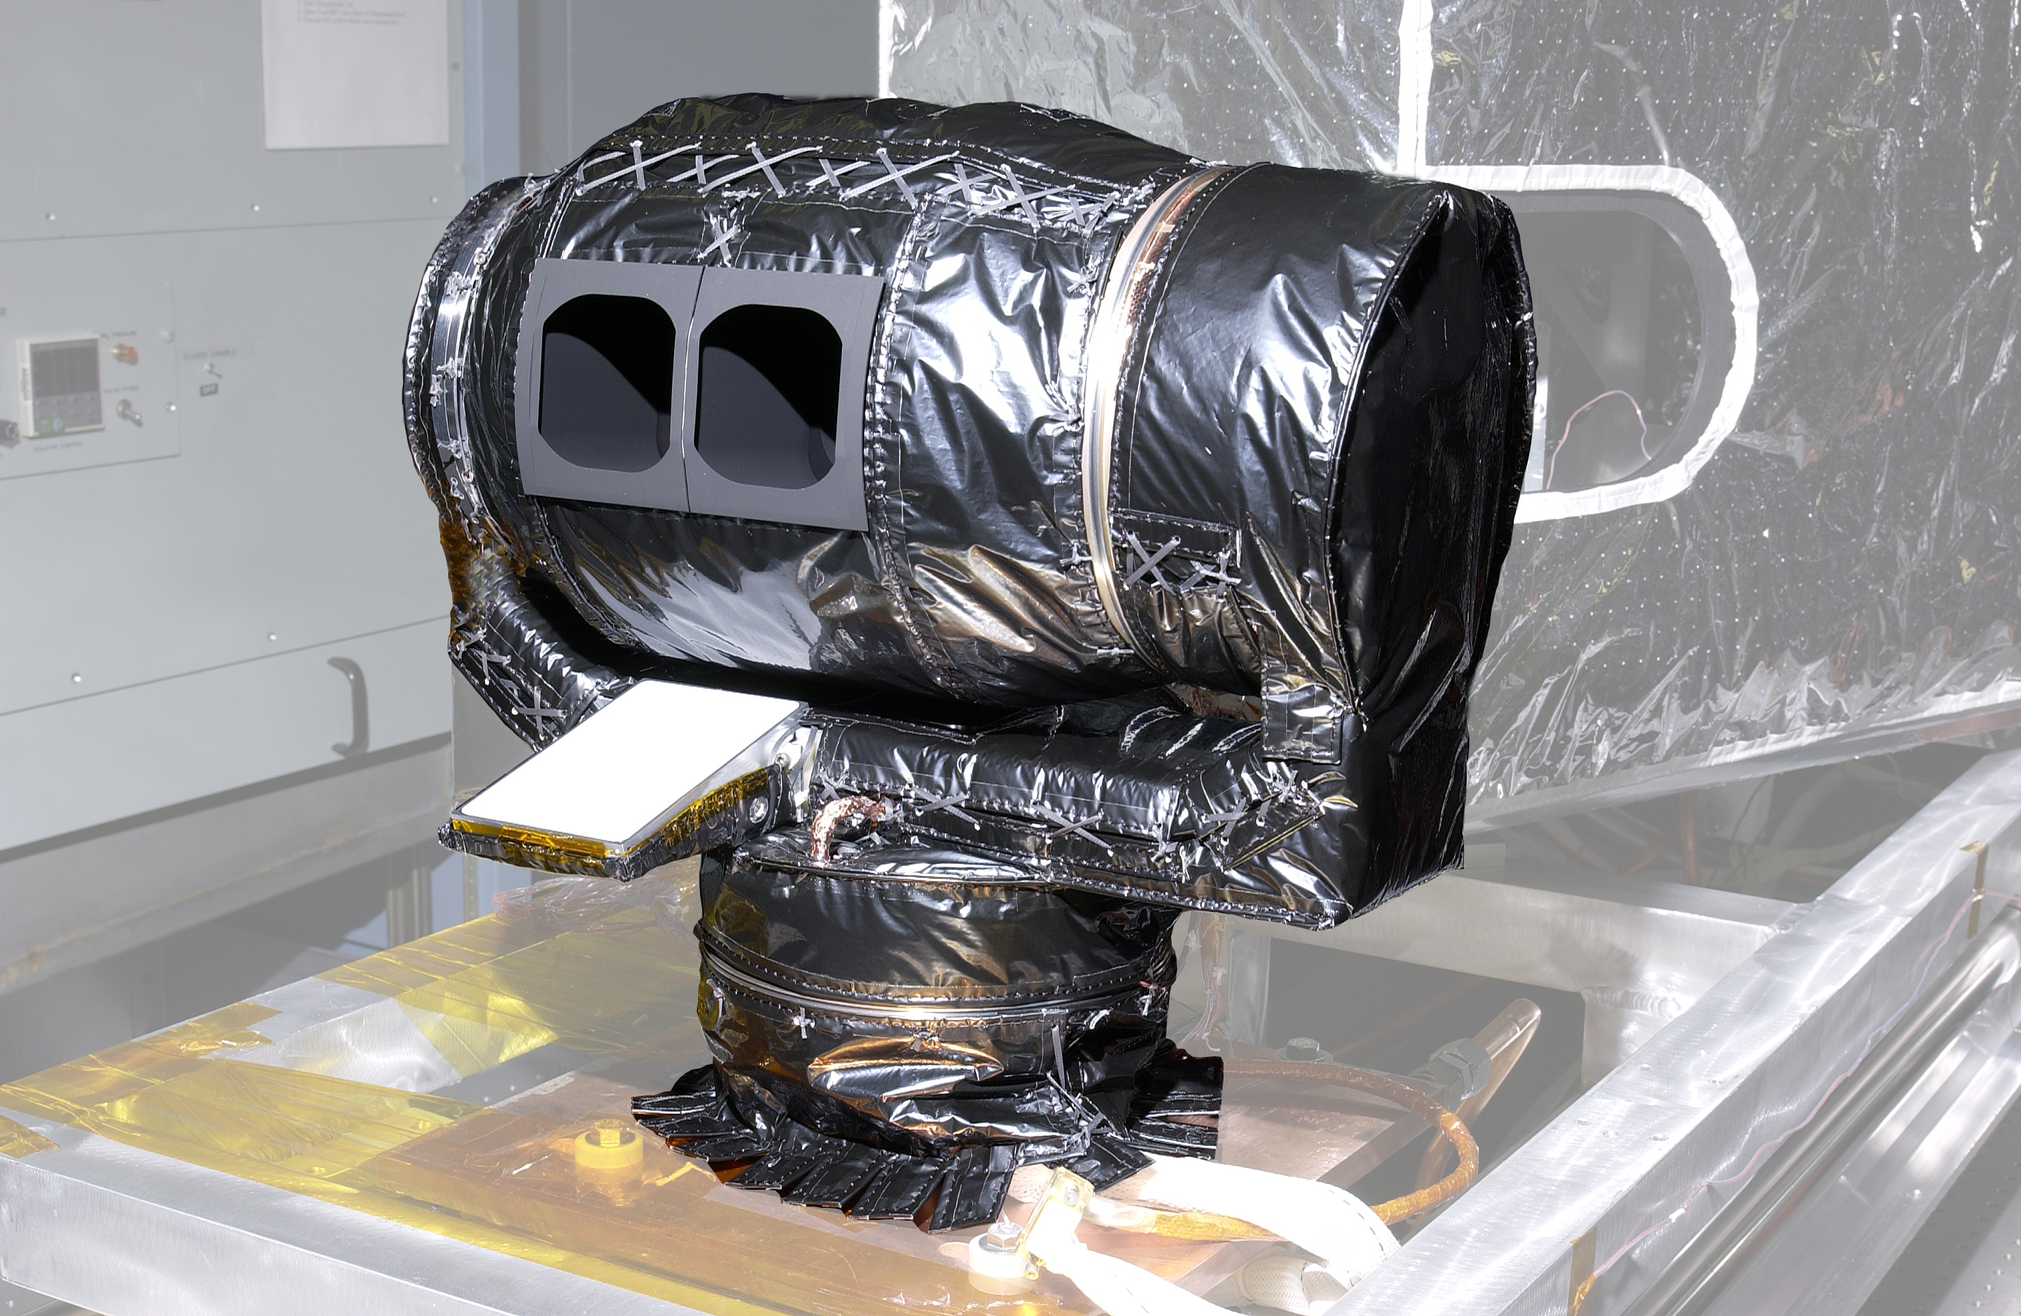
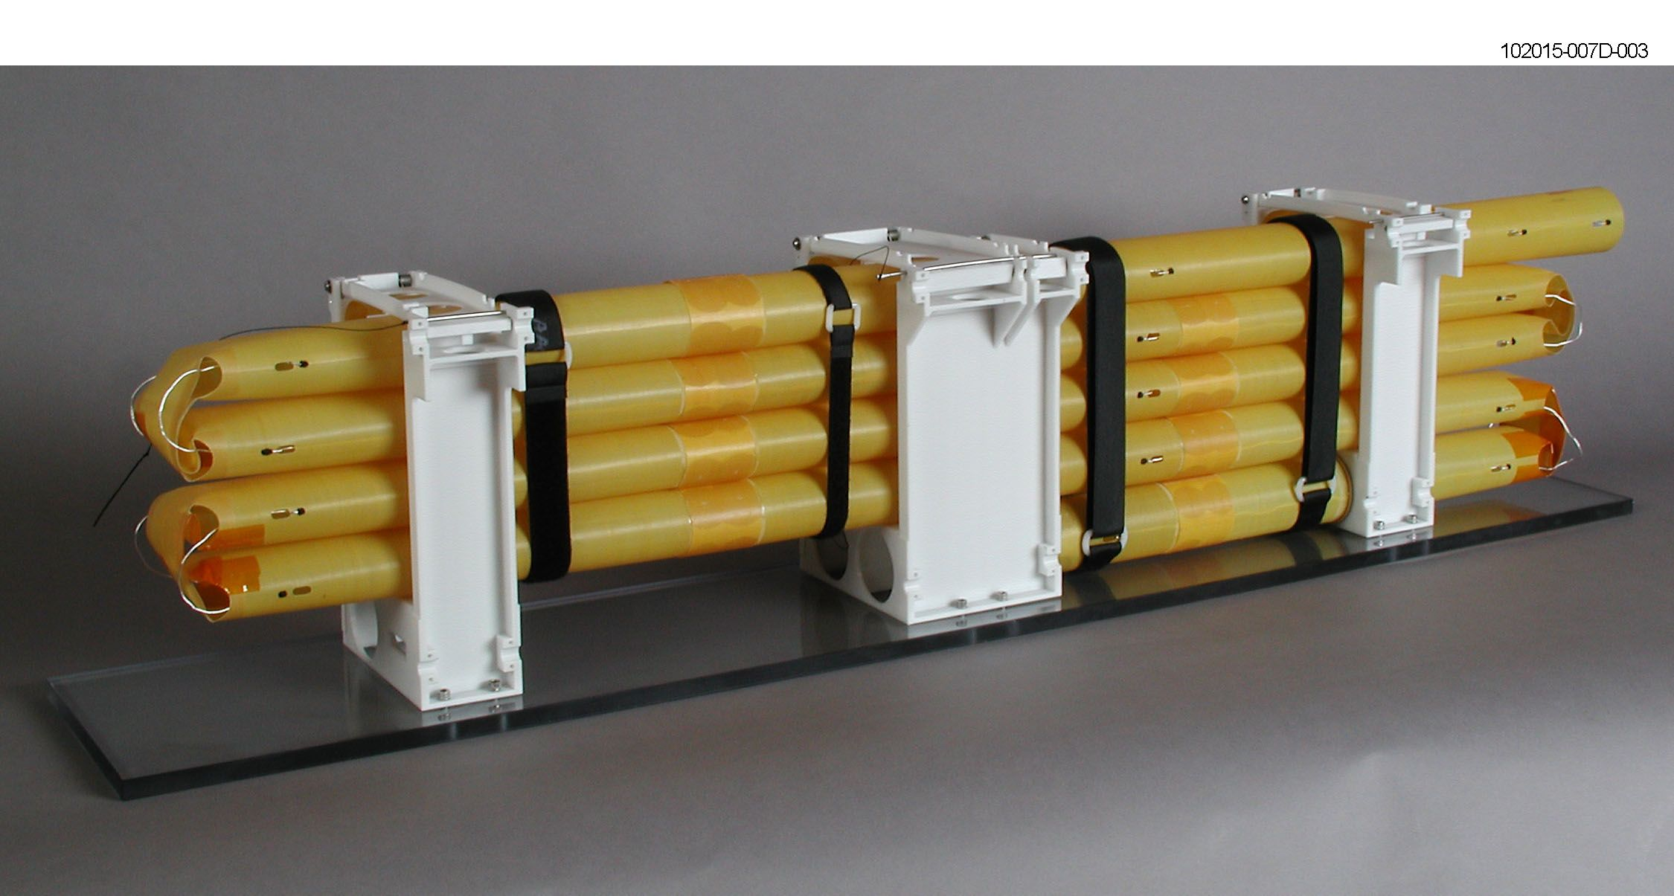
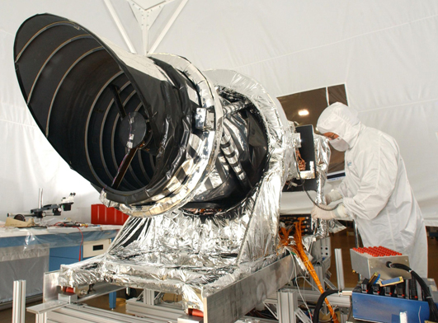
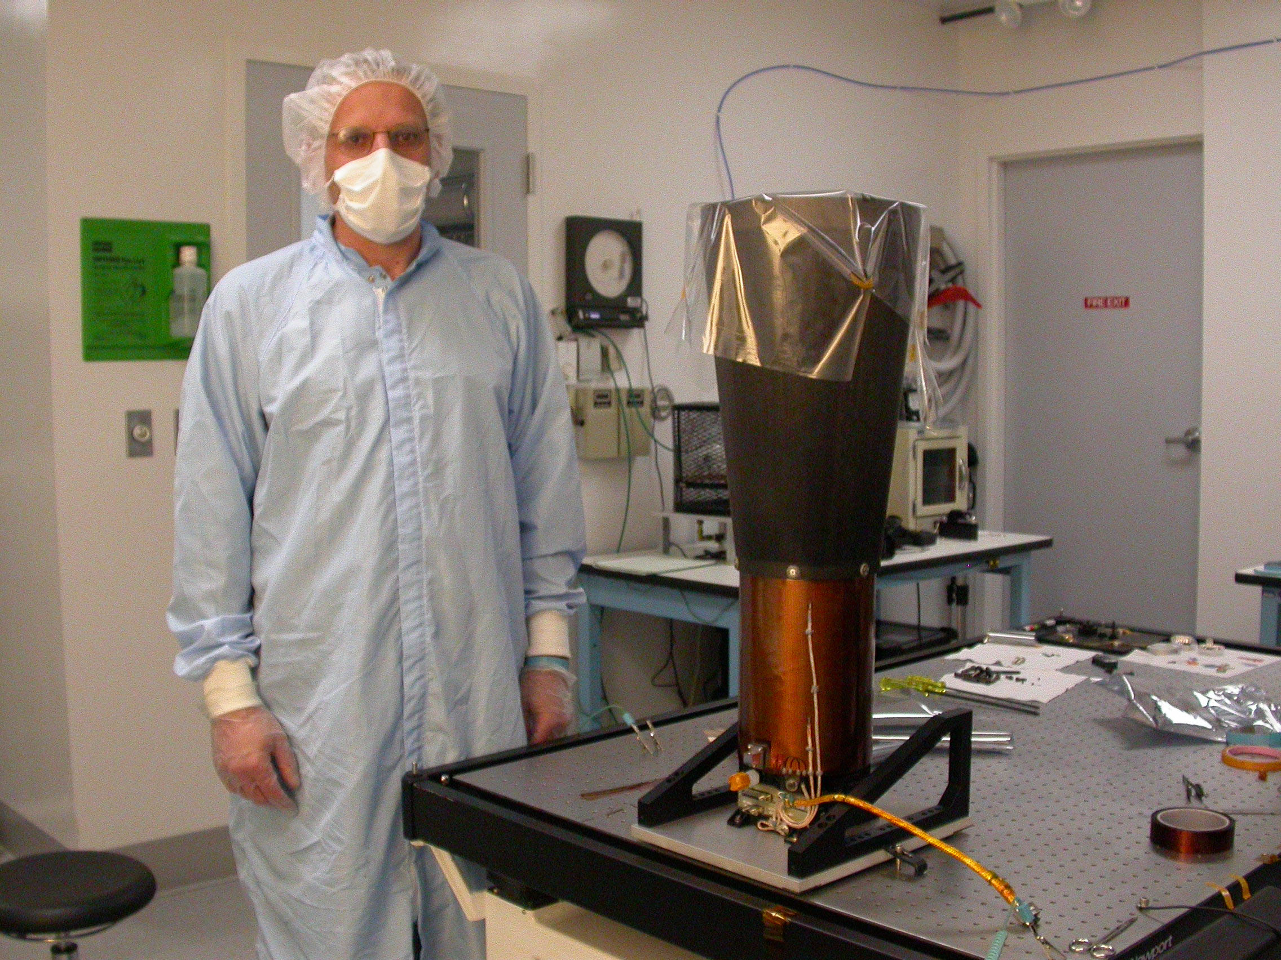
MRO Science Instruments
CRISM
MARCI
SHARAD
MCS
HiRISE
CTX

Slide 20
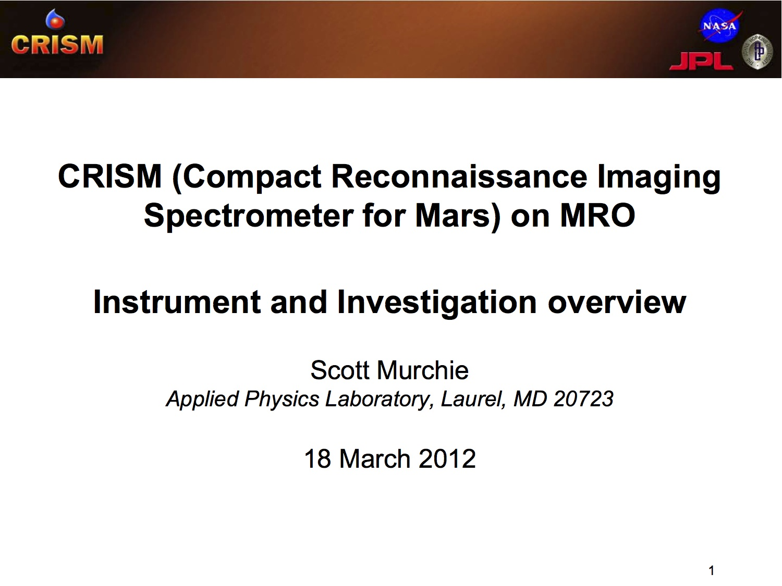

Slide 21
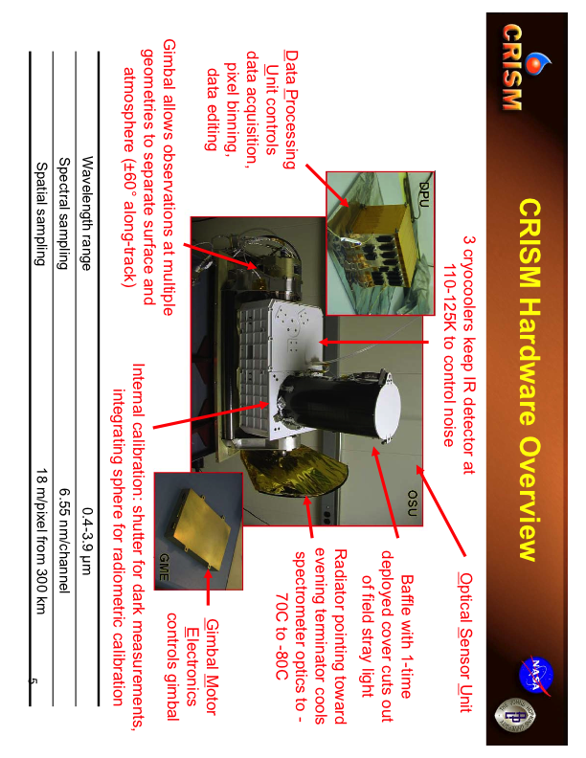

Slide 22
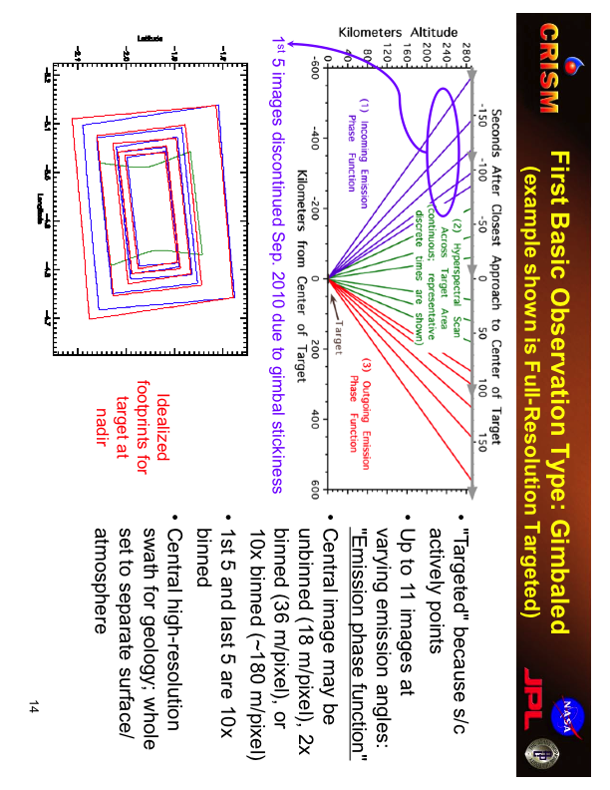

Slide 23
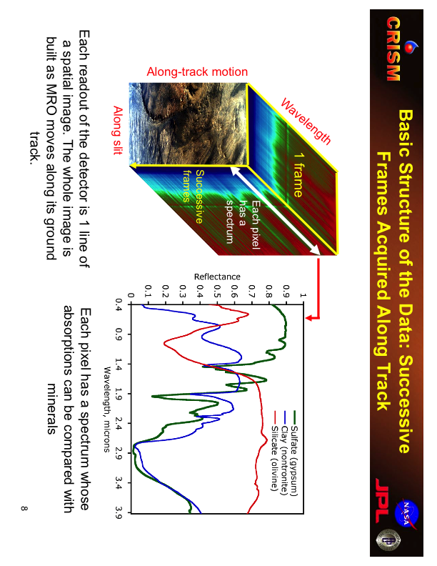

Slide 24
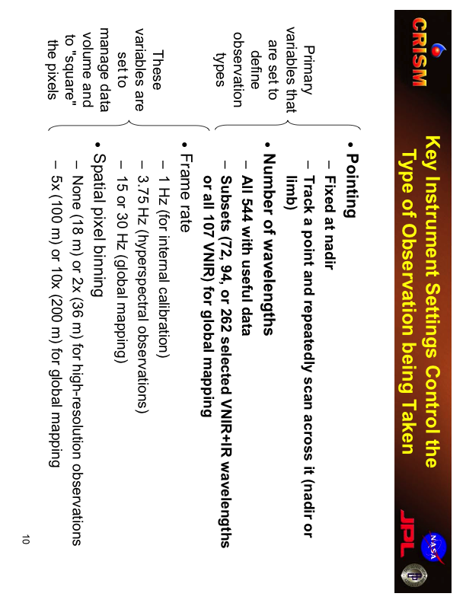

Slide 25
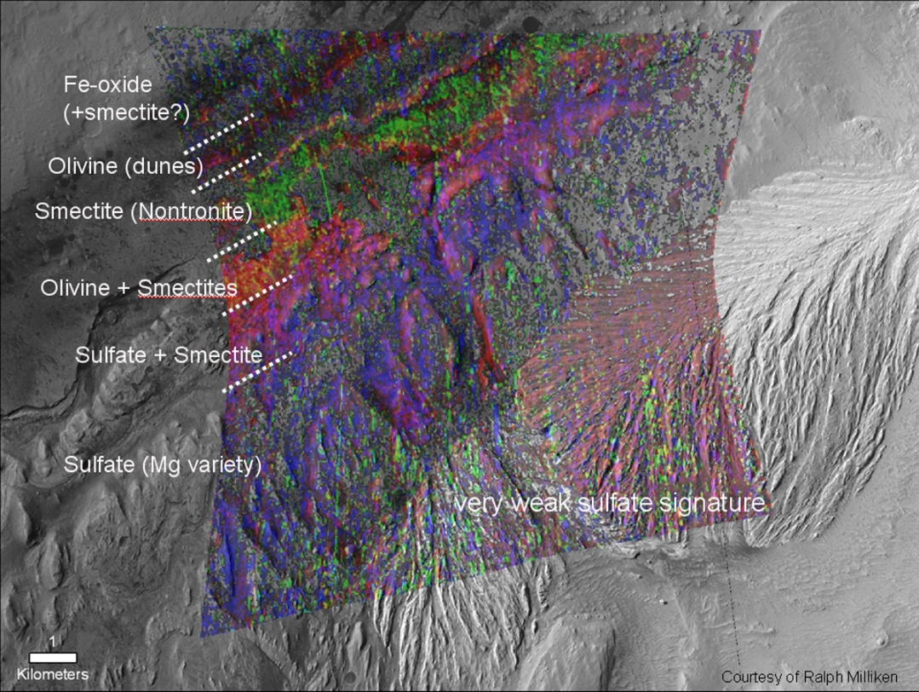
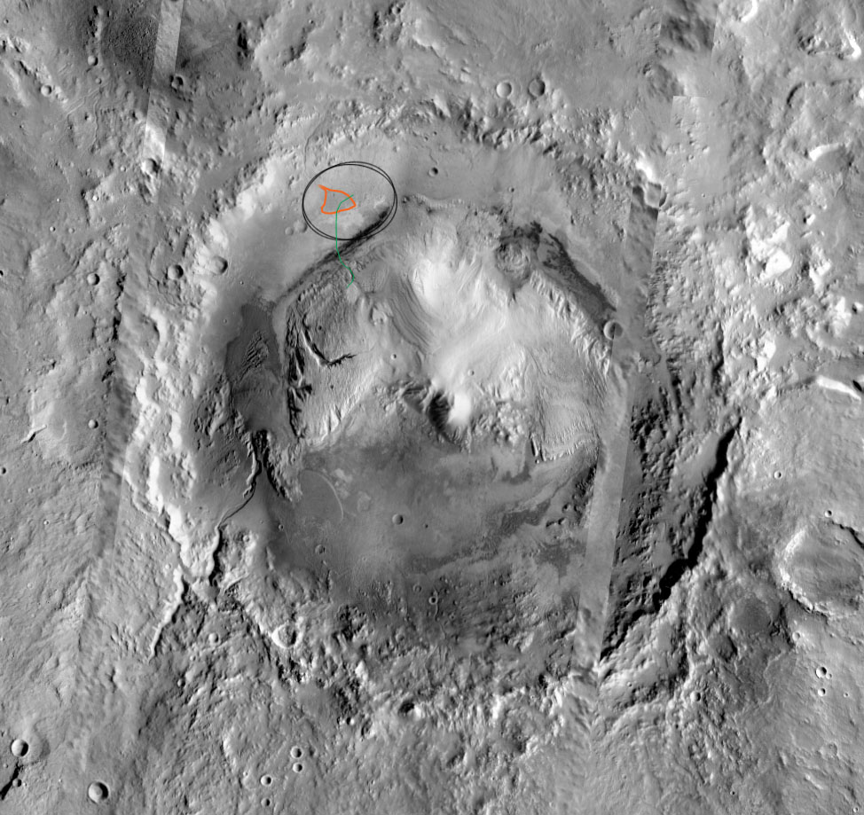
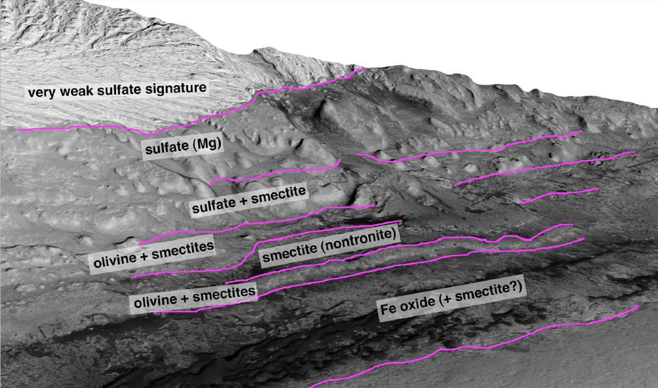
CRISM FRT 58A3 Draped on CTX
From Ralph Milliken
Minerals in Gale Crater

Slide 26
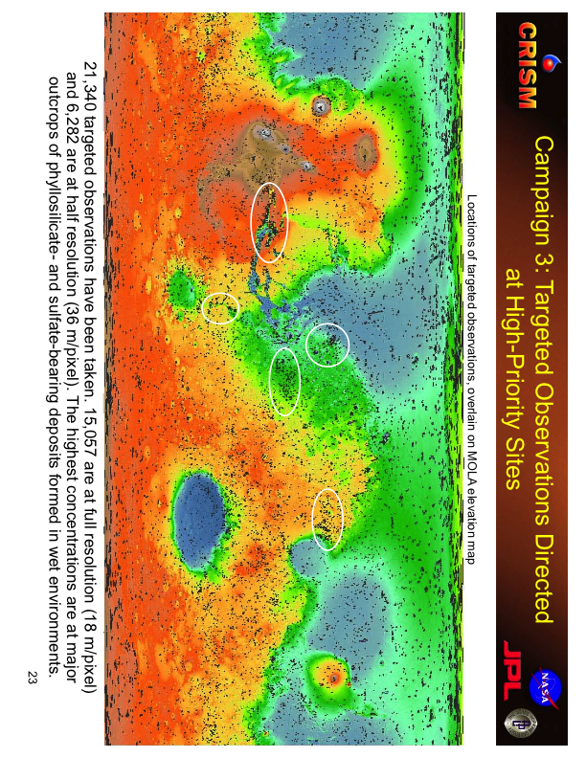

Slide 27
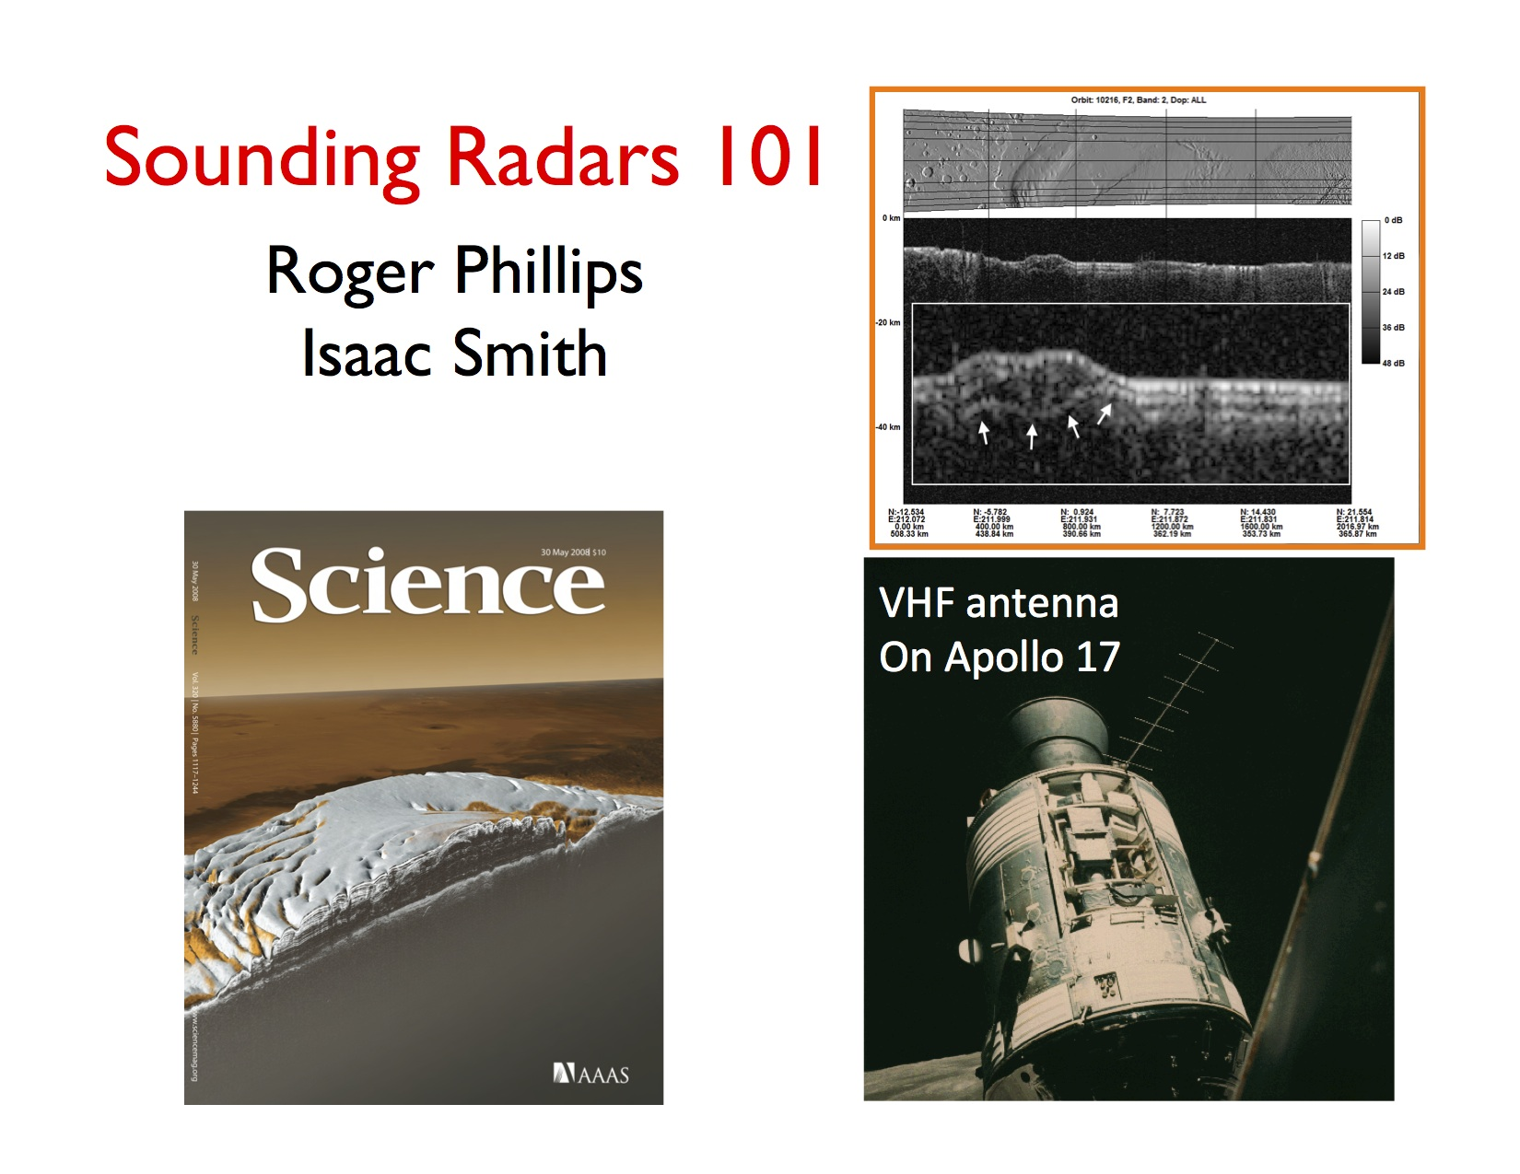

Slide 31
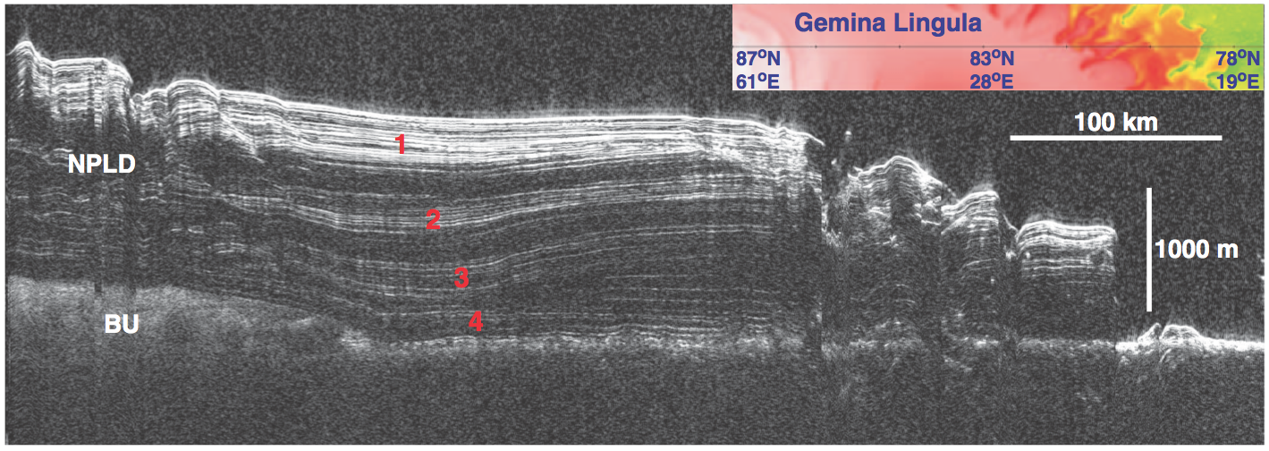
Polar layered deposits work very well with RADAR

Slide 32
ice
Water
ε’ ~80!
ε’also called the “dielectric constant”, which measures a material's ability to store and transmit electromagnetic energy.

Slide 33
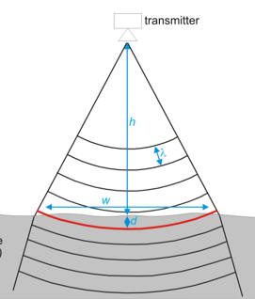
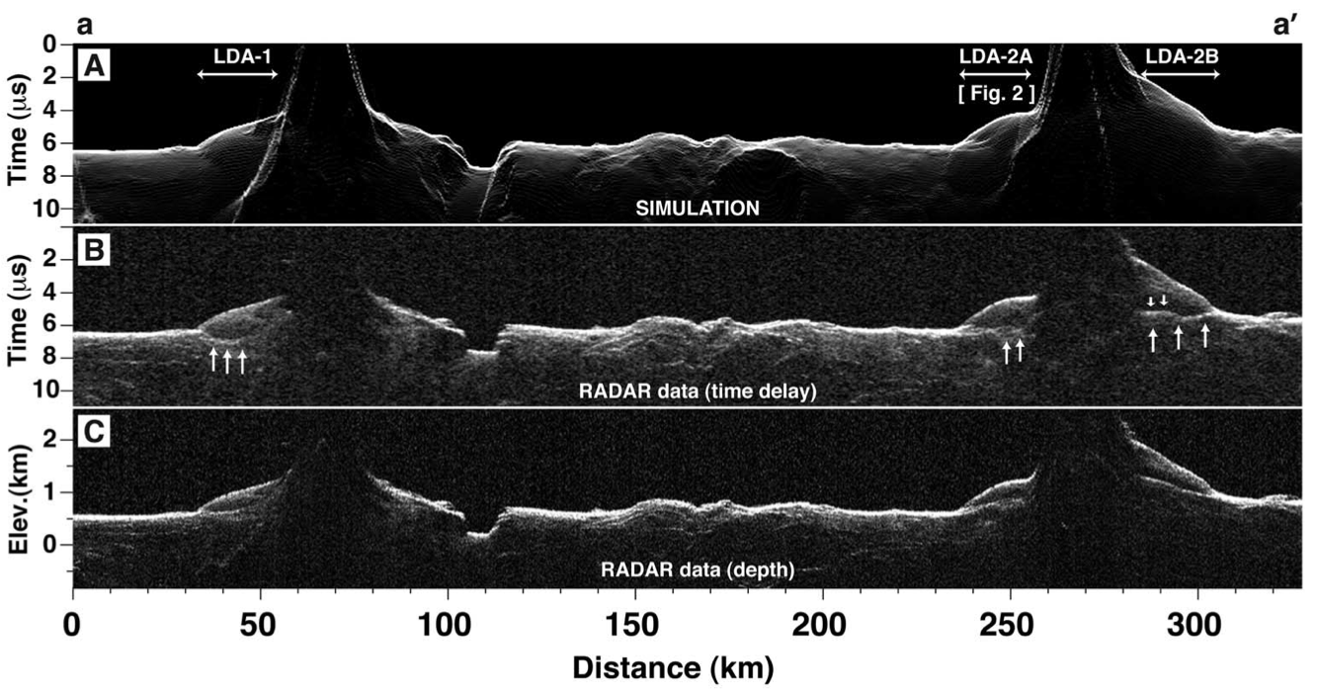
Converting time to depth and looking for surface clutter
  Off nadir surface returns can be detected at the same time as nadir surface returns
  Deep layers in a low permittivity material (e.g. ice) can be detected at the same time as shallow layers in a high permittivity material (e.g. rock)

Slide 34
Where do we find all this stuff? (I)
  The Planetary Data System (PDS) officially archives all planetary science data
  http://pds.jpl.nasa.gov
  It’s divided into several nodes: Atmospheres, Imaging, Geosciences etc…
  PDS formatted data is self-describing and so will last forever, but is not user friendly
Where do we find all this stuff? (II)
  JMARS is a great tool to find and analyse multiple datasets
  https://jmars.asu.edu/
  An image search tool that includes most imaging datasets can be found at
  http://viewer.mars.asu.edu/
  Maps of image footprints can be browsed at
  http://themis.asu.edu/maps
  Global datasets of Mars can be accessed at
  http://www.mars.asu.edu/data/
  Global CTX at 5 m/pixel: https://murray-lab.caltech.edu/CTX/
  CRISM data: http://crism.jhuapl.edu/data/publicData.php

