Slide 1
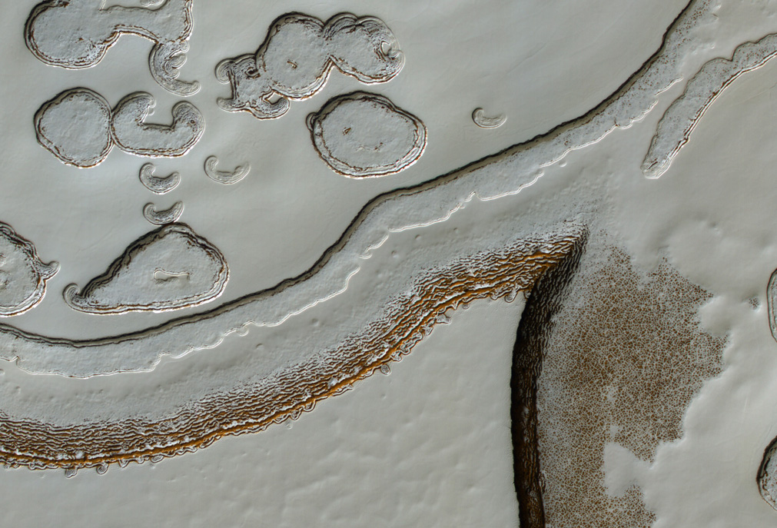
MRO, especially HiRISE
Alfred McEwen
ESP_014339_0930
S. Pole residual cap in mid-summer
ESP_012860_1830 Aram Chaos

Slide 2
JOURNAL OF GEOPHYSICAL RESEARCH, VOL. 112, E05S01, 2007 An overview of the Mars Reconnaissance Orbiter (MRO) science mission Richard W. Zurek and Suzanne E. Smrekar
Top-level science objectives of the Mars Exploration Program:
1. Search for evidence of past or present life.
2. Understand the climate and volatile history of Mars.
3. Understand geological processes and their role in shaping the surface and subsurface.
4. Assess the nature and inventory of resources on Mars in preparation for human exploration.
MRO mission objectives:
Present Climate
1. Observe seasonal cycles and daily variations of water, dust and carbon dioxide on Mars.
2. Characterize Mars’ global atmospheric structure, atmospheric circulation, and surface changes…
Aqueous Activity
Investigate local areas for compositional evidence of such environments, and in particular the presence of surface materials conducive to biological activity or having the potential for preserving biogenic materials.
Observe and quantify the detailed stratigraphy and geomorphology of key locales in order to identify formation processes of geologic features indicating the presence and persistence of liquid water.
Probe the horizontal and vertical structure of the uppermost surficial layer on Mars and its potential reser- voirs of water and water ice.
Geosciences
1. Map and characterize in detail the stratigraphy, geomorphology, and composition of the Mars surface and subsurface at many globally distributed locales to understand better the nature and evolution of different Martian terrain types.
2. Characterize the Martian gravity field in greater detail to improve knowledge of the Martian crust and lithosphere and of atmospheric mass variation.
Mission Support:
Relay from landed missions
Landing sites characterization and certification

Slide 3
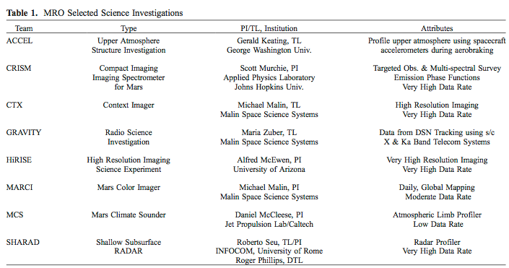

Slide 4
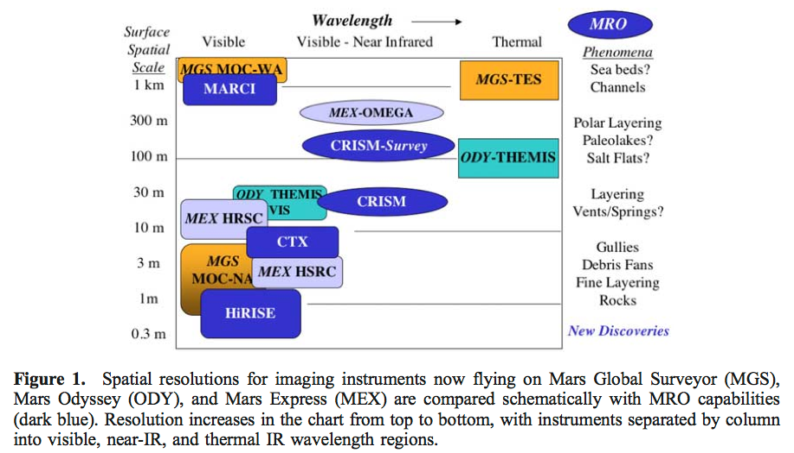
Radar sounding
SHARAD

Slide 5
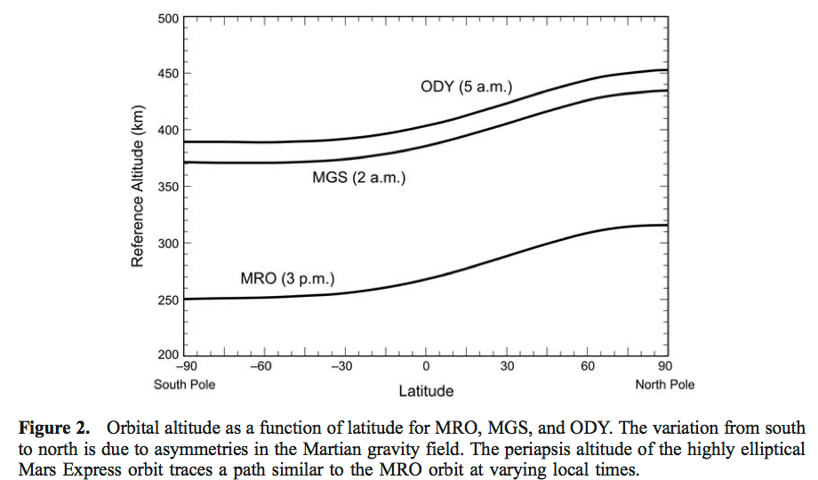
MRO Orbit
Sun-synchronous ~3 AM/PM (why that time of day?)
250-320 km altitude (why?)
Inclination 92.65 deg. (why?)
12.8 orbits/day
Nadir pointed, roll cross-track up to 30° (what does that enable?)

Slide 6
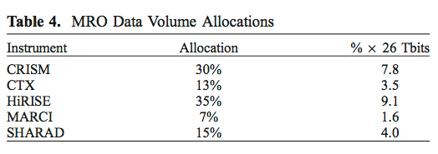
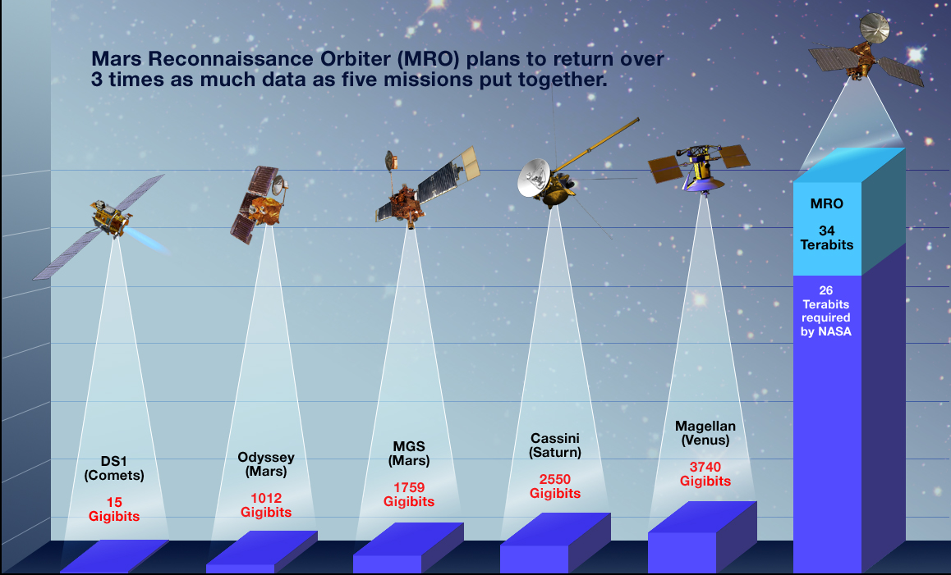
Data Return Comparison (MRO now >600 Tb)
2026 Update: HiRISE has returned >195 Tbits of Mars data

Slide 7

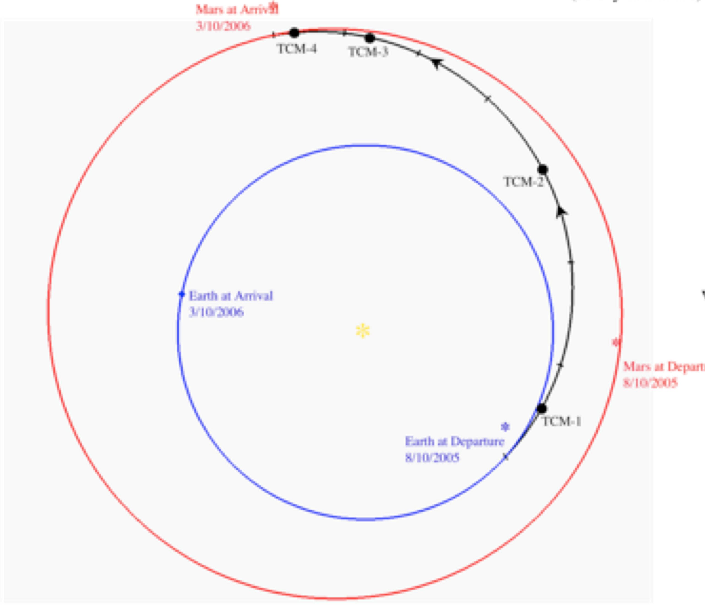
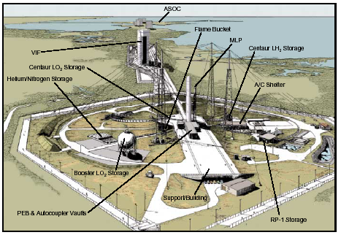
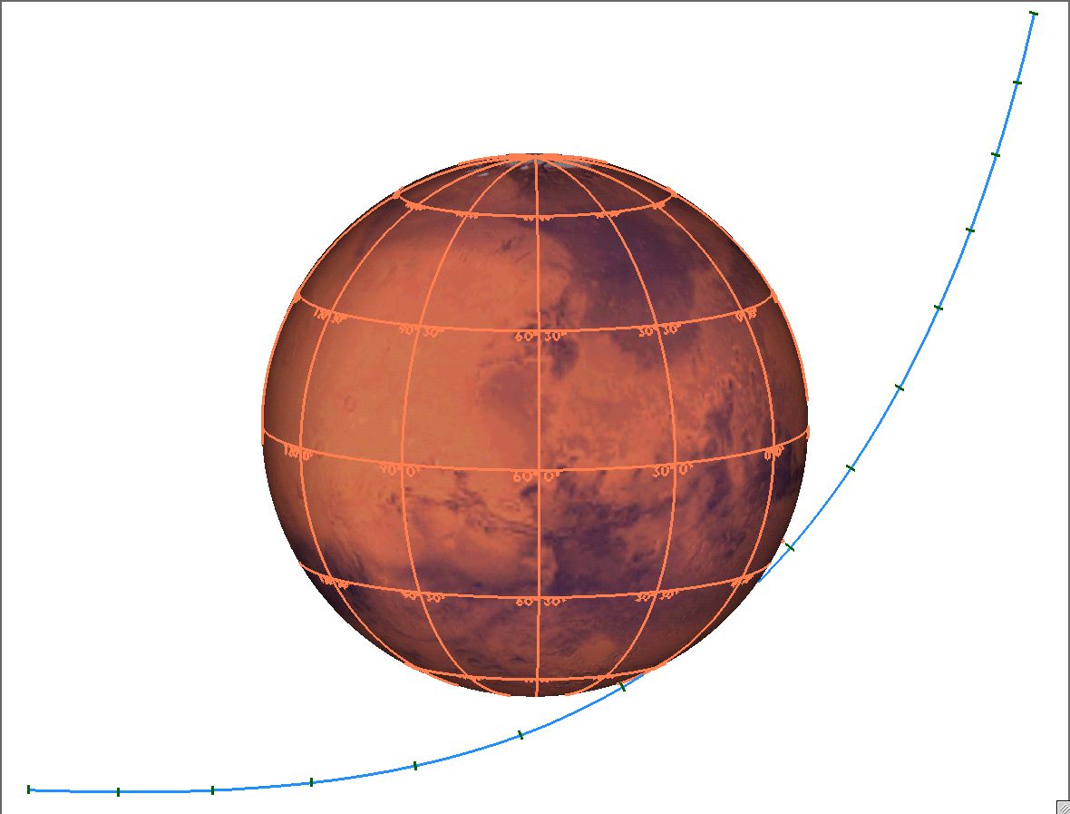
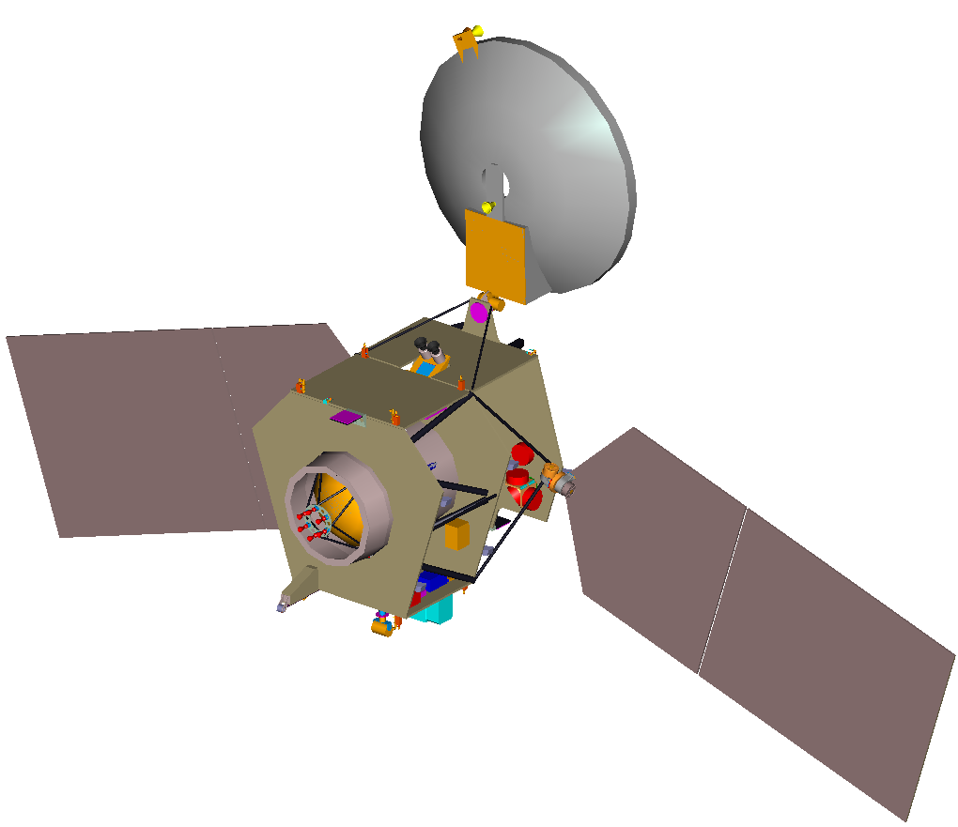
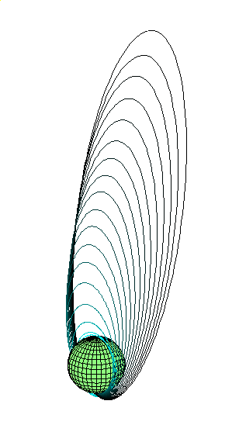
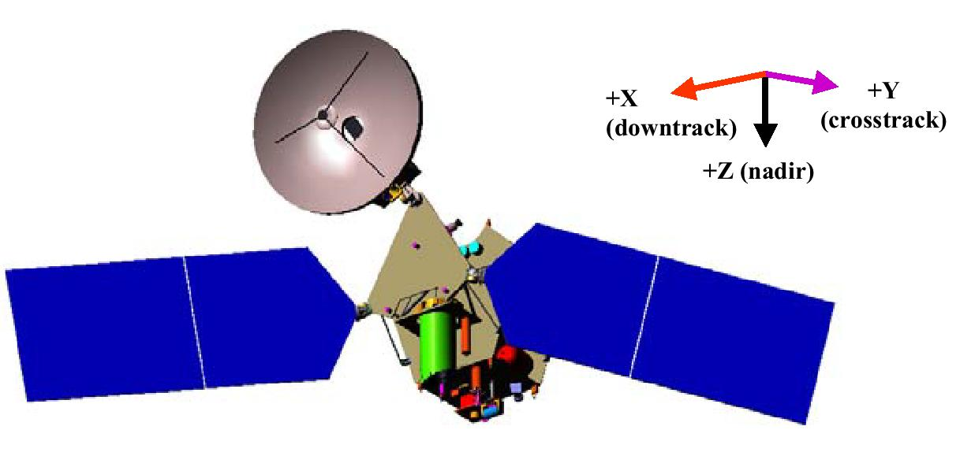
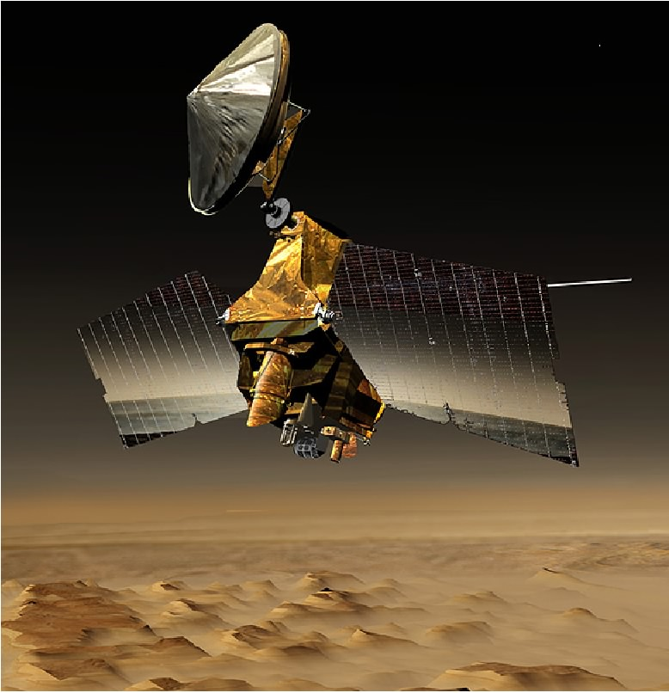
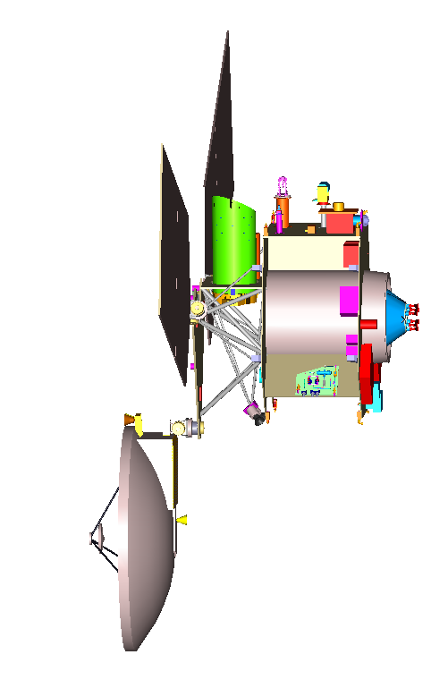
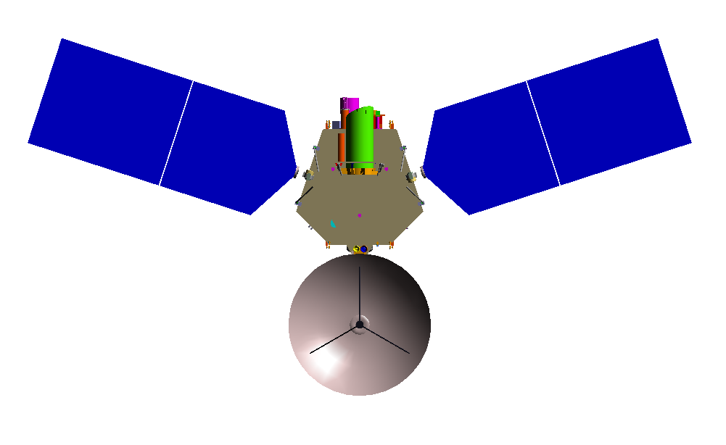

MRO Mission Overview
Launch
Interplanetary Cruise
Approach and Orbit Insertion
Aug 2005
Aug 2005 - Mar 2006
Mar 2006
LC-41
Capture Orbit ---
Period: 35 hrs
Asc Node: 8:30 pm LMST
Atlas V-401
Aerobraking
Primary Science/Relay
Mar-Sep 2006
Nov 2006 - Dec 2010
Primary Science/Relay Orbit ---
Period: 112 min
Hp: 255 km Ha: 320 km, Frozen
Ascending Node: 3:00 pm LMST (Sun-Sync)
Science Data
Acquisition/Return

Slide 8
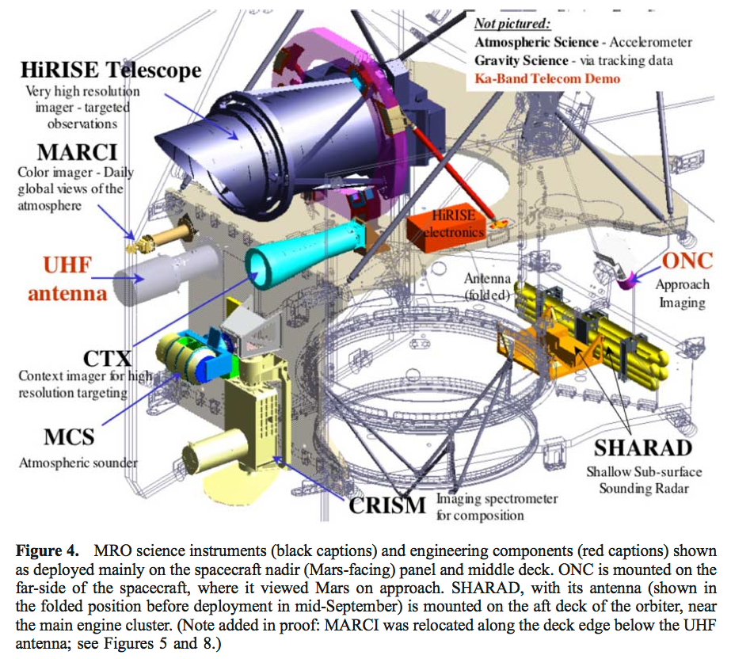

Slide 9
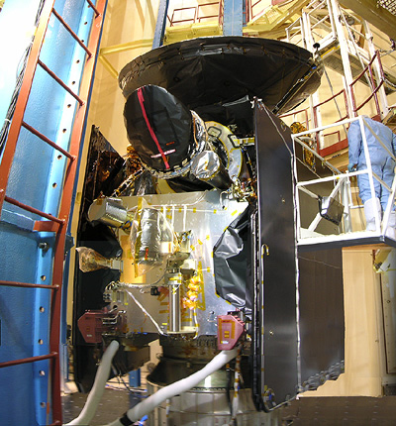
MRO in Thermal-Vacuum Chamber
Sign on cover: “REMOVE BEFORE FLIGHT”

Slide 10
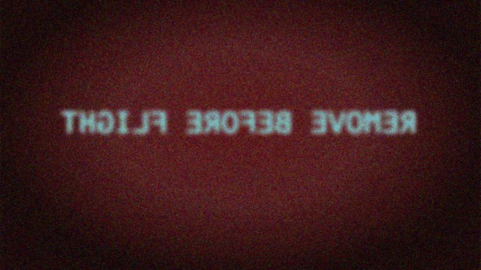
First-light image from HiRISE

Slide 11
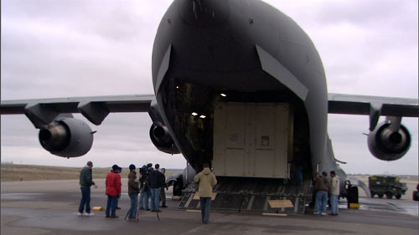
Transport to Kennedy Space Center (KSC) on Air Force C17 cargo Plane

Slide 12
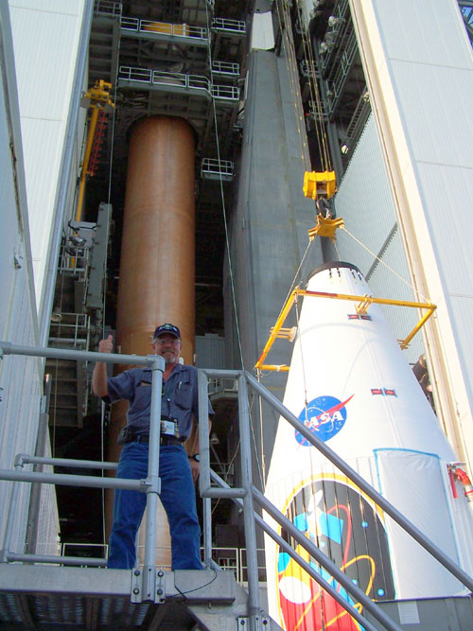
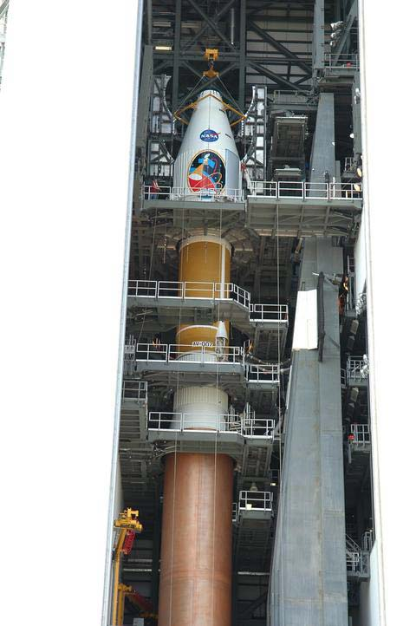

Slide 13
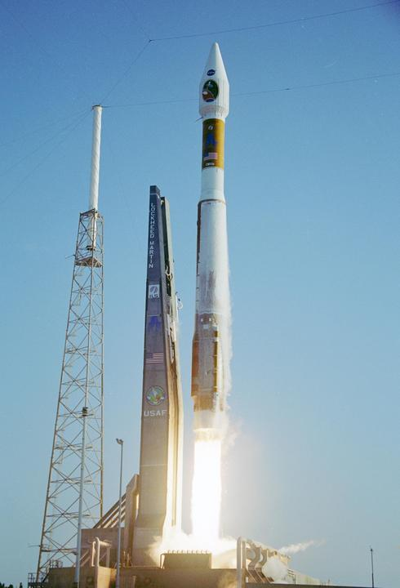
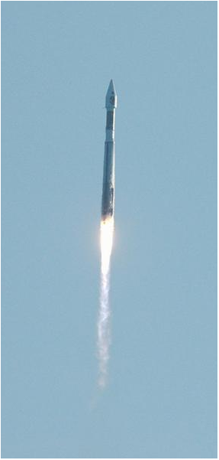
Aug 12, 2005: Launch!

Slide 14
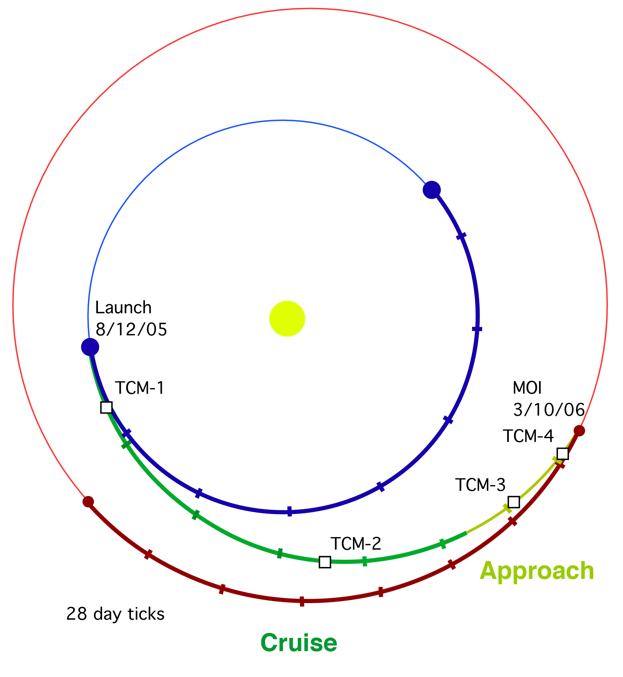


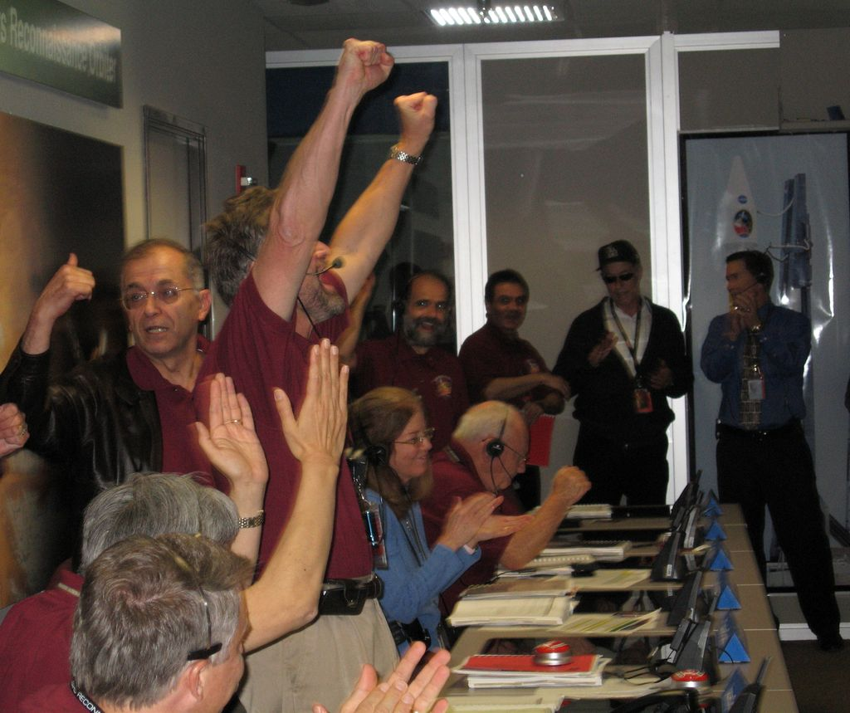
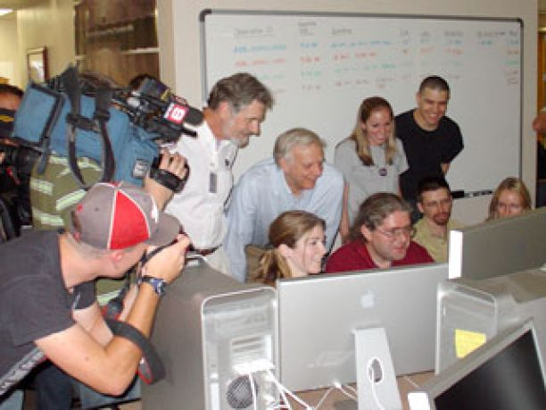
Mars Orbit Insertion March 10, 2006

Slide 15
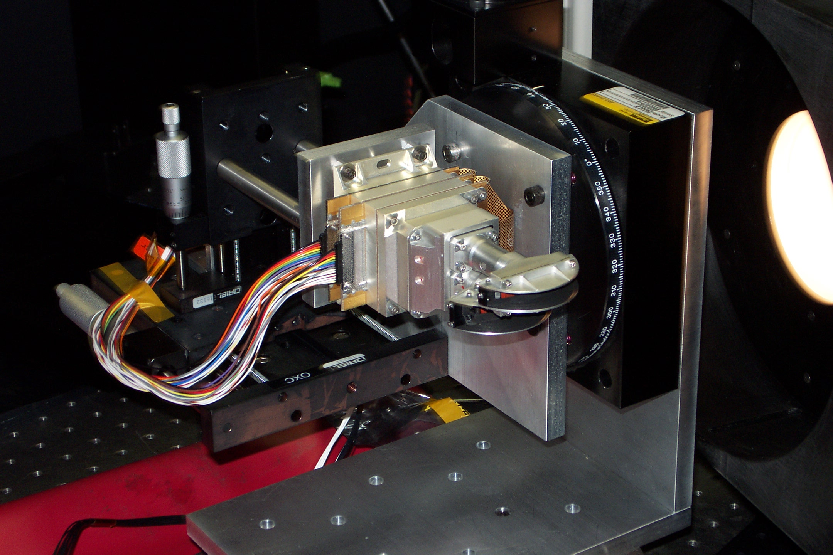
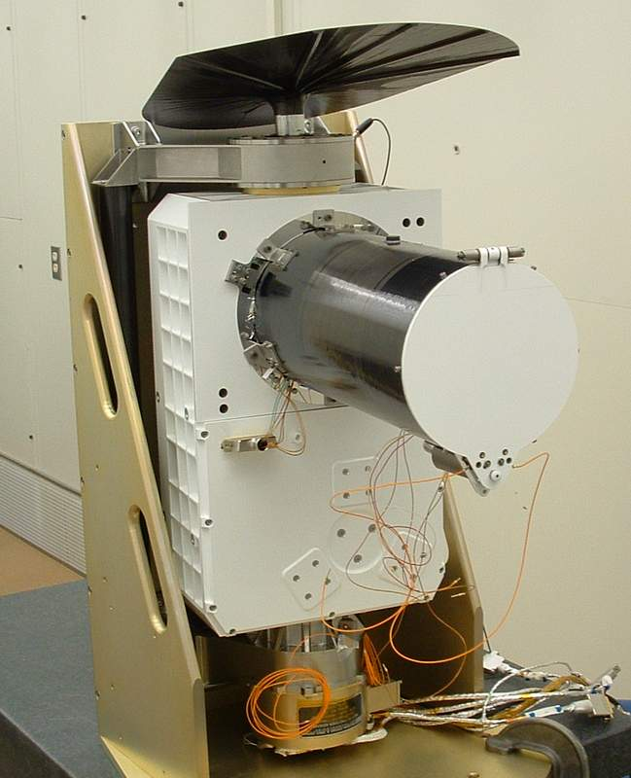
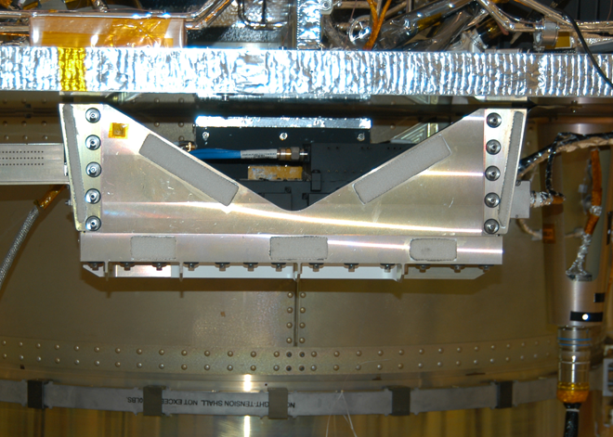
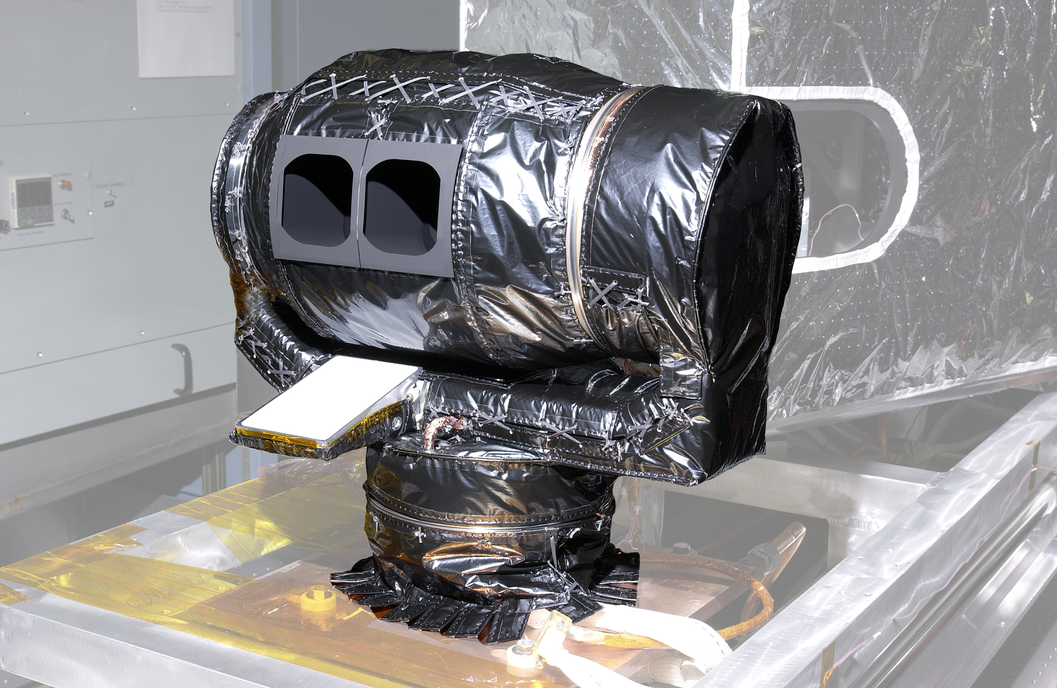
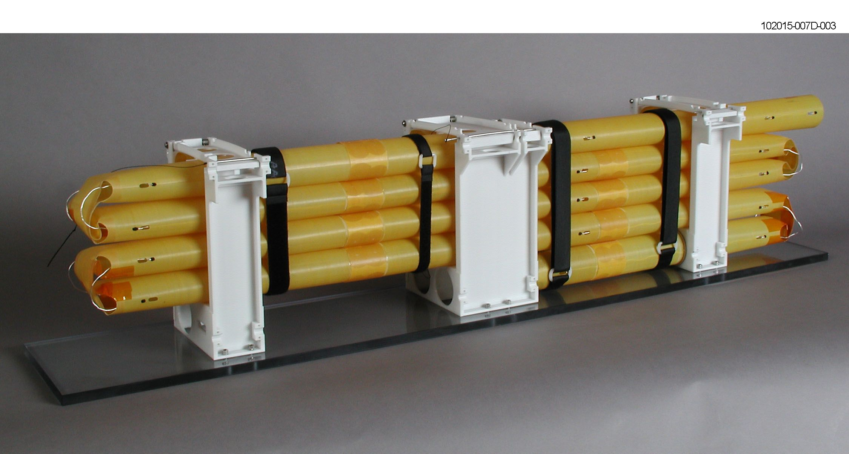
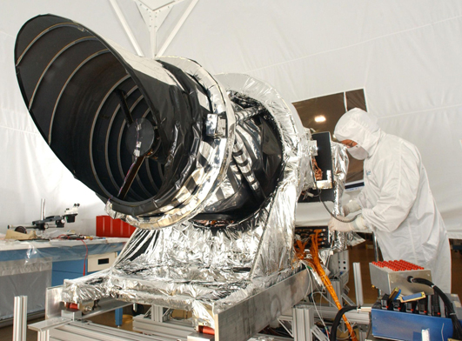
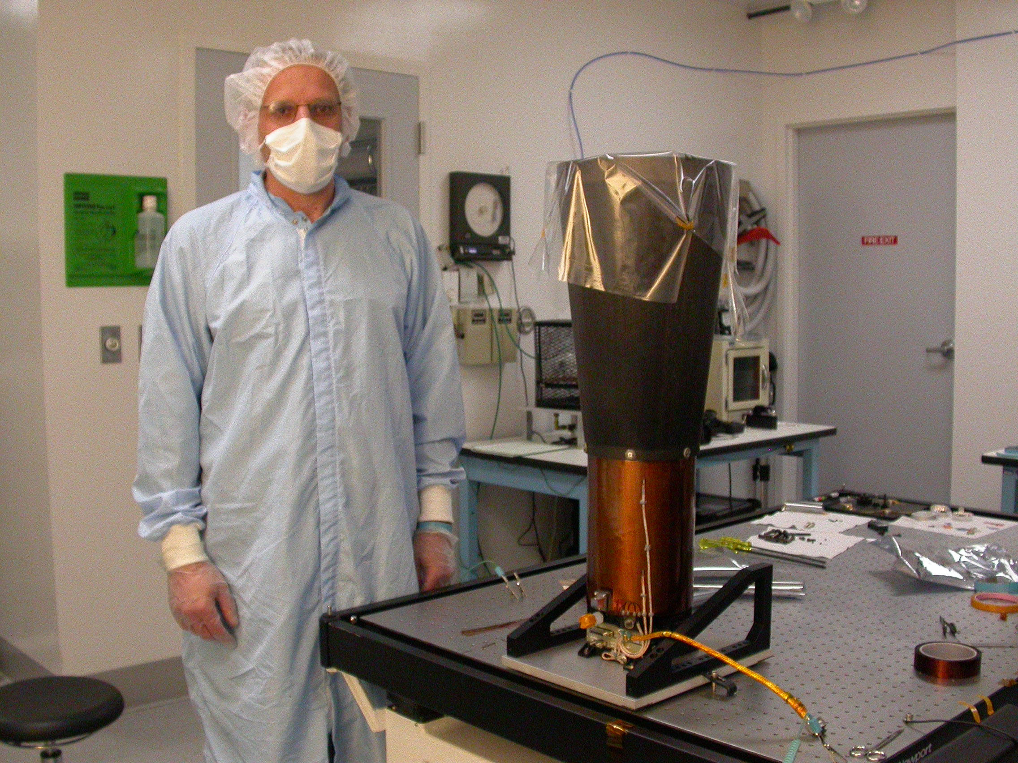
MRO Science Instruments
CRISM
MARCI
SHARAD
MCS
HiRISE
CTX

Slide 16
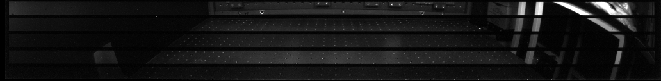
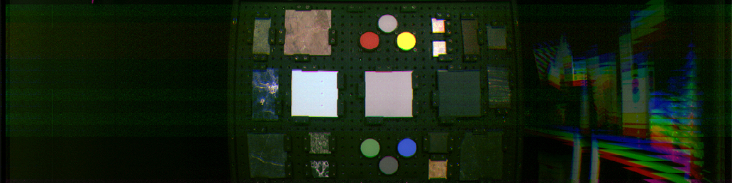
How to take images from an orbiter
Framing (like your cell phones, and Viking Orbiter cameras)
Pushbroom
CTX – single line moves across surface for s/c motion
HiRISE – same, but multiple lines (TDI) and detectors
CRISM – can use gimbals to slow rate of motion over surface, to increase exposure time
Scanner--MCS – scanner—set of “single pixel” detectors scan up and down along with s/c motion (like Landsat MSS)
Radar sounding -- SHARAD
Push-frame--MARCI (see animation), also CaSSIS on TGO

Slide 17
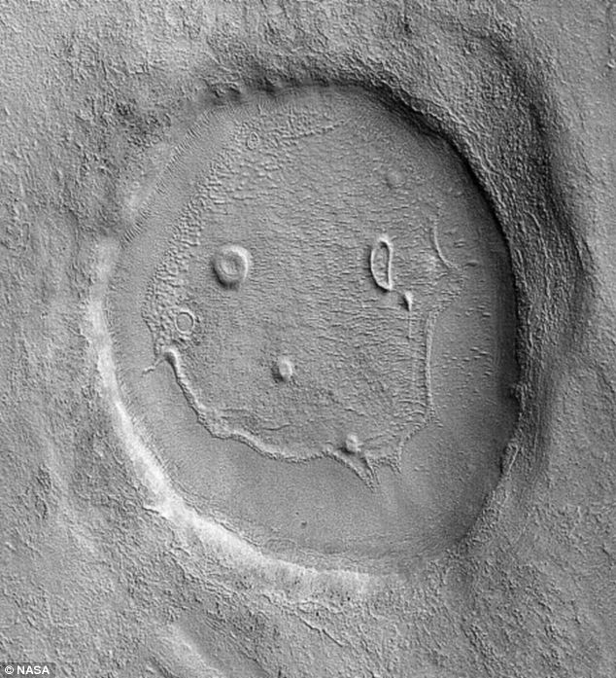
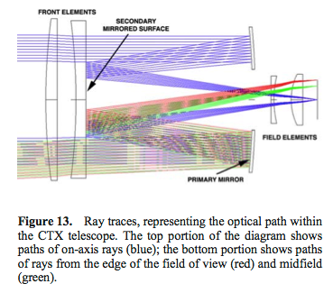
Context Imager (CTX)
Simple B&W line array, 5-6 m/pixel
Has now covered >99% of Mars!

Slide 18
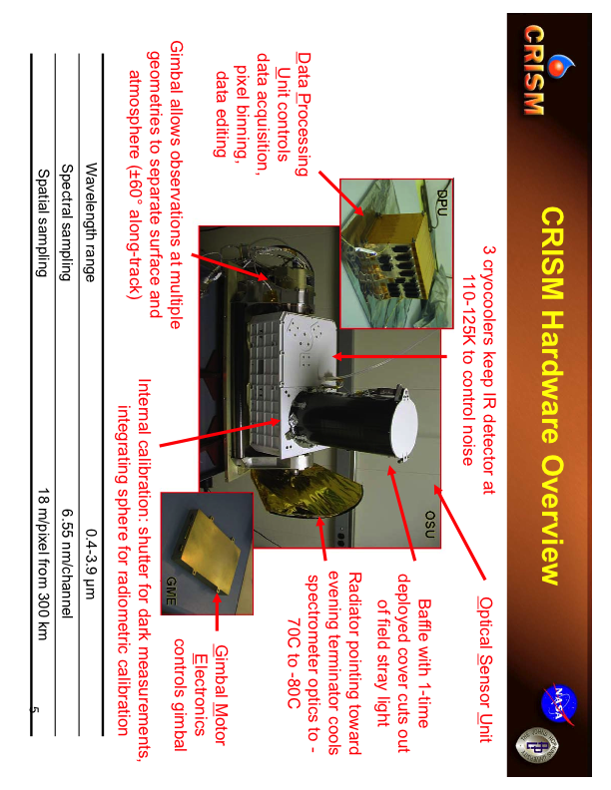

Slide 19
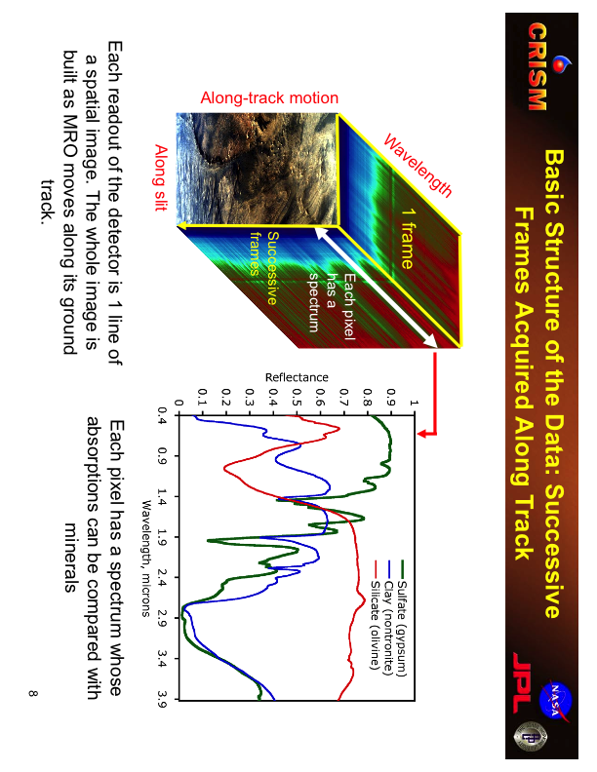

Slide 20
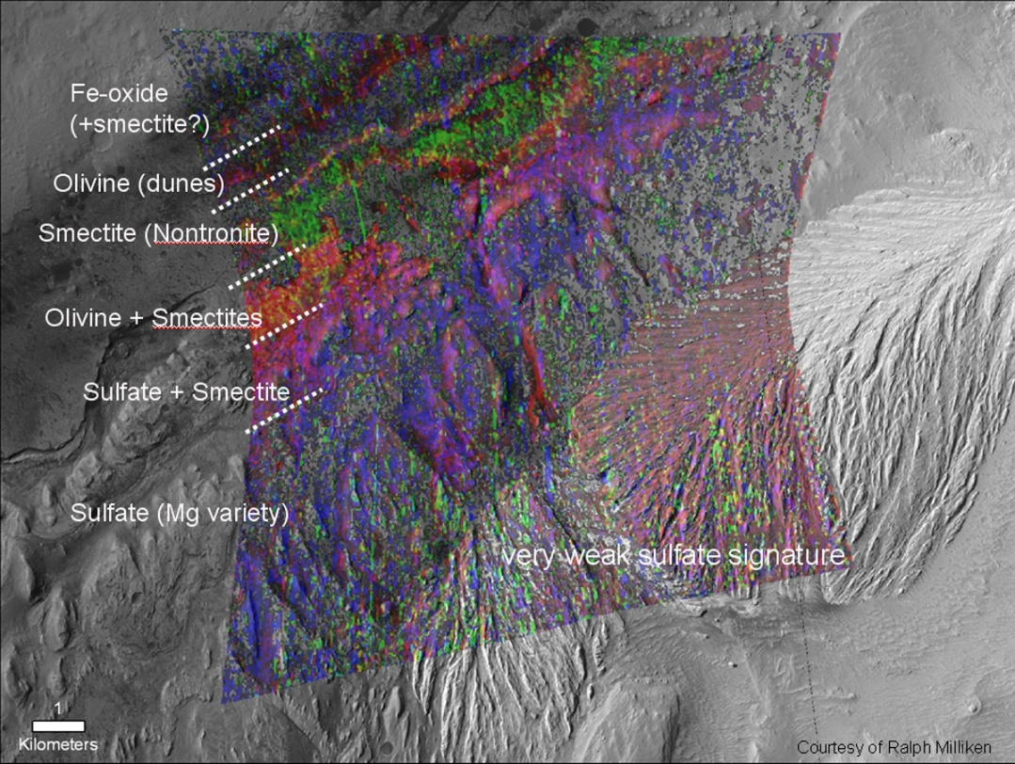
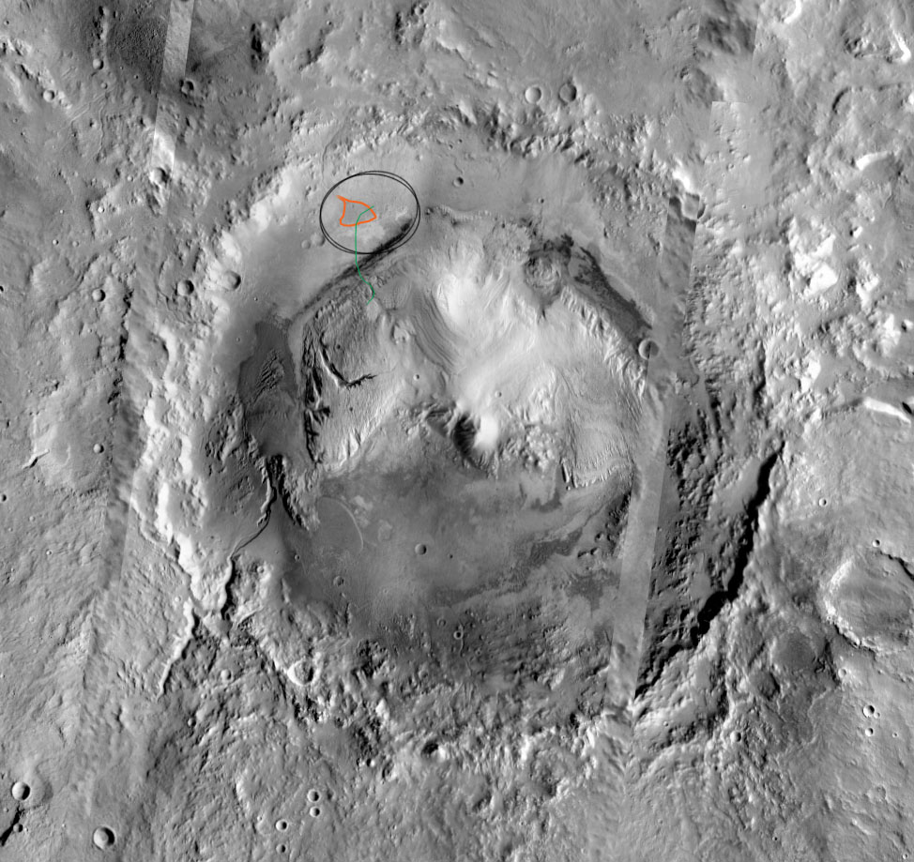
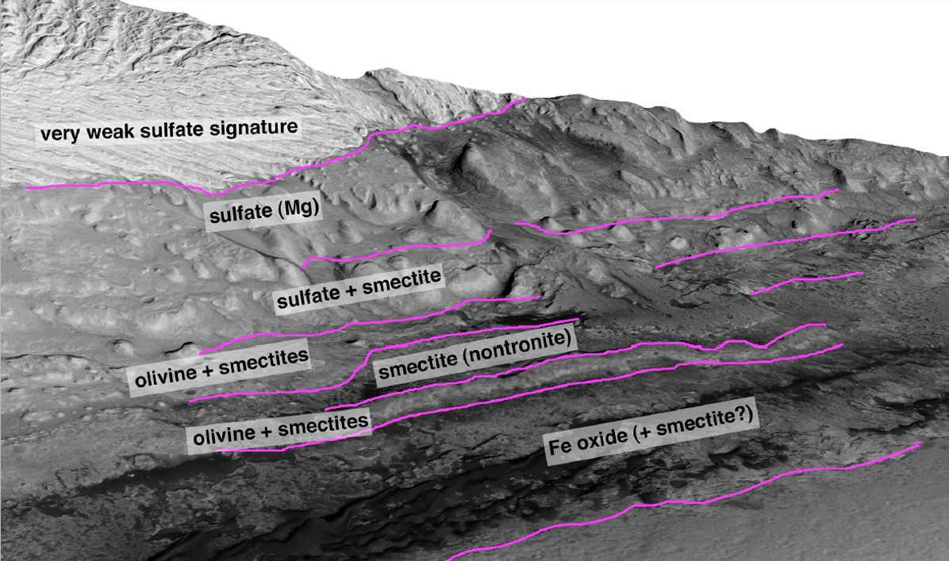
CRISM FRT 58A3 Draped on CTX
From Ralph Milliken
Minerals in Gale Crater

Slide 21
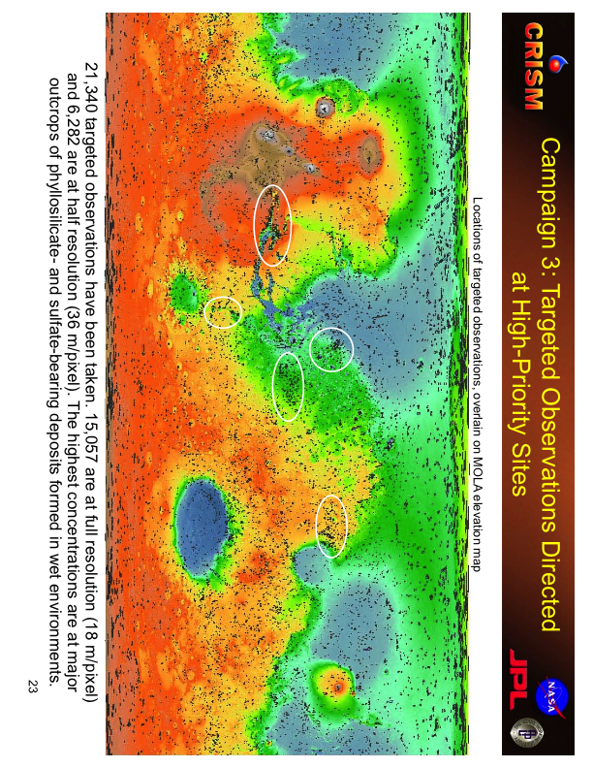

Slide 22
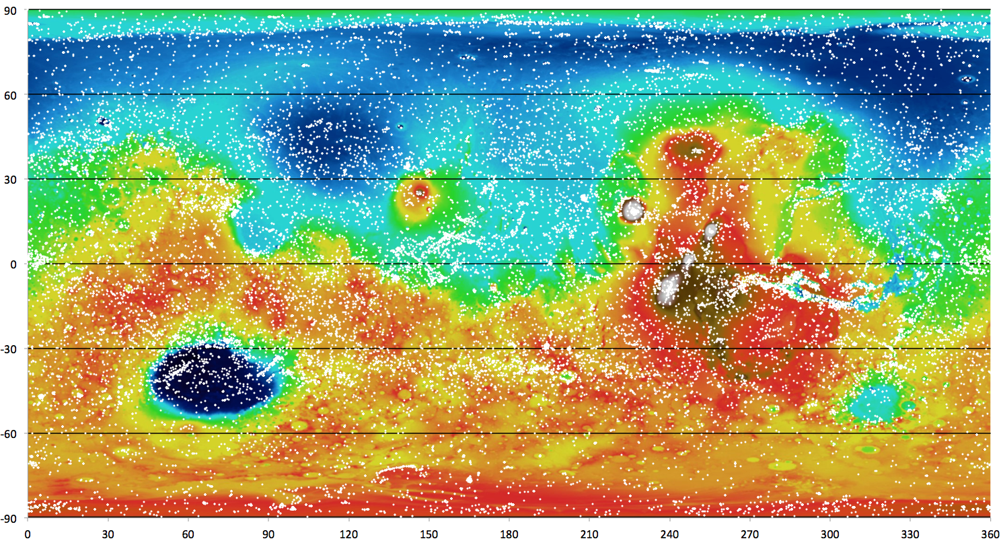
HiRISE Coverage as of 10/7/2013

Slide 23
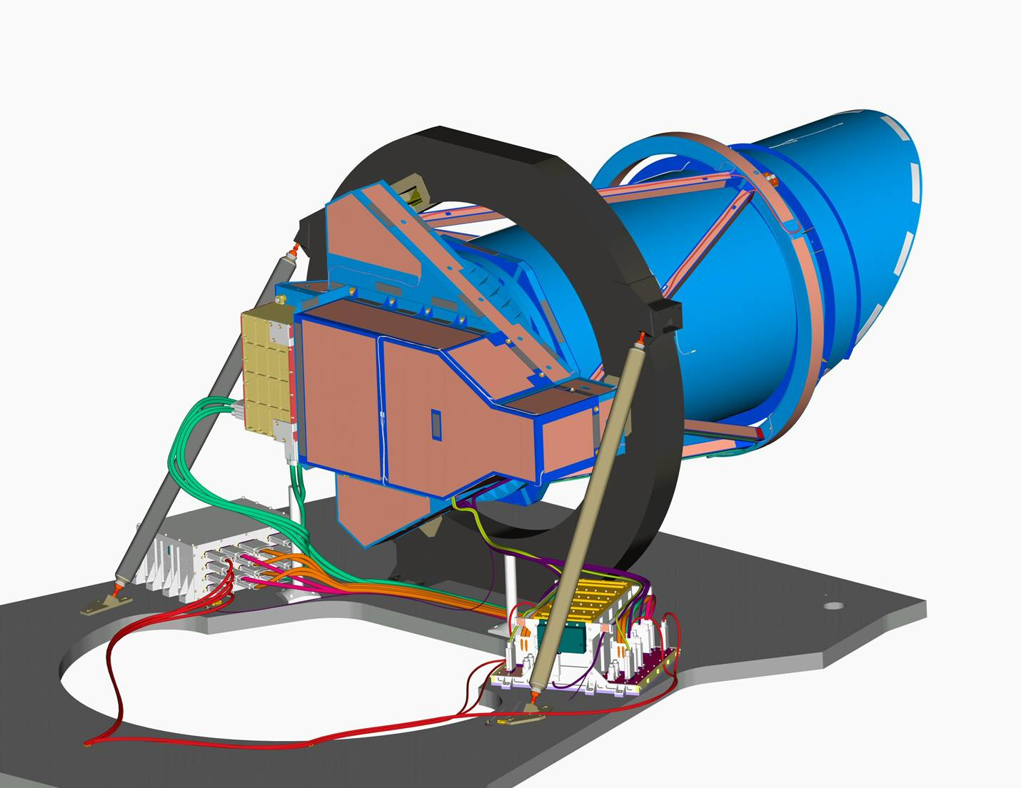
HiRISE Camera Designed, Integrated, and Tested at Ball Aerospace & Tech. Corp.
Metering Structure
Sunshade
Support ring ~1 m diameter
Focal Plane
Electronics
Baffle
Tube
Power
Supply
Spacecraft Structure
Remote Electronics

Slide 24
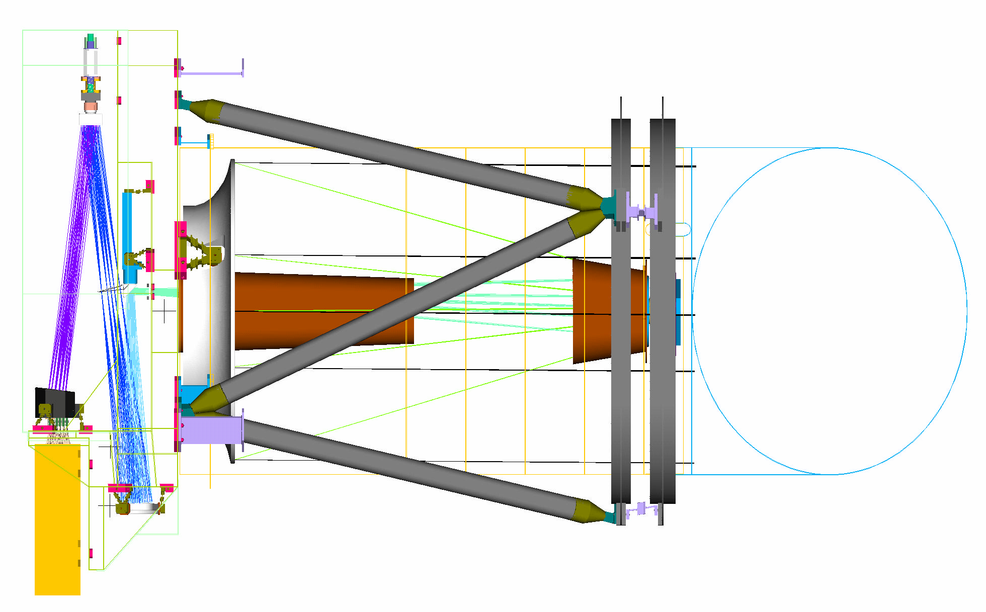
HiRISE Ray Trace
Focus
Mechanism
Primary Mirror
2nd Fold
Mirror
Primary Mirror Baffle
1st Fold
Mirror
Filters
Focal
Plane
Focal Plane
Electronics
Secondary Mirror
Tertiary Mirror
Secondary Mirror Baffle

Slide 25
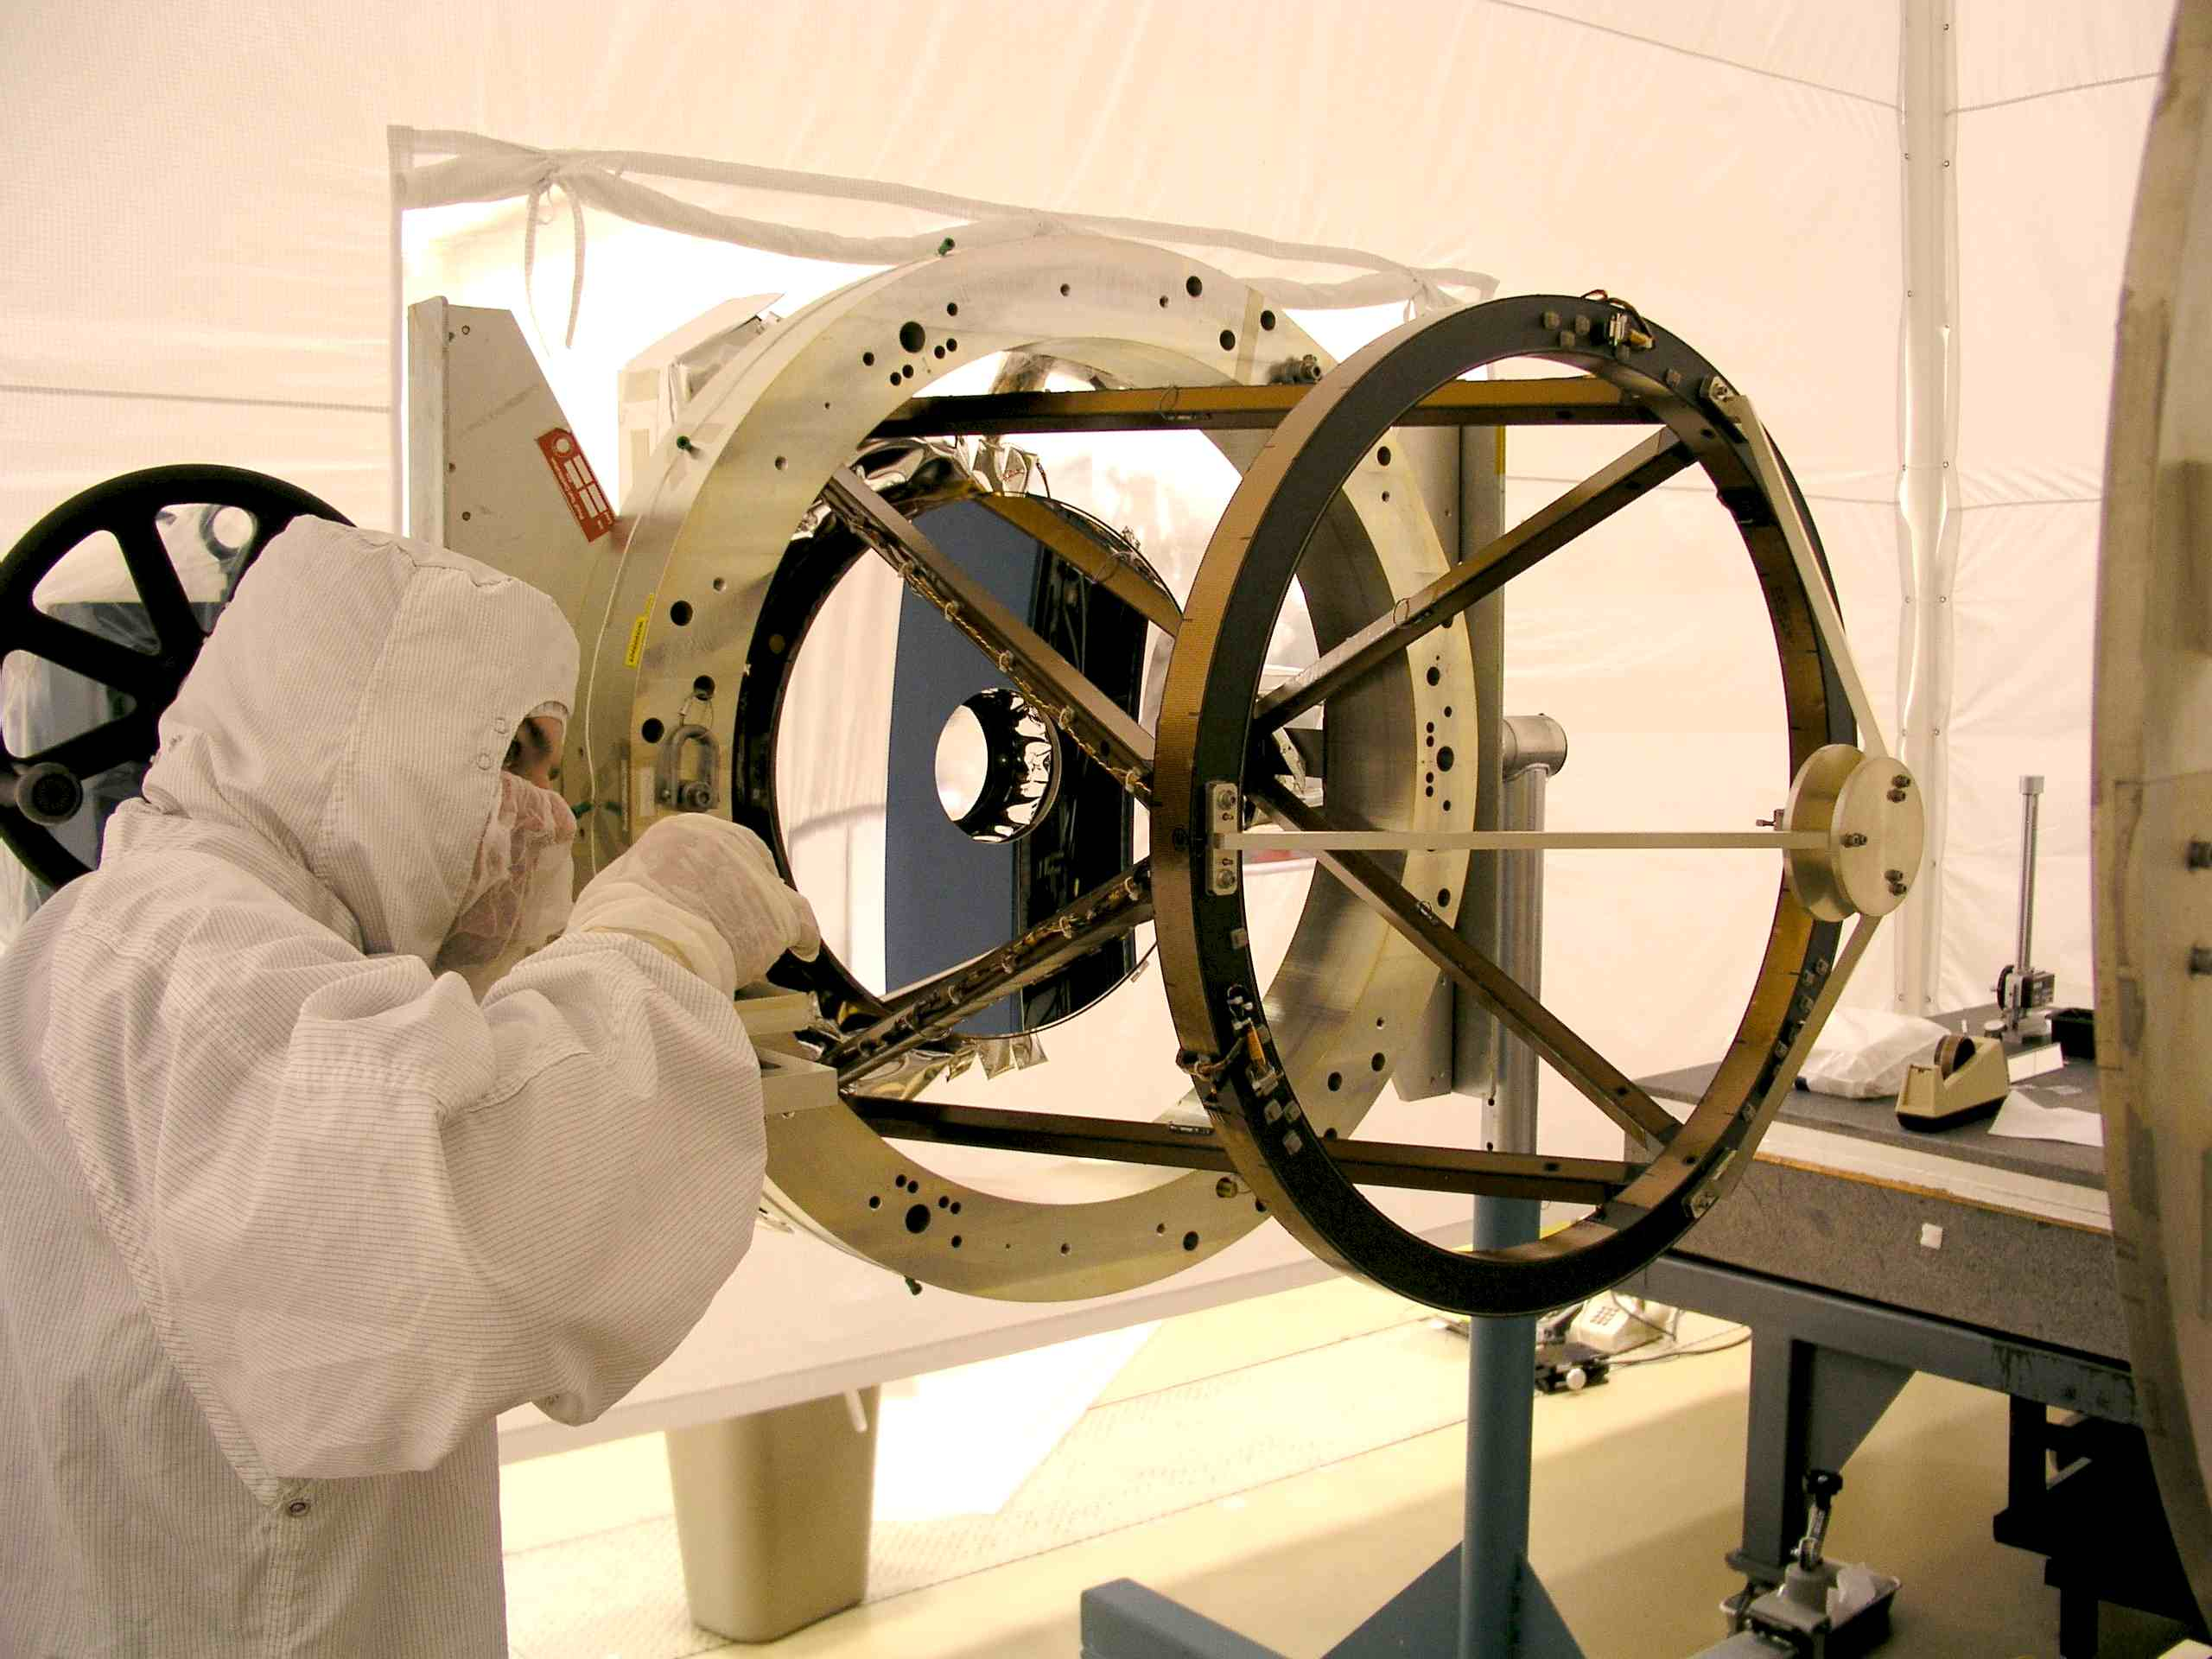
Installing the Primary Mirror

Slide 26
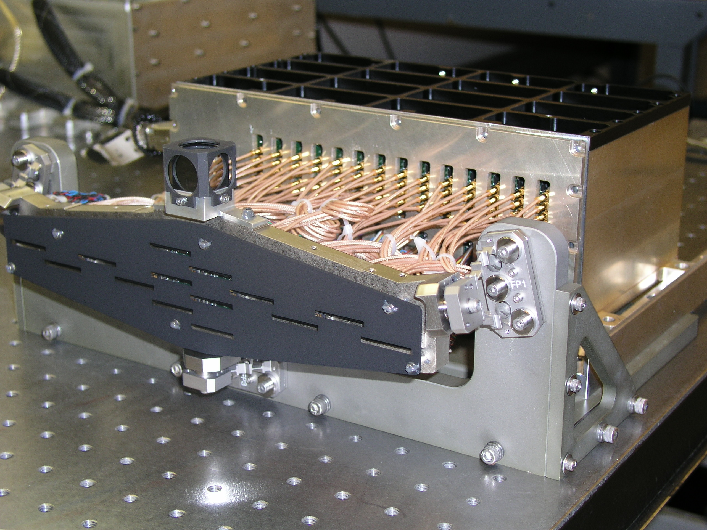
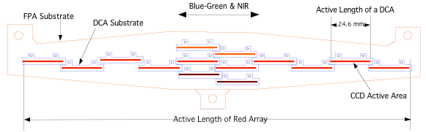
HiRISE Focal Plane Assembly
14 CCDs (2048 x 128 pixels):
10 CCDs Form Red Channel (20,000 pixels)
2 CCDs Form Blue-Green Channel (4000 pixels)
2 CCDs Form NIR Channel (4000 pixels)
Notes:
14 CCDs staggered

Slide 27
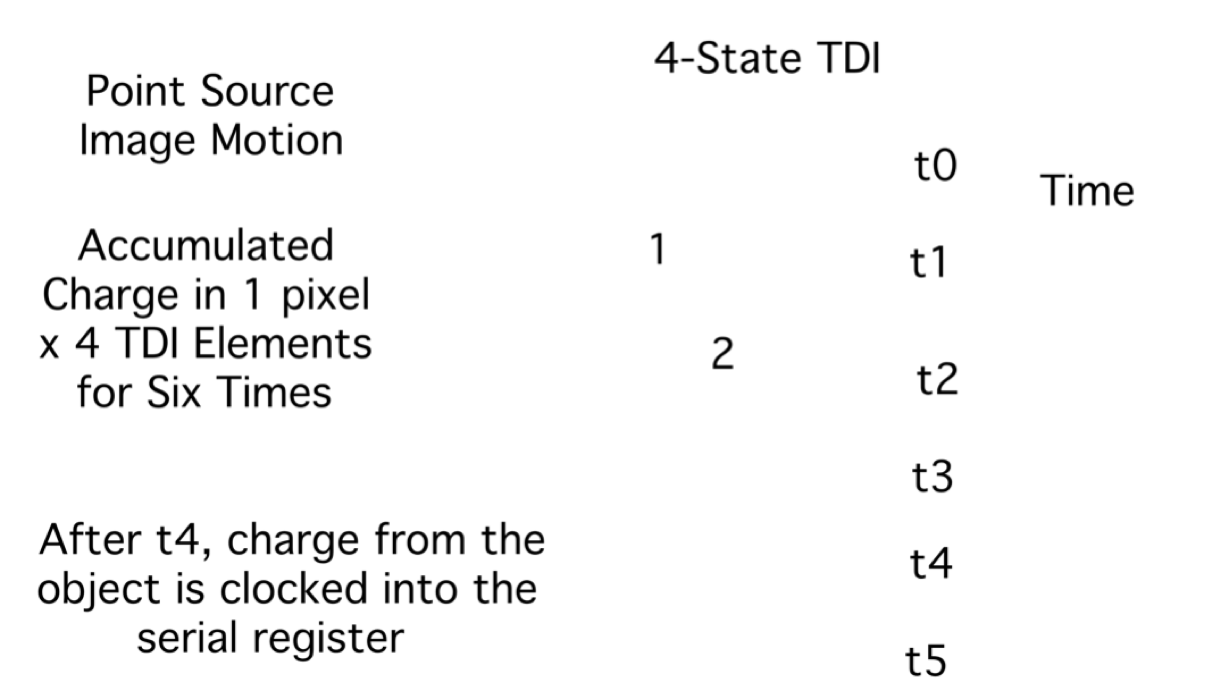
TDI (Time Delay and Integration) Increases Signal
1
2
3
4

Slide 28

Biggest Instrument Challenge: Speed!
HiRISE field-of-view moves over the surface of Mars at 3.2 km/s (~7,000 miles per hour)
Must collect and store the equivalent of 1000 1-megapixel images in ~6 seconds!
This is analogous to imaging coarse sand grains on the road while driving 125 miles/hour!

Slide 29



HiRISE “Pushbroom” Imaging
High resolution Imaging Science Experiment, Alfred McEwen, PI
S/C orbital motion (Nadir) “pushes” sensor projection across ground
Line integration timing is identically matched to orbital ground speed (~3.2 km/s or 6,912 mph!)
25-32 cm/pixel
Sensor (linear array of pixels) integrates during motion of single pixel: ~0.0001 second!
HiRISE FPA
20,000 pixels (non-overlap) in Cross-Track direction
2048 x128 TDI Line Arrays
Color Filters suspended above each detector
Flexible band tuning
Multiple colors
50 cm aperture, F/24 (HiRISE Optical System)
Color Swath Width
Altitude varies with latitude and topography, ~250-315 km
Image Length
IFOV = 1.0 µrad
FOV = 1.15 degrees (20K pixels)
“Swath Width”
Sub-satellite (nadir) velocity direction
Sub-satellite (nadir) velocity

Slide 30


HiRISE Images with color stripe and full-res sample

Slide 31


Stereo Data Acquisition on different orbits
Acquire ~1000 stereo pairs in 2 years
Digital Elevation Model (DEM) resolution ~1 m
Require θ₁+θ₂ >15° for 0.2 m vertical precision
Home Plate
Left: DEM of part of Columbia Hills (Kirk et al., 2008)

Slide 32


History of W Candor Chasm, Okubo et al., 2009.

Slide 33

Mound in Ganges Chasm https://www.flickr.com/photos/136797589@N04/
NO VERTICAL EXAGGERATION

Slide 34
HiRISE Radiometric Calibrations
Pre-flight cal with in-flight checks (why?)
HiRISE has many image modes for radiometric cal:
TDI 8, 32, 64, 128
Pixel binning 1x1, 2x2, 3x3, 4x4, 8x8, 16x16
14 CCDs
Sides A and B of remote electronics (and stim lamps)
Wide range of exposure (line) times
Need dark frames, flat-field frames, light transfer function, variations with temperature
Only 1 week to try to measure all of this at Ball Aerospace before delivery for spacecraft integration
Then we loaded new FPGA code at the launch site!
Radiometric cal is never done, you just get diminishing returns until nobody (sane) wants to work on it any more

Slide 35

HiRISE Geometric Calibrations
Pre-flight
Measure precise positions of CCDs
Measure optical distortions
In-Flight
Star cals to tweak optical distortion model
Measure and correct distortions from pointing jitter
Esp, important for digital terrain models

Slide 36

HiRISE at Mars:
Jan 27, 2026
103,247 Mars images returned
55,717 Giga-pixels
Covers 5.12% of Martian surface (3.5% unique)
Covers >0.5% in color
8,713 planned stereo pairs completed
~0.42% of Mars covered in stereo
1,216 DTMs produced for PDS archival
ESP_049009_1520

Slide 37


Opportunity at Victoria Crater
0.5 mile diameter

Slide 38



Phoenix Descending
Right: after landing and opening solar fans

Slide 39


MSL crashes stuff on Mars in 2012
Before
After

Slide 40


25 m
Opportunity rover stuck for 5 weeks in Purgatory cross drifts composed of cohesionless sand. With HiRISE images the rover avoided such areas en route to Endeavour crater.
1/25/26
Golombek: Remote Sensing Traverse
40

Slide 41


Curiosity Traverse
Wheel damage seen by 2014
MSL team uses HiRISE images to carefully select the path to minimize damage, avoiding the hard sandstone.

Slide 42

Bull’s-Eye Crater
ESP_018522_2270

Slide 43


Slide 44

Fault (All images ~1 km wide)

Slide 45

Fluvial landforms in Melas Chasm

Slide 46

Subaqueous fans in Melas Chasm

Slide 47

Folded sedimentary rock layers

Slide 48

Faulted and tilted layered sediments

Slide 49


Slide 50

Bedrock patterns in Gale crater

Slide 51

Dunes in Herschel Crater

Slide 52

Pedestal crater

Slide 53

Phreatovolcanic cones

Slide 54

NW rim of Endeavor Crater

Slide 55

Dust avalanches, triggered by dust devil?

Slide 56

Viscous flow

Slide 57

The Future of HiRISE
MRO has fuel for another 10+ years
HiRISE camera still working but has issues
One of 14 CCD electronics units failed in 2011, another fails often since 2023
Increasing noise issues
No way to predict when flight hardware might completely fail

Slide 58
How to Make HiRISE Image Suggestions
You need to enter at least 3 suggestions by Feb 18!
Go to https://www.uahirise.org/hiwish/ and register to create an account. (Demo HiWish)
Make the 3 targets differ in longitude by at least 10 deg. so they don’t conflict with each other. Current season is late southern spring, so don’t enter targets north of latitude 50 N. Avoid very popular regions like Valles Marineris and Gale crater, to get an image this semester. Floor of Hellas basin is often hazy, best to avoid in the current season. South Polar region is easy to image because the near-polar orbits converge.
Put “Mars Class” in special notes box
Look at past image suggestions to get an idea of what a good science rationale is like. First, go to https://hireport.lpl.arizona.edu/hireport/hi
username: MarsClass
password: MarsClass2015
Examples of good science rationales:
152206, 153680, 140102, 145678, 154858, 154968, 154856, 141874, 123642, 142142, 152228, 53390, 150654, 149620, 121478, 111600, 154640, 154602, 144464, 153962, 133902, 155002, 154256, 154394, 144042, 73304, 125498, 153868, 152802, 91848, 132934, 71746, 149254, 152960, 152874, 149670, 138184, 146154, 140636, 121312

Slide 59
Always Examine HiRISE Images at Full resolution
If you just look at the browse products that are easy to see in HiReport, you are missing the unique capability of HiRISE.
These are large images, and we use JPEG2000 compression to enable rapid browse and zoom
Go to : https://www.uahirise.org/hiview/
Download HiView tool, read the instructions
There are alternatives if you can first download these large images, such as ENVI, Photoshop (if you have JPEG2000 enabled), Expressview, Preview (on Macs)
JMARS (https://jmars.asu.edu/) is a great Mars analysis tool, and can also render HiRISE images at full resolution
To be demonstrated later

