Slide 1
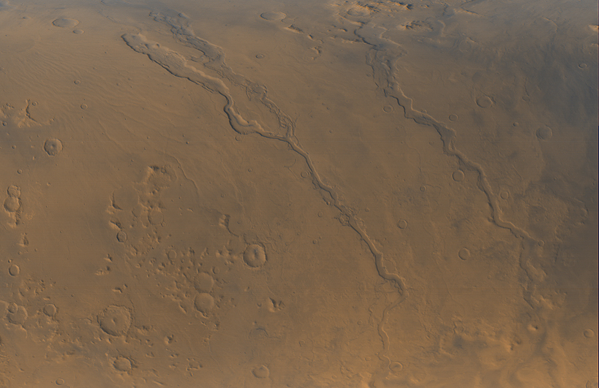
The Hesperian

Slide 2
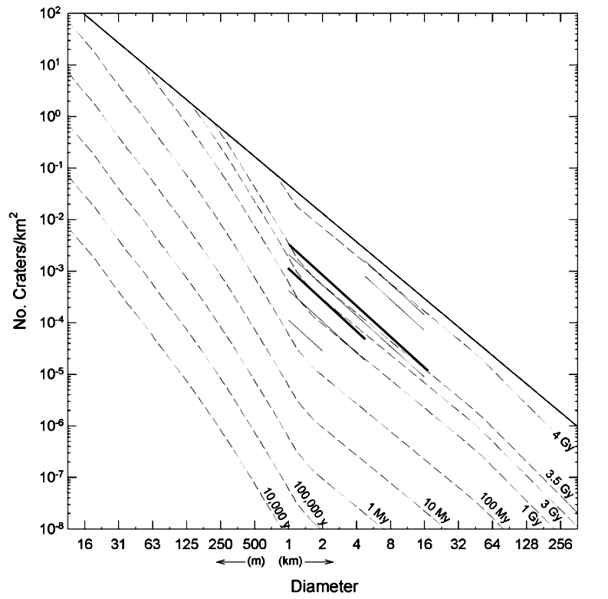
When is the Hesperian?
  Starts 3.5-3.7Ga
  Ends 3.0-3.1 Ga
What’s important in the Late Noachian/Hesperian/Early Amazonian?
  Impact rate declining rapidly
  Volcanic resurfacing at a maximum?
    Hesperian volcanic plains
  Fluvial resurfacing at a maximum near N-H boundary?
  Outflow channels in Hesperian-Amazonian
  (More difficult to assess Noachian fluvial and volcanic activity—evidence destroyed by impacts.)
Hesperian boundaries according to USGS
Hartmann, 2005

Slide 3
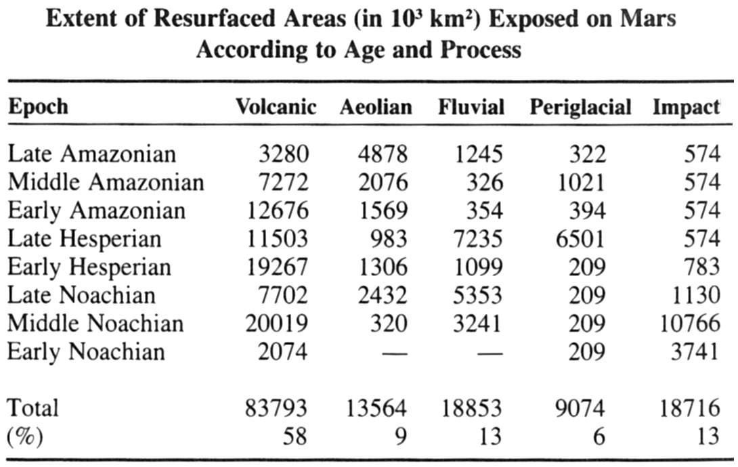
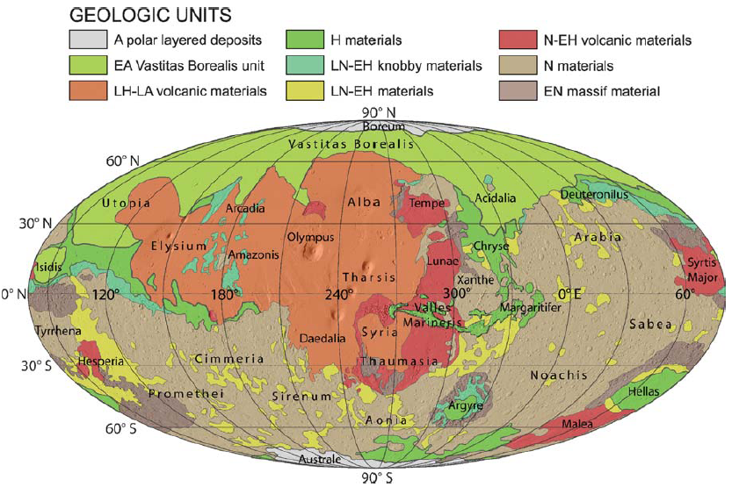
Tanaka et al., 1992
Nimmo and Tanaka, 2005

Slide 4
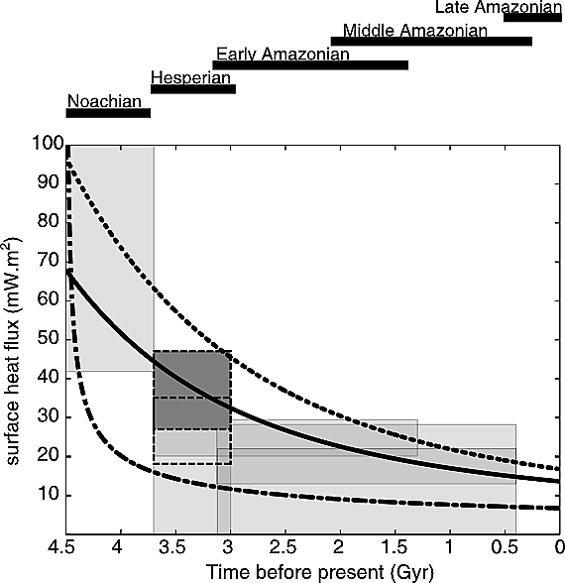
Hesperian Mars: A Changing Planet
Early thicker atmosphere quickly (?) removed
  Warm-wet transition to cold-dry
  New results suggest that Noachian was largely dry as well, with wet episodes, and there were wet episodes in Hesperian
  Some workers say the geologic evidence (like alluvial fans) points to an especially wet period at the end Noachian/early Hesperian
Planetary heat flow declines
  Lithospheric thickening
    Leads to only voluminous lava eruptions reaching the surface
  Also cryosphere thickening
    Voluminous floods of subsurface water
Montési and Zuber, 2003
Upper and lower limits to model uncertainty

Slide 5
Papers supporting intense fluvial activity at Noachian-Hesperian boundary:
  An intense terminal epoch of widespread fluvial activity on early Mars: 1. Valley network incision and associated deposits
  Alan D. Howard, Jeffrey M. Moore, Rossman P. Irwin III
  An intense terminal epoch of widespread fluvial activity on early Mars: 2. Increased runoff and paleolake development
  Rossman P. Irwin III, Alan D. Howard, Robert A. Craddock, Jeffrey M. Moore
  Possibly due to increase in temperatures and rainfall intensity, or a change from rainfall runoff to snowmelt runoff.
Paper suggesting the fluvial activity was more spread out in time:
  Persistence of intense, climate-driven runoff late in Mars history
  Edwin S Kite ^{1,*}, David P Mayer ^{1,†}, Sharon A Wilson ², Joel M Davis ³, Antoine S Lucas ⁴, Gaia Stucky de Quay ^{1,5,‡}

Slide 6
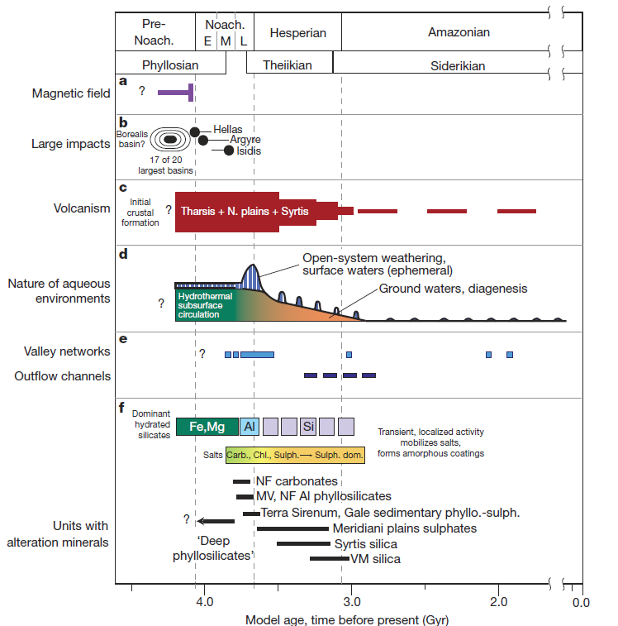
Summary of Mars geologic history (Ehlmann et al. 2011)
What caused this (apparent) spike in surface water?

Slide 7
Summary of Mars geologic history (Ehlmann et al. 2011)
What caused this (apparent) spike in surface water?
Either late heavy bombardment or pulse in volcanism (or both)
What cause the later, smaller pulses?
Impacts and/or volcanism and/or catastrophic flooding events

Slide 8
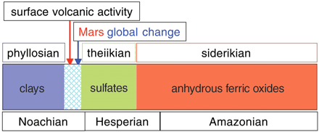
Can Minerals be Used like Fossils?
Bibring et al., 2006
18th Century geologists thought minerals could be used to date terrestrial strata
  This was disproven
  Fossils do date strata—extinction is forever
OMEGA mineralogical theory
  Clay formation ceases in Noachian
  Transition to acidic environment from sulfates
    Also requires evaporation
  Young terrains show no aqueous alteration
Problems with this theory
  Alteration can occur anytime after the rock formed, so alteration of Noachian rocks not necessarily confined to Noachian age
  There are clays of all ages in Martian meteorites
  There has certainly been subsurface water since Noachian
    Hesperian and early Amazonian outflow channels, alluvial fans

Slide 9
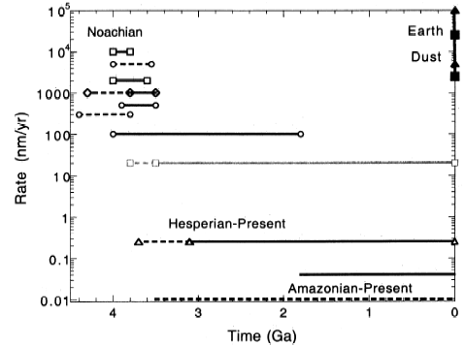
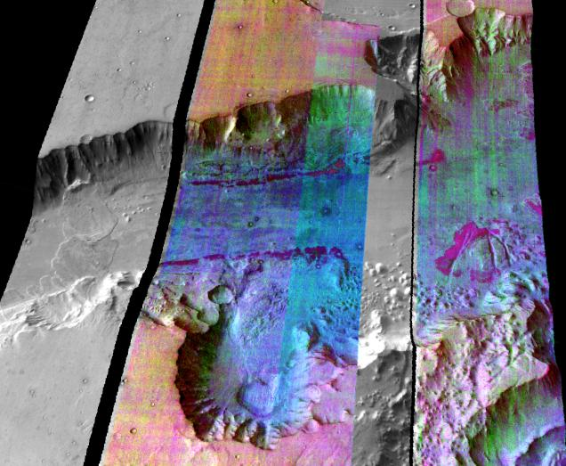
Evidence for change
Hesperian lava plains are largely undissected
  Noachian terrains are highly dissected by valley networks
  But—some terrains erode more than others
    dissection of Noachian highlands could have occurred in Hesperian
Gusev crater basalts are not weathered at all (spirit rover)
  But the Columbia Hills rocks (older) are e.g. hematite, goethite, nanophase oxyhydroxides
Erosion rates are drastically reduced
  But methods may be suspect—measuring erosion since latest impact event rather than over billions of years?
Presence of olivine on the surface
  Suggests little exposure to water, as olivine is easily altered
Golombek and Bridges, 2000
Christensen et al., 2003
Purple units are Ol-rich (THEMIS)

Slide 10
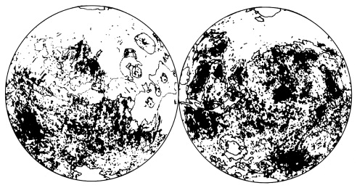
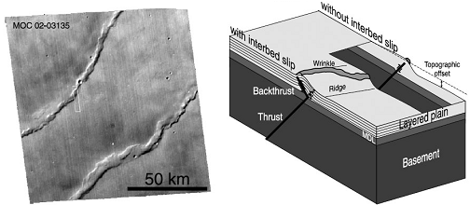
Hesperian Volcanism
Extensive plains volcanism
  with subsequent wrinkle ridges
Large amount of SO₂ released
  Combines with water to form acid rain
  Shift from phyllosilicate to sulfate deposits?
  Extent of Noachian volcanism is not well known, but may well exceed that in Hesperian, as expected from declining heat flow
Map of plains volcanism, excluding N plains that may also be covered by lava
Wrinkle ridges common on Hesperian plains, facilitated by layered surface with contrasts in strength, like flood lavas
Montési and Zuber, 2003

Slide 11
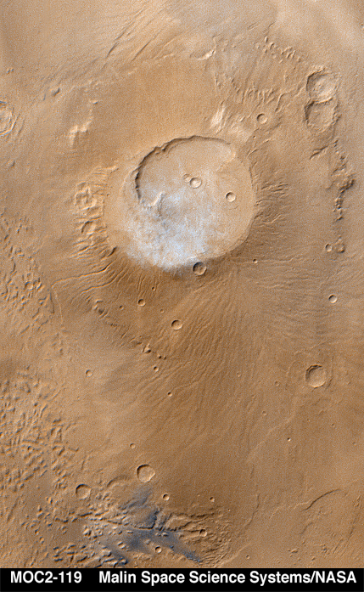
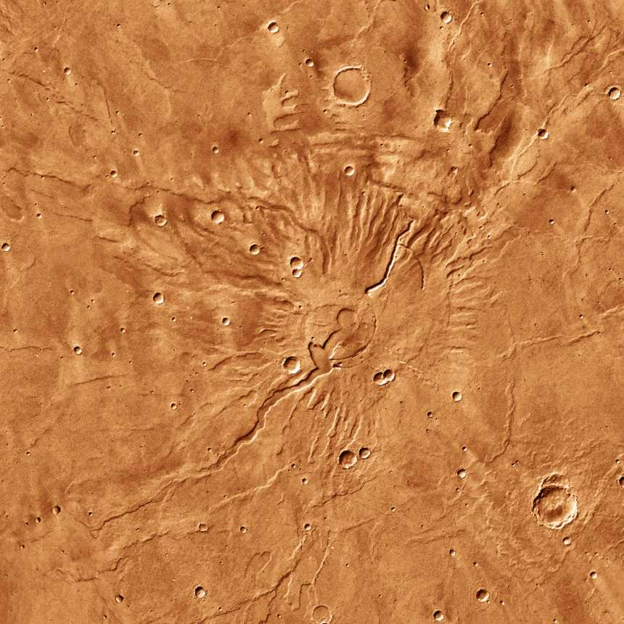
Paterae Volcanism
  Low relief
  Very low slopes <1 degree
Highland paterae - late Noachian
  Extensively dissected
  Easily erodible material – consolidated ash
Tyrrhena Patera

Slide 12
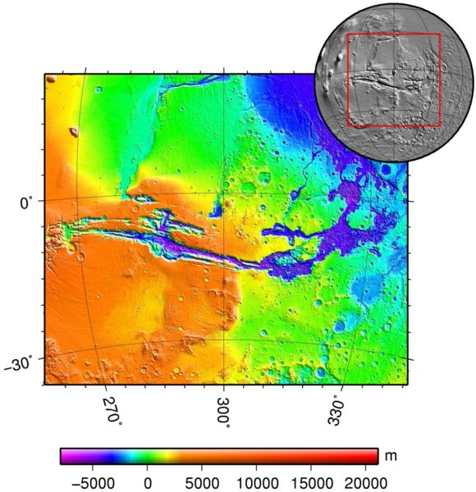
Hesperian Tectonics
Growth of Tharsis causes radial extension
  1000’s km in extent
Compressional wrinkle ridges are circumferential to Tharsis
Opening of Valles Marineris
  Radial to Tharsis
  Extension stresses begin rift
  Unclear why most extension is in one place
    Another mantle plume under Valles Marineris?
    Role of water?
  Canyon subsequently widened by landslides
  Later filled with layered deposits
    Probably from paleo-lakes and eolian deposition

Slide 13
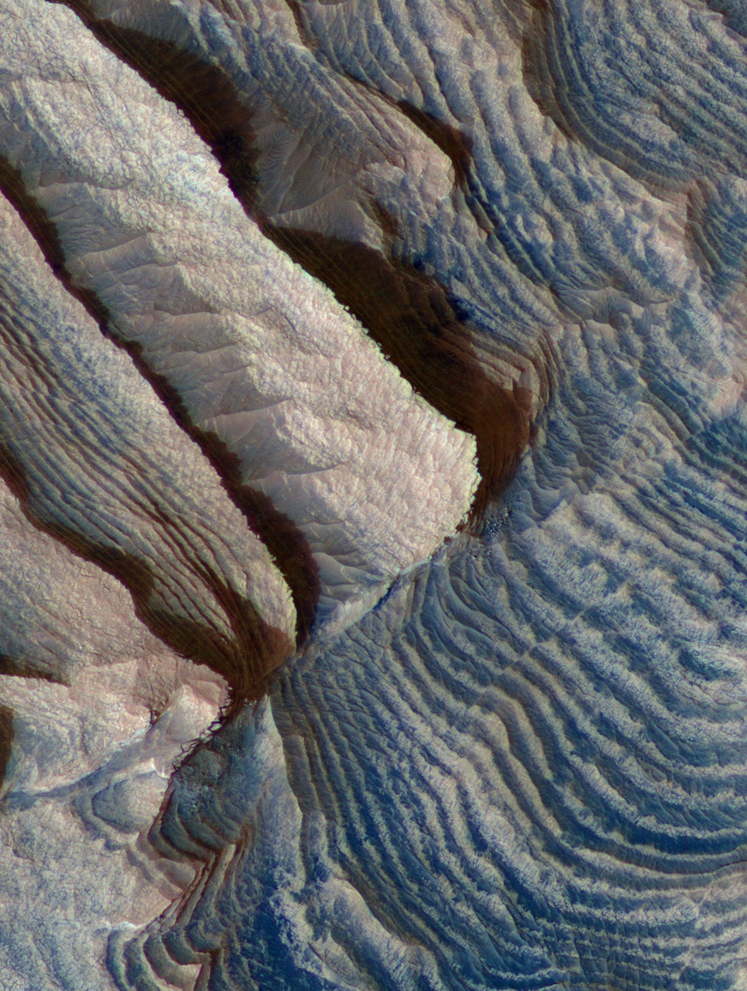
Water at the Noachian-Hesperian Boundary
Valley networks indicate surface water eroded Noachian terrains
  Infilled craters gives best measure of total volume of erosion and hence, of water.
Inevitable to have this water pool into craters and low areas
Ancient sedimentary rock layers found in craters and plains like Meridiani (explored by Opportuniity rover)
  Indicate active past
  Possible paleo-lake environments
  OMEGA indicates light toned layered deposits are sulfate rich in composition
    Implies evaporites
  Very few craters on layered materials
    Due to rapid erosion rather than young geologic age
    Superposition suggests these are largely Noachian to Hesperian in age
Layering in Becquerel crater, PSP_003656_2015

Slide 14
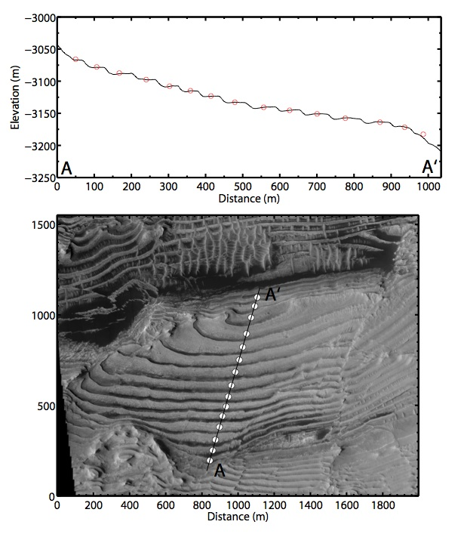
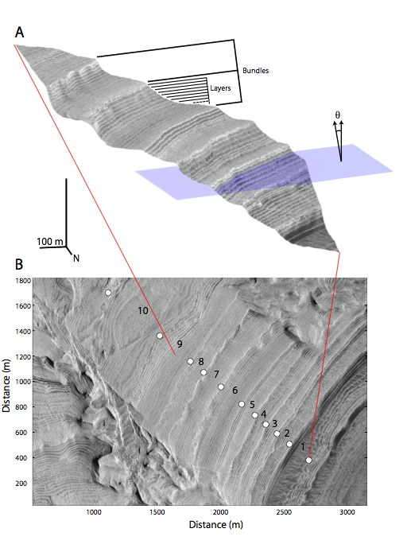
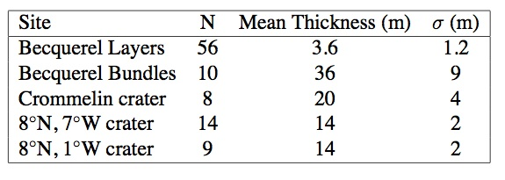
Periodic layering in sedimentary rocks (Lewis et al., 2008)
Periodicity related to orbital periods (eccentricity, obliquity)?

Slide 15
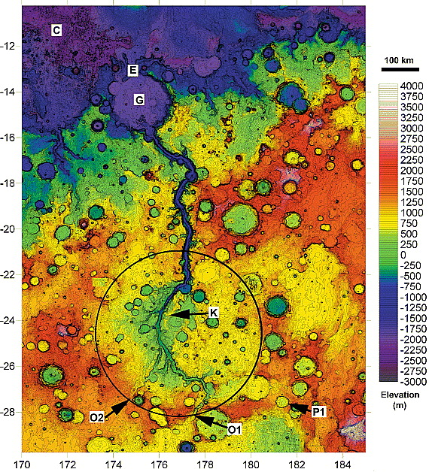
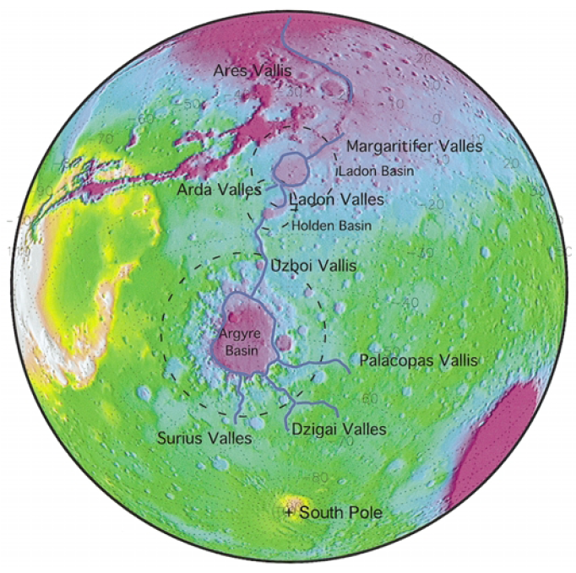
Interconnected drainage basins point to water transport from lake to lake
Parker et al., 2000
Irwin et al., 2004

Slide 16
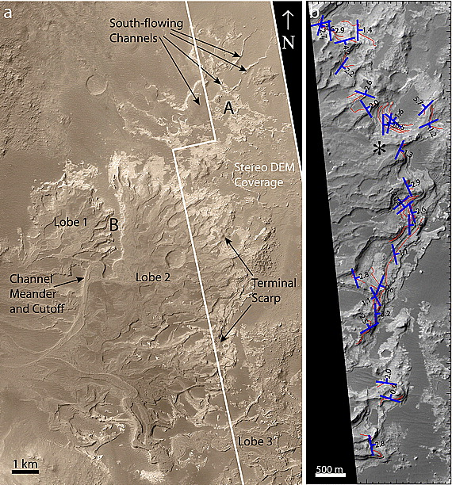
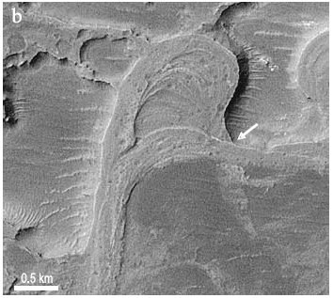
Evidence of sustained flow
Distributary fans
Indicate lengthy fluvial processes
Outflow channels could have been short lived
May have discharged into a lake (delta) or dry crater (alluvial fan)
Many such deposits of Hesperian age (although initially assumed Noachian)
Jerolmack et al., 2004
Lewis and Aharonson, 2006

Slide 17
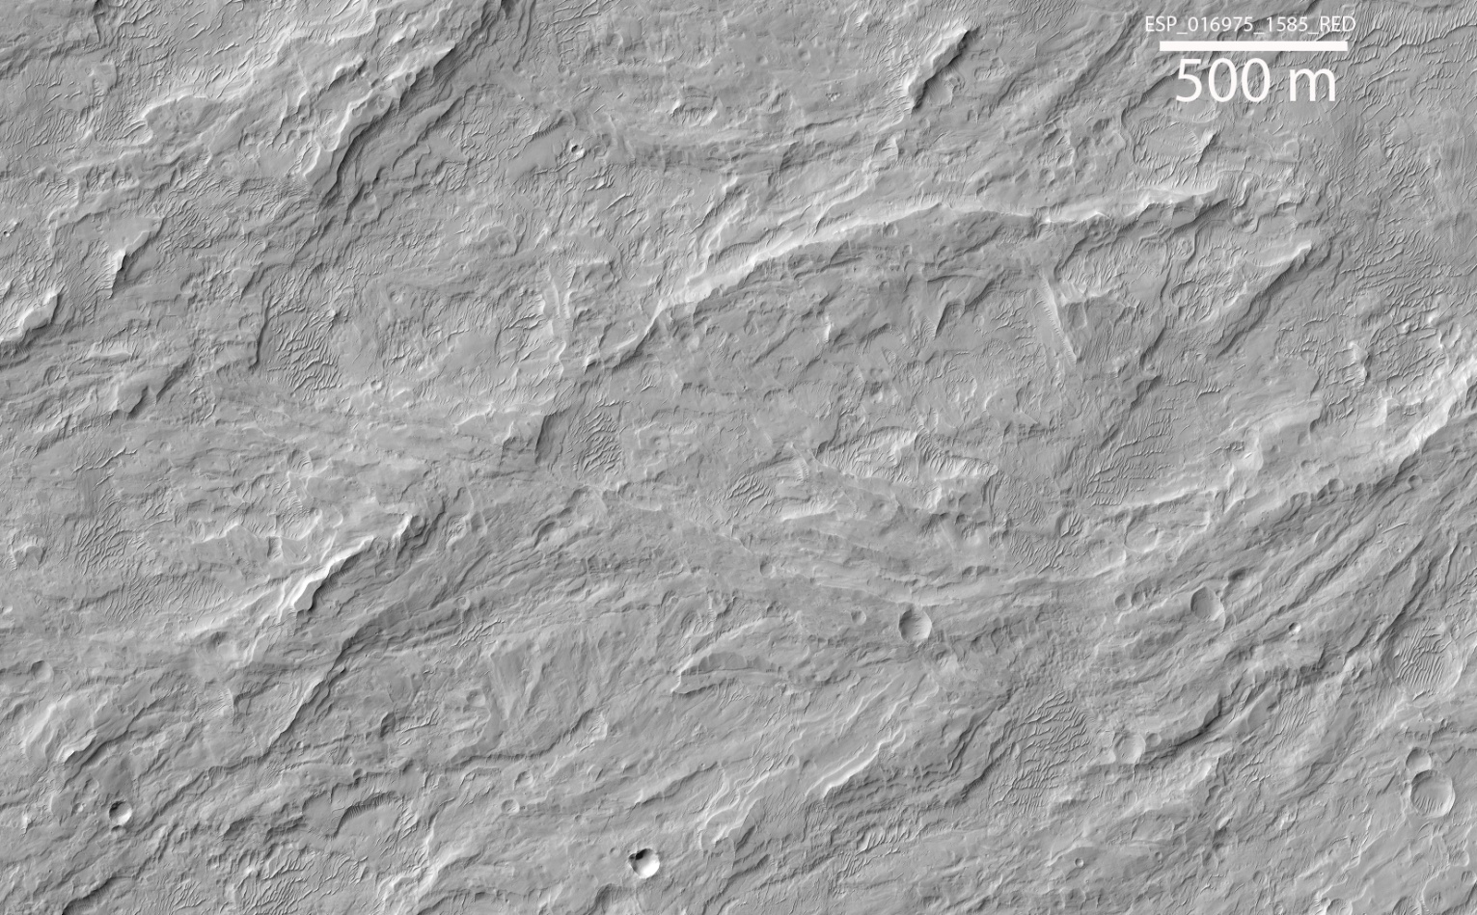
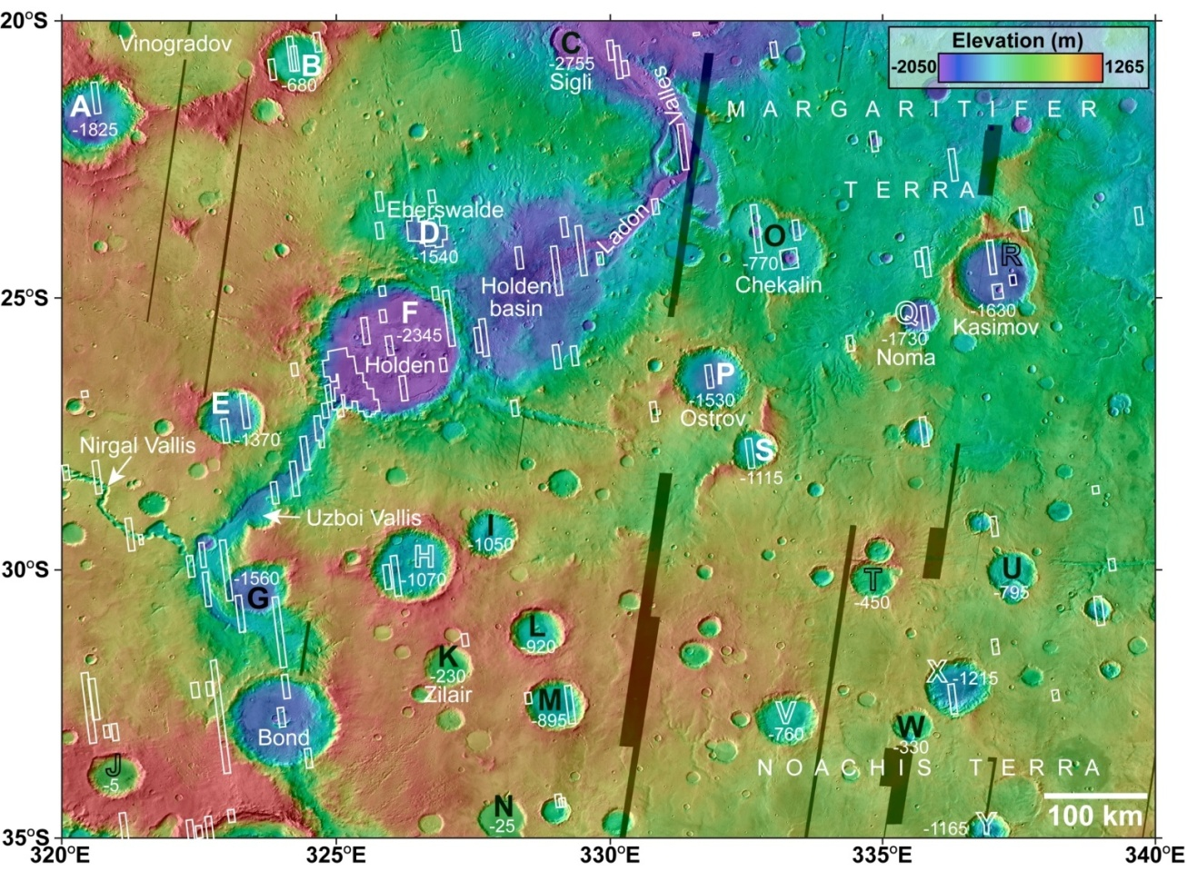
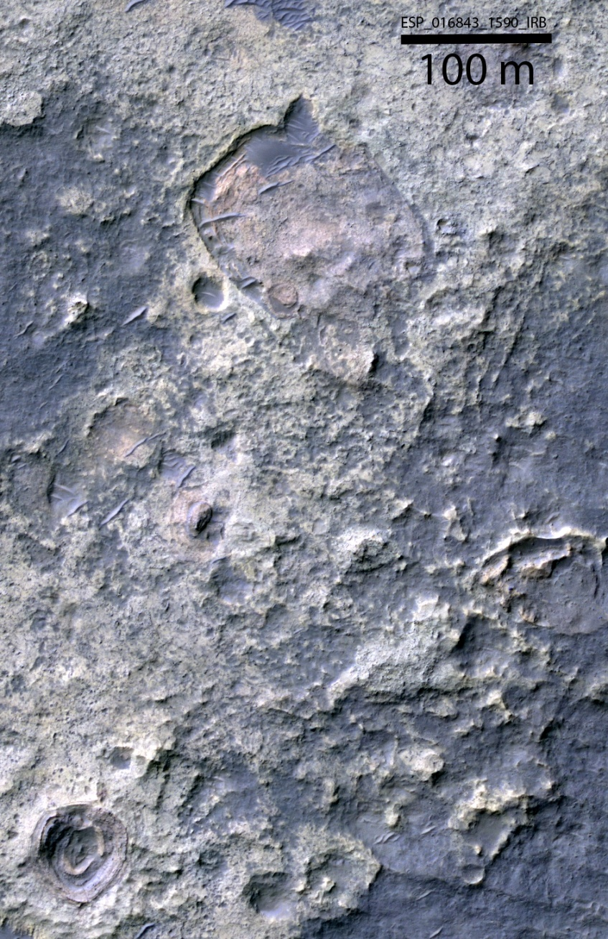

Characterizing Numerous Crater-bound Alluvial Fans in Margaritifer Terra
Crater A
White Letters – Fans, Black Letters – No Fans
Distributaries stand in relief due to removal of surrounding fines
Crater B
Numerous alluvial fans and some playa/lake deposits in craters occur at a range of latitudes and elevations and may be as young as Early to mid-Hesperian in age. May correlate with lakes in Uzboi, Holden, Eberswalde.
Fans are minimally incised, most common in craters with lowest floor elevations and greatest relief between floor and rim (1-3 km), and poorly correlated with azimuth in crater
Present distribution controlled by where preserved and exposed and not buried beneath younger deposits: fans may have been more widespread
Erosion of crater rims, absence of lacustrine deposits in some craters suggests limited groundwater, likely requires synoptic precipitation perhaps orographically enhanced, but was insufficient to deeply incise fan surfaces
Morphology points to precipitation that started and ended abruptly (Moore and Howard 2005; Kraal et al., 2008). Regional record is among best preserved on Mars and correlates with increased degradation in the late Noachian inferred by Irwin et al., 2005; Wray et al., 2009, and maybe well into the Hesperian
Friable, possible lake or playa deposits
at distal ends of fans

Slide 18
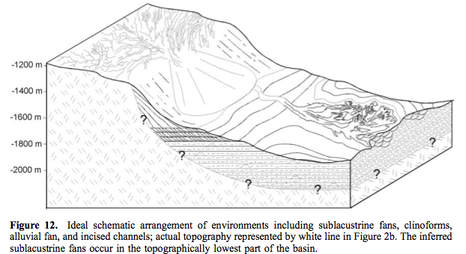
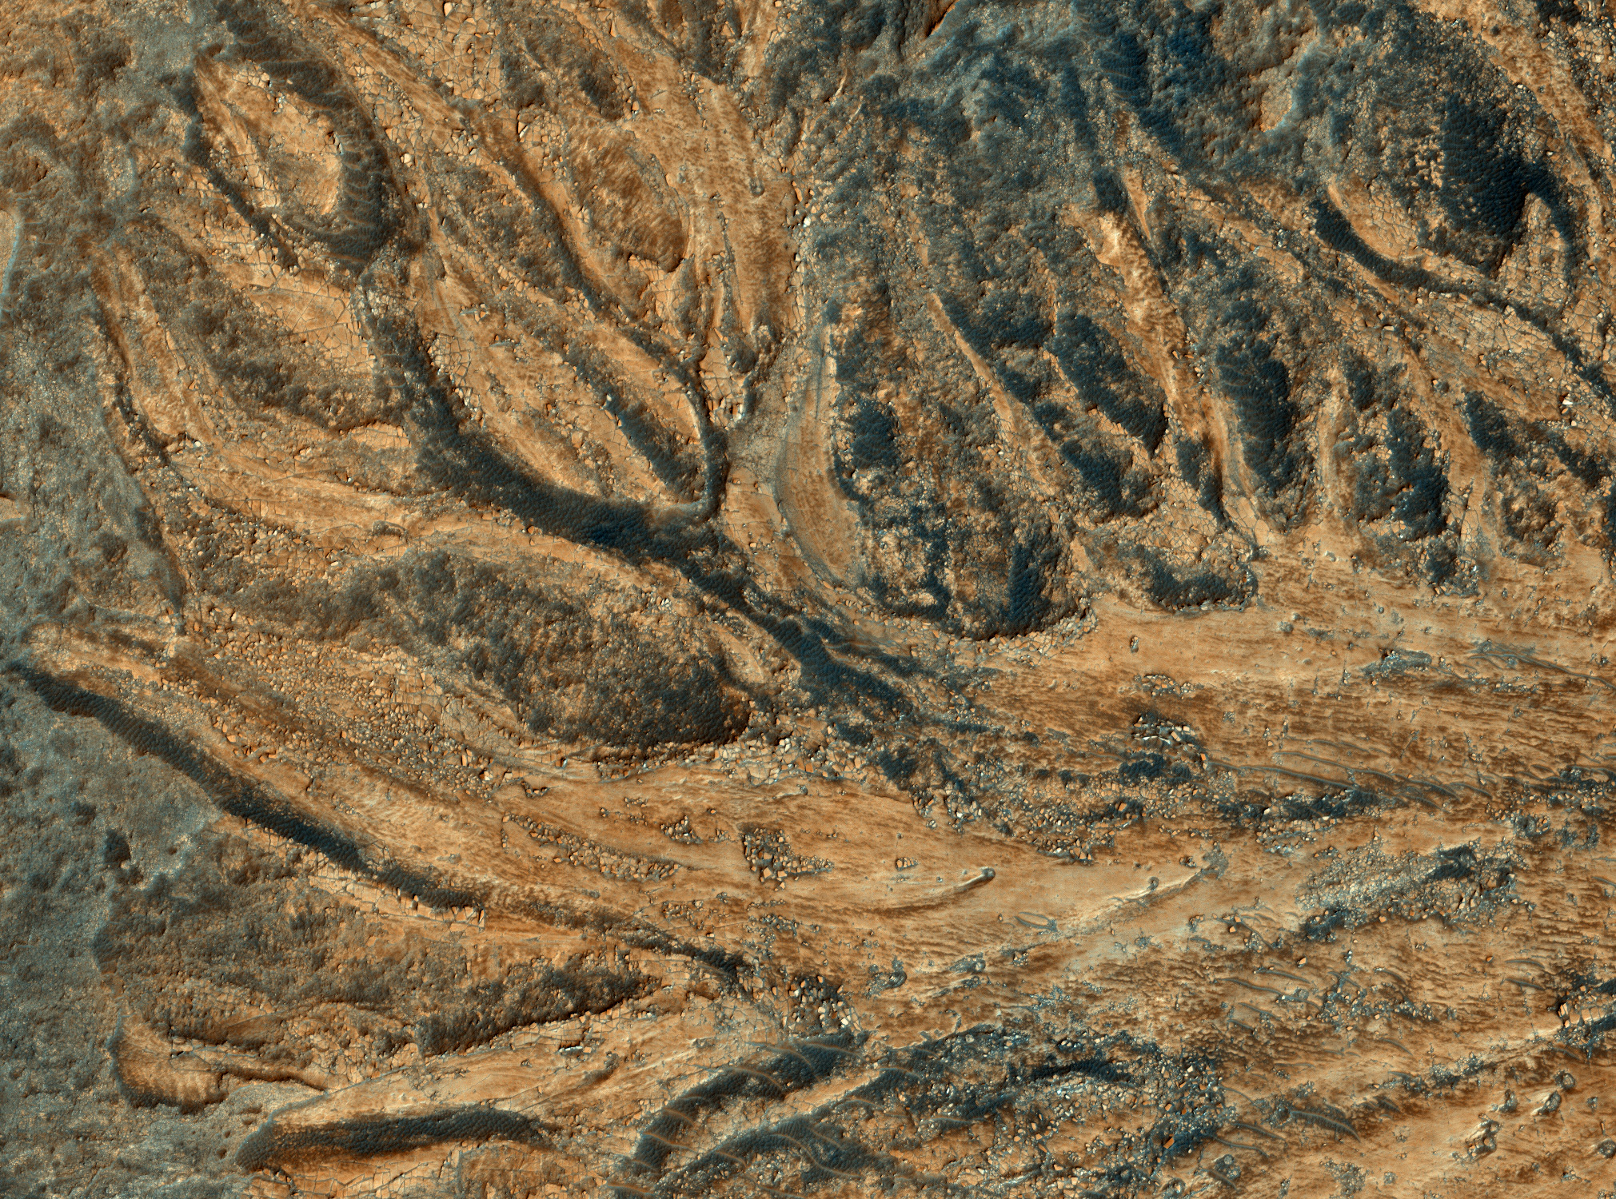
Melas Chasm Fans
Melas Chasm fans, maybe sublacustrine deposition
PSP_007087_1700, enhanced colors
Image width ~1.1 km

Slide 19
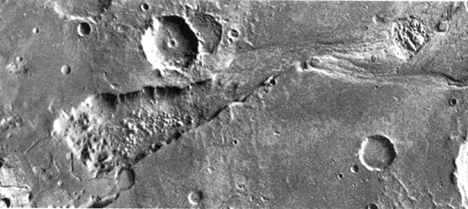
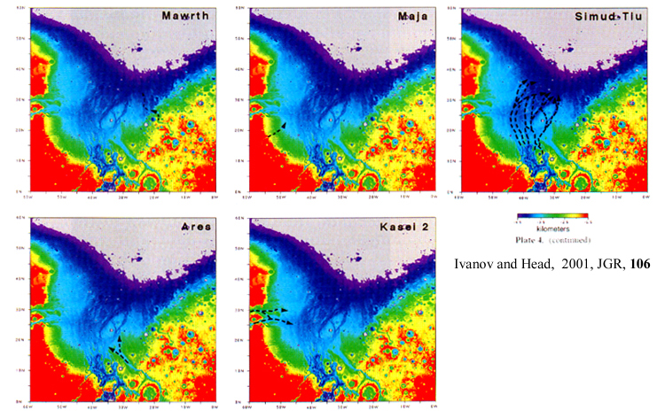
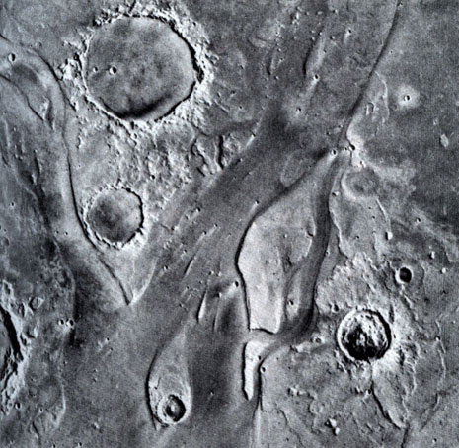
Outflow Channels
Huge floods carved channels
Contains streamlined Islands
Similar to channeled scablands in Washington
Likely that a large underground reservoir emptied catastrophically
  Source region collapses to chaos terrain
  Flood empties into northern lowlands

Slide 20
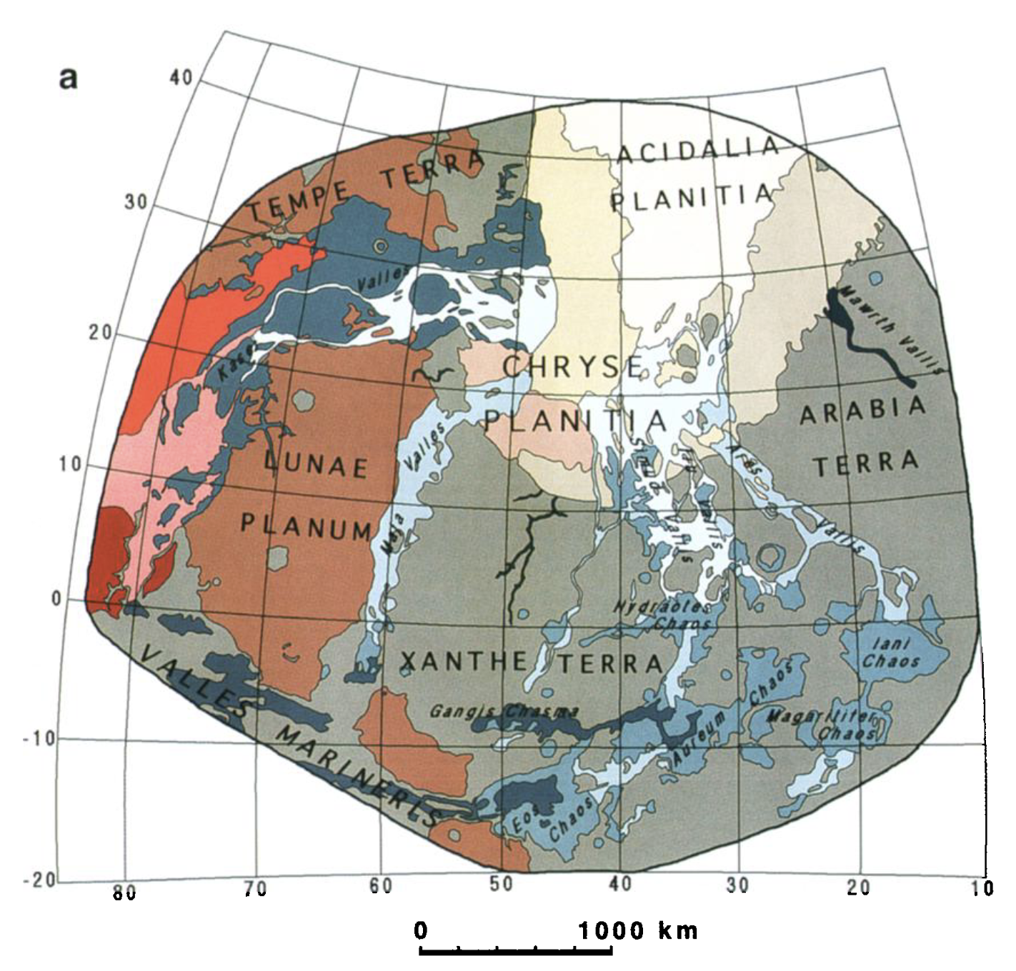
Many outflow channels begin at chaos terrain
Ivanov and Head 2001

Slide 21
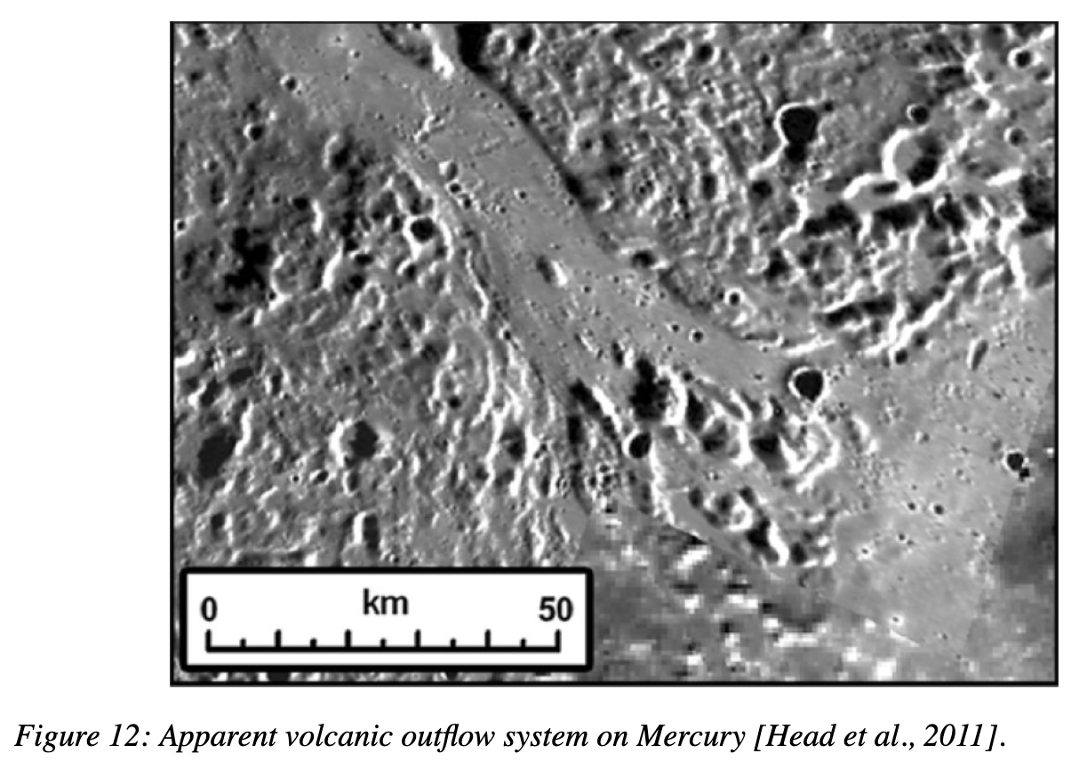
Could the outflow channels have been carved by floods of lava rather than water/ice?
Leverington published a series of papers with this hypothesis
See large channels on the Moon, Venus, and Mercury where water is extremely limited

Slide 22
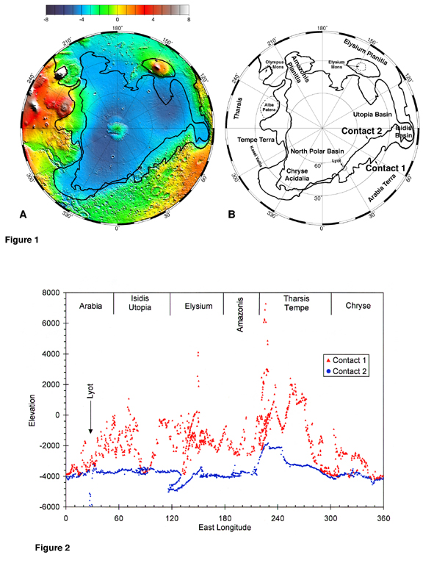
Ocean
Original ‘shorelines’ mapped by Tim Parker from Viking data in late 1980’s
One of the contacts he identified is close to an equipotental surface as shown by MGS MOLA
Water from outflow channels drained into the low-lying northern hemisphere
Still a lot of disagreement on whether to believe there was an ocean
  No obvious shoreline features in high resolution imagery
    But the ocean may not have had stable shores for long
  No (convincing) mineralogic evidence
  Vastitas Borialis Fm is full of boulders, not fine-grained sediments
  …but…
  Ocean may have been ice-covered
  Subsequent volcanic constructs have altered the shoreline elevation
  Tectonics and true polar wander may have deformed shorelines
  Debris flows can transport boulders
Head et al., 1999

Slide 23
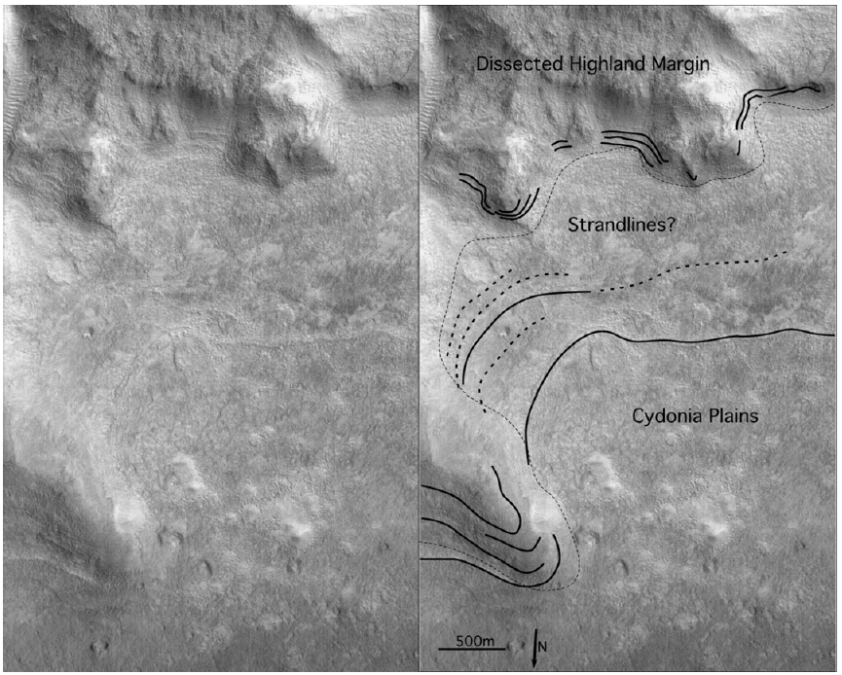
“Shoreline” erosional features are subtle
  And old—HiRISE does not reveal much new information
Recent search for depositional features turned up nothing (Ghatan and Zimbelman, 2006)
  Effects of ice cover? Are strandlines from lava flows?
Clifford and Parker, 2001

Slide 24
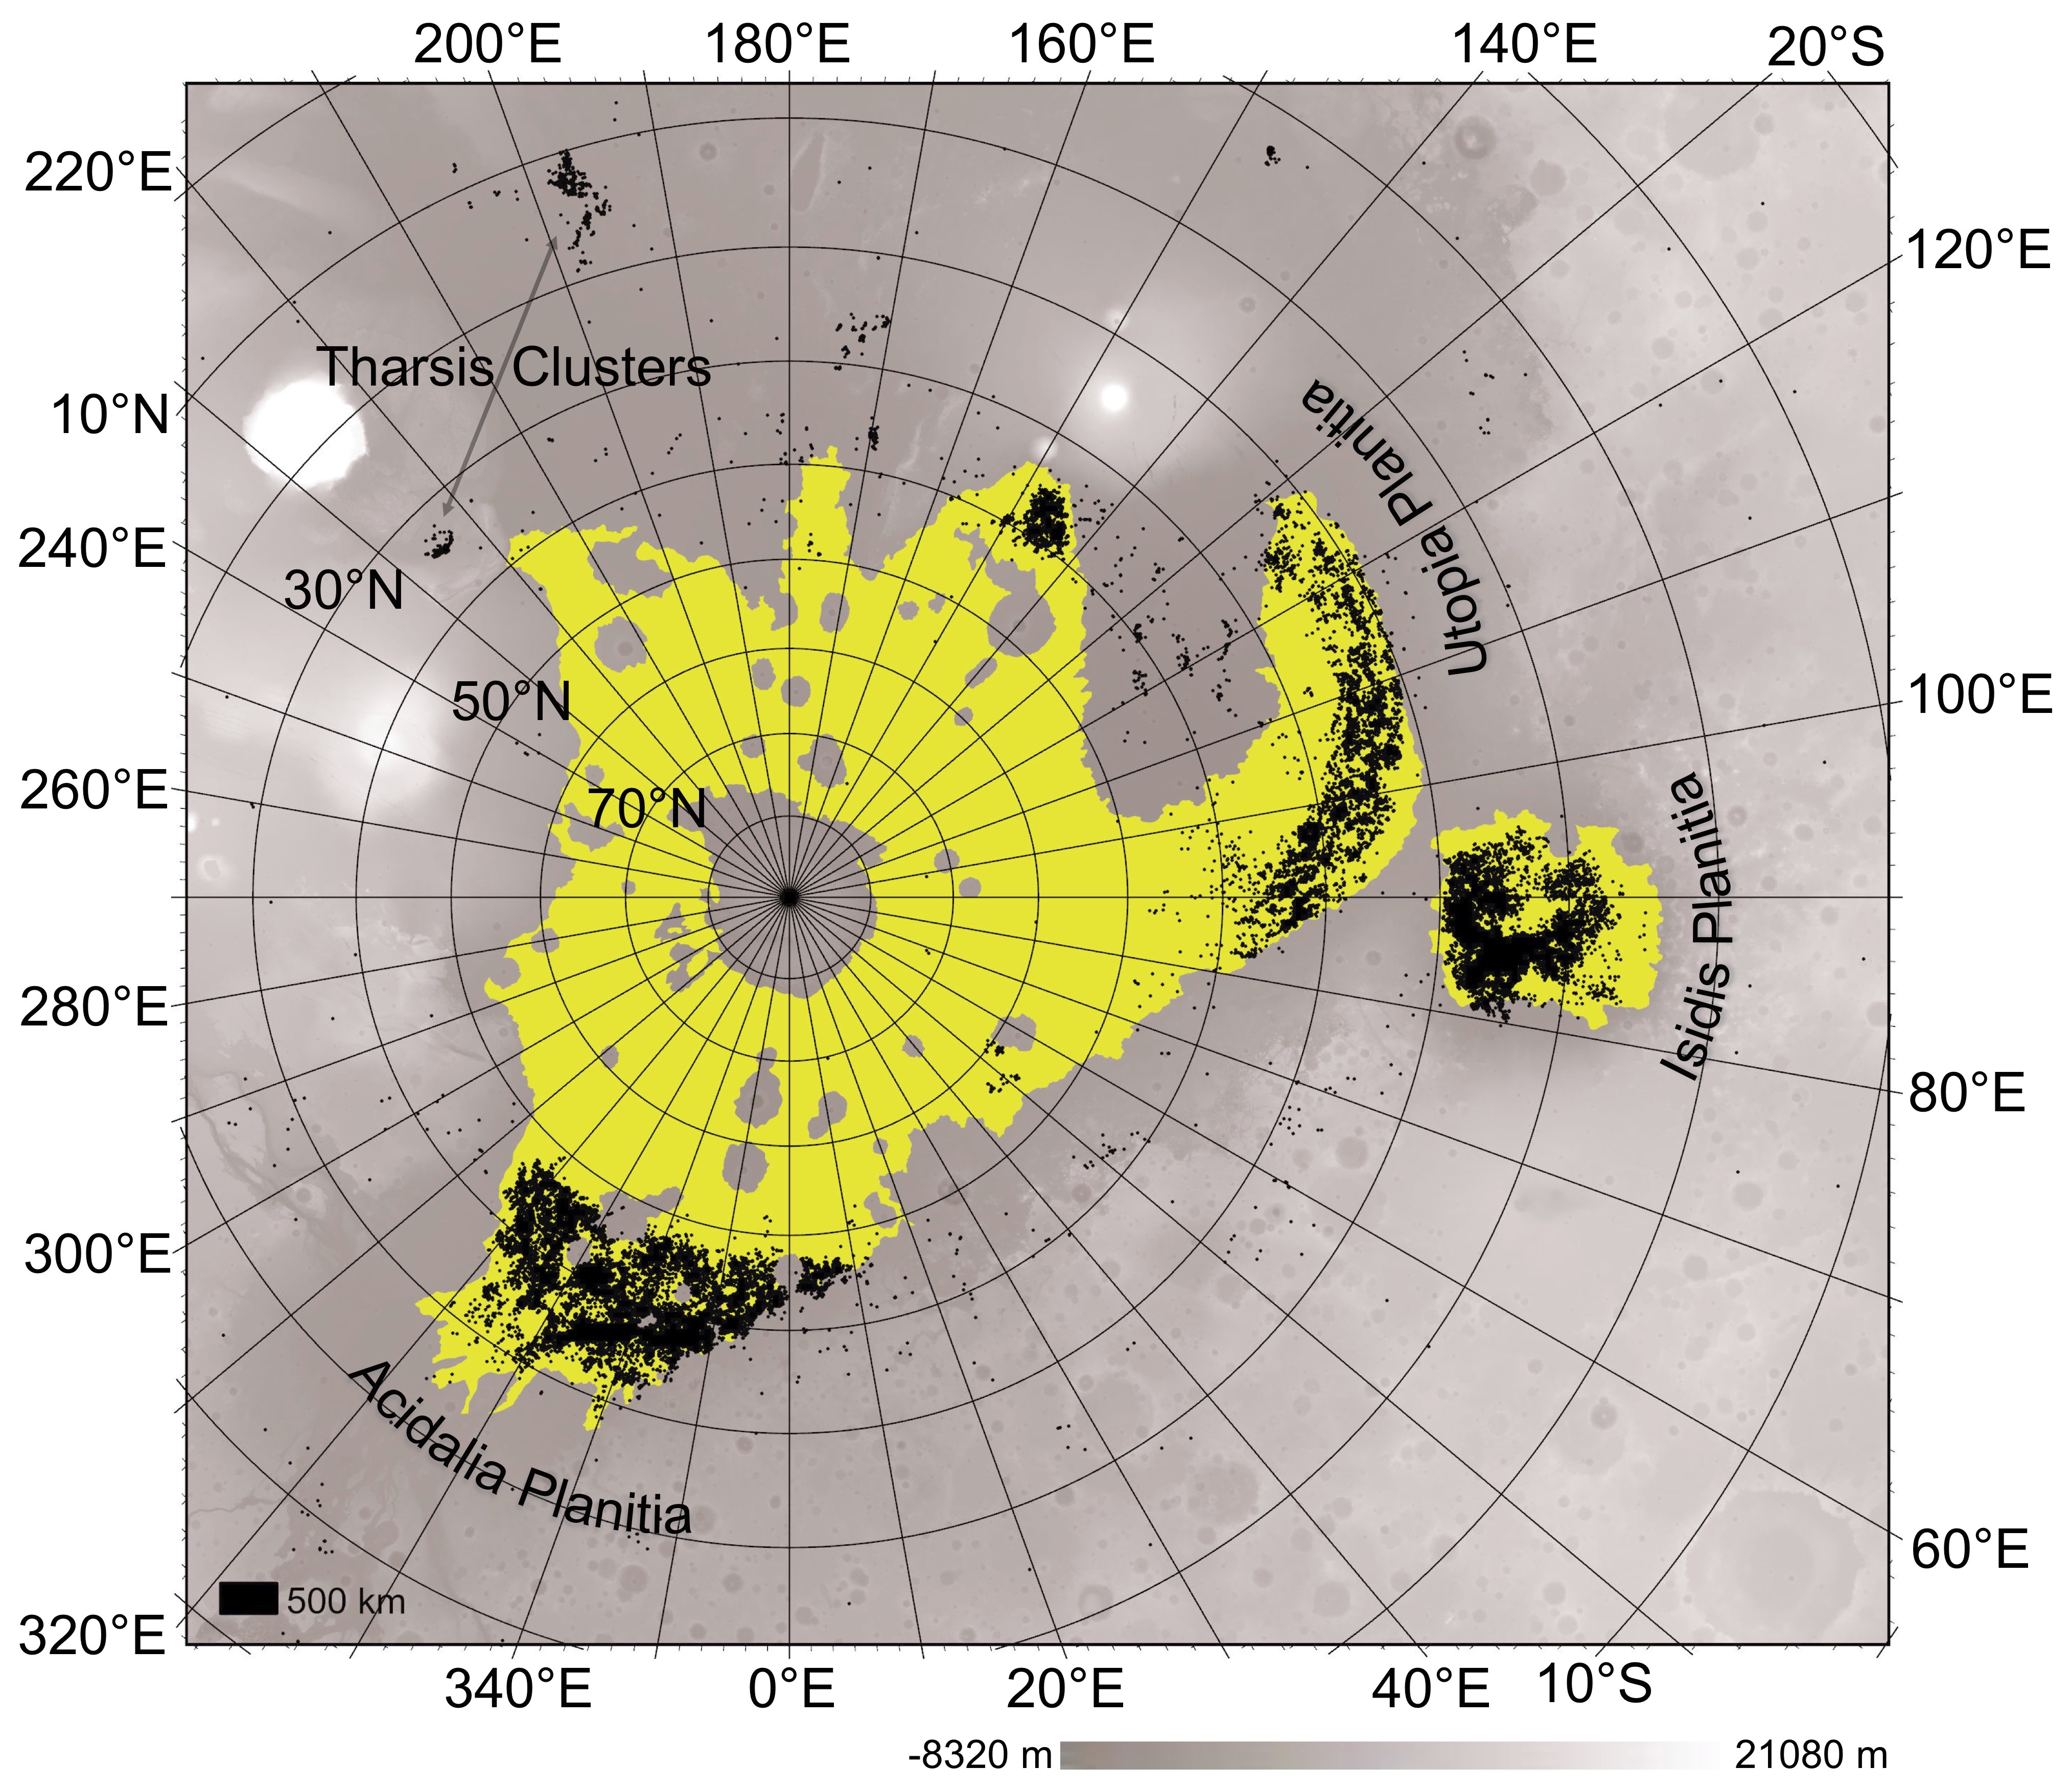
A global population of pitted cones supports sedimentary formation and link to outflow floods or ocean on Mars.
Using machine learning methods, we mapped the first global population of pitted cones on Mars.
Images from the Context Camera (CTX) were primarily used, those chosen for the global mosaic (Dickson et al. 2023).
Cones appear clustered in the northern plains’ basins and occur mainly on geologic deposits proposed to be from outflow floods or a past ocean.
Mud volcanoes on Earth occur in areas of rapid sedimentation.
This presents an important link between past surface water on Mars and most pitted cones.
Citation: M.M. Mills et al. (2024). A global dataset of pitted cones on Mars. Icarus, 116145.

Slide 25
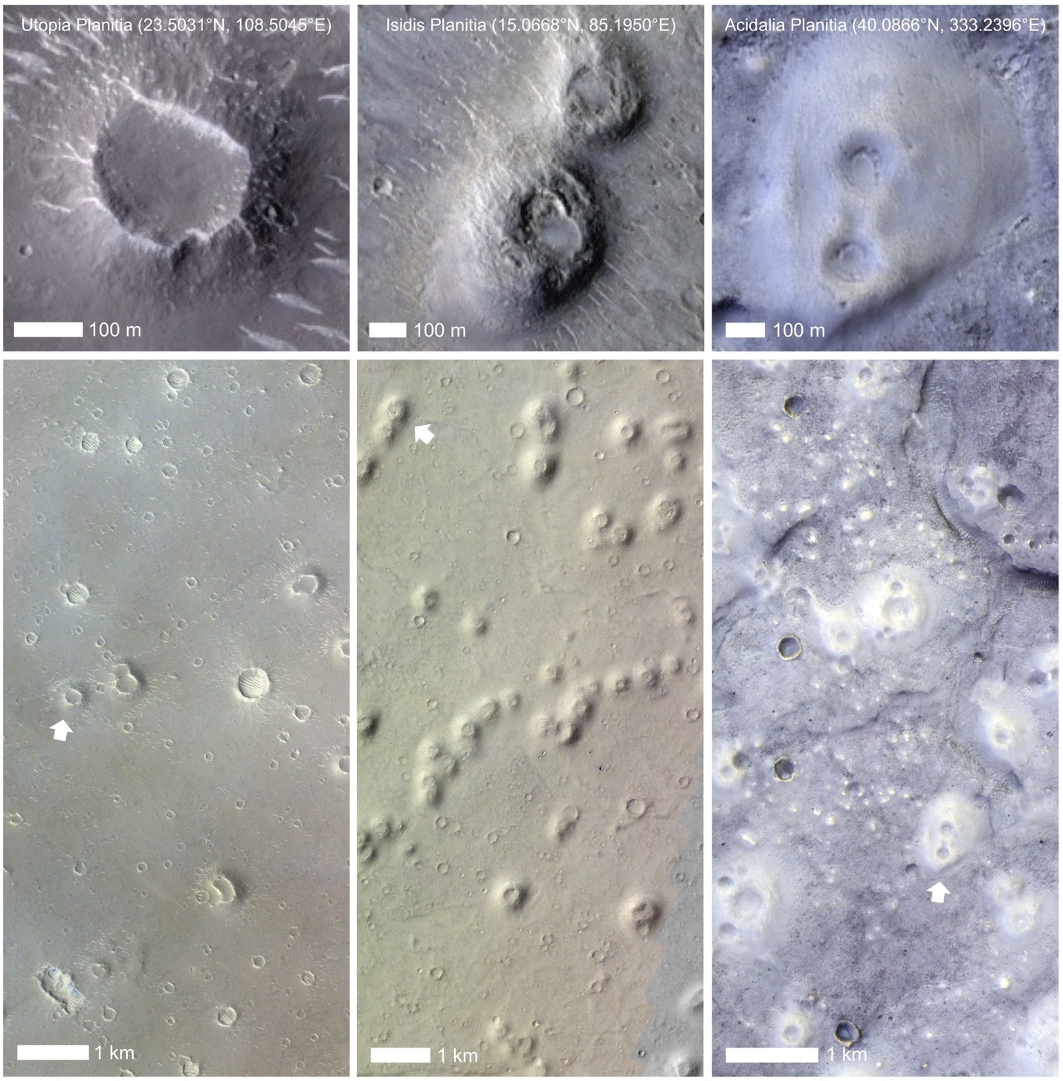
Examples of pitted cones mapped:
Top image from HiRISE and bottom image from CaSSIS.
Pitted cones are circular to quasi-circular cone-like features with smooth sloping sides, usually ~100–1000 meters in diameter (Oehler and Allen 2010). Pitted cones generally have a prominent central crater which can be nearly as large as the cone itself or multiple smaller central neighboring pits.
Tight chains of pitted cones were not mapped.

Slide 26
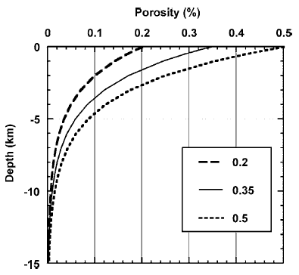
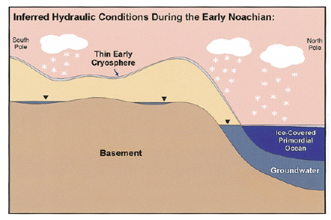
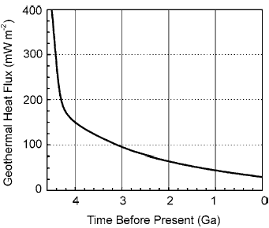
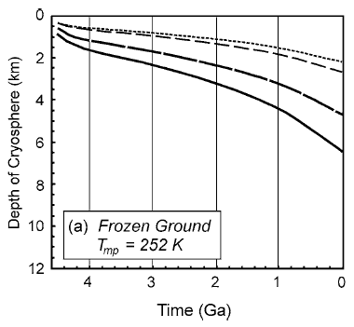

Cryosphere
Mega-regolith assumed, so crust is porous to great depth
  But former megaregolith on Mars may be cemented, forming megabreccia
Clifford and Parker, 2001
Mars starts freezing water in pore space
  Declining heat flux
  Environmental change
Early ocean freezes over

Slide 27
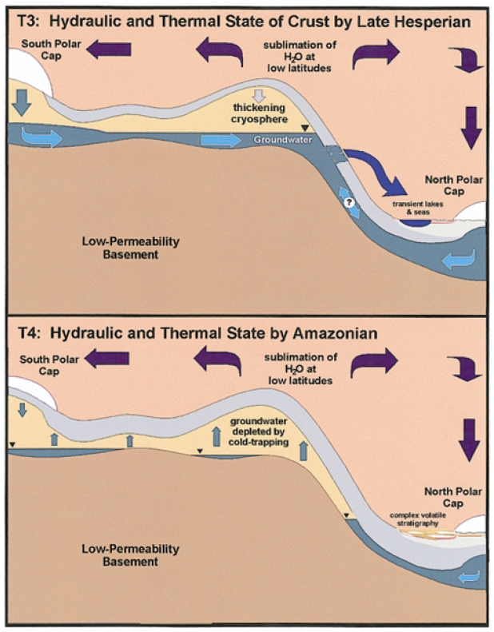
Subterranean water table is higher than ocean surface
Outflow occurs if cryosphere fails
Cryosphere continues to thicken over time
  Failure become less and less likely
  Possibly no liquid water left beneath the cryosphere today
Important shift for Mars water cycle
  Test of model: pools of water under polar caps (or elsewhere)
  Seen by MARSIS? (controversial)
Clifford and Parker, 2001
Pervasive outburst events, fluvial activity transitions to isolated events

Slide 28
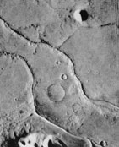
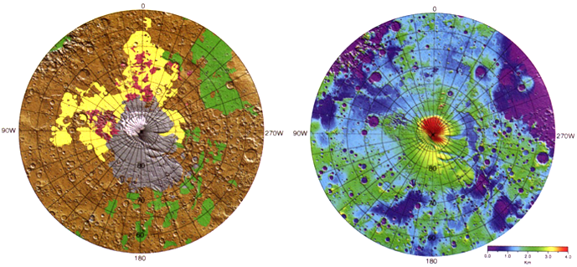
Polar activity
Evidence of first icy polar deposits in Hesperian
Dorsa Argenta formation
  Deflated ice-sheet
  Eskers – too big?
  Crater overflow channels
Early glacial concepts of Kargel and Strom (1992) now widely accepted
This Viking orbiter image (567B33) shows a scene about 50 km across. The ridges (eskers) are sharp-crested and about 1,000 m in width. (Baker, 2001
Nature 412, 228-236)
Head and Pratt, 2001

Slide 29
Summary: Hesperian Mars
A time of transition away from pervasive fluvial activity to mostly cold/dry conditions
Change in apparent alteration chemistry
  Phyllosilicates→Sulfates→Anhydrous ferrous chemistry
Erosion rates drastically reduced
  Reduction in atmospheric greenhouse → less available water
  Or, reduction in impact rate driving pulses in rainfall
Liquid water freezing
  First evidence of polar ice caps
  Thickening cryosphere
Water appears in flood outbursts rather than valley networks
Massive volcanic resurfacing and tectonic activity
Plains volcanism resurfaces large areas
  Atmospheric infusion of SO₂ may change chemical alteration of the surface
Paterae volcanoes
Pervasive wrinkle ridge formation
Circum-Tharsis extension
  Opening of Valles Marineris
Late Hesperian/Early Amazonian – building of the big Tharsis shield volcanoes?
  We can only see that the surface lavas are Amazonian

