Slide 1
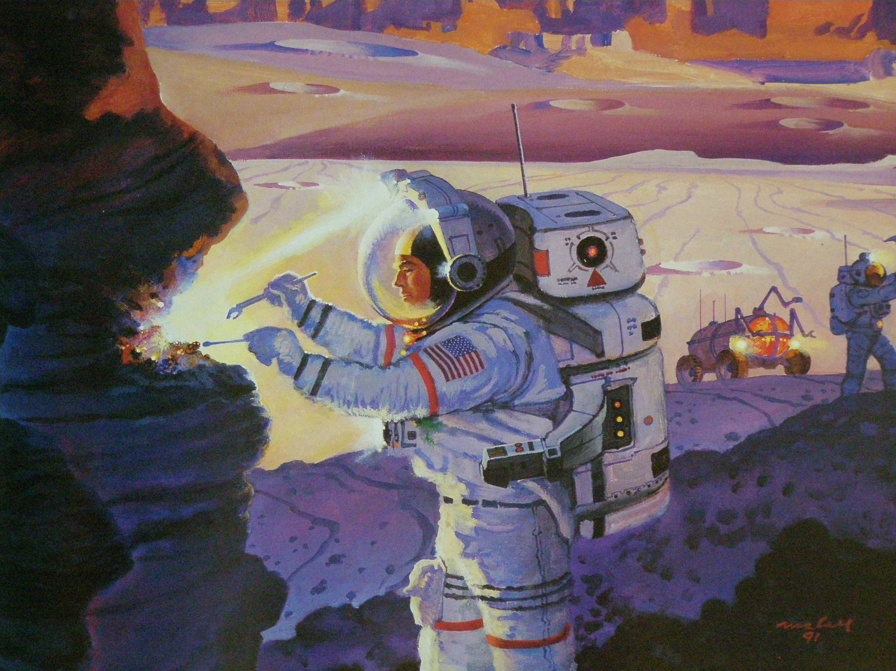
Exploring Mars

Slide 2
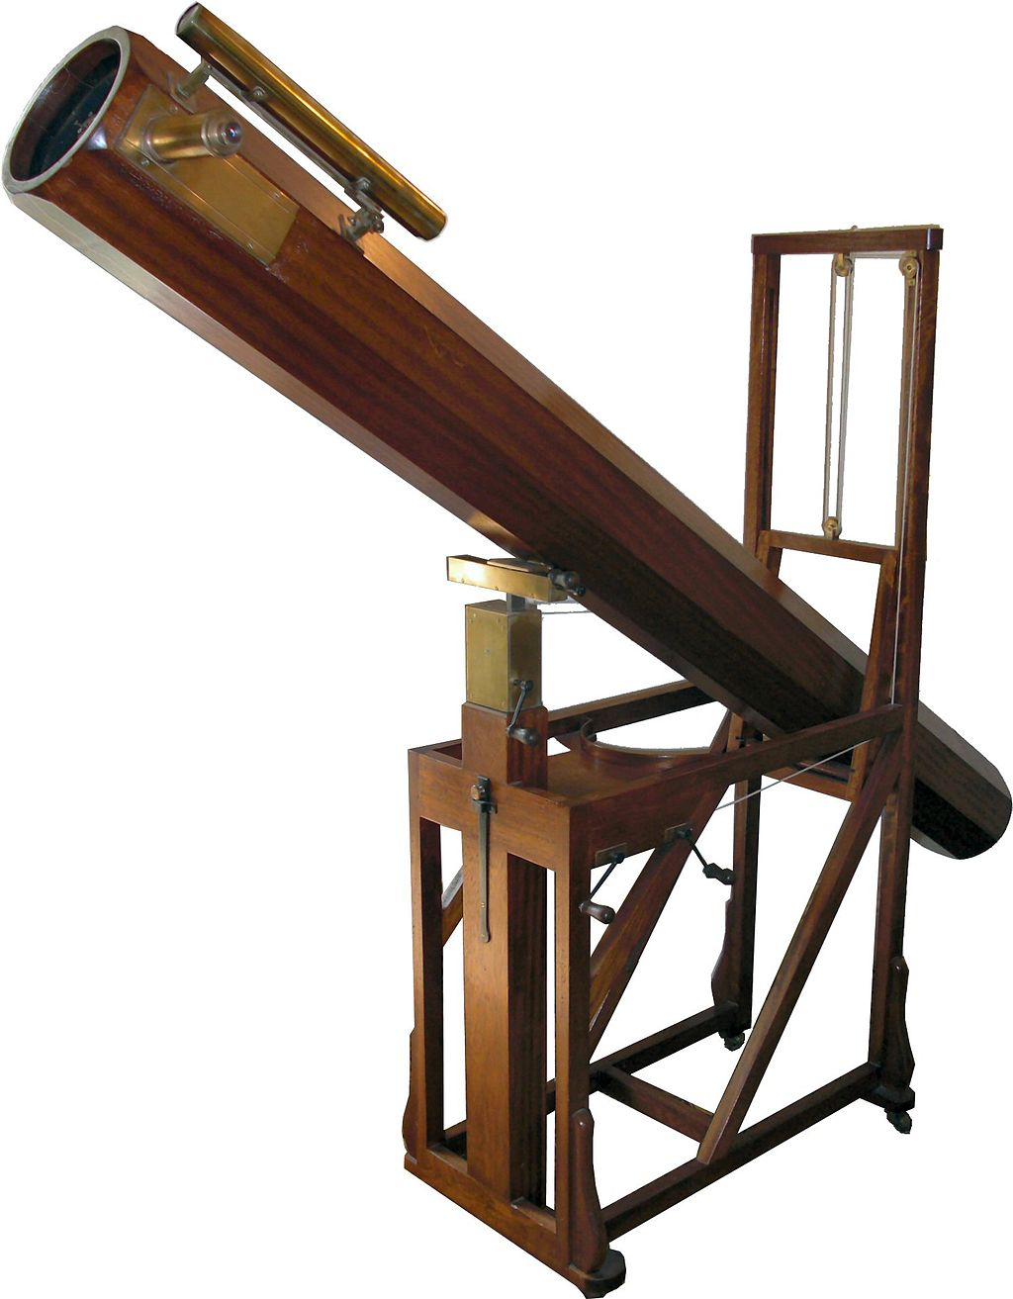
Telescopic Exploration: What was known by 1830 according to Flammarion (see Kieffer et al., 1992, Mars)
Revolution of Mars 687 days (modern value: 686.96)
Distance from Sun 1.5237 AU (1.52368)
Diameter 0.5237 that of Earth, volume ratio 0.147 (0.15)
Mass ratio Mars/Sun 1/2546320 1892 update: 1/3093500 (1/3098710)
Density 0.711 times Earth’s (0.715)
Gravity accel. (g) 0.376 that of Earth (0.3795 at equator)
Rotation 24 hours, 39 minutes (24 hours, 37 minutes, 22.7 sec)
Polar caps of ice or snow, not on exact geographic poles, vary with seasons
Inclination similar to Earth’s
Eccentricity of orbit 1.3836 to 1.6658 AU (1.3815 to 1.6666)
Mars has an atmosphere, white and dark clouds
Replica in the William Herschel Museum, Bath, of a telescope similar to that with which Herschel discovered Uranus

Slide 3
Pre-space age controversies
Canals—Schiaparelli, Lowell, etc.
Polar caps—assumed water ice—as late as 1952 Gerard Kuiper was convinced.
  1947: de Vaucouleurs proposed sublimation, not melting
  1966: Leighton and Murray atmospheric model with CO₂ seasonal caps
Brightness (albedo) and color variations
  Atmospheric, vegetation, ash from volcanoes
  Svante Arrhenius 1912: hygroscopic salts
Impact Craters
  Several observers reported seeing them
  Opik in 1950 calculated collision probabilities, concluded hundreds or thousands of craters larger than Meteor crater (1.2 km)
    >300,000 larger than 1 km (Robbins and Hynek 2012)
  Largely ignored—Mariner 4 was a big surprise to most
Water vapor
  Why is this challenging from Earth?

Slide 4
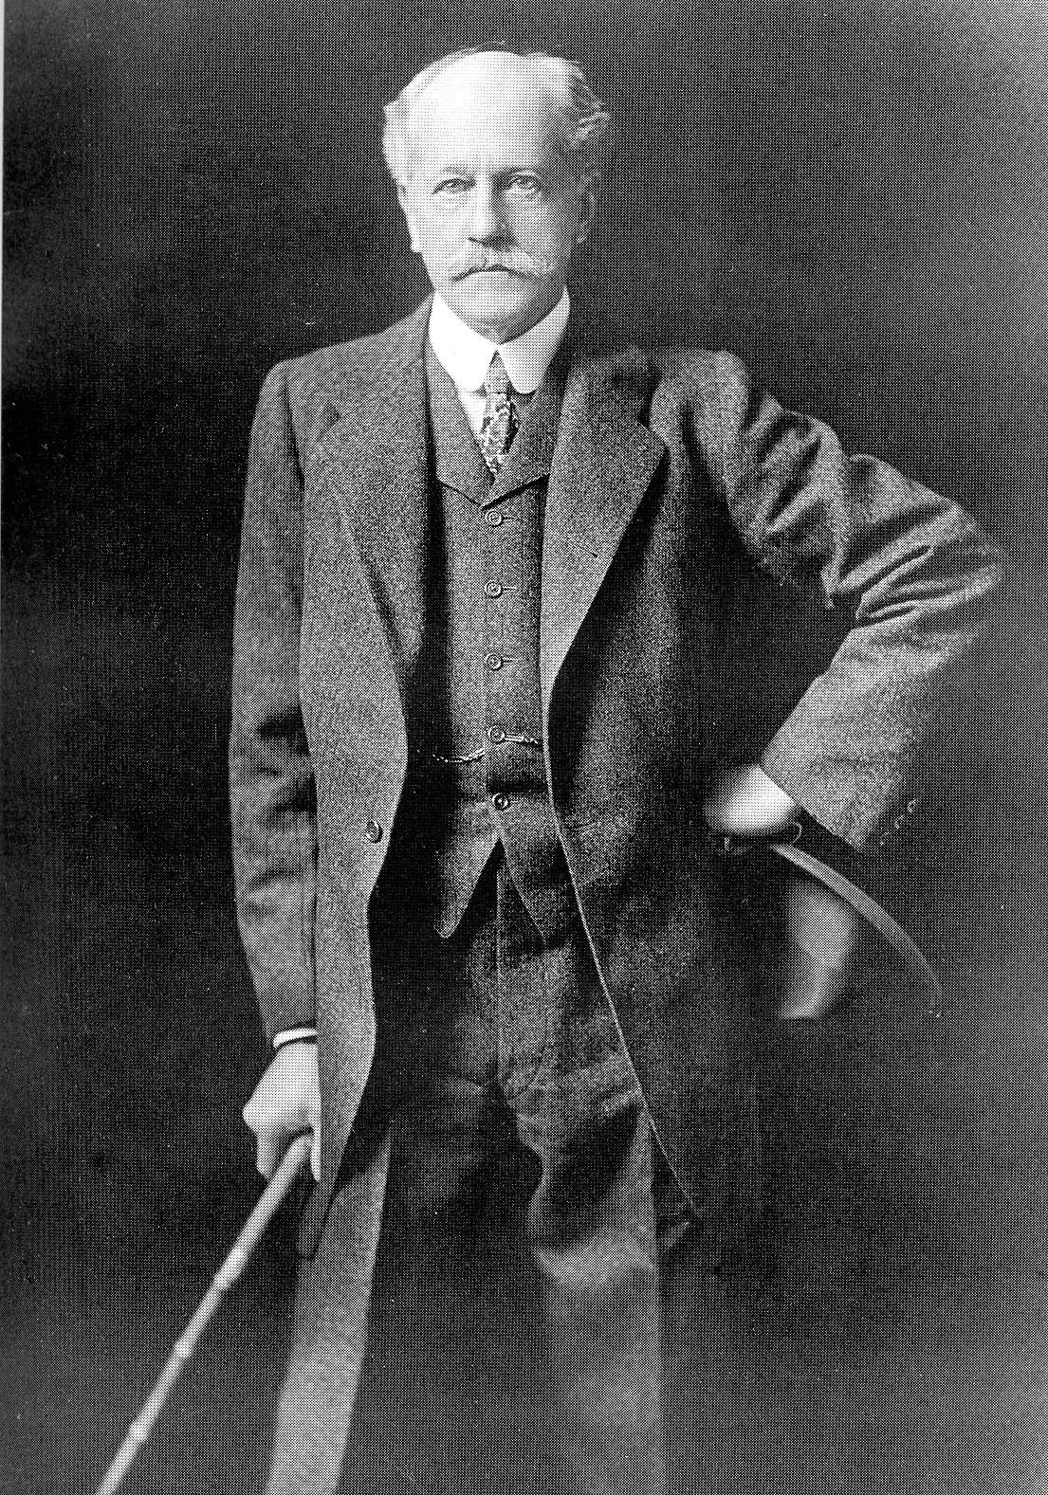
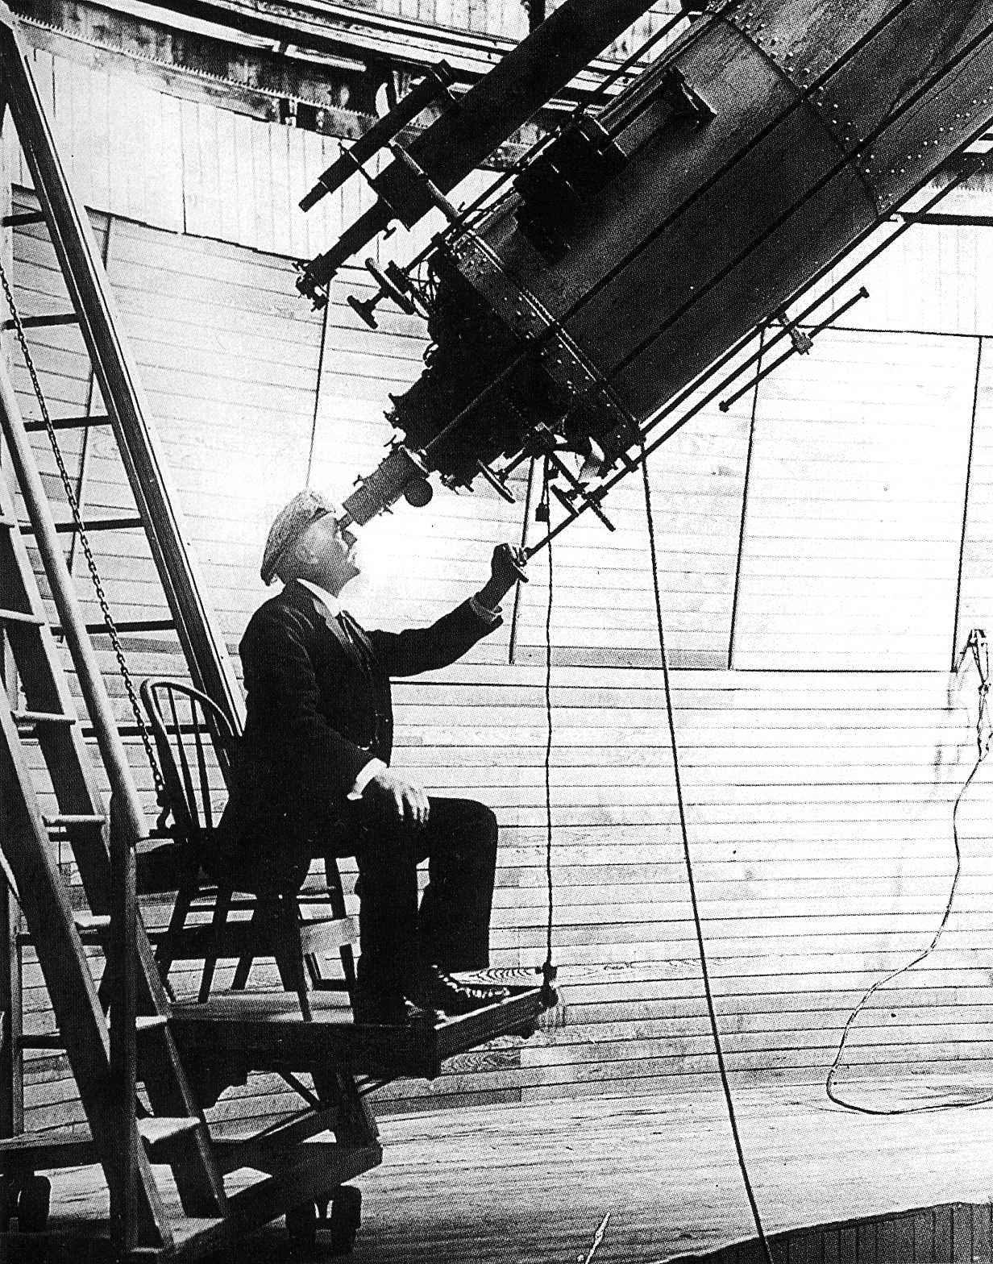

Slide 5
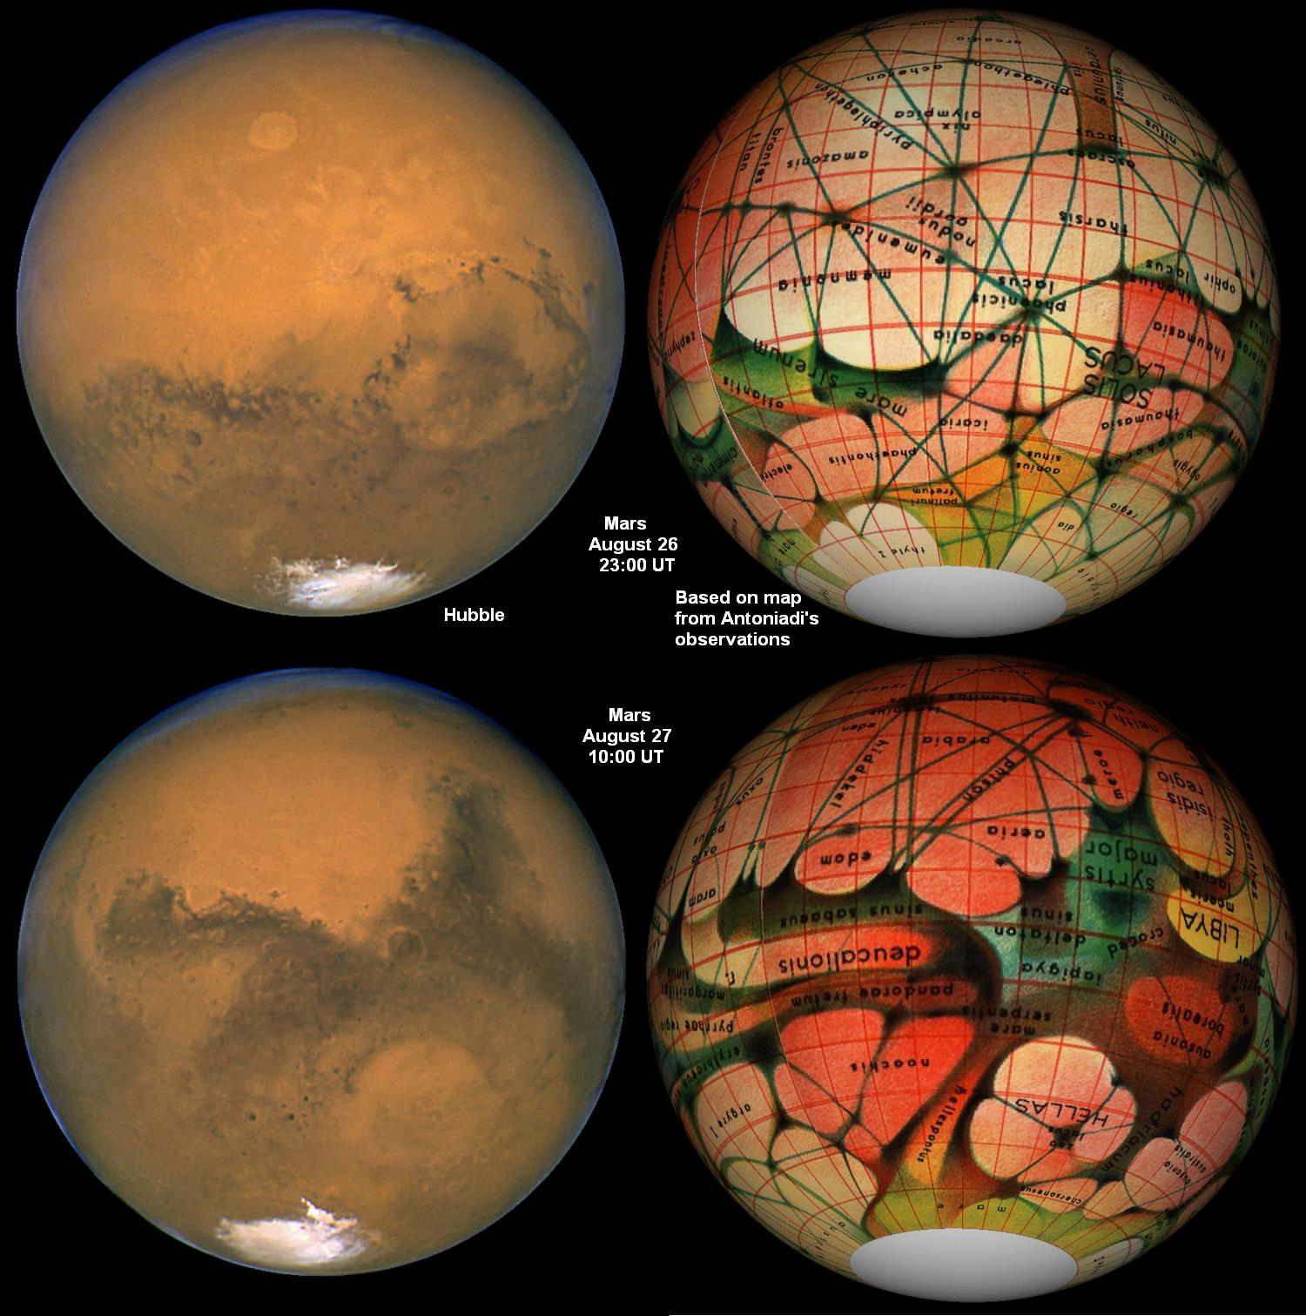

Slide 6


More Historical Background
At the turn of the 20th century:
  publication offered a reward for anyone coming forth with proof of life on another planet or anywhere in space EXCEPTING Mars
  Many Christians believed that God would not create other worlds only to leave them empty.
  1938 radio drama narrated by Orson Welles “The War of the Worlds” incited a panic by convincing some members of the listening audience that a Martian invasion was actually happening.

Slide 7
Water Vapor, Atmosphere
1867: Jules Jassen (who founded Meudon Obs) took his instruments to to of Mt Etna, compared Mars to Moon spectra, concluded “considerable water vapor”
  Results no longer believed due to crude instruments
  Spinrad et al. (1963): 14 ± 7 precipitable microns H₂O
Atmospheric composition and pressure
  Kuiper discovered CO₂ bands in 1947
  For 2 decades it was assumed to be a trace gas, with N and Ar dominant
  Mariner 4 showed CO₂ dominant; ~6 mbar

Slide 8
The Sixties: Flying by Mars
Mariner 4
  Launched 11/28/64, flew by on 7/14/65
  Returned a band of images covering 1% of the Martian surface
  Surface pressure 3-7 mbar (Earth @ sea level is 1000 mbar)
Mariners 6/7
  Launched 3/69, flew by 8/4/69
  Imaged 10% of the planet surface (4-43 km/pixel)
Lots of failed missions from Soviet Union
  http://en.wikipedia.org/wiki/List_of_missions_to_Mars

Slide 10
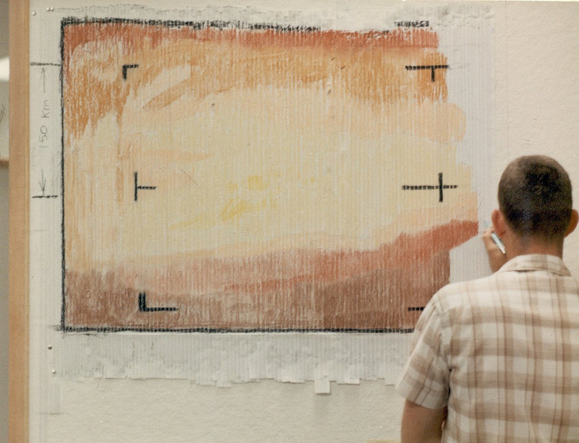
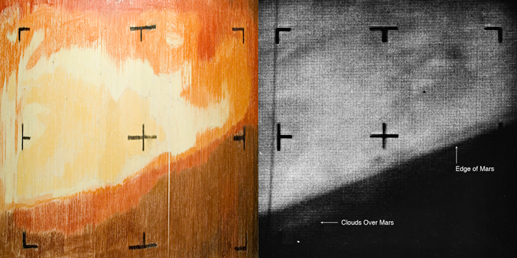
First Mariner 4 Image of Mars
(1965) A "real-time data translator" machine converted Mariner 4 digital image data into numbers printed on strips of paper. Too anxious to wait for the official processed image, JPL employees attached these strips side by side to a display panel and hand colored the numbers like a paint-by-numbers picture.
http://www.flickr.com/photos/nasacommons/7651152780/

Slide 11
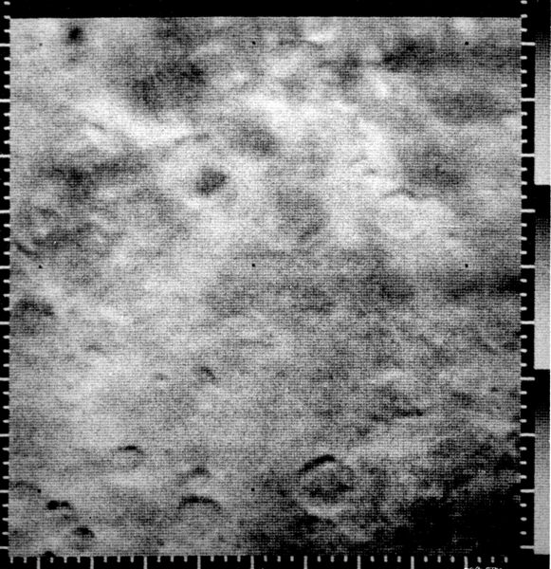
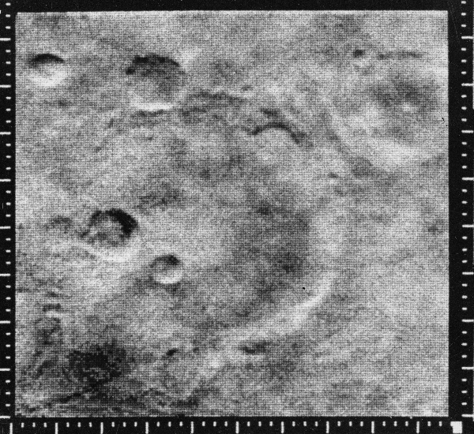
Mariner 4 Images
What can you conclude about Mars from these images?

Slide 12
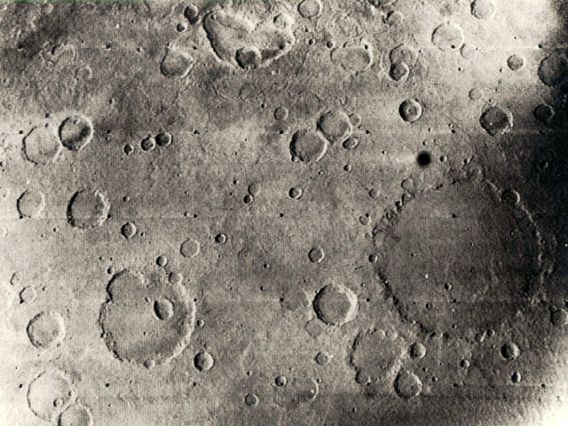
Mariner 6 or 7 image
What is this?
15°S, large crater 265 km in diameter

Slide 13
The 70’s: Orbiters and Landers
Mariner 9
  Launched 5/30/71, arrived 11/13/71
  First images showed that Mars was completely enveloped in a dust storm
  After a couple of months of waiting, the dust settled and >7000 images were returned covering 80% of the planet
  Revelation of Mars’ geologic diversity
  Mission ended 10/27/72
USSR Mars 2 and 3 orbiters had pre-planned image sequences that ended before the dust cleared

Slide 14
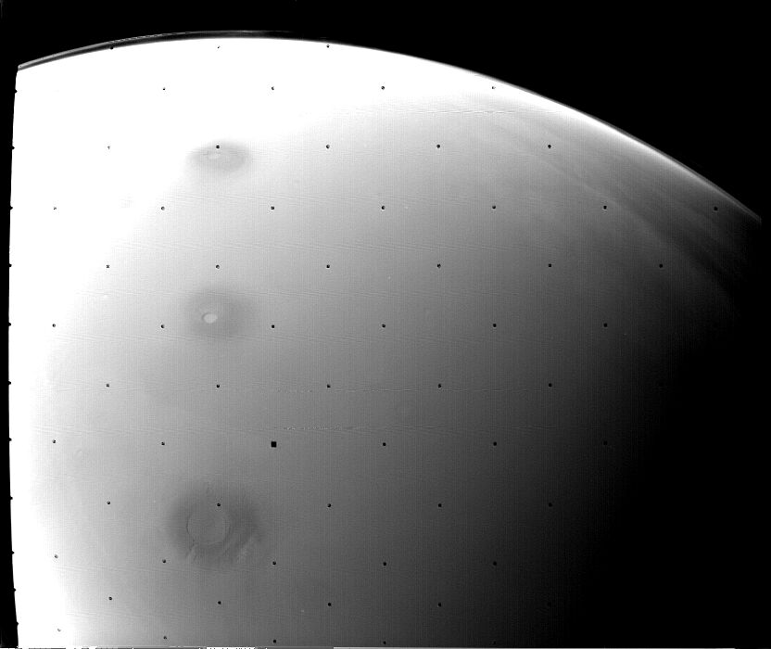
Discovery of Tharsis Volcanoes
Even though dust covered, there were several ‘crater-like’ features visible rising above the dust...
Picture from Mariner 9
during the dust storm
(ignore black dots)

Slide 15
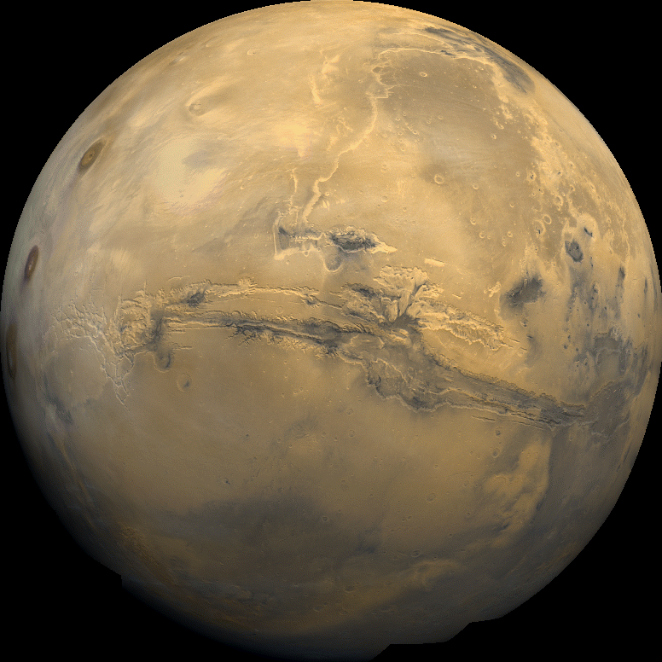
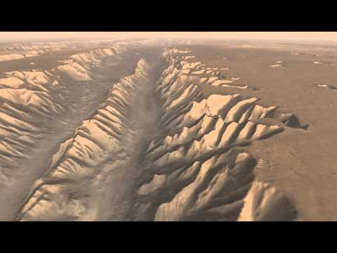
Valles Marineris - “Grand Canyon of Mars”
stretches for at least 2500 miles (NYC ←→ LA)
https://www.youtube.com/watch?v=_11KG7f4fvQ

Slide 16
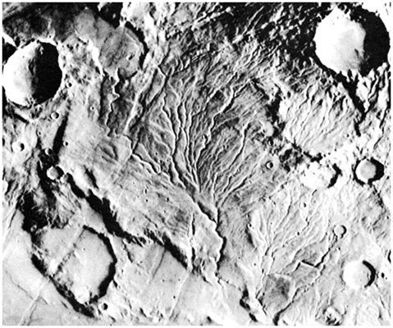
Viking Orbiters
Viking 1
  6/19/76 to 8/7/80
Viking 2
  8/7/76 to 7/25/78
Valley networks on ancient Mars imply climate change

Slide 17
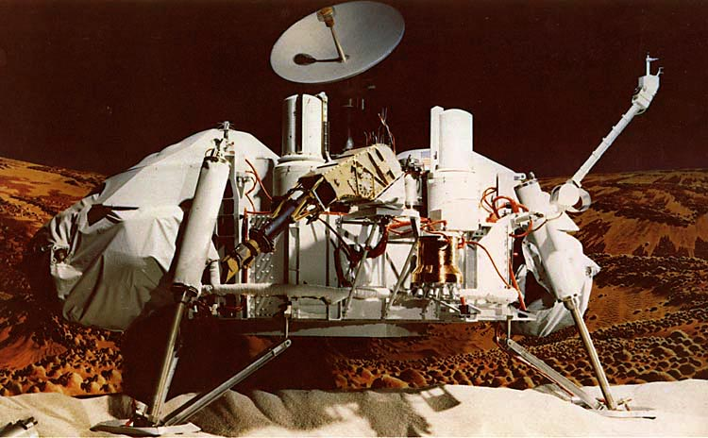
Viking Landers
Viking 1
  7/20/76 to 11/13/82
  Landed in Chyse Planitia in northern lowlands
  Latitude ~20°N
Viking 2
  9/3/76 to 8/7/80
  Latitude ~45°N, opposite side of planet

Slide 18
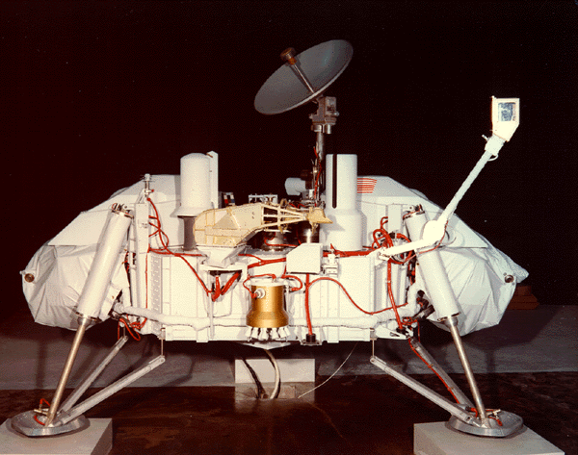
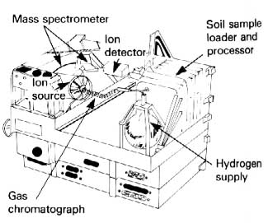
Frustrating Viking Lander Results
Viking carried 4 instruments designed to detect any sign of biology:
The Labeled Release (LR), Gas Exchange (GEX), and Pyrolytic Release (PR) experiments, all designed to detect extant life on Mars.
The Gas Chromatograph/Mass Spectrometer (GC/MS) was capable of detecting organics at a level of a few parts per billion (ppb)
The GC/MS detected no organics above the 10 ppb level !

Slide 19
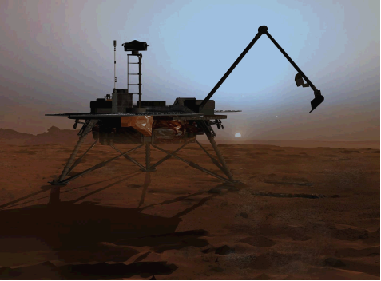
The 2008 Phoenix Mission
Discovered perchlorates, which react with and destroy organics when heated as in Viking GC/MS, so really no constraint on organics.

Slide 20
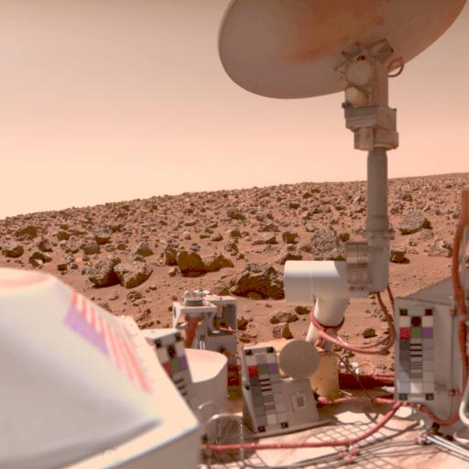
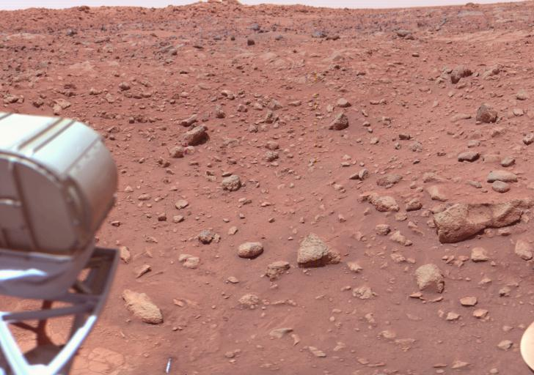
Viking Lander Images of Mars’ Surface
landing site chosen from Orbiter images – two different regions in Northern Lowlands
revealed that the surface of Mars was littered with jagged rocks and fine dust everywhere
rocks were probably result of crater-forming impact (“ejecta”)
rocks resemble lava-rocks on Earth – lava flows broken up by impacts
HiRISE result: ice-exposing impacts near VL-2—they needed to dig only 10-20 cm to have found it!

Slide 21
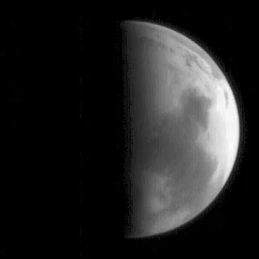
The Eighties
No missions to Mars
There is almost a 20 year gap between Viking and the missions starting with Pathfinder in 1997
Mars Observer failed in 1993
  All Mars Observer experiments finally replaced with MRO launched in 2005
Mars Orbital Camera image on approach of Mars Observer, before it failed

Slide 22
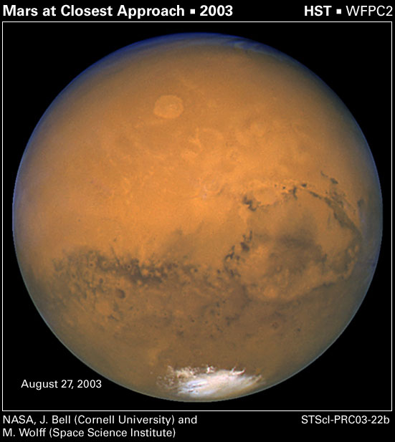
The Nineties Leading into the 21st Century
Hubble Space Telescope global views
Some meteorites are determined to be Martian and claims of evidence of Life were made in 1996
  This was impetus for a systematic Mars Exploration Program, continuing today
Pathfinder and MGS begin a parade of spacecraft to Mars, slowed by the crash of Mars Polar Lander and Mars Climate Orbiter in 1999

Slide 23
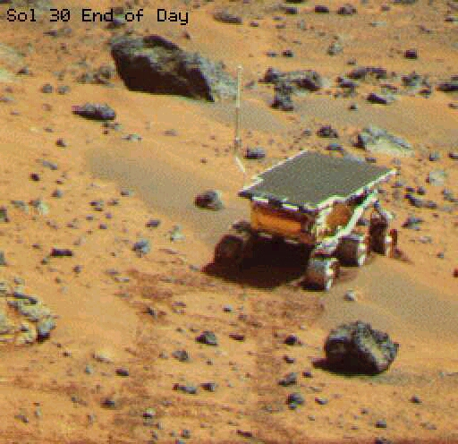
Mars Pathfinder Mission – landed on Mars 4 July 1997
Precursor mission for
“Faster Better Cheaper”
NASA mantra
used lightweight airbags
to land
small, efficient robotic
vehicle
10x as many images as
previous missions
landed 500 miles from
Vikings – flood plain area
(more volcanic rocks)

Slide 24
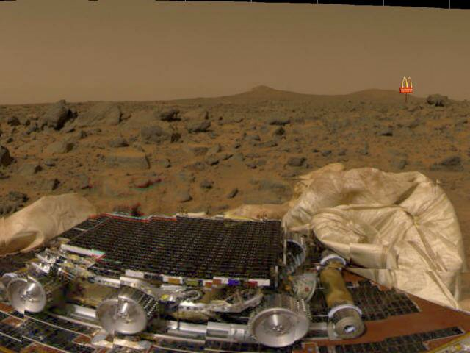

Slide 25
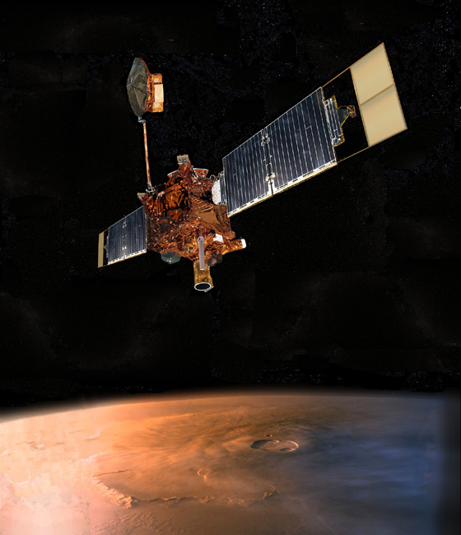
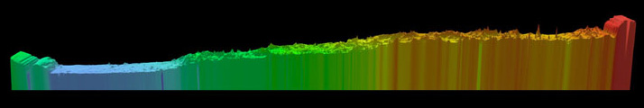
Mars Global Surveyor
- NASA launched in December 1996
- 5 instruments including
MOC – Mars Orbital Camera
MOLA – Mars Orbiter Laser Altimeter
TES – Thermal Emission Spectrometer
MAG/ER – Magnetometer and Electron Reflectometer
USO/RS -- Ultrastable Oscillator for Doppler measurements
Solar array issue led to phasing orbit before finishing aerobraking to a circular orbit
Laser Altimeter (MOLA)
bounce laser beams off surface
time delay between signals gives height measure
plot of Mars’ height as a function of position on the planet – North to South

Slide 26
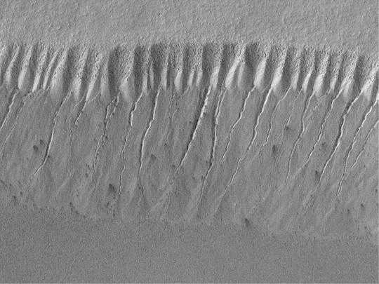
Evidence for Recent Water Flow?
MGS: MOC camera

Slide 27
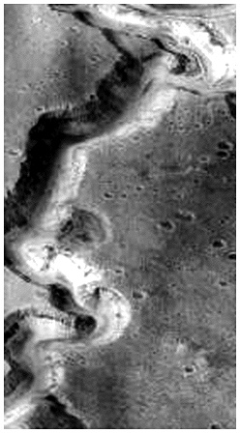
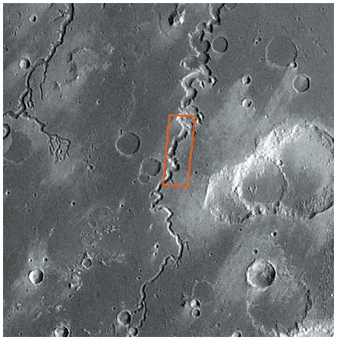
Meandering River Channel:
Sustained Water Flow

Slide 28
1999: A Very Bad year for NASA
Dan Goldin, NASA Administrator “Faster, Cheaper, Better”
Mars Climate Orbiter failed during orbit insertion due to confusion between English and metric units!
Mars Polar Lander and probes: never heard from them
These missions were funded at ~1/2 level of MGS and Pathfinder
Nov. 10, 1999: Metric Math Mistake Muffed Mars Meteorology Mission
  http://www.wired.com/2010/11/1110mars-climate-observer-report/

Slide 29
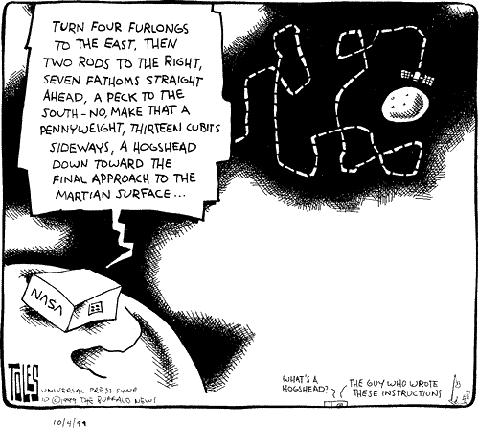

Slide 31
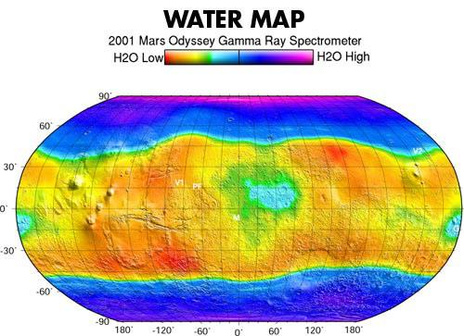
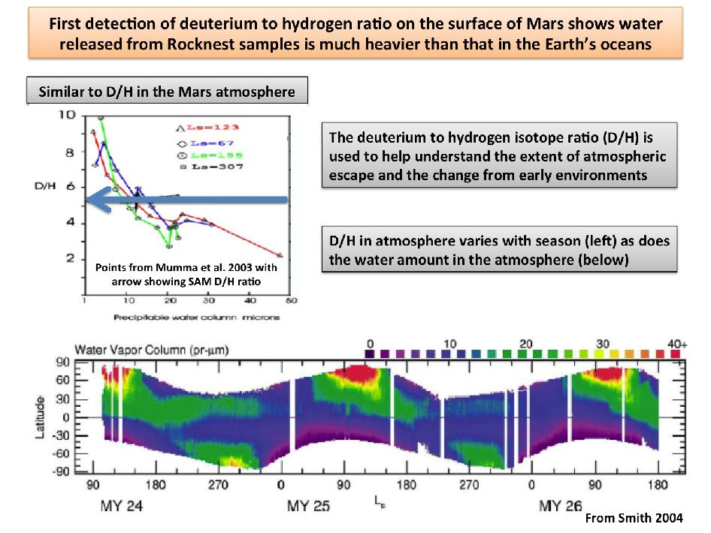
Mars Odyssey Gamma Ray Spectrometer
Phoenix mission landed here
Mars Global Surveyor- Thermal Emission Spectrometer
  Zonally Averaged Seasonal Water vapor column abundances

Slide 32
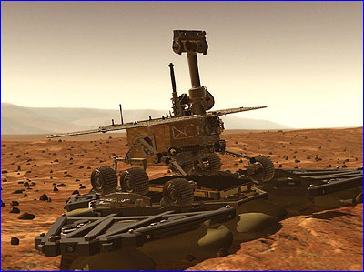
MARS EXPLORATION ROVERS
Opportunity & Spirit (or MER A and MER B)
Launched in June and July of 2003
arrival at Mars – January 2004
Each Rover weighs 180 kg, is ~5 ft high
Spirit died in 2010, but “Opportunity never dies” (until it did so in 2018)

Slide 33
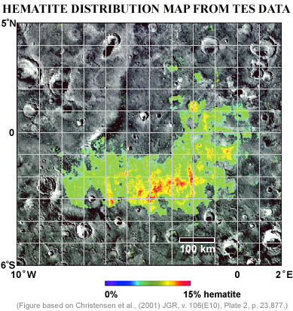
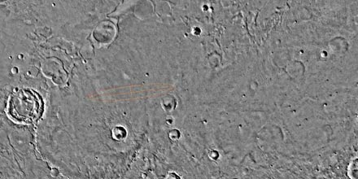
Opportunity rover landing site: Meridiani Planum
- 2 degrees South of Mars’ equator
- other side of planet from Gusev Crater (Spirit)
- place where coarse-grained hematite has been found; indicates water

Slide 34
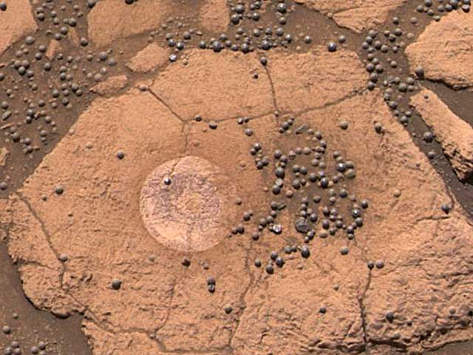
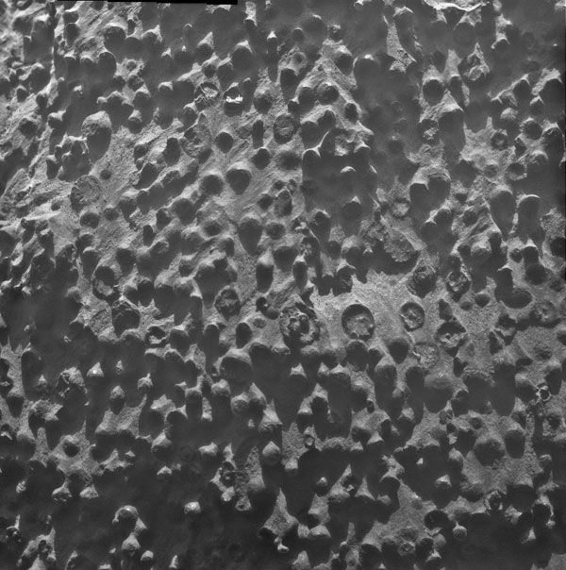
Mars Exploration Rover- Opportunity
  MGS previously detected large section in high concentration of hematite
  MER clusters of marble-sized spheres (“blueberries”). Pebble-like hematite spherules
  associated with liquid water, form in wet environment (ie. hot springs on Earth)
  Why are they concentrated on the surface?
Notes:
Certain mineral deposits can indicate past presence of liquid water.
Terra Meidiani
MGS- detected large section in high concentration of hematite.- associated with liq water, form in wet environment (gray hematite found in hot springs areas been standing water.)
Opportunity – clusters of marble-sized spheres. Pebble-like hematite spherules

Slide 35
Mars Reconnaissance Orbiter (MRO)
Mars Orbit Insertion March 10, 2006
Carries the HiRISE telescope, the CRISM NIR spectrometer, shallow radar, and other instruments
Polar orbit 3pm—3am
Returned more data than all previous missions to another planet (ignore The Moon) combined
Much more later…

Slide 36
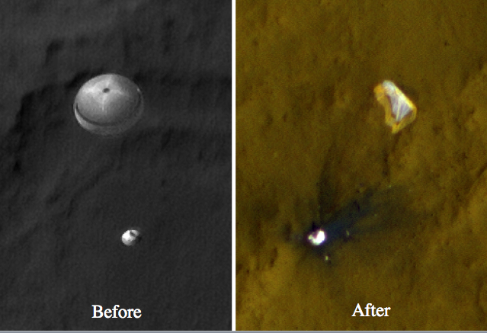
Curiosity (Mars Science Laboratory) landed 2012
HiRISE images of rover descending on parachute, and after crashing

Slide 37
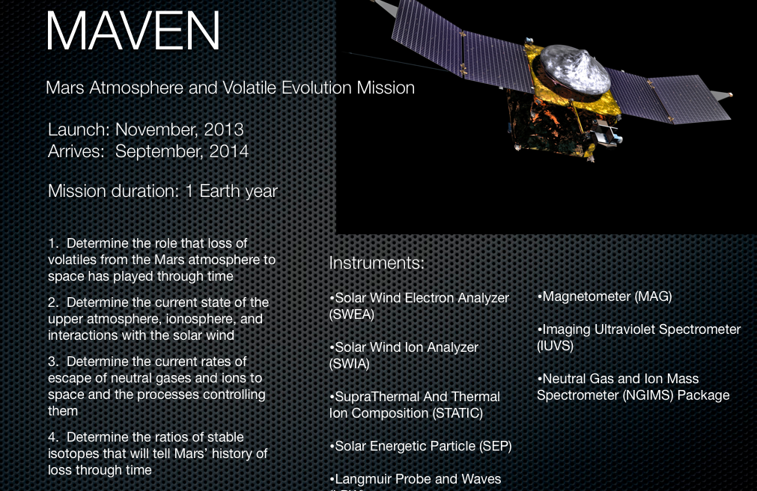
Lost contact December 2025

Slide 38
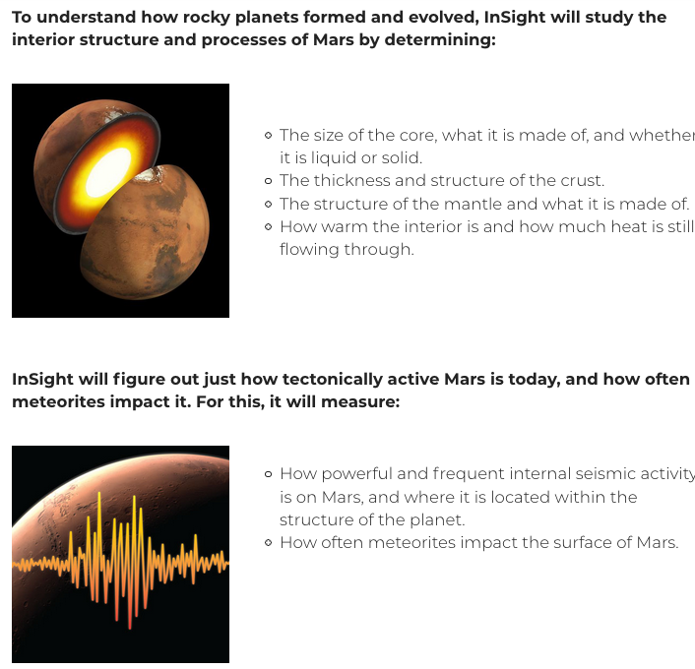
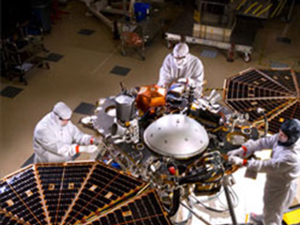
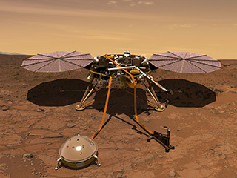
InSight landed in 2018

Slide 39
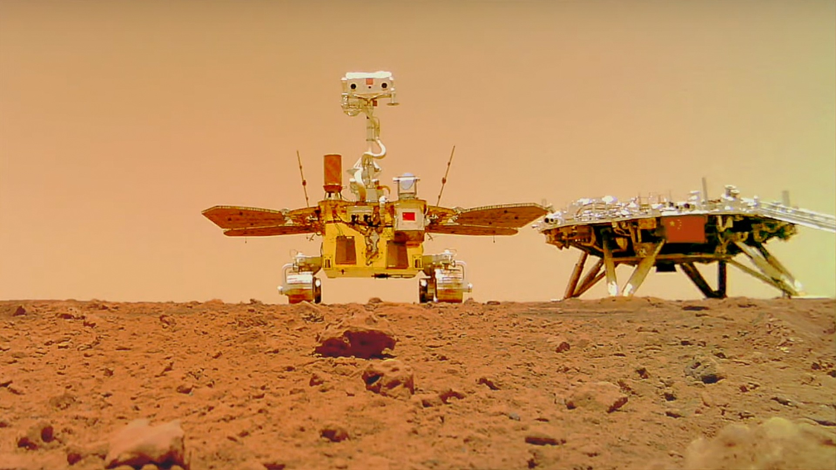
Tianwen-1
“Questions to Heaven”
Arrived 2021, orbiter and lander with a rover
  All firsts for China
  Fully successful?
    HiRIC orbital imaging TDI probably didn’t work
  Landed S. Utopia Planitia
    Mudflows and mud volcanoes
Image generated by AI? No, actual photo by detached camera

Slide 40
Mars Missions from Other Countries
Many Soviet/Russian attempts—no full successes
One Japanese mission failed
  Developing Mars Moons Exploration (MMX)
China has ambitious plans, including sample return
European Space Agency (ESA)
  Mars Express Orbiter arrived 12/2003
    Highly elliptical orbit
    Still operating
  Beagle 2 lander failed on Christmas day 2003
    HiRISE found it on the surface in 2015
  ExoMars:
    Trace Gas Orbiter launched in 2016
    Rover supposed to launch in 2018 or 2020, then 2022, now ???
India-Mars Orbital Mission (MOM)
UAE Hope mission

Slide 41


Slide 42
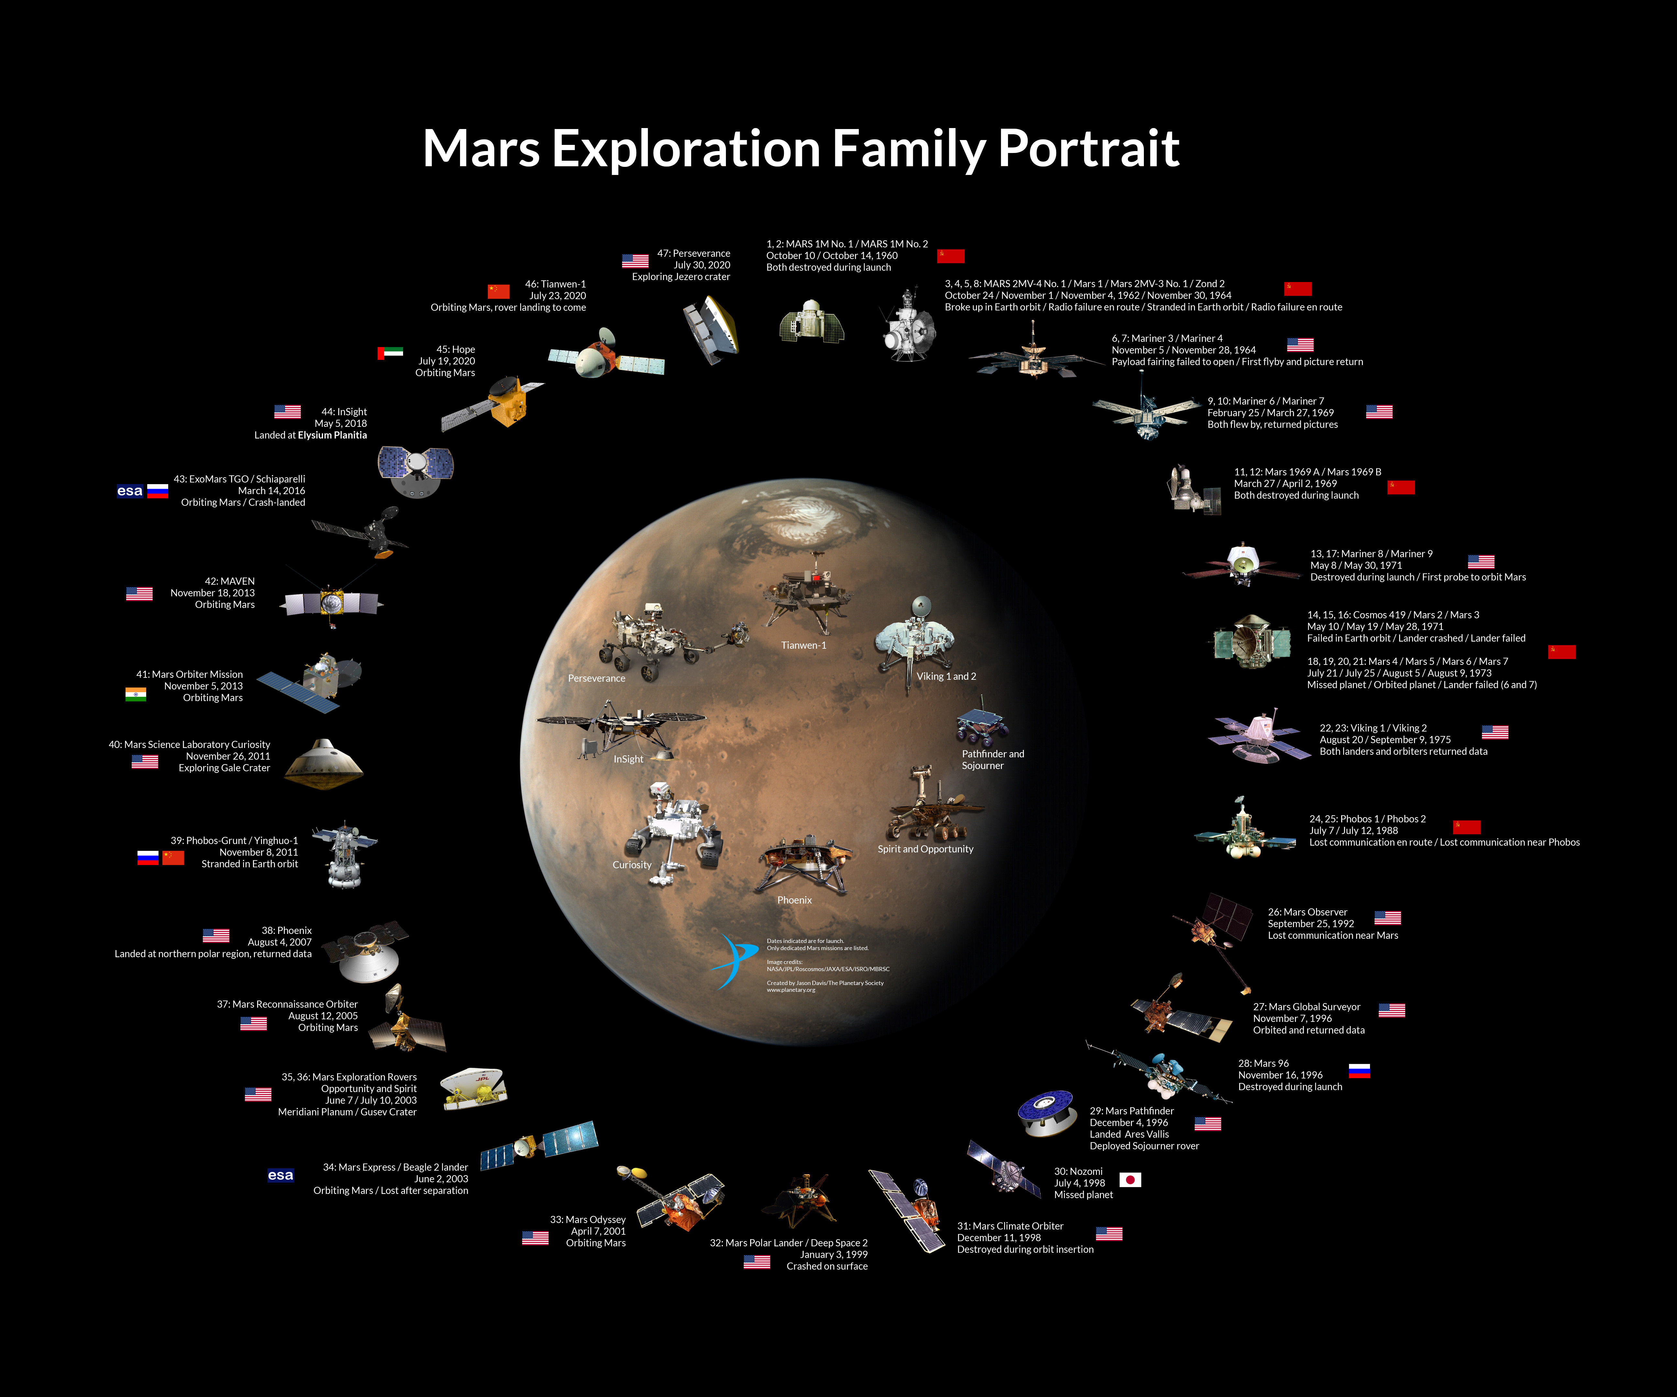

Slide 43
NASA Chart:

Slide 44
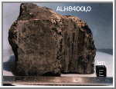
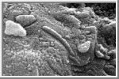
Mars Sample Return?
Long history
Considered “Holy Grail” by some for finding life
  But Mars meteorite life controversies
Planetary Protection
Cost
When?

Slide 45
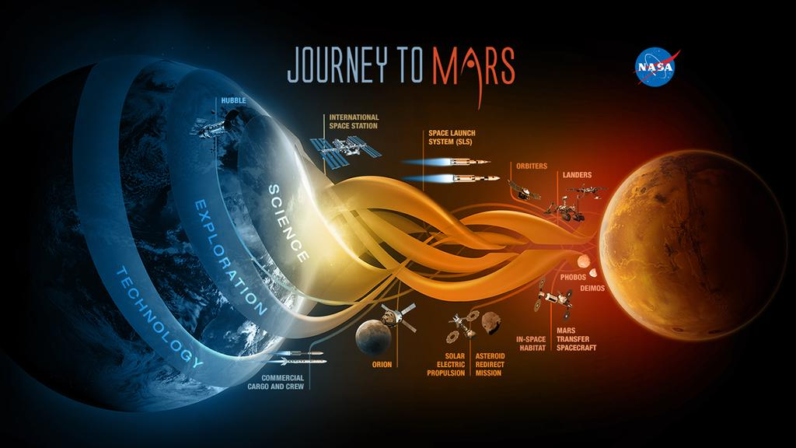
NASA Human Exploration Plans (or fantasies)

Slide 46
Non-Governmental players (or pretenders)
1990: Mars Direct: http://en.wikipedia.org/wiki/Mars_Direct
Mars One missions: http://www.dailymail.co.uk/sciencetech/article-2154336/New-Mars-One-mission-aims-establish-human-colony-Red-Planet-2023.html
Dennis Tito: fly couple around Mars in 2018 for $1B: http://lightyears.blogs.cnn.com/2013/02/27/group-aims-to-send-2-humans-on-mars-mission-in-2018/ http://www.space.com/19985-private-mars-mission-flyby-dennis-tito-infographic.html
Elon Musk/SpaceX: https://www.spacex.com/human-spaceflight/mars/

Slide 47
Why Explore Mars at all?
Many severe problems to address here on Earth
  Understanding global change is the great scientific challenge for today’s generation
  The Sputnik generation is largely retired
Inspire young people to learn math and science
Fundamental research: we can’t predict the future benefits
Robotic exploration is not expensive
Is there a case for sending people to Mars?
  If so, when?

