Slide 1
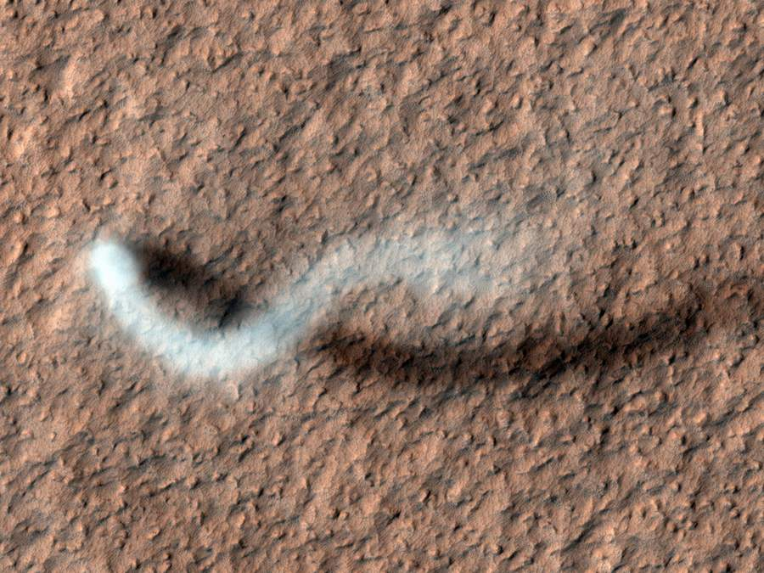
The amazonian

Slide 2

Amazonian Earth

Slide 3
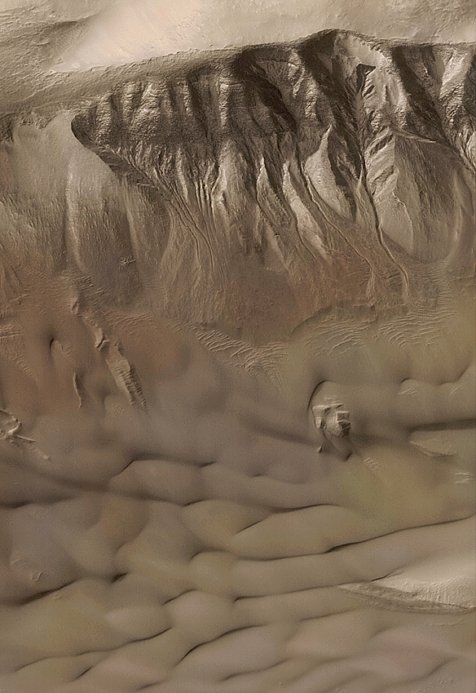
Amazonian
Volcanism
Tectonism
Cratering
Fluvial processes
Eolian—see current processes
Mid-latitude deposits
Gullies
Flow features (glaciers)
Ground ice
Current non-polar activity on Mars
Future class
Polar activity
Separate ppt
msss.com

Slide 4
Pre-Noachian
4.5 – 4.1 Ga
Planetary accretion
Magma ocean
Core differentiation <13 Myr (¹⁸²W – ¹⁸²Hf isotopes)
Central magnetic field – (driven by ⁴⁰K decay?)
Mantle solidifies (unstable density structure)
Degree-1 convection?
Crustal asymmetry forms
Mars is heavily cratered
Magnetic field switches off
Formation of Hellas and Argyre
Construction of Tharsis
Outgassing of large greenhouse atmosphere
Warm(?) & Wet Period
Valley networks and ocean(?) form
Phyllosilicate weathering products
Volcanic plains laid down
Northern hemisphere mantled
SO₂ released – causes switch to sulfate weathering?
Extensive tectonism
Wrinkle ridges
Opening of Valles Marineris
Removal of greenhouse atmosphere
Thickening cryosphere
First polar ice caps
Dry environment – anhydrous ferric oxides
Outburst flooding
How did we get here?
Noachian
4.1 – 3.6 Ga
Hesperian
3.6 – ~3 Ga

Slide 5

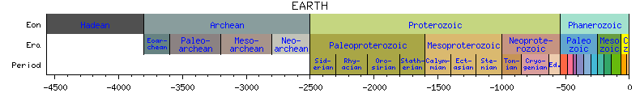
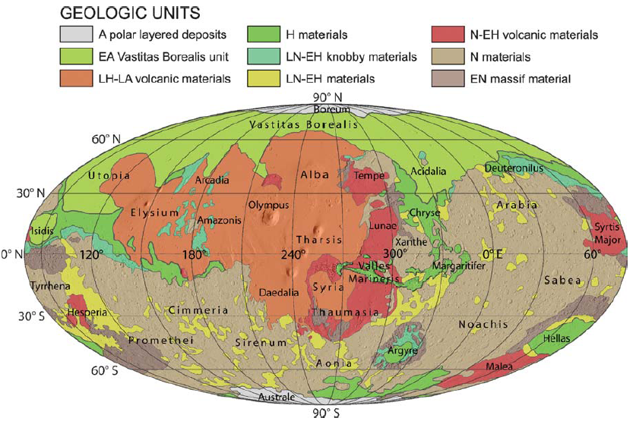
Mars
Amazonian-age terrains concentrated Tharsis to Elysium, Northern plains, and polar caps
Eolian and other processes affected all terrains in the Amazonian
Many Amazonian impact craters
Nimmo and Tanaka, 2005

Slide 6
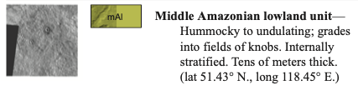
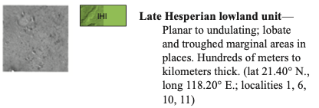
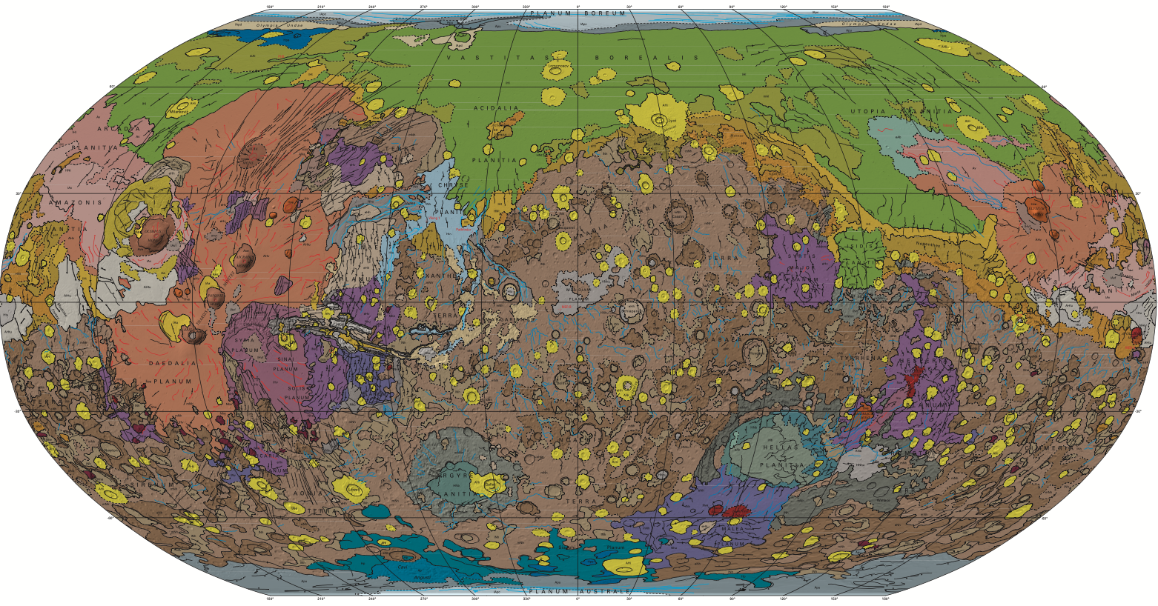
Vastitas Borealis unit mapped as Hesperian with overlying Amazonian units (Tanaka et al., 2014)

Slide 7

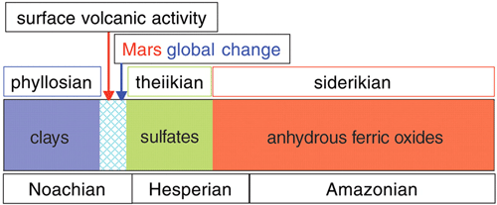
Jean-Pierre Bibring, PI of OMEGA: Observatoire pour la Minéralogie, l'Eau, les Glaces, et l'Activité
Minerals ≠ Fossils
When did secondary mineralization occur on Mars?
Anytime after host rock formed
Mars meteorite dates indicated alteration throughout geologic time

Slide 8
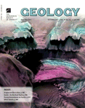
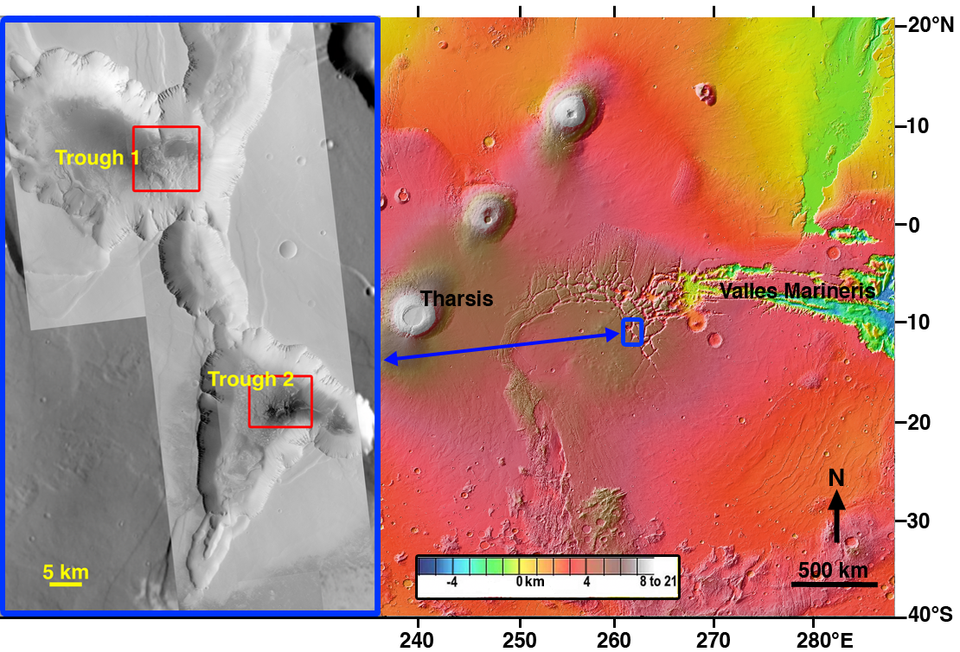
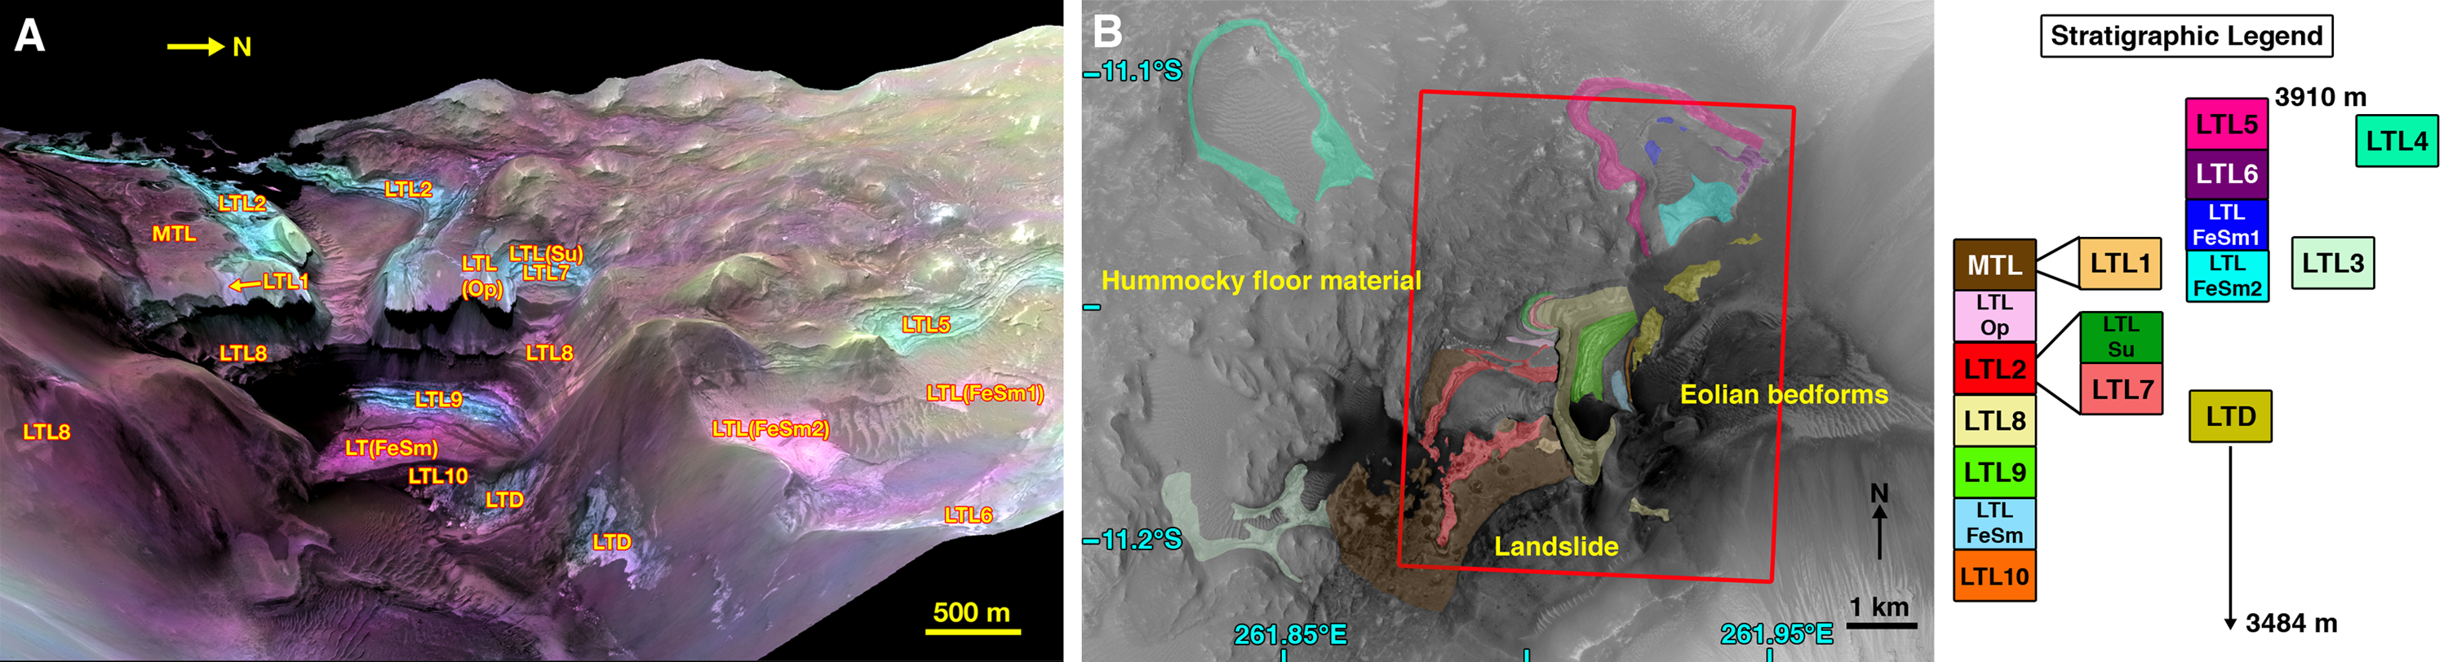
Young clays on Mars could have been habitable regions for life
C.M. Weitz et al., doi:10.1130/G32045.1
Two troughs (small depressions) at Noctis Labyrinthus on Mars have many kinds of minerals that formed by water, including Al and Fe/Mg clays, polyhydrated and monohydrated sulfates, hydrated silica, leached clays.
The clays are Late Hesperian to Early Amazonian in age (2-3 Ga) compared to elsewhere on Mars where the clays are Noachian (>3.6 Ga).
Progression of mineral deposition from sulfates to clays in these Noctis troughs is reverse relative to global Mars conditions where Noachian is characterized by formation of clays followed by climate change that favored sulfate deposition in the Hesperian.
These two troughs are unique and could have been more habitable regions on Mars in the recent past when drier conditions dominated the surface.

Slide 9
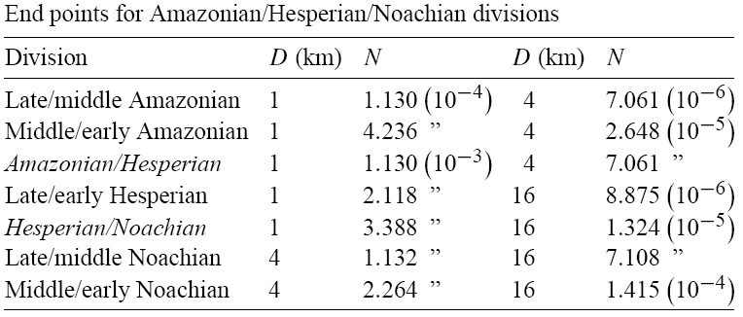
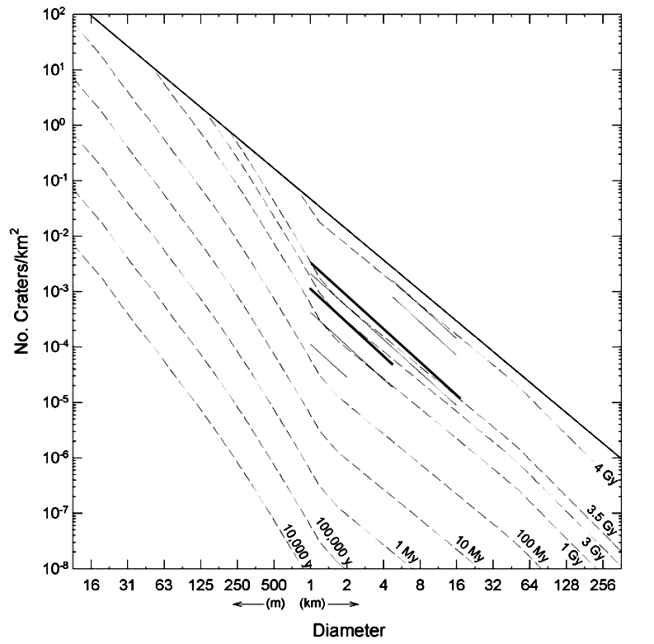
When is the Amazonian?
Current epoch
Starts ~3 Ga
Tanaka (1992) divisions (# craters equal to of larger than 1, 4, or 16 km per km²) compatible with Hartmann (2005) chronology using craters >1 km diameter.
Smaller craters must be used over young terrains with small areas.
Hartmann, 2005
http://www.psi.edu/research/isochrons/chron04a.html

Slide 10
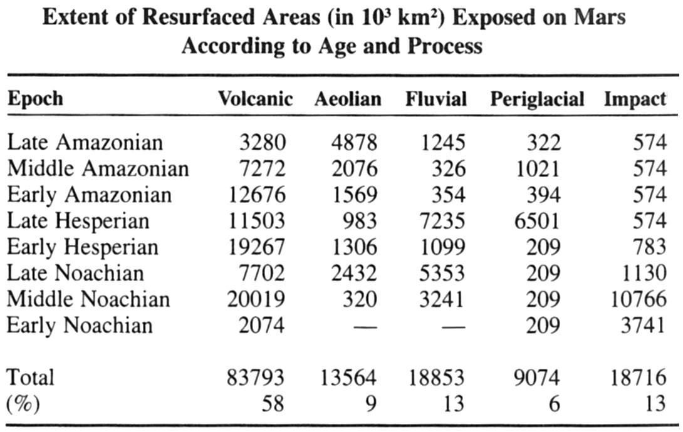
Amazonian Resurfacing
Tanaka et al., 1992

Slide 11
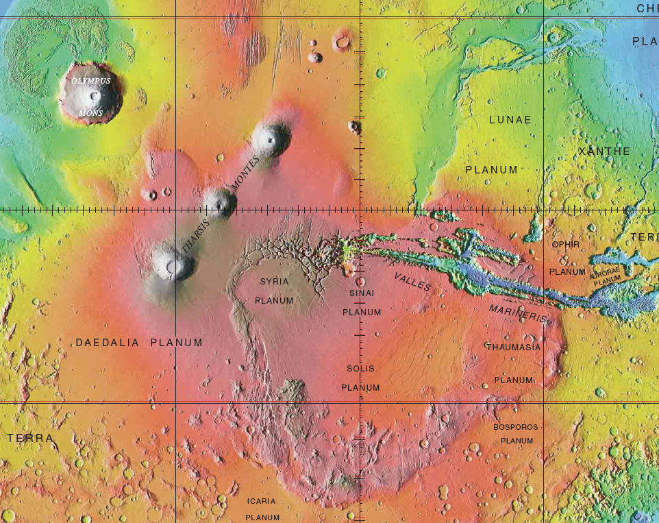
Volcanism
Hesperian
Plains volcanism
Paterae
Amazonian dominated by shield volcanism
Construction of big Tharsis shields e.g. Olympus Mons
NE-SW eruption preference
Also more plains volcanism
Outflow channel controversies
Why are there few but voluminous lava eruptions in Hesperian and Amazonian?
Thick lithosphere—only large volumes of magma can reach the surface

Slide 12
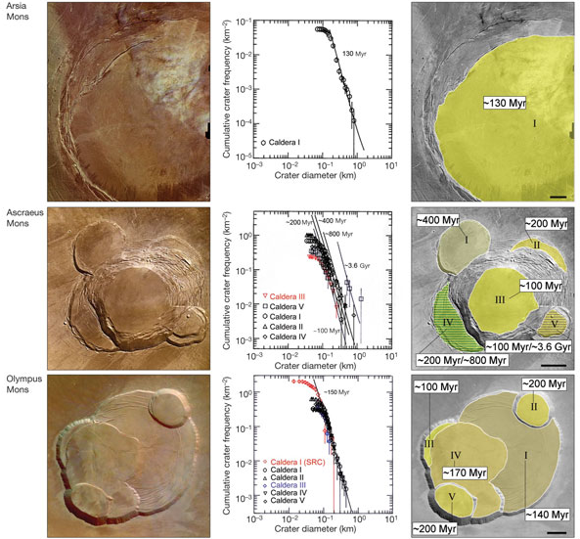
Volcanism continues up to the present day, Surge of activity 100 & 200 Myr ago?
Neukum et al., 2004
Are crater ages consistent with cross-cutting relations?

Slide 13
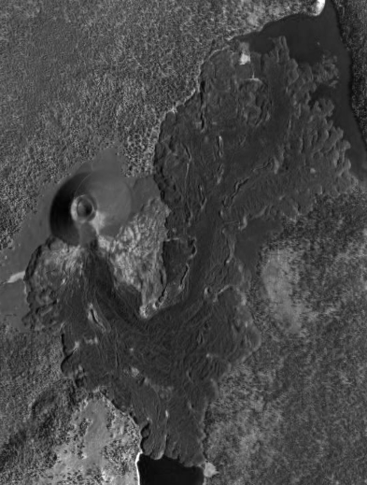
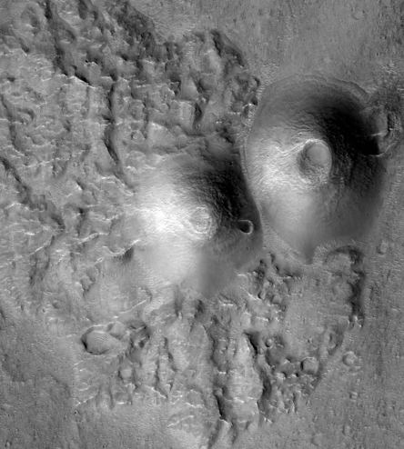
Cinder Cones on Mars?
Earth
Mars
Cone Base Width: 737 m
Crater: 291 m
Cone Base Width: 130 m
Crater: 28 m
Cinder Cone, Lassen National Park
HiRISE ESP_013177_1800
Notes:
The approximate size of the Cinder Cone Volcano in Lassen National Park is 213meters tall, 737.36meters wide and the caldera is 291.27meters wide, while the Cinder Cones on Mars are about 130meter wide and the calderas are about 28meters wide.

Slide 14
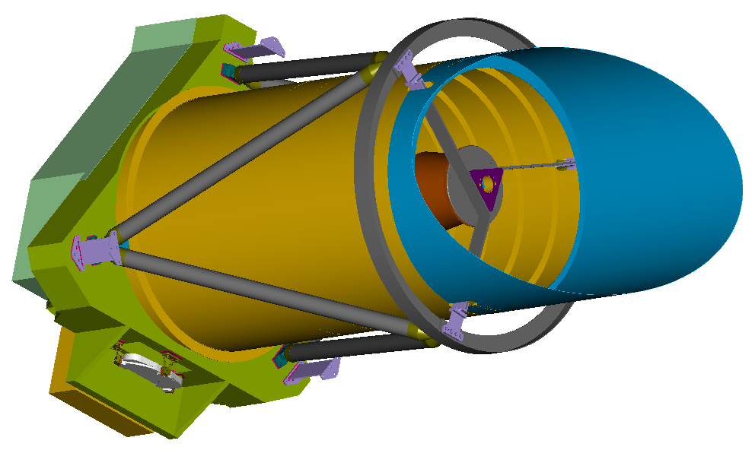

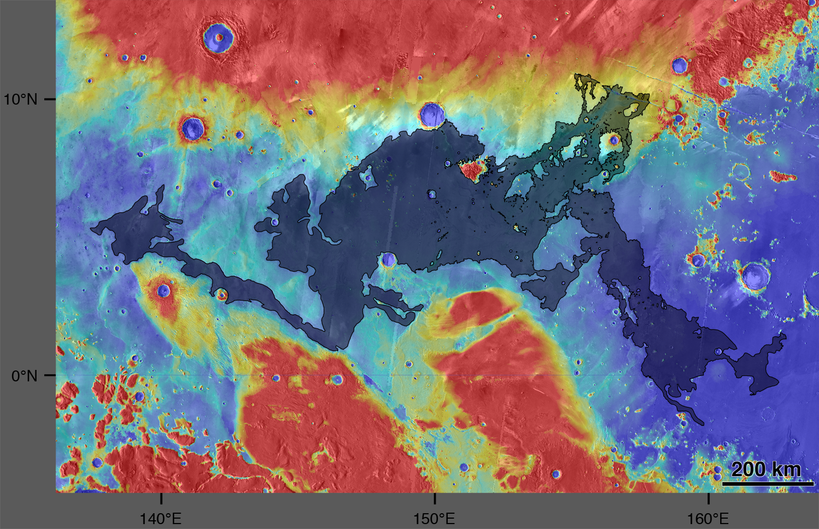
The Cerberus Flood Lava from Athabasca Valles (Jaeger et al., 2010)

Slide 15
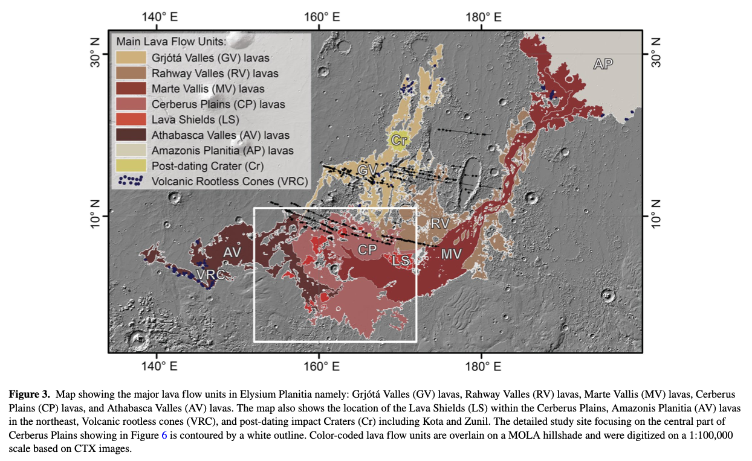
Larger Elysium Planitia lavas (Voight et al., 2023)

Slide 16
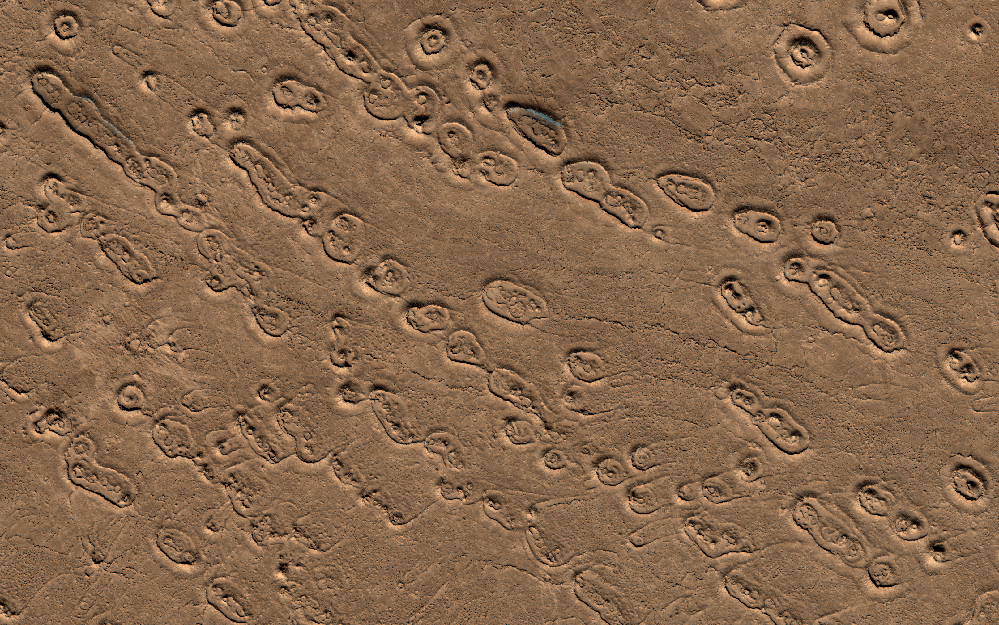
Ring/Cone Structures in Athabasca Flood Lava

Slide 17
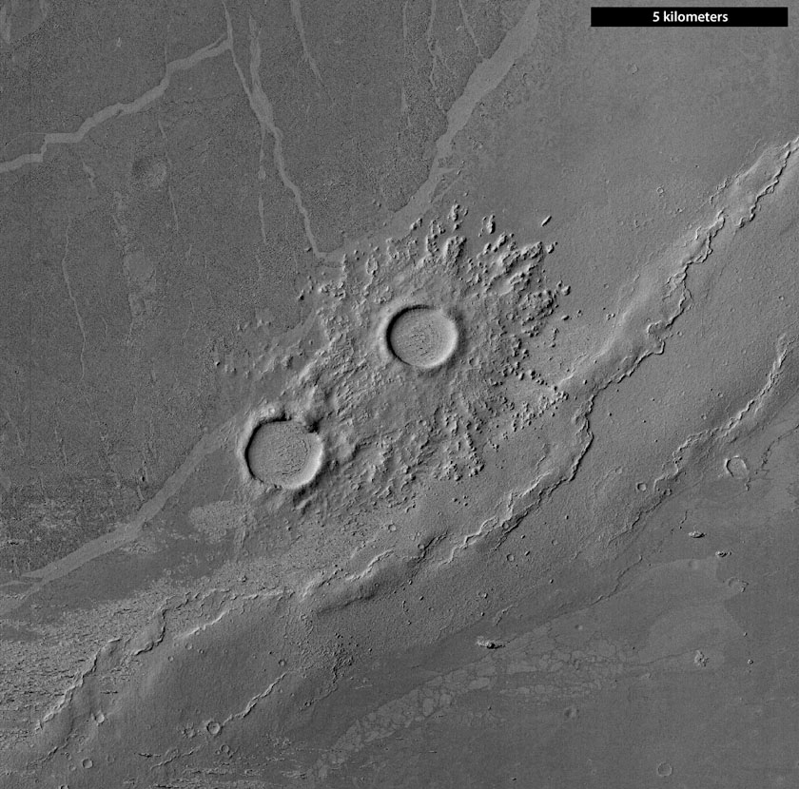
Image zoom sequence of lava plains (from Emily’s blog at www.planetary.org) MRO Context Camera Image, then HiRISE zooms

Slide 18
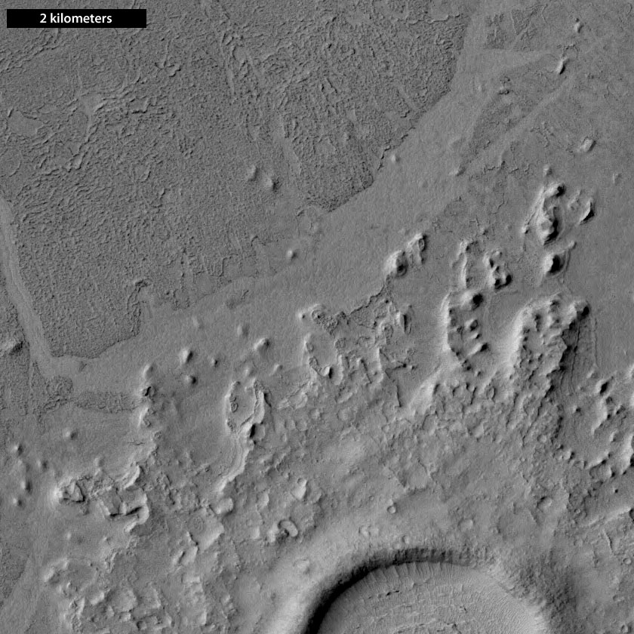

Slide 19
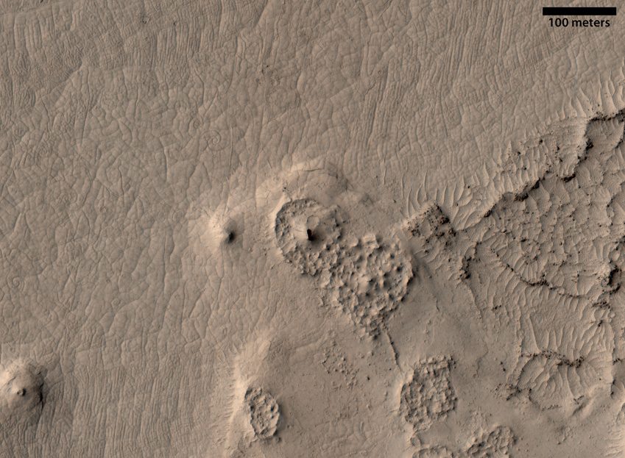

Slide 20
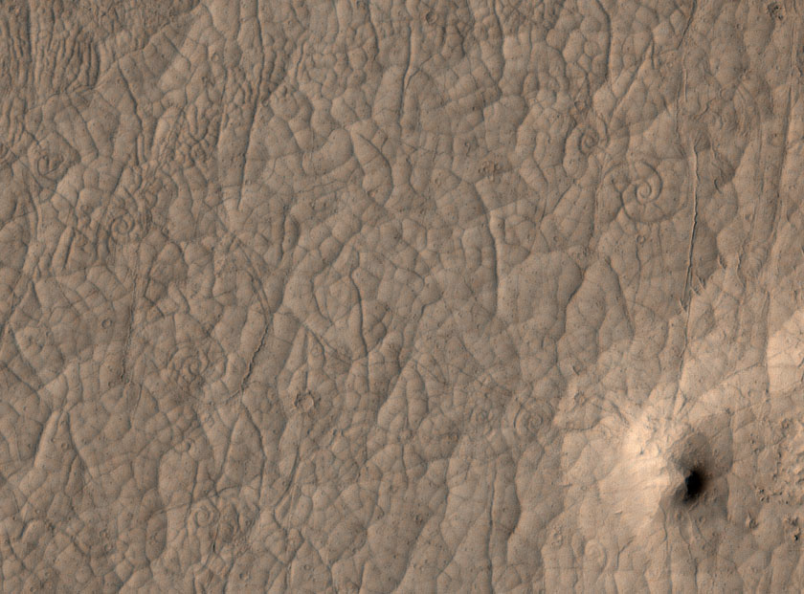
Lava coils in flood lava
This image was acquired in Feb 2008, but features were not discovered until 2011

Slide 21
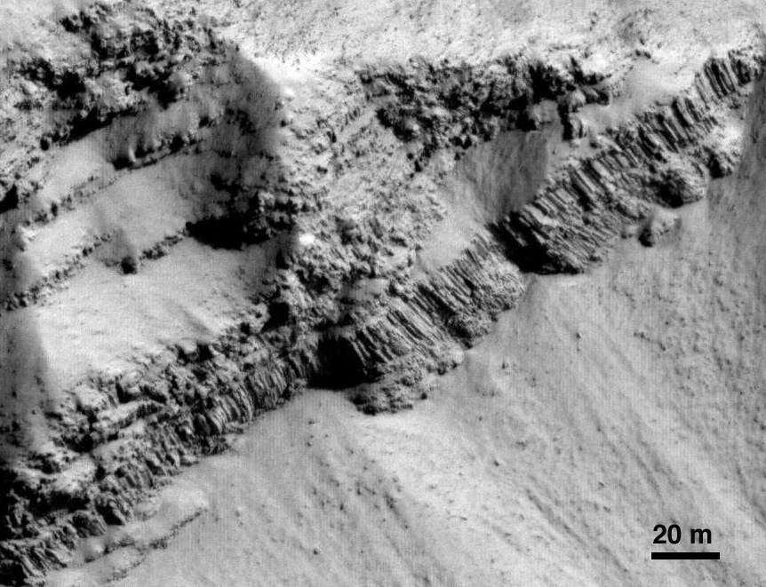
Two-tiered columnar jointing with lower colonnade and upper entablature
Based on numerical models of terrestrial 2-tiered columnar basalts, liquid water must be available episodically during the >5 yrs of cooling (Milazzo et al., 2009)
PSP_005917_2020
Crater wall in Marte Vallis

Slide 22
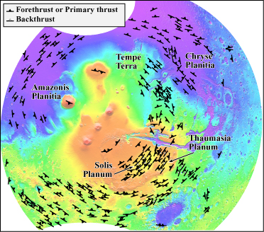

Tectonism
Loading the lithosphere
Lithosphere
Tharsis bulge
www.lpl.arizona.edu
Chris Okubo
www.seismo.unr.edu

Slide 23
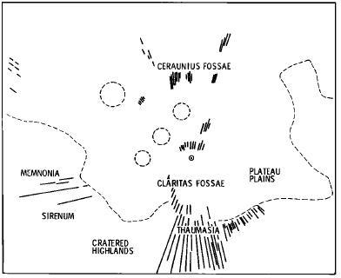
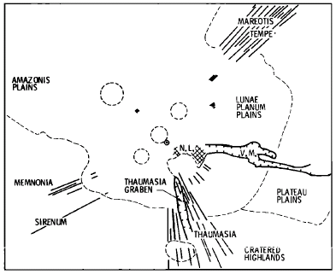
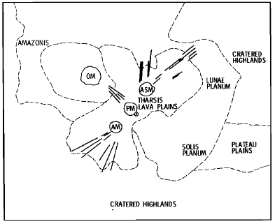
Stress field centers through time
Plescia, 1982

Slide 24
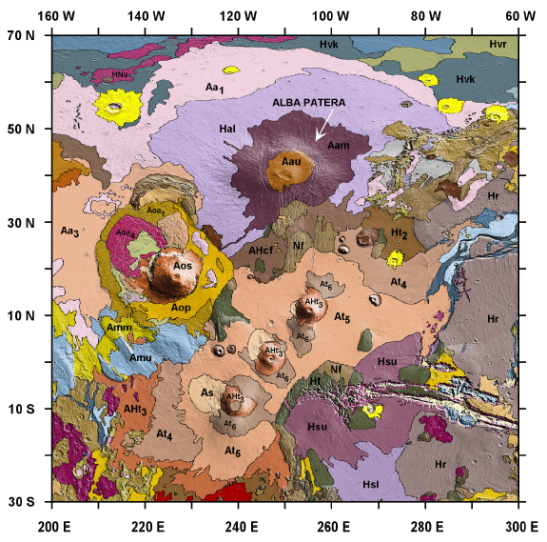
1: Claritas, Noachian
2: Valles Marineris, Late Noachian to Early Hesperian
3: Noctis Labyrinthus, Early Hesperian
4: Alba Patera, Late Hesperian to Early Amazonian
5: Ascreus Mons, Amazonian
4
5
3
1
2

Slide 25
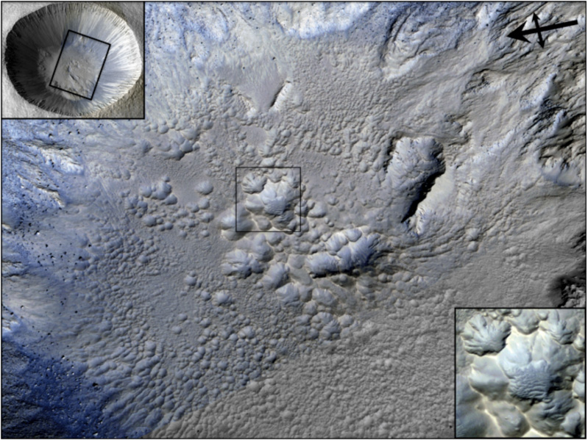
Fresh Large (>1 km diameter) Impact Craters
One unique feature, not seen in terrestrial craters, are pits in ponded materials (likely impact breccia with melted rock and/or mud)
Pits forming from loss of volatiles likely; also form in terrestrial craters but are rapidly eroded or buried.
Image width ~1.1 km

Slide 26
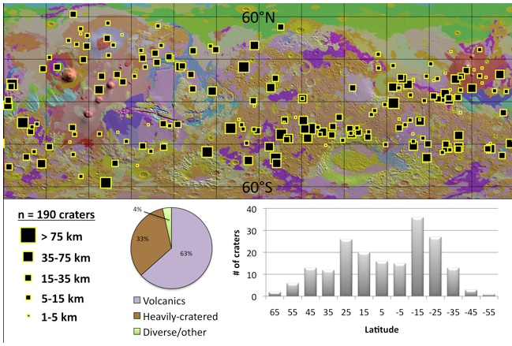
Global Distribution of fresh craters with pitted deposits
Tornabene et al., 2006

Slide 27
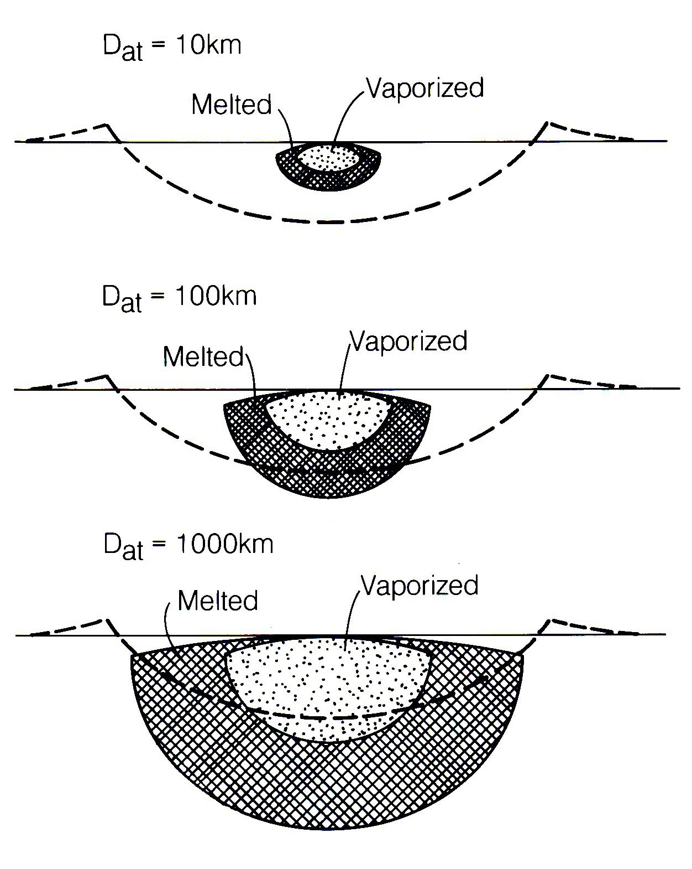
Impact Melting
Peak shock pressures: can reach 10⁵ - 10⁸ bar (10¹¹ - 10¹⁴ Pa)
Consequence: Fracturing, pulverization, melting and vaporization of target
Peak shock, hence melting, is dependant on total energy yield
Size of final crater dependent on gravity

Slide 28
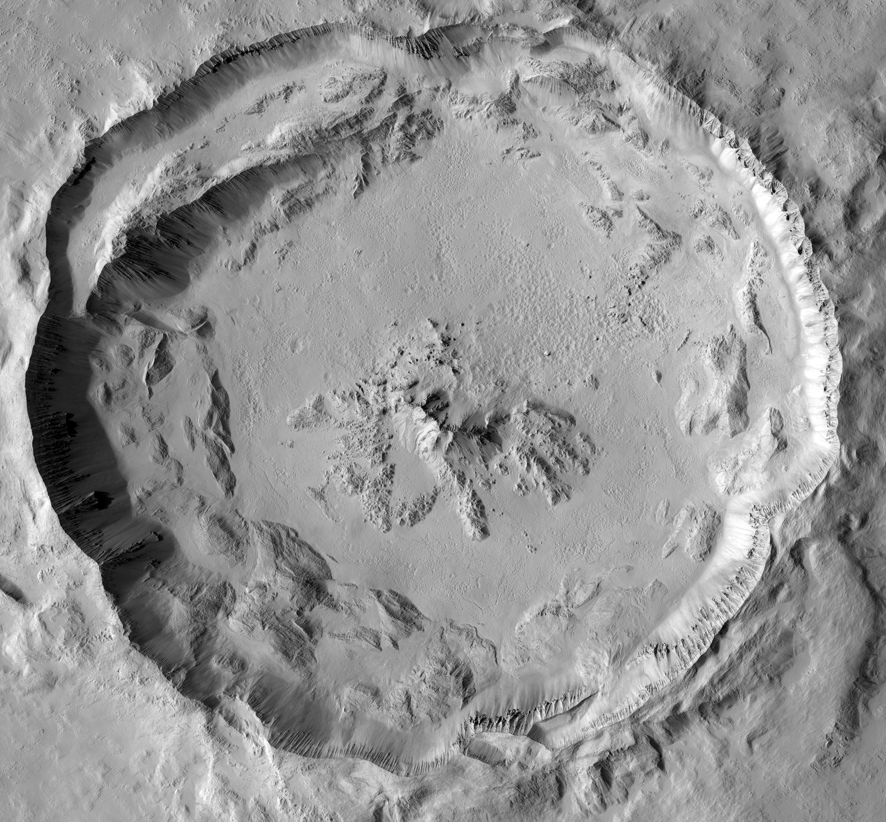
HiRISE and CTX observations of fresh and well-preserved craters
Terrace ponds
~5 km
Pristine and well-preserved craters have consistently revealed similar features
e.g., Hale, Mojave, Tooting, Zunil, Gratteri, Zumba and 30 unnamed craters ~1-150 km in D
1) Ponded materials
2) Ventless flow features
3) “Dewatering” features: Channels, fans (e.g., Mojave crater) and “wet” debris flows
Morphology, distribution and relationships between these features suggest
Volatile-rich impact melt-bearing deposits are present on Mars
Subsurface water can be released as surface run-off during impact process
Ejecta pond
Channelized flow
Pitted melt sheet
Uplift pond
Ejecta pond
Pitted & Fractured melt sheet
Ejecta pond
Near rim flows
Terrace pond
CTX image of Tooting (D~29 km); ~23N, 207.5E
Notes:
Move more info to later in presentation?
So what of melt-bearing impactites on Mars? HiRISE and CTX observations of fresh and well-preserved craters, such as Hale, Mojave, Tooting, Zunil, Gratteri, Zumba and others indicate the presence of melt-bearing features such as ponded materials, which exhibited both the pitted and pitted and fractured types and flow features. These are interpreted to be impact melt-bearing bodies based on morphology, inferred mode of emplacement, comparative geology with other terrestrial bodies and impact models. Other features that appear to be pervasive in fresh and well-preserved craters, and this is particularly true of Hale and Mojave, are “dewatering features, which appear to be directly associated with the melt-beairng bodies. These “dewatering” features consist of channels, alluvial fans and “wet” debris flows.
NOT ENOUGH TIME TO GO THROUGH ALL IN DETAIL!

Slide 29
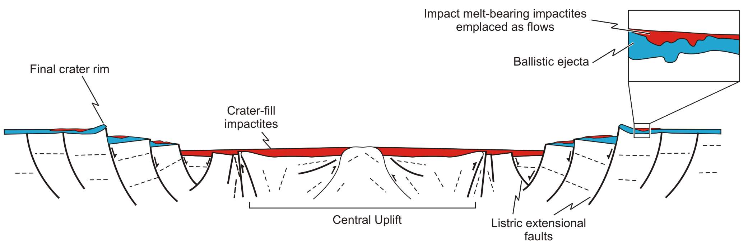
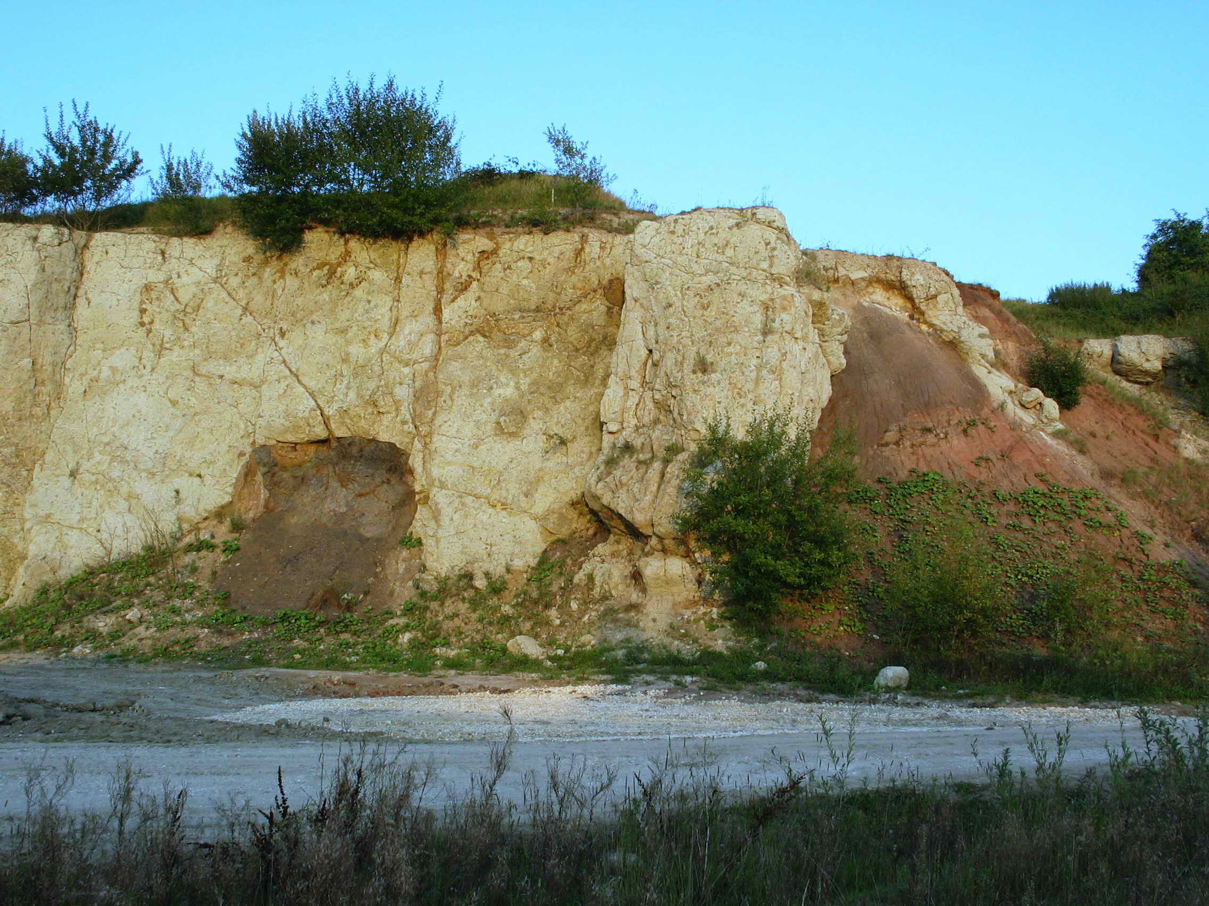
Volatile-rich impact melts?
Ries Crater ejecta blanket
Ejecta ponds
Terrace ponds
Pitted & Fractured melt sheet
Melt-bearing ejecta
Ballistic ejecta
Evidence that ponds and flows are melt-rich
Features most common in fresh craters (57 craters so far; 1-150 km in D) all across Mars (~ 55˚N to 45˚S)
Similar to lunar impact melt features (ponds and flows)
Distribution is as expected from impact models and field studies of terrestrial structures (above)
Largest pond(s) on crater floor w/ smaller ponds with increasing distance from crater interior
Flows within terraces and on the near rim ejecta
Channelized flows connect ponds on the terrace with the pond on the crater floor
Complex fractured surfaces suggestive of rapid surface
Breccia fragments strongly suggestive of a melt-bearing impactite deposit

Slide 30
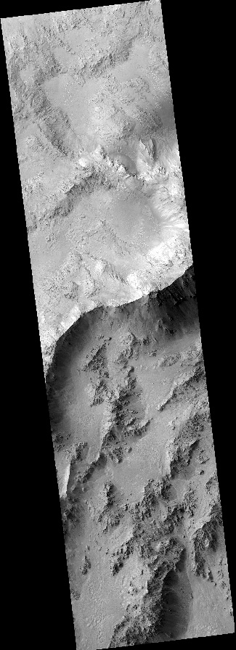
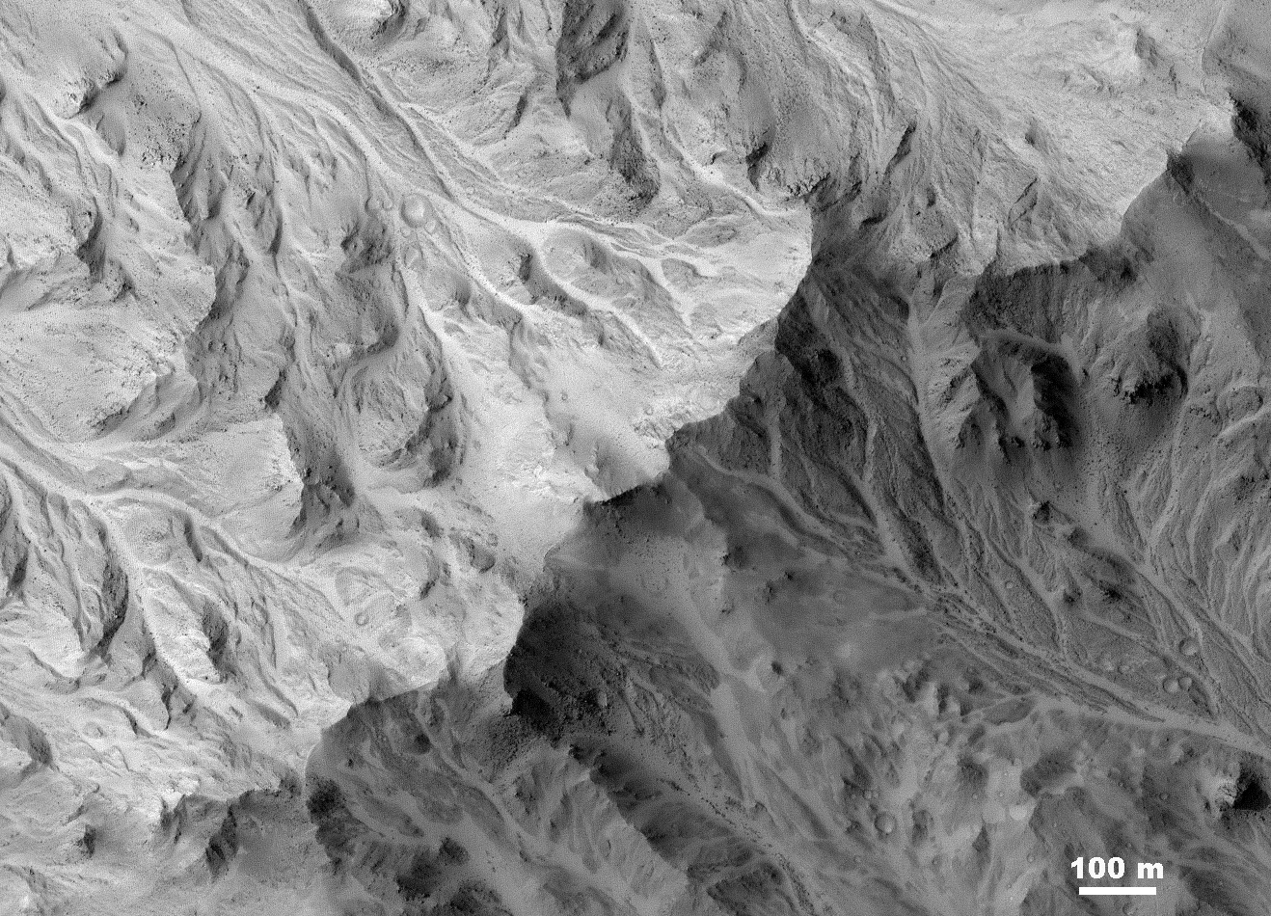
Channels on some well-preserved large craters like Mojave crater extend to tops of drainage divides, so it can’t be from groundwater. Fluids fell from above, probably as part of the impact ejecta.
PSP_1481_1875 Mojave crater rim

Slide 31
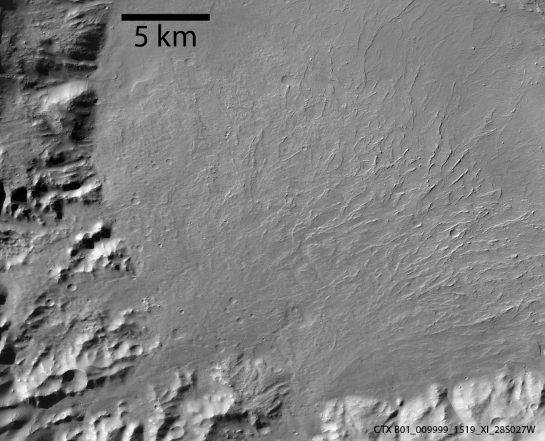
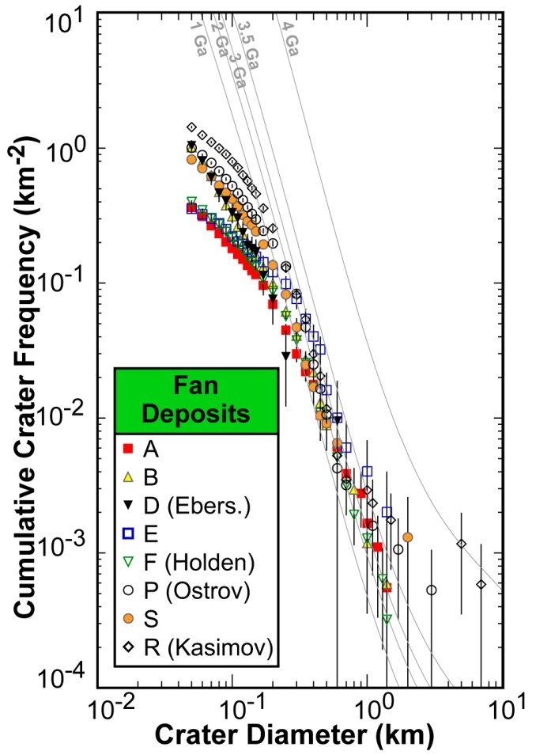
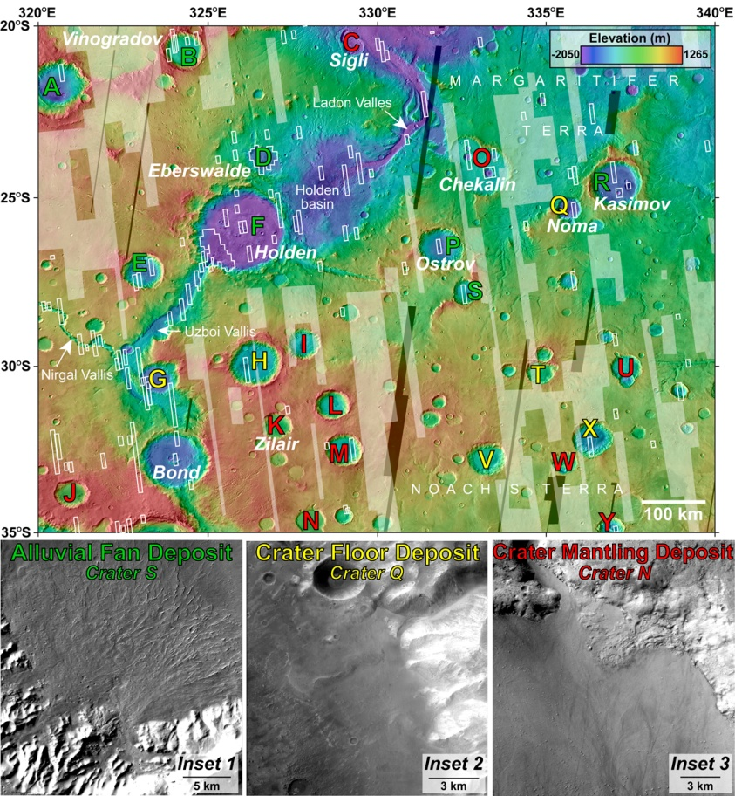
Late Alluvial Fan Formation in southern Margaritifer Terra, Mars
Crater fans, floor and mantling deposits are mapped and help constrain the timing of their emplacement
Fan deposits include the candidate MSL landing sites in Holden and Eberswalde craters.
Fans likely Amazonian to near time of Amazonian-Hesperian boundary in age.
Floor and mantling deposits Hesperian and Amazonian, respectively.
Fans are younger than thought, may reflect late fluvial activity, and imply MSL might not access hoped for ancient organics.
See also: Grant, J. A. and Wilson, S. A., 2011, Late alluvial fan formation in southern Margaritifer Terra, Mars: Geophys. Res. Letts., 38, L08201, doi:10.1029/2011GL046844.

Slide 32
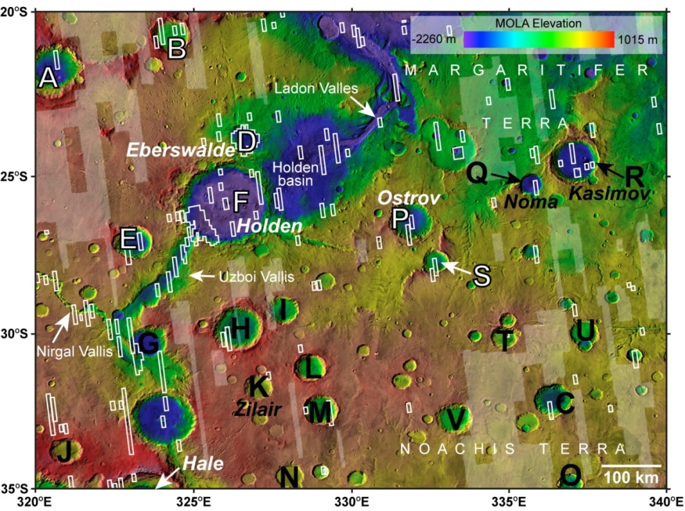
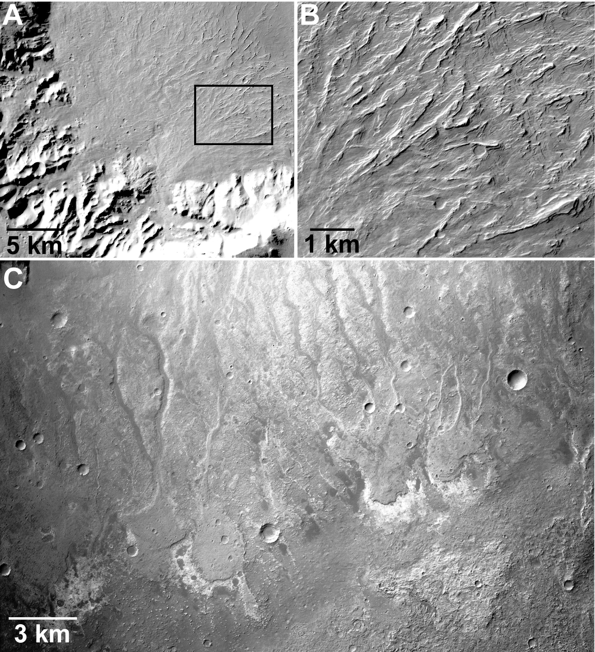
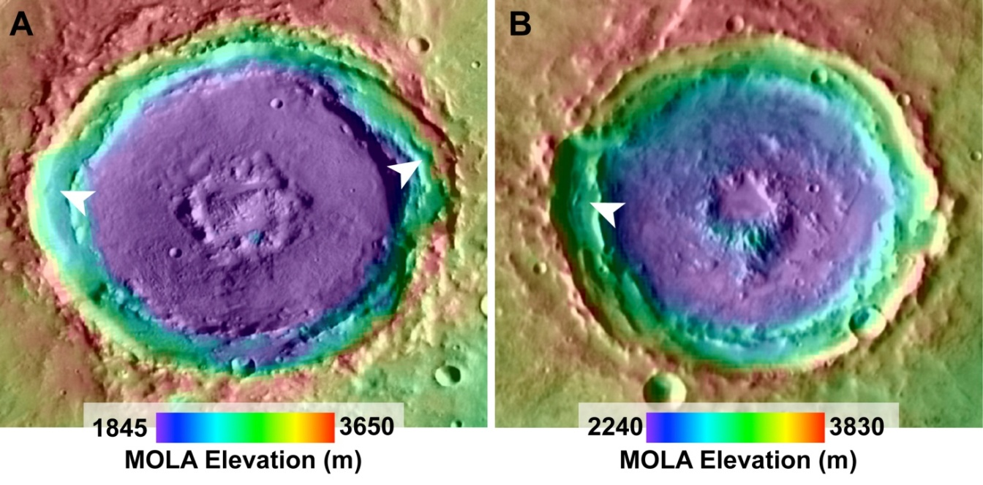

Widespread Snowfall as the Water Source for River Deposits on Mars Published in Planetary and Space Science in 2012 by John Grant and Sharon Wilson
White – Fans
Black - No Fans
Numerous alluvial fans within craters in Margaritifer Terra are comprised of fine-grained sediments formed by relatively uniform, quiescent runoff, as shown by images from the Mars Reconnaissance Orbiter.
The distribution and appearance of the fans is most consistent with widely occurring precipitation, probably as snow.
Snow was possibly concentrated into preexisting crater rim depressions (white arrows in figure to the right) by the wind and facilitated weathering to form fines (gravel, sand, and silt) that was washed onto the fans when the snow melted.
Fans may record and preserve evidence of habitable conditions on Mars that occurred relatively recently (Early Amazonian), when the cold, dry climate on Mars was punctuated by wetter conditions.

Slide 33
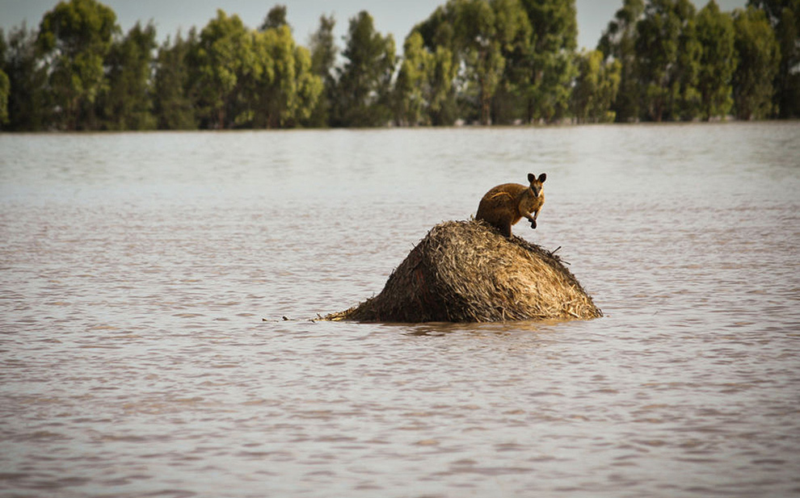
Have there been large, recent (mid-late Amazonian) water floods on Mars?
Alfred McEwen, U. Arizona
Laszlo Keszthelyi, USGS
John Grant, CEPS Smithsonian

Slide 34
A Key Question for Astrobiology
Is groundwater currently abundant within the Martian crust?
Could be best habitat for extant life
Direct detection unlikely with present orbiting radars (Farrel et al. 2009)
Ground inventory of H₂O whould be all ice today unless the H₂O volume exceeds the accessible pore volume of the cryosphere (Clifford et al. 1993)
Global water estimates based on outflow channel erosion suggest this was the case in the Early Hesperian (Carr 1996).
Extant deep groundwater less likely given recent results but still possible (Clifford et al. 2010).
Extant deep groundwater highly unlikely due to high loss rates during low obliquity (Grimm and Painter 2009).
Have there been large groundwater-fed floods in geologically recent times?
Many workers assume the answer is “yes” based on published literature.
If the water inventory remained sufficiently high within the past 1 Ga, the deep groundwater is probably still there.
But we suggest that all of the <1 Ga age estimates in the literature date lava flows that either post-date channel incision, or itself carved the channel.

Slide 35
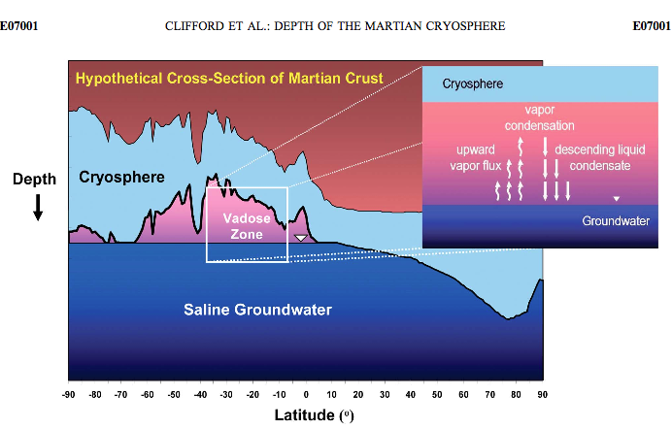

Slide 36
Reports of young outflow channels
Channels in Elysium Planitia
Multiple studies with crater retention ages (CRAs) <10 Ma for Athabasca V., and late Amazonian for other channels
Mangala Valles
Water flooding episodes at ~3.5 Ga, ~1 Ga, ~0.5 Ga, and ~0.2 Ga reported (Basilevsky et al. 2009)
Kasei Valles and Echus Chasma
Fluvial CRAs <1 Ga reported (Neukum et al. 2010)
High-altitude channels on volcanoes
Very young CRAs
Require local recharge rather than sourcing from a deep groundwater table, and may be lava channels.
Either way, not relevant to question about deep groundwater

Slide 37
Were the outflow channels actually carved by lava?
Most workers accept that outflow channels on Mars were carved by water
Leverington (2011) proposes that all outflow channels were carved by lava.
He makes some good points:
Analog landforms exist on the Moon, Mercury, and Venus where voluminous water is extremely unlikely.
Many Martian outflow channels are covered by lava.
Viking 1 and Mars Pathfinder results from Chryse Planitia did not convince everyone that these were sites of catastrophic flooding.
Absence of clear fluvial deposits along outflow channels and at terminal basins
Longitudinal bars, eddy bars, and “giant current ripples” (subaqueous dunes) are widespread in the Channeled Scabland
We have searched extensively for such deposits with HiRISE, and they are indeed rare, but not absent. The best examples are from Uzboi Valles.
Leverington argues for a form of Occam’s razor:
“The volcanic hypothesis for the development of outflow channels represents the simplest and most effective means by which these systems can be understood.”
Others argue that old channels mostly covered by younger lava may be the simplest model.

Slide 38
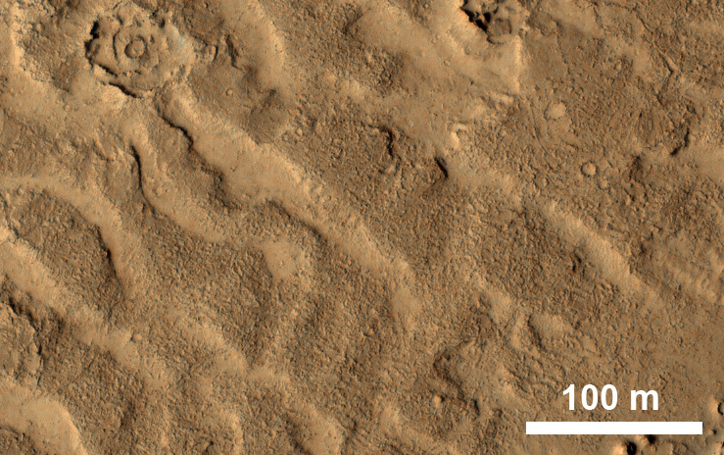
Are there subaqueous dunes on Mars?
Appeared to be present in Athabasca Valles from MOC images (Burr et al. 2004)
HiRISE showed these to be covered by lava (Jaeger et al. 2007)
PSP_003294_1895

Slide 39
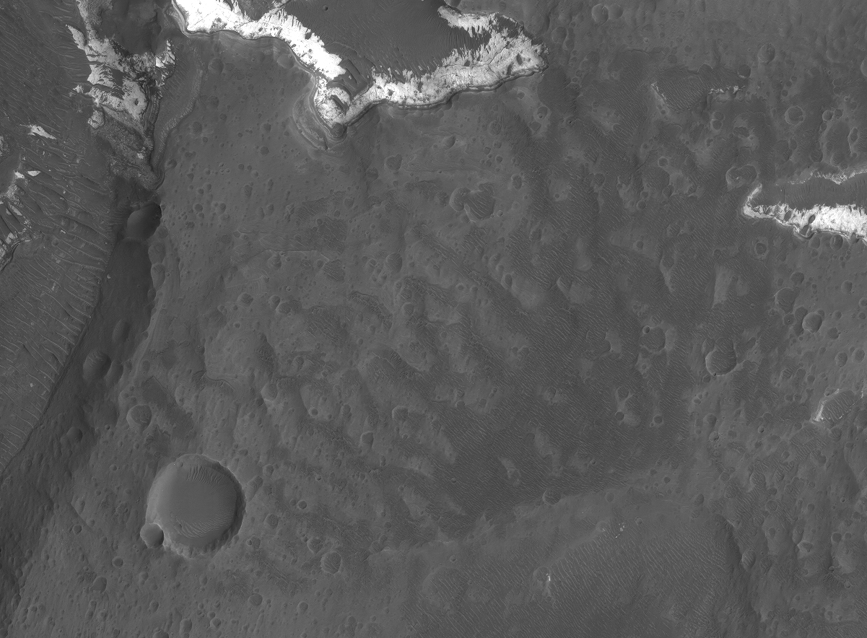

Subaqueous Dunes (Giant Current Ripples)
on Upper Unit Fans in Holden Crater
Discharge from Uzboi Breach
500 m
PSP_003644_1530_RED
The dunes contain boulders
50 m
PSP_003644_1530_RGB

Slide 40

Uzboi Valles offers the best counterexample to Leverington’s hypothesis (Grant and Parker 2002, Grant et al. 2011, Wilson et al., 2018)
No lava infilling in this highlands channel
Channel preserves local layered alluvial deposits and shorelines
Where Uzboi debouches into Holden crater there is a series of broad, boulder-laden fans and capping by subaqueous dunes
There are other outflow channels with evidence for fluvial processes, but Uzboi best addresses the specific objections of Leverington.
We cannot explain all outflow channels as resulting from lava erosion.
Initial incision was in the Noachian, with late activity persisting into the Hesperian.

Slide 41

Mangala Valles
Some workers proposed only ancient dates for channel incision.
Most recent paper includes young dates (~1 Ga, ~0.5 Ga, and ~0.2 Ga), interpreted as fluvial resurfacing (Basilevsky et al. 2009)
We think the surfaces with young dates are where lava has followed the channels, and date the volcanism.
CTX image P04_002646_1616

Slide 42

Kasei Vallis and Echus Chasma
CRAs <1 Ga reported (Neukum et al. 2010)
Most of channels floors covered by lava (Chapman et al. 2010).
The floor of the Amazonian-age innermost channel of Kasei Valles (Williams and Malin 2004) is lava-coated.
Large region; evidence for large Amazonian water floods unclear (at least to us)
~1 km
ESP_024202_2101

Slide 43

Athabasca and other channels in Elysium Planitia
Multiple studies with crater retention ages (CREs) <10 Ma for Athabasca V., Late Amazonian for other channels.
All date lava that completely coats the channels
Geologic mapping shows Marte, Rahway, and Grota Valles cutting unit AEc2, Late to Middle Amazonian (Tanaka et al. 2005)
However, this unit could be more lava that postdates (but does not completely fill) older channels.
Need to find a non-lava-covered terrain cut by a channel and with enough superimposed craters to get a CRA
Haven’t seen this yet in this region
Maybe study lava-coated craters?

Slide 44


How old are Athabasca Valles channels?
Some of us (e.g., McEwen et al. 2005) misinterpreted MOC images as showing channels cutting young lava flows, so channels must be young.
MRO data showed that the lava completely filled and overflowed the channels in places, then drained downstream. No age constraint on the channel unless it was carved by the lava.
Athabasca V. channel
Young lava flow
M15-01822
ESP_025908_1875

Slide 45


Conclusions: Have there been large, recent (mid-late Amazonian) water floods on Mars?
We conclude that this is a good question!
Published evidence for young, large water floods is not convincing
High-resolution geologic mapping may help
We also conclude that water must have carved at least some of the outflow channels (best example: Uzboi Valles).
Simplest hypothesis is that water flooding is the main outflow-channel mechanism, but many channels have been covered by younger lava
Map of Athabasca Flood Lava

Slide 46


Ground ice
Neutron spectrometer on Mars Odyssey spacecraft has detected hydrogen in near surface.
Several 10’s percent by volume at high latitudes
New ideas about exchange of ice between the polar caps and the mid-latitudes
Vapor diffusion models alone cannot explain these quantities of ice
Surface ice sheets that are thinly buried are probably required

Slide 47

Periglacial polygon sizes and morphology versus latitude

Slide 48

Glaciation
Extensive viscous flows in middle latitudes
Were considered debris flows containing ice
SHARAD showed nearly pure ice—so they are glaciers
Glaciation on Mars first proposed by Kargel and Strom
Was widely rejected by the “mainstream”
Now widely accepted
Head et al., 2005

Slide 49


Apparent flow-like deformation
PSP_004062_2110
Milliken et al., 2003

Slide 50

Gullies
Recently carved gullies observed on crater walls
Occur preferentially on poleward facing slopes in the southern mid-latitudes (above 40 S)
Thought to be carved by liquid water
Liquid CO₂ people have given up
Solid CO₂ probably key today
Water is not currently stable on the Martian surface, theories:
Gully formed beneath snowpack
Under a recently deposited mid-latitude snow layer
Local or deep pressurized aquifer

Slide 51

Recent activity?
Bright deposits appeared between 1999-2004
Steep-slopes indicate mass movement is a possibility
Lack of hydrated minerals
Boulders on smooth deposit
Problem for snow pack hypothesis?

Slide 52


Slide 53

Near surface ice related to
Gullies
Viscous flow features
Dissected terrain – basketball
Obliquity variations can move ice back and forth between the poles and mid-latitudes
Milliken et al., 2003

Slide 54



Slide 55
Amazonian: Summary
Amazonian = past 3 Ga
Dryer than Noachian and Hesperian, but
Late outflow channels
Some might be volcanic, or at least are coated by younger lava
Alluvial fans
Aqueous minerals like clays
Volcanism
Big Tharsis shield volcanoes
Volcanic plains
Athabasca region has youngest lava flows
Impact cratering
Ejecta deposits well preserved
Pitted and ponded material may be impact melt
Ice, gullies, climate change
More later

